Slide 1
Discussant remarks:
Racial Discrimination in the Auto Loan Market
By Alexander Butler, Erik Mayer and James Weston (2020)
Does CFPB Oversight Crimp Credit?
By Andreas Fuster, Matthew Plosser and James Vickery (2021)
The opinions expressed herein are my own and do not necessarily reflect the views of CFPB.

Slide 2
Racial Discrimination in the Auto Loan Market
Alexander Butler, Erik Mayer and James Weston (2020)

Slide 3
The Data:
Authors create a Credit Bureau/HMDA linked dataset
The HMDA data contains race and ethnicity information missing from the credit bureau data.
The match is between originated mortgage files in the HMDA data and credit bureau data.
This yields a panel dataset for 2005-2016 of auto loans for homeowners.
The matched dataset, as a result, has people who have higher credit scores, are younger and are more likely to have a mortgage than the average US resident.

Slide 4
Auto Lending:
Three types of lenders:
Banks
Indirect auto lenders: Ford Motor Credit, Ally Financial, independent finance companies
Buy Here Pay Here

Slide 5
Auto Lending:
Three types of lenders:
Banks
Indirect auto lenders: Ford Motor Credit, Ally Financial, independent finance companies
Buy Here Pay Here
Bias can occur in either type of lending:
Banks—due to biases in loan officers' preferences or beliefs about creditworthiness
Indirect lenders—at the point of dealer markup
CFPB has conducted enforcement actions challenging discriminatory interest rates

Slide 6
Results:
Loan Approval
Shows evidence of market discrimination:
Authors use hard credit inquiries to determine whether minorities search more or less for auto loans
Find that minorities shop slightly harder but are less likely to obtain credit
Loan pricing
Shows evidence of racial bias not statistical discrimination
Higher loan pricing not justified by ex post default rates
Default tests show that subprime minority borrowers have a lower P(default)
Bias is both in the extensive margin (approval) and the intensive margin (pricing)

Slide 7
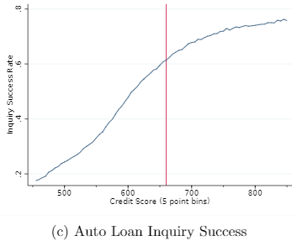
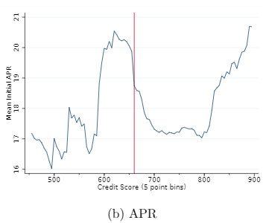
Comments:
Source: Romeo and Sandler (2021)
“minorities pay interest rates 70 basis pts higher…[equivalent] to a 37 pt decrease in credit score.”

Slide 8
Comments:
Credit card falsification test:
For autos you study approval rates
For credit cards you study credit limits, not approval rates
Geographic distribution of auto loan reporting to CRAs
E.g., reporting to Experian is greatest on the west coast.
Omitted variables:
The authors don’t observe down payment. If down payment is correlated with race this could bias treatment effect.
Need a proxy for down payment that varies over time and states and is race specific. Method of Freyaldenhoven, Hansen and Shapiro (2019) to produce consistent estimates.

Slide 9
Does CFPB Oversight Crimp Credit?
Andreas Fuster, Matthew Plosser and James Vickery (2021)

Slide 10
The Data:
HMDA data for 2 time periods
2010 – 2013 to capture the impact of CFPB oversight after operations launched in July 2011.
2015 – 2018 to capture the impact of a decrease in CFPB oversight after the 2016 election.
The data includes whether the FHA was the mortgage lender.
FHA borrowers have lower incomes, higher default risk and are often first-time buyers.

Slide 11
Mortgage Lending:
With its founding, CFPB gained supervision and enforcement authority over banks with at least $10bn in assets
Nonbanks are subject to CFPB supervision regardless of their size.

Slide 12
Period Results:
Period 2010 – 2013: with the beginning of CFPB oversight
FHA lending drops at CFPB supervised banks
Total mortgage lending at these banks is unaffected
Supervised banks shift into jumbo lending
Away from high-credit risk borrowers
Period 2015-2018: with the reduction in CFPB oversight
FHA lending increases at CFPB supervised banks

Slide 13
Servicing Results and comment:
Servicing
30-day delinquencies are unchanged post-CFPB oversight, but 60 and 90-day delinquencies decrease
FHA loans from CFPB supervised lenders are not less risky ex-ante
Seems in some conflict with the finding that banks have moved away from high-risk borrowers.
The authors explain this as reduced risk on the extensive margin—originating fewer FHA loans—rather than on the intensive margin—by adjusting the risk profile of FHA loans they originate.
Why?

Slide 14
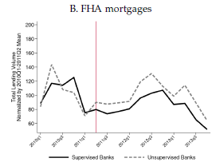
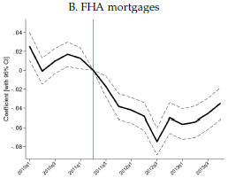
Timing comments: Dodd-Frank effective 7/21/2010; CFPB begins operations 7/21/2011
Total mortgage originations
Probability mortgage was originated by a CFPB supervised bank

Slide 15
Technical comments:
Section on regulatory arbitrage. Study movement of mortgage activity to non-CFPB supervised entities
Table 5, column 4. You include Census tract x quarter FEs in the top and bottom panels.
In the bottom (FHA) panel this reduces the effect by 18% and the dataset size by 35%
Not sure these results should be included without more explanation
Event study confidence bands.
The object of interest is the path of the coefficients, not any one coefficient. Confidence bands should take this into account.
Olea and Plagborg-Moller (2019) offer a method for adjusting the confidence bands.

