Slide 1
Who pays the price?
Overdraft fee ceilings and the unbanked
Jennifer Dlugosz, Federal Reserve Board
Brian Melzer, Dartmouth
Donald Morgan, Federal Reserve Bank of New York
Disclaimer: The views expressed in this presentation are those of the authors and do not necessarily reflect the positions of the Federal Reserve Bank of New York or the Federal Reserve System

Slide 2
Question and Takeaways
Would capping overdraft fees promote financial inclusion?
Test using selective relaxation of state fee caps in 2001
Find:
Unfettered banks raise OD fees but also expand OD credit
Returned check rates decline savings on NSF fees
More low-income HH banked
Conclude that caps reduce overdraft credit supply and financial inclusion
Boosting (weak/non-existent) overdraft competition a better way?

Slide 3
Plan
1. Background
2. Study Design/Findings
3. Conclusion

Slide 4
The Unbanked
≈ 25% of low-income HH without a checking account
Being unbanked is costly:
  Rely on more expensive alternatives (check cashers, money transfers,etc.)
  Accumulate less wealth (Celerier and Matray, 2019)
  Less small dollar credit (payday and overdraft)

Slide 5
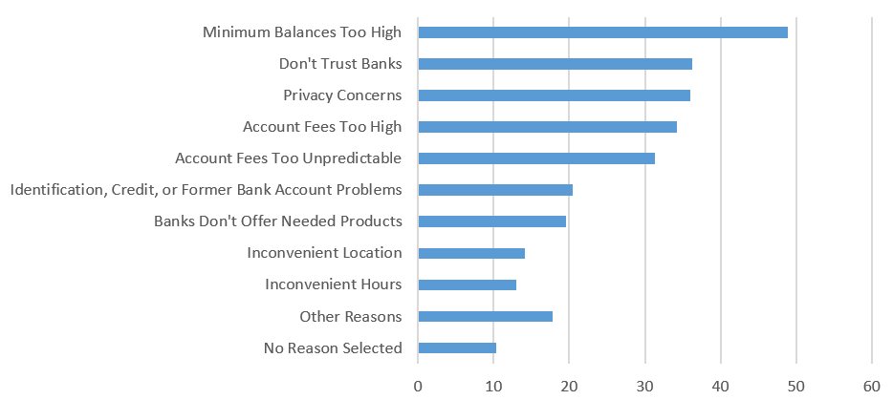
Why Unbanked?
% FDIC (2019)
Many reasons but overdraft fees rank high
Half of depositors whose accounts were closed involuntarily (“bounced out”) cite overdrafts as main reason (FDIC 2019)

Slide 6
Background: Overdraft Credit Demand
Demand essentially bi-modal
- Most depositors rarely/never overdraw; small proportion overdraw almost monthly (CFPB 2013)
Depositors must opt-in for overdraft coverage via debit and ATM
- Opt-in higher (45%) for heavy uses of OD (CFPB 2013)
Depositors that don’t repay credit/fees “bounce out”
- Bank closes account and reports to debit bureaus (e.g. Chex systems)
  - 6.5M accounts closed in 2005 (Campbell et al 2012)
Notes:
Source: OCC Comptroller’s Handbook (2018), Deposit-Related Credit
(https://www.occ.treas.gov/publications-and-resources/publications/comptrollers-handbook/files/deposit-related-credit/index-deposit-related-credit.html)
Since 2010, customers have to opt in for overdraft on non-recurring debit transactions
Outstanding overdraft balances affect risk-based capital requirements.
Regulations require banks to charge off an overdraft balance when considered uncollectible, but no later than 60 days from the date the balance first became overdrawn.

Slide 7
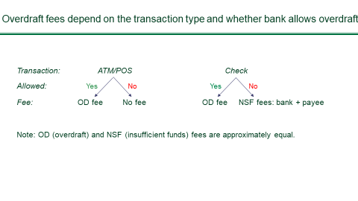
Background: Overdraft Pricing
Mean OD fee ≈ NSF ≈ $30
Bouncing a check especially costly: $60 plus stigma, loss of check-writing privileges…

Slide 8
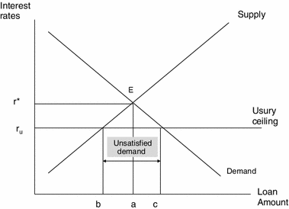
Question: Would Fees Caps Promote Inclusion?
Many consumer advocacy groups (Pew, CRL) recommend caps
Federal cap proposed in 2019 (“Stop Overdraft Profiteering Act”)
  “overdraft fees … push low-income consumers away from
  banking products altogether” (Sen. Cory A. Booker, 2018)
Price theory predicts unintended effects:
- Overdraft credit is credit per fee
- Fee cap credit rationing
- Less credit more NSF fees to merchants
Notes:
Proposed federally (2020) and implemented by some states

Slide 9
“Experiment”
Study effect of fee caps in four states circa 2000
Caps relaxed for National Banks by OCC in 2001
Triple difference: National v other banks; limit state v others; pre v post.
State | Cap
Alaska | $25
Illinois | $25 (or actual collection costs)
Missouri | $20 overdraft; $15 NSF
Tennessee | $20
Notes:
States w requirement to offer basic banking account: NJ, NY, MA for elderly and minors, RI for minors, VT at the discretion of the banking commissioner.
Other possibly gray states:
Indiana – in 1994 criminal law limited overdraft to $20 or 5% of the amount of the check but no more than $250; CSBS document in 1998 says ‘by contract’
Minnesota – no limit on overdraft fees but limit on returned check

Slide 10
Three Main Outcomes
Overdraft (fees and availability)
Returned checks
Unbanked

Slide 11
Overdraft Data
  Data: Annual telephone survey of bank branch OD pricing and offering by Moebs Services.
  Cross-section of roughly 600 institutions per year
  National banks charged higher fees on average

Slide 12
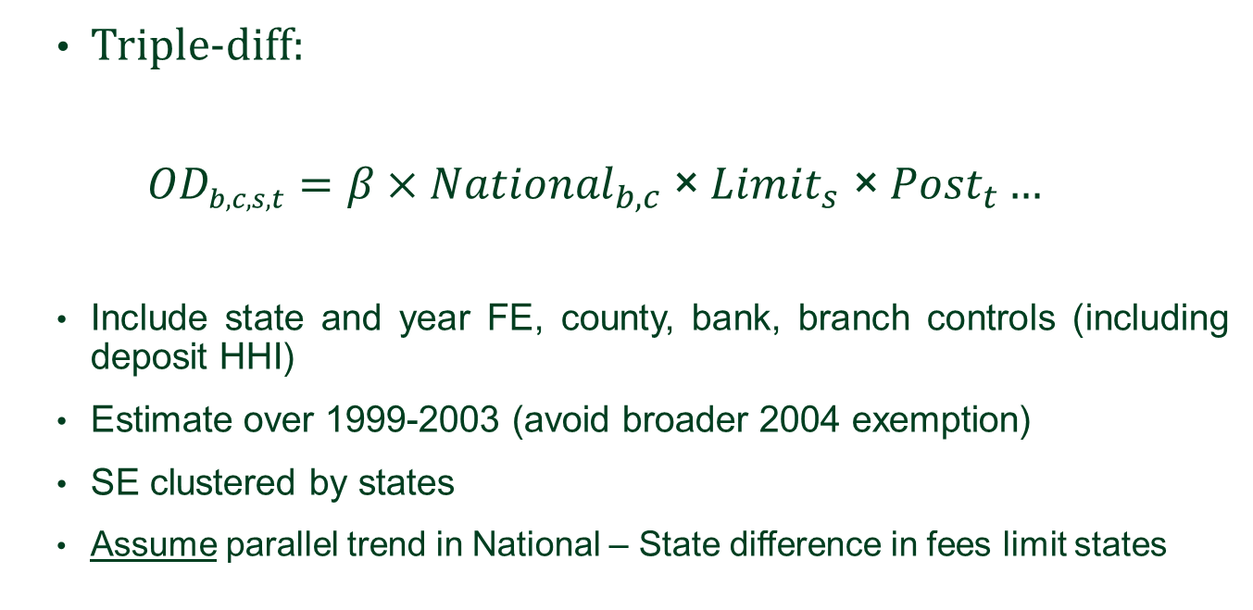
Overdraft Model
  Triple-diff:
  $${OD}_{b,c,s,t}=β{×National}_{b,c}\text{×} {Limit}_{s} \text{×}{ Post}_{t}…$$
  Include state and year FE, county, bank, branch controls (including deposit HHI)
  Estimate over 1999-2003 (avoid broader 2004 exemption)
  SE clustered by states
  Assume parallel trend in National – State difference in fees limit states
Notes:
Mention we include state and year fixed effects as a baseline

Slide 13
Overdraft Fee Result: Higher Fees
Nat’l banks increase coverage of OD by 17% relative to mean in fee limit states pre-preemption

Slide 14
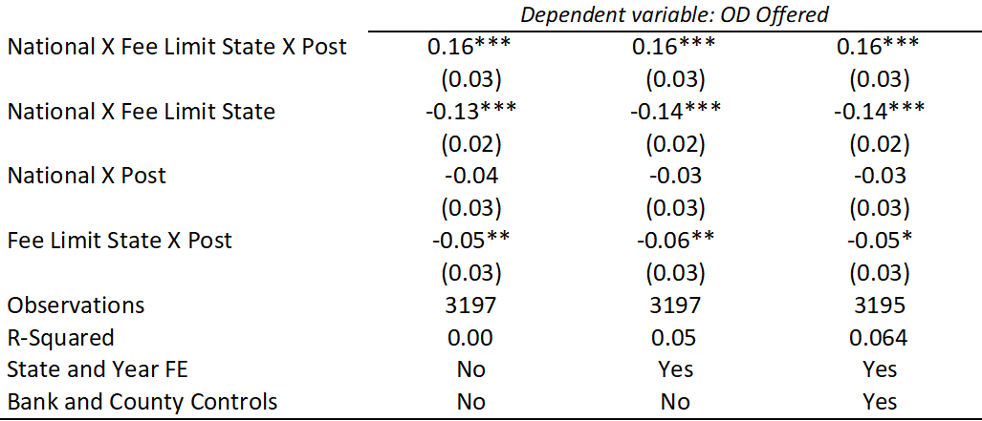
Overdraft Offered Results: Increased Supply
Nat. banks increase coverage of OD by 17% relative to mean after preemption

Slide 15
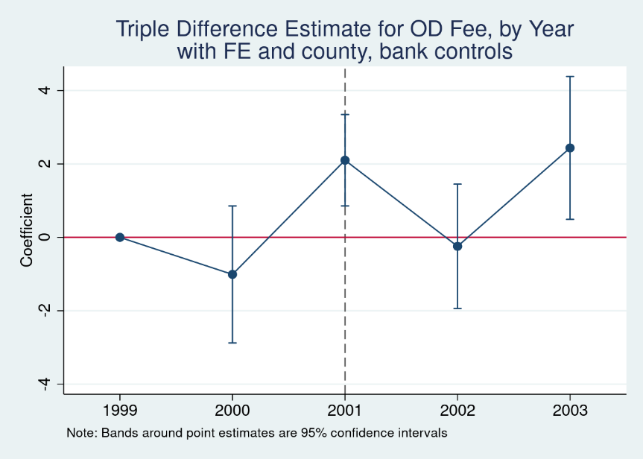
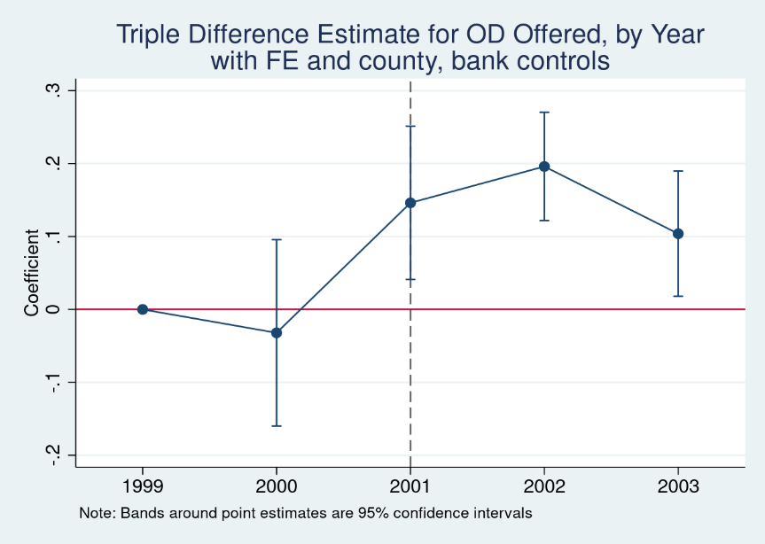
Overdraft Results: Parallel Trends
Nat. banks raise fees roughly 10% relatively after preemption
Nat. banks increase coverage of OD by 17% relative to mean after preemption

Slide 16
Returned Checks Data
      Data from Fed check processing centers (CPC):
      Checks processed and returned (“bounced”) per quarter
      Estimate diff-in-diff at CPC level.
      46 CPC ≈ one per state; 6 in limit states

Slide 17
Returned Checks Data
Check Summary Statistics, by State
 | Limit States (N=120) |  | Other States (N = 780)
 | Mean |  | Mean |  | Diff.
Log(# processed) | 11.36 |  | 11.43 |  | -0.07
Log($ processed) | 10.99 |  | 11.19 |  | -0.20***
# returned (millions) | 1.21 |  | 1.23 |  | -0.02
$ returned (millions) | 9.32 |  | 10.32 |  | -1.01
# returned /# processed (%) | 1.34 |  | 1.16 |  | 0.18***
$ returned /$ processed (%) | 1.28 |  | 1.11 |  | 0.16***

Slide 18
Returned Checks Results: Fewer Bounced Checks
-0.22 ≈ 15% decline relative to mean in limit states
Substantial potential savings in NSF fees to merchants

Slide 19
Banked Data
      SIPP: Quarterly survey (roughly) on HH checking account ownership

Slide 20
Banked Results: Increased Inclusion
4.8 p.p. increase in banked low-income HH ≈ 11% of mean in limit states
Effect only evident for low income HH (bottom quintile)

Slide 21
Banked: Behavioral Concerns
Newly banked not necessarily better off if fees “shrouded” (Gabaix and Laibson 2006)
“Naïve” depositors open/re-open account but later have it closed after a rash of overdrafts/returned checks
Lower returned check rates suggest otherwise
Also find lower account turnover and enduring relationships

Slide 22
Banked Result: Less Turnover
Low income HH less likely to lose account & more likely to gain after preemption.

Slide 23
Banked Result: Enduring Relationships
Largest effect at sample end

Slide 24
Recap
Fee caps lower OD fees but less OD credit
Higher returned checks rates under caps less OD credit (and $$$ in NSF)
Low income HH less likely banked with cap

Slide 25
Conclusion
Urge to curb high overdraft fees understandable but beware Ec:101: caps reduce overdraft credit, so more bounces checks and less financial exclusion
Banked depositors pay $$$ in returned check fees that might have been covered absent cap
Increasing competition may be better path to increased inclusion

Slide 26


Competition Instead of Caps?
Overdraft very profitable to banks and credit unions ($35 bn annually)
Competition weak among depositories (no advertising!)
But works across small dollar lenders (Melzer and Morgan 2004)
Notes:
Competition is “natures” price cap; keeps fees in line with costs

Slide 27
Reference Slides

Slide 28
Contribution
Financial Inclusion. Campbell, Martinez-Jerez, Tufano (2012), Celerier and Matray (2019), Dupas, Karlan, Robinson, Ubfal (2018), Bord (2020).
Behavioral economics/consumer financial regulation. Gabaix and Laibson (2006), Mullainathan, Barr, and Shafir (2009), Heidhues and Koszegi (2018), Alan, Cemalcilar, Karlan, Zinman (2018), Stango and Zinman (2011, 2014), Ru and Schoar (2019), Melzer and Morgan (2005)
Price ceilings in banking. Agarwal, Chomsisengphet, Mahoney, Stroebel (2014), Nelson (2018), Kay, Manuszak, Vojtech (2017)); Knittel and Stango (2003), DeYoung and Phillips (2009), Melzer and Schroeder (2018).

Slide 29
OCC preemption
OCC historically preempts state fee and usury limits for National banks
Before 2001, OCC had granted only qualified exemption from state overdraft fee limits; evaluated case-by-case
OCC removed qualification in July 2001 and categorically exempted national banks from state limits
Natural experiment: only national banks exempted, only some states limited

Slide 30
Banked Results: Only Low-income HH Affected

