Slide 1
Making Ends Meet: The early impact of the COVID-19 pandemic on consumer finances
Webinar | September 2021
Notes:
Heather

Slide 2
Disclaimer
This presentation is being made by a Consumer Financial Protection Bureau representative on behalf of the Bureau. It does not constitute legal interpretation, guidance, or advice of the Consumer Financial Protection Bureau. Any opinions or views stated by the presenter are the presenter’s own and may not represent the Bureau’s views.

Slide 3
Disclaimer
The inclusion of links or references to third-party sites does not necessarily reflect the Bureau’s endorsement of the third party, the views expressed on the third-party site, or products or services offered on the third-party site. The Bureau has not vetted these third parties, their content, or any products or services they may offer. There may be other possible entities or resources that are not listed that may also serve your needs.

Slide 4
CFPB’s mission
The Consumer Financial Protection Bureau (CFPB) is a 21st century agency that helps consumer finance markets work by making rules more effective, by consistently and fairly enforcing those rules, and by empowering consumers to take more control over their economic lives.

Slide 5
When you join CFPB FinEx
Receive updates on research, tools, and webinars via e-mail
Engage with a network of over 30,000 financial practitioners
Discuss news, research, and best practices with more than 3,500 practitioners on our LinkedIn discussion group
Stay up to date with 10 to 20 webinars a year
Attend regional meetings and conferences
Get to know CFPB presenters who can work with your organization
https://www.consumerfinance.gov/consumer-tools/educator-tools/adult-financial-education/join-cfpb-finex-network/
Notes:
New Slide for FinEx Intro 9/14/2021

Slide 6
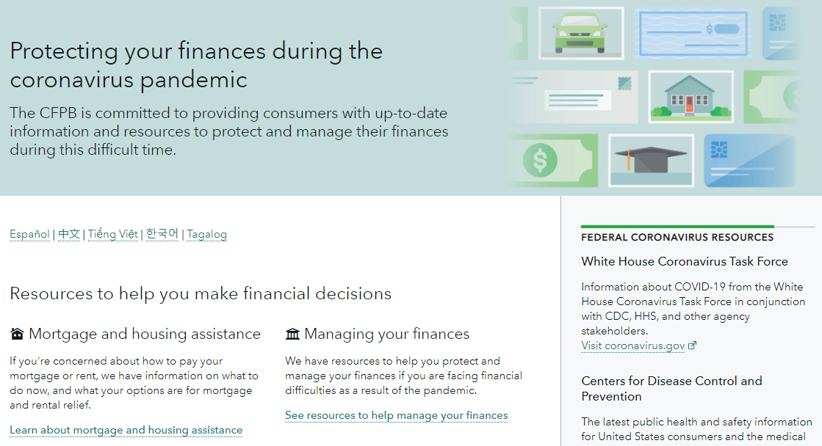
Managing and protecting money during COVID-19
consumerfinance.gov/coronavirus
Notes:
New Slide for FinEx Intro 9/14/2021

Slide 7
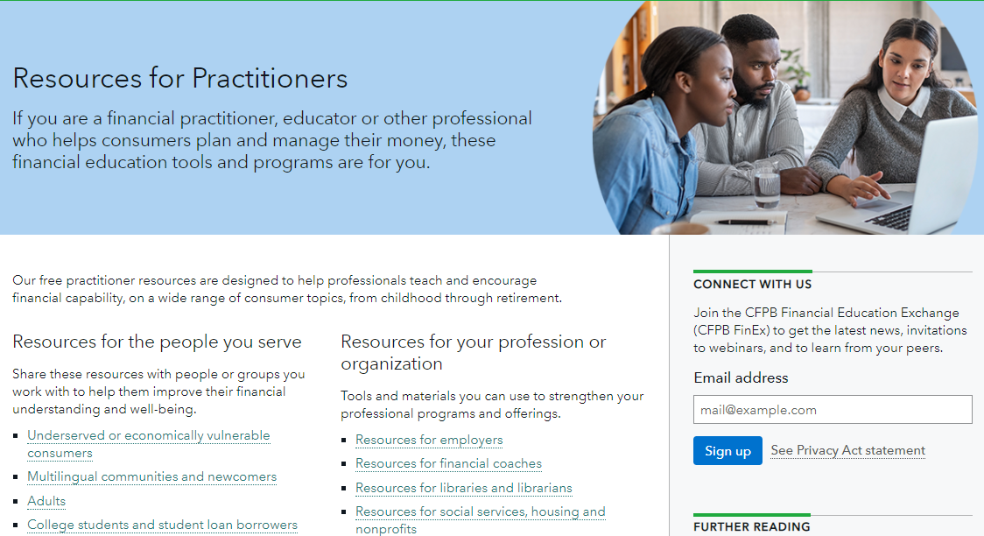
Online resources for practitioners
www.consumerfinance.gov/consumer-tools/educator-tools/
Notes:
New Slide for FinEx Intro 9/14/2021

Slide 8
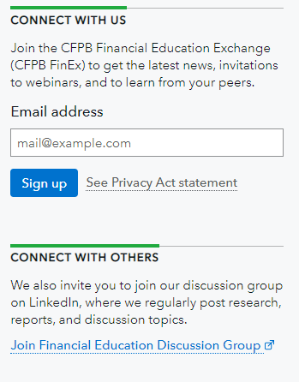
Resources for working with adults
www.consumerfinance.gov/consumer-tools/educator-tools/adult-financial-education/join-cfpb-finex-network/
Notes:
New Slide for FinEx Intro 9/14/2021

Slide 9
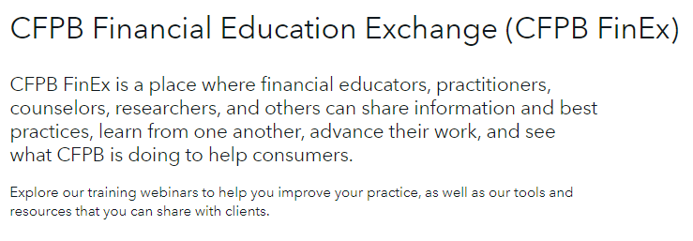
CFPB FinEx webinar info and archives
consumerfinance.gov/consumer-tools/educator-tools/adult-financial-education/cfpb_finex
Notes:
New Slide for FinEx Intro 9/14/2021

Slide 10
Making Ends Meet: The early impact of the COVID-19 pandemic on consumer finances
Webinar | September 2021
Notes:
Heather

Slide 11
Your presenters
Scott Fulford
Senior Economist
Office of Research, CFPB
Marie Rush
Research Analyst
Office of Research, CFPB
Eric Wilson
Research Analyst
Office of Research, CFPB
Notes:
Heather
Scott Fulford: Scott Fulford is a senior economist in the Office of Research. At the Bureau he led the development of the Making Ends Meet surveys. His research focuses on how consumers manage shocks using credit and savings. Before coming to the Bureau, he taught development economics and international studies at Boston College.
Marie Rush: Marie Rush is a Research Analyst in OR who primarily focuses on the Making Ends Meet survey. She has co-authored previous reports using the Making Ends Meet data in addition to this report. She has been at the Bureau for just over two years.
Eric Wilson: Eric Wilson is a Research Analyst in OR and serves as program manager for surveys like the one we’ll be discussing today. He recently celebrated his one-year anniversary as a CFPB employee. Before joining the Bureau, Eric worked at the Financial Health Network, where he co-authored the US Financial Health Pulse, an annual study of consumers designed to measure financial health in America using both survey and transactional account data.

Slide 12
Today’s presentation
The Making Ends Meet survey
Changes in consumer financial status during the initial months of the pandemic
Financial Well-Being, Difficulty paying bills and expenses, credit scores
Whose financial status got worse?
What’s next for the survey?
Notes:
Scott

Slide 13
Making Ends Meet Survey: Background
General financial survey with focus on what happens when consumers face financial problems
Survey associated with respondents’ credit records
Survey samples from the Bureau’s Consumer Credit Panel: a random and de-identified sample of credit records maintained by one of the three nationwide credit reporting agencies
Association allows us to understand how consumers’ credit and debts evolve before, during, and after the survey waves
Notes:
Scott
Goal is to understand the things that cause consumers to have problems, what they do when they have problems, and how consumers can help avoid having problems or markets can provide better products that are there when consumers do have problems. Of course, we are also interested in a broad range of consumer financial questions including how financial status differs by race and ethnicity, by age, and by military status to name just a few.
For those who like surveys: the association with the credit bureau data also allows us to oversample in a very targeted way. In this survey, we oversampled by low credit score, recent delinquencies, and living in a rural area. The association also allows us to correct for non-response in a far more sophisticated way than is possible with most surveys. For example, we observe the credit scores of both respondents and non-respondents so can correct if people with lower credit scores respond less. Most surveys see NOTHING about non-respondents.

Slide 14
Making Ends Meet Surveys during the pandemic
Three waves of the survey to the same respondents:
Wave 1 (May 2019): Financial status of consumers before the pandemic (2990 responses)
Wave 2 (May 2020): Financial status during the initial stages of pandemic with some COVID-related options (1742 responses)
Wave 3 (February 2021): Financial status after a year of the pandemic with COVID-policy specific questions
This webinar focuses on the first two waves but expect more soon!
Notes:
Scott
We focus on data from Wave 1 and Wave 2 for this webinar

Slide 15
Key findings
Despite volatile economic conditions, the average consumer’s financial status improved between June 2019 and June 2020
Financial well-being and credit score increased, difficulty paying bills decreased
These financial improvements were widespread across race, ethnicity, age, rural status, and income level
But the large pre-existing differences persisted
Many consumers were financially worse off, with declines in financial status correlated more with income and savings losses rather than job loss
Notes:
Scott
Emphasize: The existing differences are large, and they didn’t get worse, but they also didn’t get better.

Slide 16
Limitations
Timing
Causality
Sample size
Statistical differences
Notes:
Scott
Timing-We are discussing results during the pandemic from a survey in May and June 2020. Our results are representative of consumers in June 2020, but not necessarily afterwards. Other evidence the Bureau has put out since then suggest that there have not been dramatic reversals. For example, delinquencies were still down as of June 2021. But it has been a volatile two years and much of the support will be ending in the next several months.
Causality- the data does not support conclusions about causality only associations.
Sample size- as we noted the sample for the survey while it was nearly 2000 people, once you starts cutting into smaller subgroups, the samples become smaller, this limits our ability to get reliable results or confidently assess whether the tendencies and patterns we observe are significant, that is they are not just by chance. That brings me to the last point.
Statistical differences - We try to show when a result or difference is statistically significant. But I want to note a few things. There are wide variations in the FWB score generally, and as a result you don’t necessarily see difference sin the averages, but you can see interesting patterns when you look at the distribution. Lastly, the lack of differences itself is an important result, especially if you are looking at categories where you expect to see a difference.

Slide 17
Financial status: Three key measures
Financial Well-Being Score
Number from 0-100 based on five questions that together measure “a person’s ability to meet current and ongoing financial obligations, feel secure in their financial future, and make choices that allow them to enjoy life.”
Difficulty paying bills or expenses
“At any time in the past 12 months have you or your household had difficulty paying for a bill or expense?”
Credit score
Notes:
Eric
To get a broad-based sense of people’s financial conditions, we wanted to know about multiple aspects of their financial lives. So we used three measures: Financial Well-being Scores, a survey question about financial difficulty, and credit scores.
The financial well-being score is a survey-based measure we developed that essentially tells us how people are feeling about their financial conditions. It’s a number from 0-100 based on five questions that measures “a person’s ability to meet current and ongoing financial obligations, feel secure in their financial future, and make choices that allow them to enjoy life”
The survey question about financial difficulty, in turn, gives us a general sense of what people say actually happened in their financial lives over the past year. It’s a broad question, asking if, at any time in the past 12 months, a household has had difficulty paying for a bill or expense. This can capture a lot of different financial problems people have, as we’ll discuss later
And credit scores give us information on actual financial outcomes, since it’s a combination of information on delinquency, credit utilization, and other key indicators of financial status.

Slide 18
Improvement in financial status
Metric | June 2019 | June 2020 | Difference
CFPB Financial Well-Being Score | 51.1 | 52.1 | +1*
Percentage of individuals who had difficulty paying for a bill or expense in the previous year | 40 | 36 | -4*
Credit Score | 699 | 710 | +11*
Notes:
Eric
We saw improvement across these three measures between June 2019 and June 2020, in the midst of the early pandemic.

Slide 19
Elements of the Financial Well-Being Scale
Percentage reporting that statement describes themselves “Completely” or “Very Well” | June 2019 | June 2020 | Difference
I am just getting by financially | 34.7 | 34.8 | 0.1
I am concerned that the money I have or will save won’t last | 43.1 | 37.7 | -5.4*
Because of my money situation, I feel like I will never have the things I want in life | 31.9 | 28.6 | -3.2
Percentage reporting that the statement occurs “Always” or “Often” | - | - | -
I have money left over at the end of the month | 42.7 | 46.6 | 3.9*
My finances control my life | 42.7 | 34.7 | -8.0*
Notes:
Eric
We saw significant improvements in three of the five components of the scale: “I am concerned that that the money I have or will save won’t last”, “I have money left over at the end of the month”, and “My finances control my life”.

Slide 20
Financial Well-Being Change by Demographics
Group | Financial Well-Being Score (June 2019) | Financial Well-Being Score (June 2019) | Financial Well-Being Score (June 2020) | Difference | Difference | 95% Confidence Interval
Overall | 51.09 | 51.09 | 52.13 | 1.04 | 1.04 | 0.18 to 1.91
Race/Ethnicity | - | - | - | - | - | -
Non-Hispanic White | 52.29 | 52.29 | 53.41 | 1.12 | 1.12 | 0.29 to 1.94
Black | 47.79 | 47.79 | 48.21 | 0.42 | 0.42 | -2.47 to 3.31
Hispanic | 47.75 | 47.75 | 48.93 | 1.18 | 1.18 | -2.99 to 5.34
Other | 50.44 | 50.44 | 51.68 | 1.23 | 1.23 | -2.68 to 5.14
Household Income in 2018-
$40,000 or less |  | 44.75 | 46.42 | 1.67 |  | 0.02 to 3.31
$40,001 to $70,000 |  | 51.08 | 52.15 | 1.06 |  | -0.22 to 2.34
$70,001 to $100,000 |  | 53.24 | 55.36 | 2.12 |  | 0.61 to 3.63
More than $100,000 |  | 58.62 | 58.71 | 0.09 |  | -2.24 to 2.42
Notes:
Eric
One of our main findings was that the improvements we observed were widespread across groups, but that differences between groups remained large.
This table shows that finding.
How big are the differences by race and ethnicity in June 2019? Big. The nearly 5-point difference between non-Hispanic white and Black and Hispanic consumers is slightly larger than difference between income of $40-70,000 and 70-100,000.
Overall across groups there were increases in financial well-being between June 2019 and June 2020. But once we start splitting up by group, the size of our groups gets smaller and smaller, which gives us reason to be cautious about interpreting these numbers.

Slide 21
Fewer reporting difficulty paying a bill or expense
 | June 2019 | June 2020 | Difference | 95% Confidence Interval
Had any difficulty paying for a bill or expense | 39.9 | 35.9 | -4.0 | -7.8 to -0.3
Had more than one instance of difficulty | 31.2 | 29.7 | -1.5 | -5.3 to 2.3
Had difficulty in the past three months | 22.1 | 23.3 | 1.2 | -2.4 to 4.8
Notes:
Eric
We saw decrease in the rate at which people had difficulty, but we did not see a decrease in the intensity or recency of those difficulties

Slide 22
Reasons for difficulty in 2019 vs 2020
Reason for experiencing difficulty | June 2019 | June 2020
Medical expenses or fees | 12.3 | 8.3
Less work available because of actions to limit coronavirus | - | 7.1
Auto repair | 8.4 | 6.9
Could not work - workplace was closed because of actions to limit coronavirus | - | 5.7
Helping children, parents, or other family members | 6.4 | 4.8
Taxes or fees | 5 | 3.6
Home repair | 5.6 | 3.3
Other loss of income | 3.8 | 2.9
Student loan, school, or tuition costs | 4.3 | 2.3
Loss of income from illness | 4 | 2.3
Loss of job | 6.1 | 2.1
Notes:
Eric
We also looked at why people said they had difficulty—I mentioned that this question captured a lot of different problems people can have. Here’s how those problems changed.
Medical dropped, Auto repair dropped. Home repair dropped.
Note that overall difficulty fell even though many people could not work because workplace was closed—that’ll be important when we come back to what we conclude from all this. But for now, I’ll pass to Marie

Slide 23
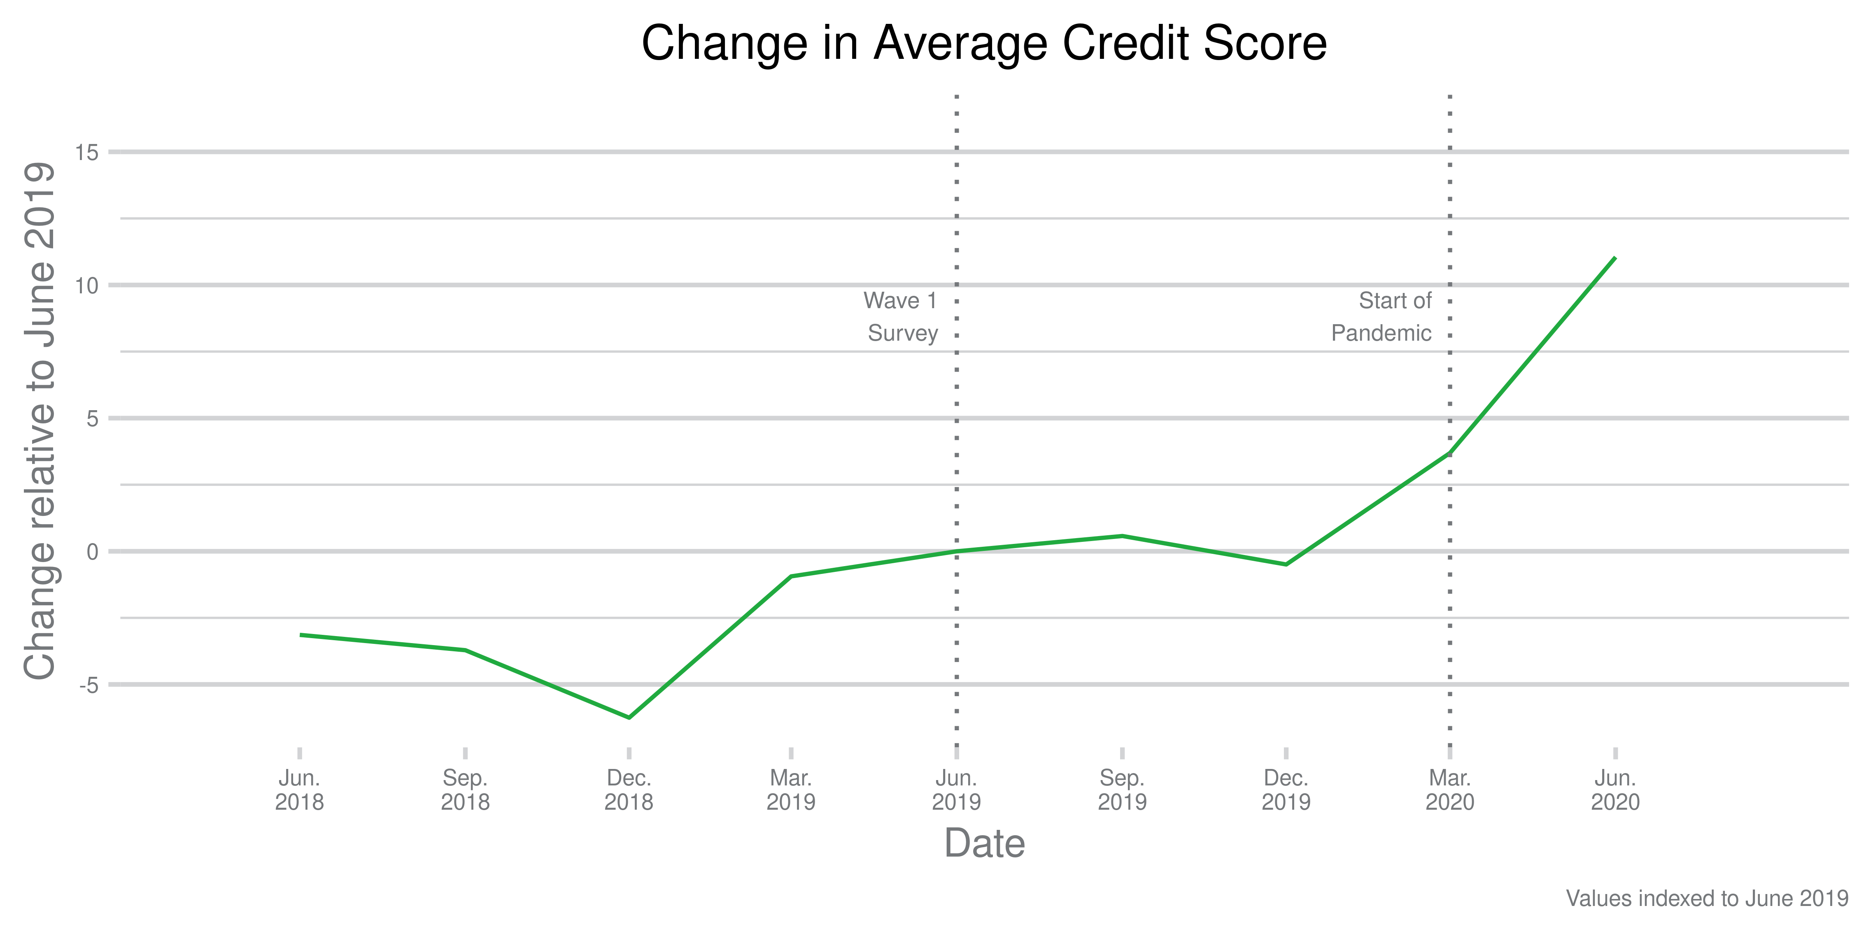
Improvement in Credit Scores
Notes:
(Marie) Thanks Eric. Now we’ll take a look at credit trends over time using our CCP data. This figure shows the trend in average credit scores from June 2018 to June 2020 with values indexed to June 2019, when the Wave 1 survey was fielded. As you can see, credit scores increased steeply during the pandemic relative to the same period a year before.

Slide 24
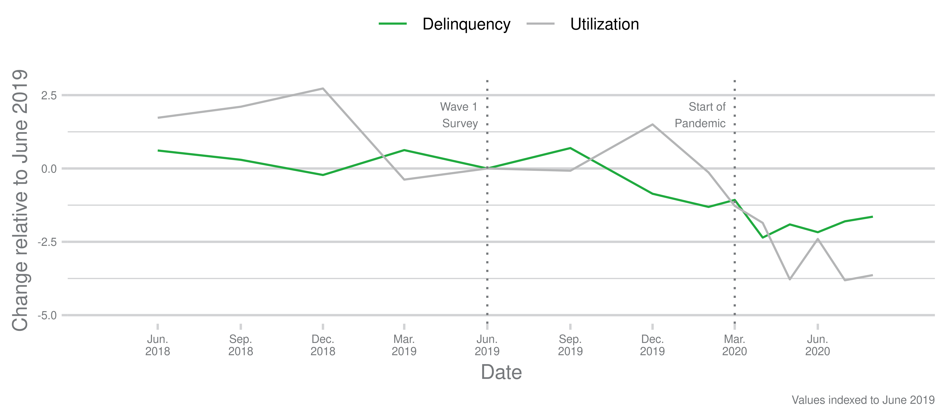
Decrease in overall delinquency/utilization
Notes:
(Marie) Next we look at trends in two important components of credit score – delinquency and utilization. Again, values are indexed to June 2019. This graph shows that between March and June 2020, credit card utilization declined by 2.4 percentage points and the share with at least one delinquency on their credit report decreased by 2.2 percentage points. These declines play a significant role in the steep, upward trend in credit scores we saw on the previous slide. Additionally, credit scores may also have improved because consumers who might otherwise have had delinquencies instead entered some sort of forbearance or assistance.

Slide 25
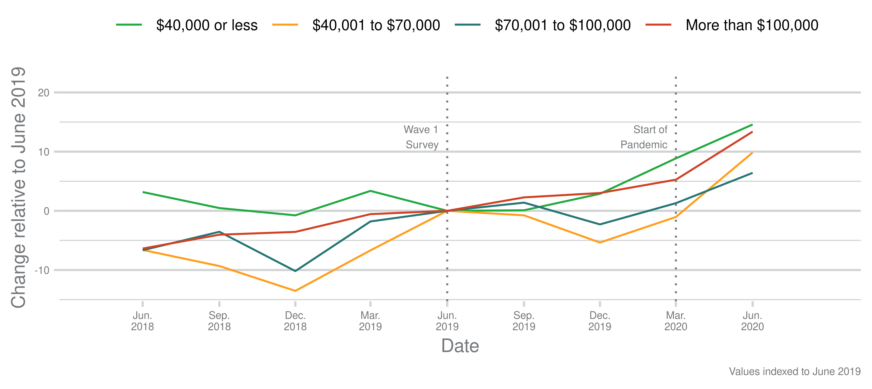
Increase in credit score by income
Notes:
(Marie) Here we examine trends in credit score by income groups. All income groups experienced an increase in credit score following the onset of the pandemic, which is a stark contrast to the trends seen the previous year. Those with $40,000 or less in annual income experienced the largest increase in credit scores between June 2019 and June 2020, though the differences across groups are not statistically significant. It is also important to note that the lowest income group also had the lowest credit scores throughout the year, even after the relatively large increase during the pandemic.

Slide 26
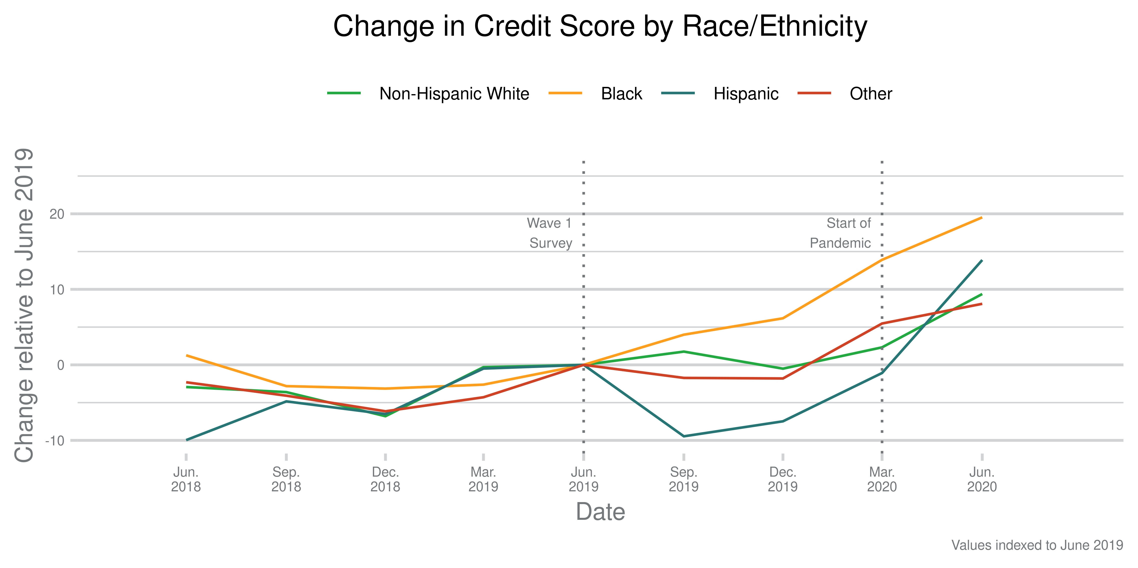
Increase in credit score by race/ethnicity
Notes:
(Marie) Finally, we look at credit score trends by race and ethnicity. Here we see that increases in credit scores among Black and Hispanic consumers play an important role in the overall increase in credit scores (though not statistically significant). One important thing to keep in mind is the disparities in credit scores prior to the pandemic. Average credit scores among non-Hispanic White consumers were about 100 points above those of Black consumers and about 60 points above those of Hispanic consumers. Similar to the trend seen across income groups, those who had lower credit scores prior to the pandemic experienced the largest increases following the onset of the pandemic.
We know from other Bureau research that consumers in majority-Black and majority-Hispanic areas were more likely to receive assistance from lenders, which may play a role in the post-pandemic trend we see here.
Now I will turn things back to Eric to discuss declines in financial status.

Slide 27
Declines in financial status: Employment
 | Financial Well-Being score declined | Credit score declined | Had a difficulty in 2020 but not in 2019
Overall | 41.5 | 34.0 | 9.8
Did not become unemployed | 40.5 | 34.2 | 8.4
Became unemployed | 51.0 | 32.2 | 23.3
Notes:
Eric
So we’ve talked a lot about how financial conditions improved, but because we were looking at a major economic upheaval, we wanted to look at those whose financial conditions got worse. This slide and the next few slides provide statistics on those whose financial status declined along our three measures.
The survey-based measures were both related to employment status
But! We didn’t see a difference in declining credit score for people who became unemployed

Slide 28
Declines in financial status: Savings & cash flow
 | Financial Well-Being score declined | Credit score declined | Had a difficulty in 2020 but not in 2019
Overall | 41.5 | 34.0 | 9.8
Change in income
Income went up | 35.4 | 29.7 | 9.0
Income stayed the same | 40.8 | 34.5 | 8.4
Income went down | 53.4 | 39.5 | 15.8
Change in savings
Savings went up | 31.1 | 29 | 3.3
Savings stayed about the same | 42.8 | 33.1 | 9.7
Savings went down | 51.5 | 41.5 | 17.1
Change in expenses
Expenses went up | 46.3 | 38.9 | 13.3
Expenses stayed about the same | 37.1 | 30.0 | 6.4
Expenses went down | 39.1 | 28.3 | 11.6
Notes:
Eric
Meanwhile, negative changes in cash flows predicted declines in all three measures

Slide 29
Declining financial status: Credit forbearance
 | Financial Well-Being score declined | Credit score declined | Had a difficulty in 2020 but not in 2019
Overall | 41.5 | 34 | 9.8
Did not receive forbearance on a non-student tradeline | 42.8 | 33.7 | 9.4
Received forbearance on a non-student tradeline | 28.4 | 37.7 | 14.6
Notes:
Eric
We saw an interesting pattern with forbearance, where different measures moved in opposite directions. Note that people who received forbearance did have troubles---but those troubles did not cause their credit score or FWB to decline.

Slide 30
Discussion
A combination of unemployment insurance and Economic Impact Payments meant that unemployed consumers did not necessarily face a large decline in income.
Forbearance and assistance from financial institutions were effective at keeping unemployment from causing default on loans reported to credit bureaus.
Notes:
Eric
What we conclude from all of this is… [slide text] (Connect to findings discussed earlier). Now I’ll hand it to Scott to get into some of the more general implications and see us to the finish line.
Pass to Scott

Slide 31
Discussion
While the financial status of the average consumer improved early in the pandemic, those gains may not have lasted, and not everyone’s financial status improved.
Unemployment policies have been inconsistent
Many of these policies have ended recently
An overall improvement in financial status does not imply more general improvement in consumers’ lives
Financial status partly improved because of the fall in spending when consumers could no longer travel or eat at restaurants
Notes:
Scott
Improvements seem to have continued. We’ve been seeing how consumer’s financial status in credit bureau has changed. Through June, delinquencies and credit card debt were still down. But unemployment benefits and eviction protections ended two weeks ago. Other protections end soon.
There’s a real cost to not being able to visit your grandkids (which was one of the problems for my family) or go out if you are single. Financial benefits to not spending as much, but also costs.

Slide 32
What’s next for the Making Ends Meet Survey?
Research using Wave 3 (February 2021) – the first wave of the survey specifically designed to capture insights about consumers during the pandemic
More research from the Making Ends Meet Series
Insights from the Making Ends Meet Survey (Inaugural report)
Credit card debt fell even for consumers who were having financial difficulties before the pandemic (Blog post)
Consumer use of payday, auto title, and pawn loans: Insights from the Making Ends Meet Survey
Financial conditions of renters before and during the COVID-19 pandemic
Notes:
Scott
Links sent out while on this slide.

Slide 33
Questions?
Notes:
Scott

