Slide 1
Mortgage Markets Update
November 18, 2020

Slide 2
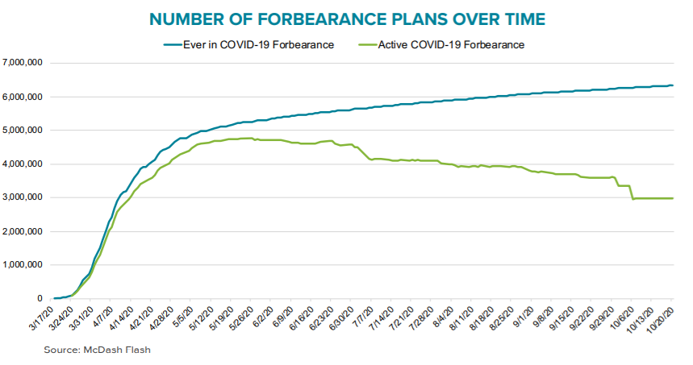
Forbearances Peaked in May
Notes:
Under the CARES Act, consumers who have federally backed mortgages and are experiencing financial hardship during the COVID-19 outbreak may request a forbearance on their mortgage payments. This forbearance is for up to 180 days and may be extended for an additional180 days. That covers about 70% of the market, and mortgage servicers are providing forbearance for many privately held loans as well.
About 3 million consumers are in an active mortgage forbearance, as of Oct 20 (shown in green), which is less than half of all those who have ever signed up for a COVID-related forbearance. You can see many people exited around the 3-month and 6-month marks.

Slide 3
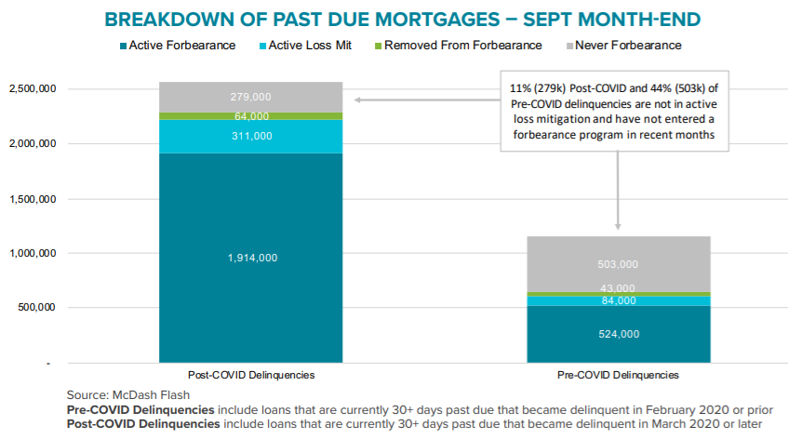
Most Delinquent Borrowers in Forbearance
Notes:
There are a couple segments of borrowers we are concerned about. One group is the set of borrowers who are behind on their mortgage payments, but have not gotten forbearance shown in gray. The 279,000 borrowers on the right are those who were current on their payments before the pandemic hit. We believe many of these borrowers are eligible for forbearance.
We are collaborating with industry and nonprofits on a campaign to reach these borrowers and urge them to contact their servicers about their options. We’d also welcome the CAB’s feedback on ways to reach these borrowers or any data you have about who these borrowers are.

Slide 4
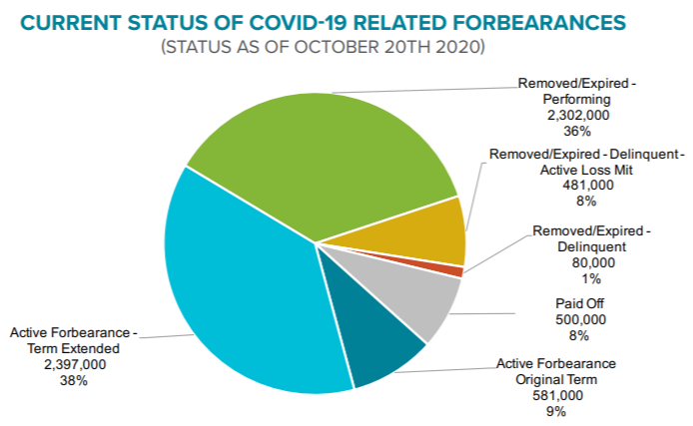
Forbearance Exits
While most borrowers who exited forbearance are back on track, a portion are delinquent or still in the loss mitigation process.
Notes:
We are also monitoring how consumers are faring as the exit forbearance. This graph looks at the 6.3 million borrowers who ever got forbearance and tells us how they are doing now. The good news is that 2.3 million borrowers have exited forbearance and are current on their payments. Some stayed current the whole time, others got deferrals or loan modifications. Either way, they’re back on track and making timely payments. Another 500k have paid off their loans, likely be refinancing.
However, some borrowers exited forbearance are still in the loss mitigation process (yellow) and a small number are delinquent (red). We are monitoring these trends and provide borrowers with guidance on forbearance exits on our housing hub website.

Slide 5
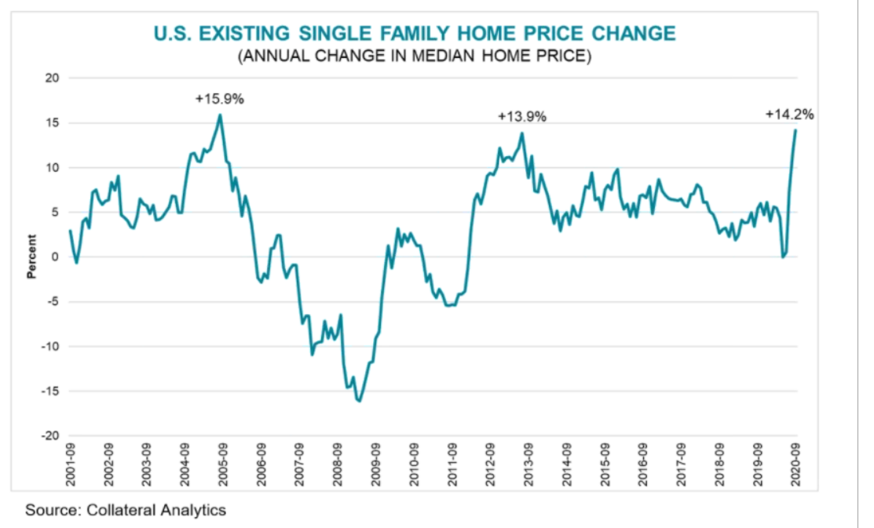
Home Price Appreciation Strong
Limited inventory and strong demand have caused a surge in home prices.

Slide 6
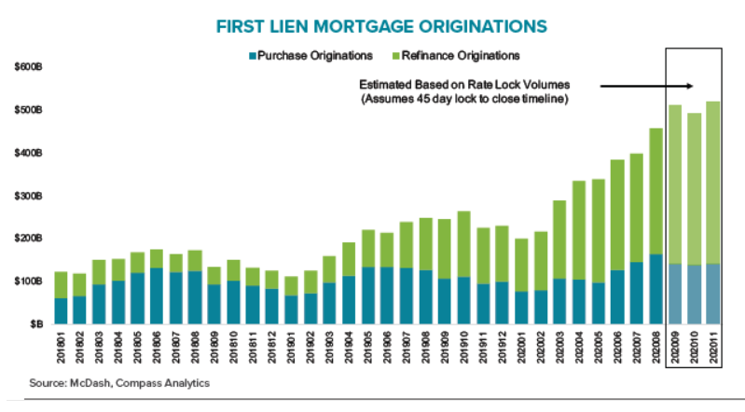
Low Interest Rates Fuel Originations
Origination volume has largely recovered from early disruptions due to COVID-19, but access to credit remains an issue for many borrower segments.

Slide 7
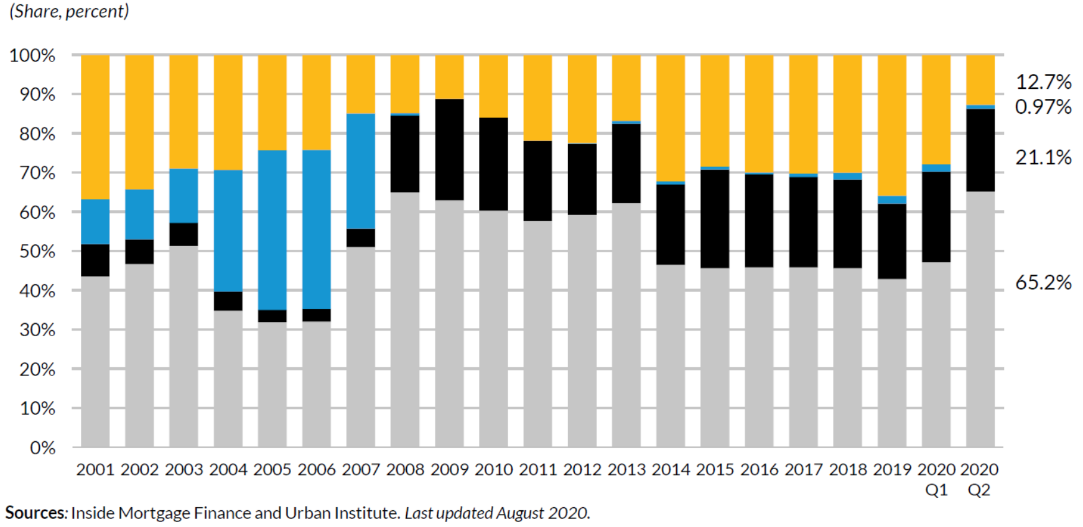
Origination Share Composition
With the COVID-19 pandemic, GSE market share has increased, but access to credit for non-agency financing and lower credit GSE and government borrowers remains tight.

