Slide 1
Trends in mortgage complaints
Office of Consumer Response Presentation to Advisory Committee
November 18, 2020

Slide 2
Most-complained-about products and services January – September 2020
Declaration of Emergency
Mortgage complaints represent approximately 5.9% of complaints in 2020
Source: Consumer Complaint Database

Slide 3
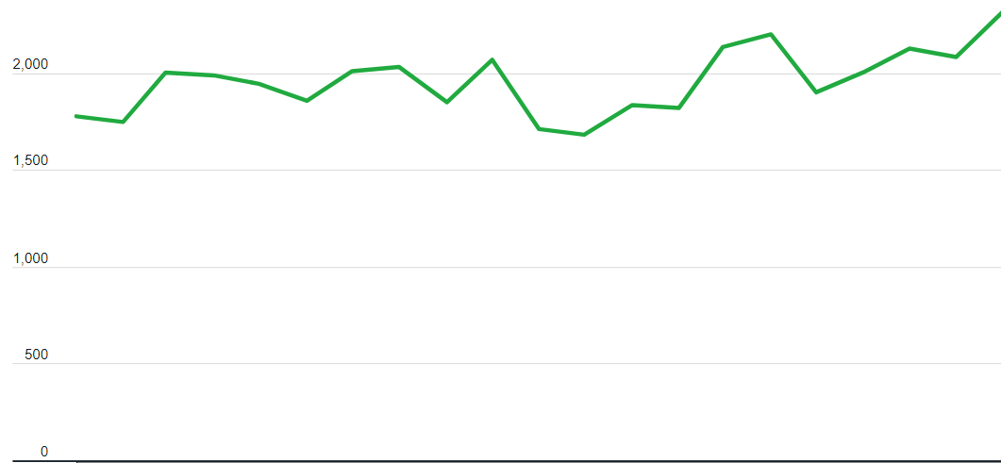
Mortgage complaints by month CY2019 – September 2020
Declaration of Emergency
Jan Feb Mar Apr May Jun Jul Aug Sep Oct Nov Dec Jan Feb Mar Apr May Jun Jul Aug Sep
2019
2020
Source: Consumer Complaint Database

Slide 4
Top 5 issues in mortgage complaints CY2019 – September 2020
Source: Consumer Complaint Database
Notes:
The forbearance options provided to consumers with government-backed mortgage loans likely explains the decrease in prevalence of the “Struggling to pay” issue.

Slide 5
Themes in consumer’s mortgage complaints
Forbearance options provided to consumers with government-backed mortgage loans likely explains the decrease in complaints about Struggling to pay mortgage
Some consumers report:
misapplied payments when attempting to bring their loan current following a forbearance plan
receiving confusing or conflicting information when they inquired about extending their forbearance plan
being told that financial documentation would be required to have their mortgage loan reviewed for a forbearance extension

Slide 6
Themes in consumer’s mortgage complaints
In their complaints about Applying for a mortgage or refinancing an existing mortgage some consumers report:
Some self-employed consumers report being required to submit extensive documentation or denied for a loan because of their self-employment status
loan applications being denied
delays in loan processing and closing dates

