Slide 1
Behind on bills?
Start with one step.
Notes:
This slide deck is designed to support training frontline staff and volunteers to use the Your Money, Your Goals booklet, Behind on bills?
The training notes include suggested activities and additional information you may find helpful as you equip people to use these tools with the people they serve. Additional adapted activities are included for webinar trainings.
You’ll notice that a variety of training techniques are used. In some cases, tools are discussed as a group or in small groups. In others, some tools are demonstrated, and in others, role plays are used. These varied activities allow participants to explore the resource, learn its content, practice sharing its tools and information, and begin considering how to incorporate it into their day-to-day meetings and encounters with the people they serve.
Materials needed
1 copy of Behind on Bills? for each participant
Photocopies of each tool (In a folder or clipped together)
Pens
Markers
Sticky notes (15-20 per participant)
Sticky dots for voting (3 per participant)
Flipchart(s) to use as “parking lot”

Slide 2
DISCLAIMER
This presentation is being made by a Consumer Financial Protection Bureau (CFPB) representative on behalf of the CFPB. It does not constitute legal interpretation, guidance or advice of the Consumer Financial Protection Bureau. Any opinions or views stated by the presenter are the presenter’s own and may not represent the CFPB’s views.
This document includes links or references to third-party resources. The inclusion of links or references to third-party sites does not necessarily reflect the CFPB’s endorsement of the third-party, the views expressed on the third-party site, or products or services offered on the third-party site. The CFPB has not vetted these third-parties, their content, or any products or services they may offer. There may be other possible entities or resources that are not listed that may also serve your needs.

Slide 3
Behind on bills?
Overview of the training and introductions

Slide 4
Training objectives
Understand the content of Behind on bills?
  Be able to identify moments in which you could introduce the tools to the people you serve
  Be able to use its tools to help people take steps to reach their financial goals
Understand how this booklet complements the information and tools in the full Your Money, Your Goals toolkit
Have an increased understanding of the Consumer Financial Protection Bureau and be able to access and refer people to its resources
Notes:
As a result of this training, you will understand the content of Behind on bills? That includes being able to identify moments in which you could introduce the tools to the people you serve. By taking advantage of those moments, you will be able to use the booklet to help people take steps to reach their financial goals.
You will also understand how this booklet complements the information and tools in the full Your Money, Your Goals toolkit.
You will have an increased understanding of the Consumer Financial Protection Bureau — CFPB —and be able to access and refer people to its resources.

Slide 5
Behind on bills?
Introduction to the CFPB and financial empowerment

Slide 6
Introduction to the CFPB
Consumer Financial Protection Bureau
We are a 21st century agency that helps consumer finance markets work by regularly identifying and addressing outdated, unnecessary, or unduly burdensome regulations, by making rules more effective, by consistently enforcing federal consumer financial law, and by empowering consumers to take more control over their economic lives.
Notes:
Instructions for Facilitator:
Introduce key facts about the CFPB using information from Introduction Part 1 of the Your Money, Your Goals toolkit and the website.
Share additional information about the CFPB: The CFPB is working to ensure that consumers get the information they need to make financial decisions they believe are best for themselves and their families – that prices are clear up front, that risks are visible, and that nothing is buried in fine print.
Explain that a key goal of the training is to connect frontline staff to CFPB resources, including Consumer Response.

Slide 7
Office of Community Affairs
Part of the CFPB’s Division of Consumer Education and Engagement
Serves populations who may lack full, affordable access to financial services
  Low- to moderate-incomes
  Low wealth
  Otherwise financially underserved or vulnerable
Notes:
Use the following information to introduce the Office of Community Affairs:
The Office of Community Affairs serves the variety of populations that may lack full, affordable access to financial services, including people with low- to moderate-incomes; low wealth, and people who are in other ways financially excluded or vulnerable. By any measure, the numbers of consumers whose income level contributes to financial fragility constitutes a significant portion of the U.S. population.
According to 2018 data from the U.S. Census Bureau, some 38.1 million people, including children, live in households that have incomes below the federal poverty level, while another 55.5 million live between 100 and 200 percent of the poverty threshold.
The CFPB created Your Money, Your Goals to reach these consumers by empowering those that serve them: frontline nonprofit or tribal social service staff, community volunteers, staff in legal aid organizations, and people that serve workers. By providing these intermediaries with high quality information, they have the tools and resources to start the financial conversation with the individuals they already serve. And the training provides them the confidence to use these tools and resources. The training that you will ultimately provide to them.

Slide 8
Financial empowerment
What is financial empowerment?
How is it different than financial education, financial literacy, financial capacity, or other commonly used terms?
Skill and confidence to use knowledge
Financial empowerment
Financial literacy
=
Notes:
Facilitated Discussion and Presentation
NOTE: Use these two slides if participants have not received prior training on Your Money, Your Goals. Use the animations in this slide to guide the questions and discussion
Transition by reminding participants that an informed consumer is the best defense and that Your Money, Your Goals ia a “financial empowerment” toolkit.
ASK: What is financial empowerment?
Write their ideas on flip chart paper.
ASK: How is it different from financial education, financial literacy, financial capability, or other commonly used terms?
Ask them how financial empowerment is different from other commonly used terms: financial education, financial literacy, financial capability, financial fitness, financial coaching, and so on.
NOTE: It may be helpful to differentiate strategy terms (financial education, financial coaching, and financial counseling) from outcome-based terms (financial literacy, financial capability, financial fitness).
Share definition of financial empowerment using the slide and information from page 7 of the Introduction to the toolkit
While financial empowerment includes the concept of financial literacy, it goes beyond just acquiring knowledge. The main focus of financial empowerment is to build the skills you need to manage money and learn to choose the financial products and services that work for you.
When you’re financially empowered you’re both informed and skilled. You know where to get help with your financial challenges and can access and choose financial products and services that meet your needs. This sense of empowerment builds confidence, helping you effectively use your financial knowledge, skills, and resources to reach your goals.
FACILITATION TIP: Consider writing this definition on a flip chart and leaving it posted throughout the training.
Share the relationship of financial empowerment to financial literacy by using the slide and information.
Explain that financial education, which is inclusive of other strategies, such as coaching, counseling, technology-based approaches, and so on, leads to financial literacy and that financial literacy plus confidence—the confidence to make decisions and use knowledge, skills, and tools including financial products and services—is financial empowerment.

Slide 9
Financial empowerment and service providers
Trust
Opportunities for providing financial empowerment
Access
=
‘’
Notes:
Introduction to the CFPB and financial empowerment
Corresponding section of the toolkit: Introduction, pages 6-8
Instructions for facilitator:
Explain rationale for the toolkit. Be sure to highlight that:
As a trusted source of information and resources, you are in a good position to provide financial empowerment services to the people you serve. You have access to and the trust of many people that would benefit from financial empowerment services.
Review the intended audience of the toolkit.
This toolkit is designed for anyone who works directly with people that have low-income or are economically vulnerable that are served by a wide range of organizations and on a broad range of issues.
Users of this toolkit may have different titles, but you generally come from non-profit, community-based, or private sector organizations or city, county, or tribal government agencies, and are generally responsible for working with people to:
Conduct needs assessments
Develop action plans
Provide resources and referrals needed to implement action plans
Monitor progress and evaluate results
ASK: Given this explanation, are you within the target audience for this toolkit?
Instruct participants to raise their hands if the answer to this question is “yes.”
Facilitate a dialogue with those participants who do not see themselves reflected in this definition using questions such as:
“How is your job fundamentally different from the functions described?”
“How do you feel this kind of toolkit may benefit your work even though you see yourself as outside the target audience for the toolkit?”
FACILITATION TIP: In all likelihood, participants may not identify as being within the target audience if they have a supervisory role to staff that provide direct service, or they see their job as encompassing more than the broad functions listed here. It is important to help them identify how they are within the target audience for the toolkit.

Slide 10
The suite of Your Money, Your Goals resources
Your Money, Your Goals toolkit
  The toolkit (English, Spanish, Mandarin, and Braille)
  The training (English and Spanish)
  Implementation guide
  Sample survey instruments
Companion guides for special populations
  Focus on Native Communities
  Focus on People with Disabilities
  Focus on Reentry
Access electronic materials and order printed copies online: consumerfinance.gov/your-money-your-goals
Notes:
The CFPB has developed a robust suite of Your Money, Your Goals resources.
Your Money, Your Goals is a financial empowerment toolkit for use by frontline staff members and volunteers in a wide variety of contexts. More than 40 practical tools and information on a wide variety of financial topics help them to address the needs of the people they serve.
Training decks, an implementation guide, and sample survey instruments are also available.
Companion guides support the toolkit by helping you contextualize the money conversation to the unique needs of specific populations.
Training decks are also available for each companion guide.
Access electronic materials and order free printed copies online on the CFPB’s Your Money, Your Goals webpage at consumerfinance.gov.

Slide 11

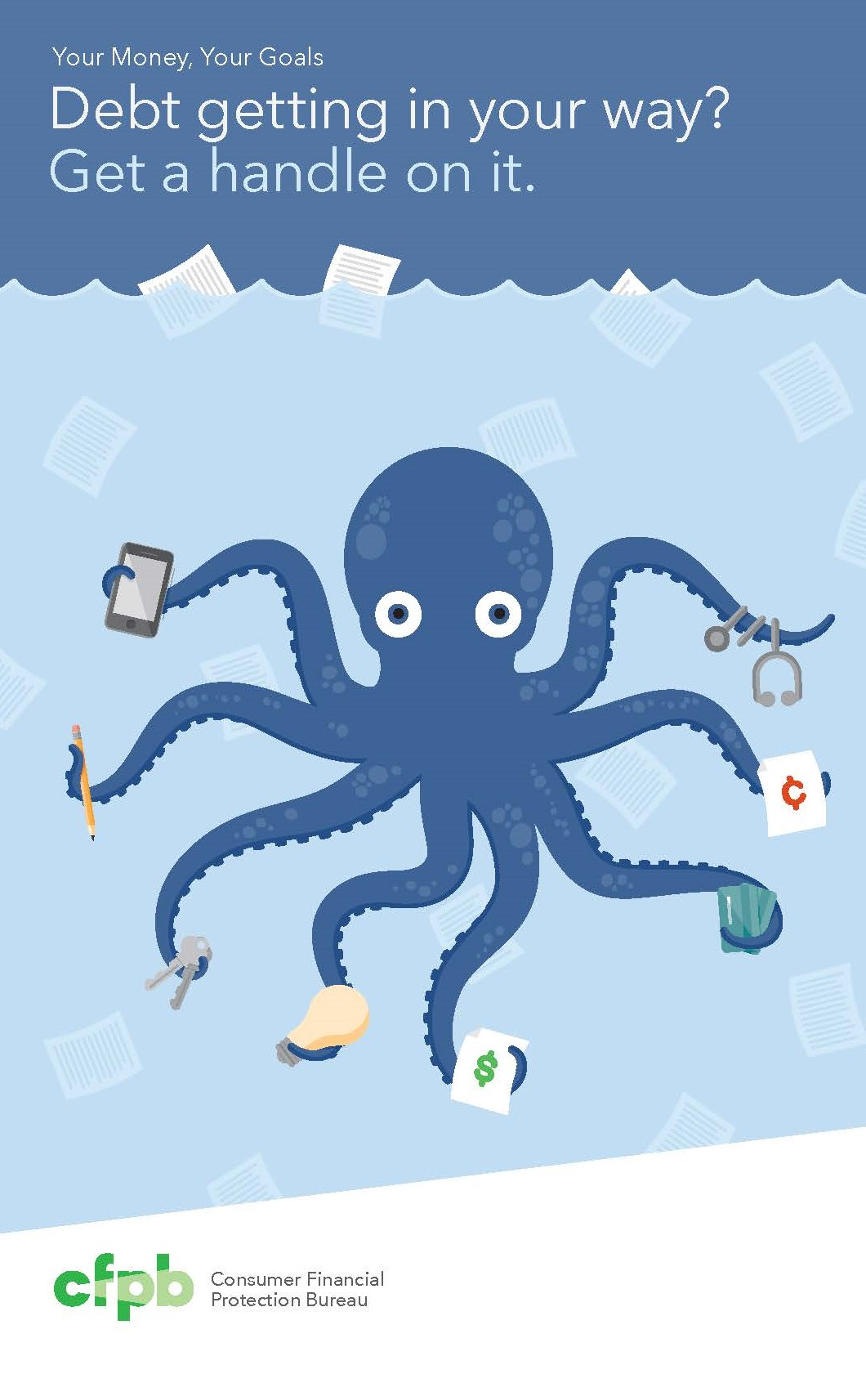


The suite of Your Money, Your Goals resources
Behind on bills?
  Available in English and Spanish
Debt getting in your way?
Want credit to work for you?
Building your savings?
Specially formatted copies available for correctional facilities
Access electronic materials and order free printed copies online: consumerfinance.gov/your-money-your-goals
Notes:
The booklets are small, colorful, spiral-bound collections of eight tools.
Behind on bills? is available in both English and Spanish. It provides a welcoming and easy-to-understand means of helping clients to address their challenges related to paying bills.
Debt getting in your way? brings together tools that help people take stock of their debt, and set goals and build a plan to address it.
Want credit to work for you? helps people understand and take action regarding their credit reports and develop a plan to build or improve their credit.
Building your savings? Helps people set savings goals and take steps to reach them.
Specially formatted copies of all booklets except Building your savings? are available for correctional facilities
Access electronic materials and order printed copies online on the CFPB’s Your Money, Your Goals webpage at consumerfinance.gov.

Slide 12
Behind on bills?
Start with one step.

Slide 13
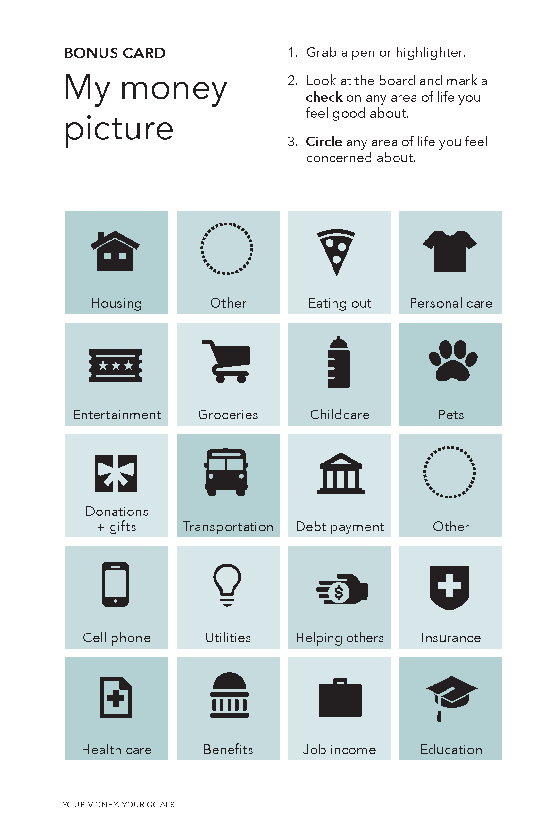
Introductory exercise
The My money picture bonus card is located in the inside back cover of the booklet.
Check areas you feel good about
Circle areas where you have concerns
Notes:
Let’s start with an introductory exercise that will get us thinking about income, expenses, and other things that related to bills.
The My money picture bonus card is located in the inside back cover of Behind on bills?
Take a moment to use the tool, thinking about your own money picture. Check areas that you feel good about. Circle areas where you have concerns.
What did you check and circle and why? How do the items you checked and circled relate to your payment of bills? Was it helpful to highlight areas that were positive to you in addition to those that felt more negative?
Now put yourself in the shoes of an individual or family that you work with. How would they experience this exercise? When would it be helpful to use this with the people you work with? Jot down your ideas on sticky notes and stick them on this page of the booklet.
If you are training other frontline staff members or volunteers, you can begin with this introductory exercise. It sets the expectation that your training will be participatory and gets people thinking about subjects that are relevant to being behind on bills.
Webinar instructions
Using chat or unmuted voice lines, facilitate discussion. Ask one or two participants to share why they made those choices and when they would consider using this tool.

Slide 14
Introductions
Your name
Where you work and who you serve
How you address financial topics that come up in your work
If you have been trained on the Your Money, Your Goals toolkit, how you are using it in your work
Notes:
During in-person trainings on Behind on bills?, you may want to pause after the My money picture activity to allow participants to introduce themselves. Consider doing so whenever you lead trainings on the booklet for frontline staff members or volunteers in your community. You can ask participants to briefly share their name, where they work and who they serve, how they address financial topics that come up in their work, and whether they have been trained in the Your Money, Your Goals toolkit. If they have been trained in Your Money, Your Goals, ask them how they are using it in their work so that other participants can benefit from those ideas.
Webinar instructions
Time permitting, facilitate participant introductions.

Slide 15
Exploring Behind on bills?
Use a pencil and sticky notes to annotate your copy or jot down notes
Notes:
Behind on bills? is a set of tools that have been developed and combined to provide frontline staff and volunteers hands-on tools to help the people they serve who may be facing challenges in making ends meet.
Its tools and information can help people:
Identify goals and develop action plans
Prioritize bills and spending
Track and monitor income and spending
Understand how to better align the timing of income and expenses
Understand their rights and responsibilities if they are contacted by debt collectors
Access digital and local resources
The CFPB developed it with the assistance of frontline staff who shared their experiences with using Your Money, Your Goals. Based on what they learned, the CFPB worked to build a resource that could work alongside the full toolkit – or stand on its own.
It’s portable, durable, easy to photocopy, colorful, and engaging
It’s also versatile. Its tools can be used when people have immediate financial challenges or when they want to build a spending or saving plan.

Slide 16
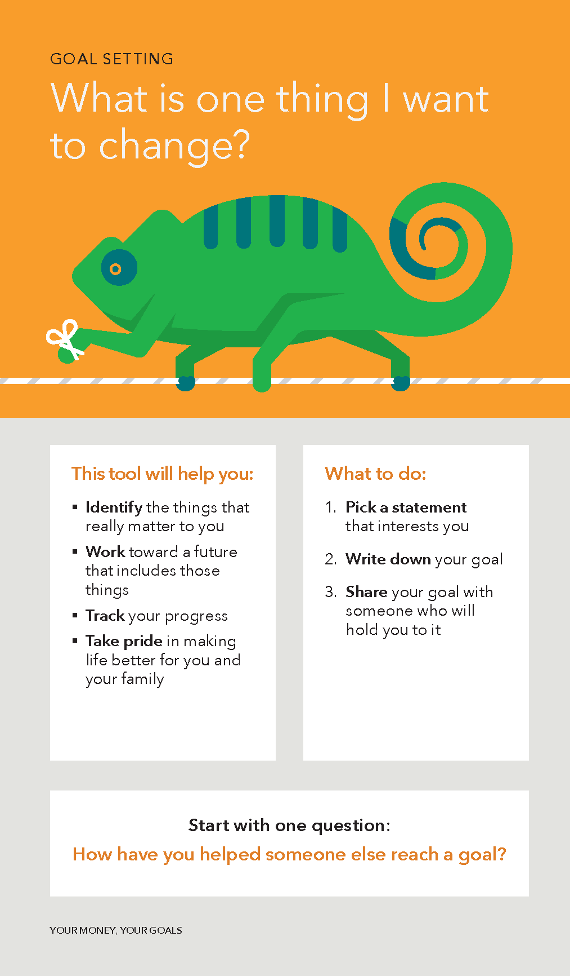
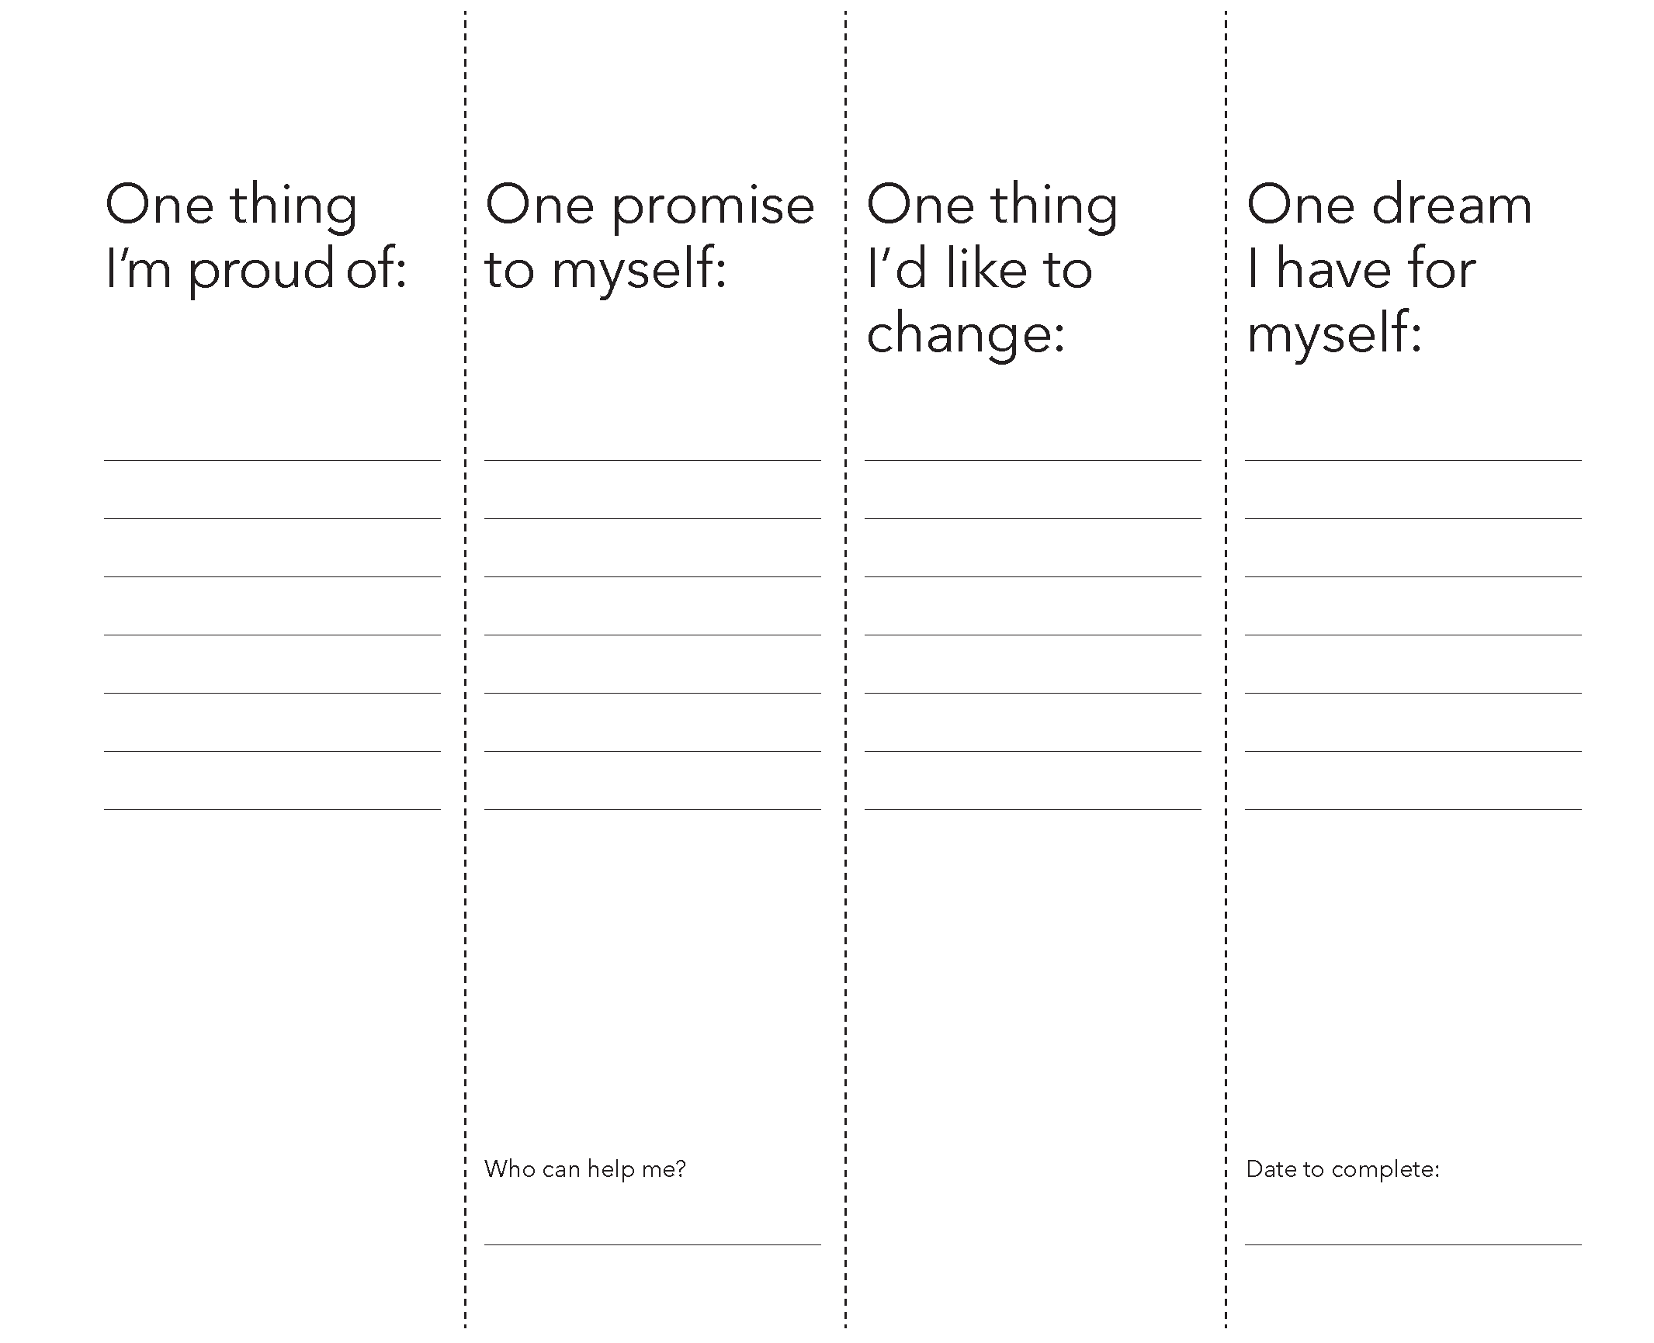
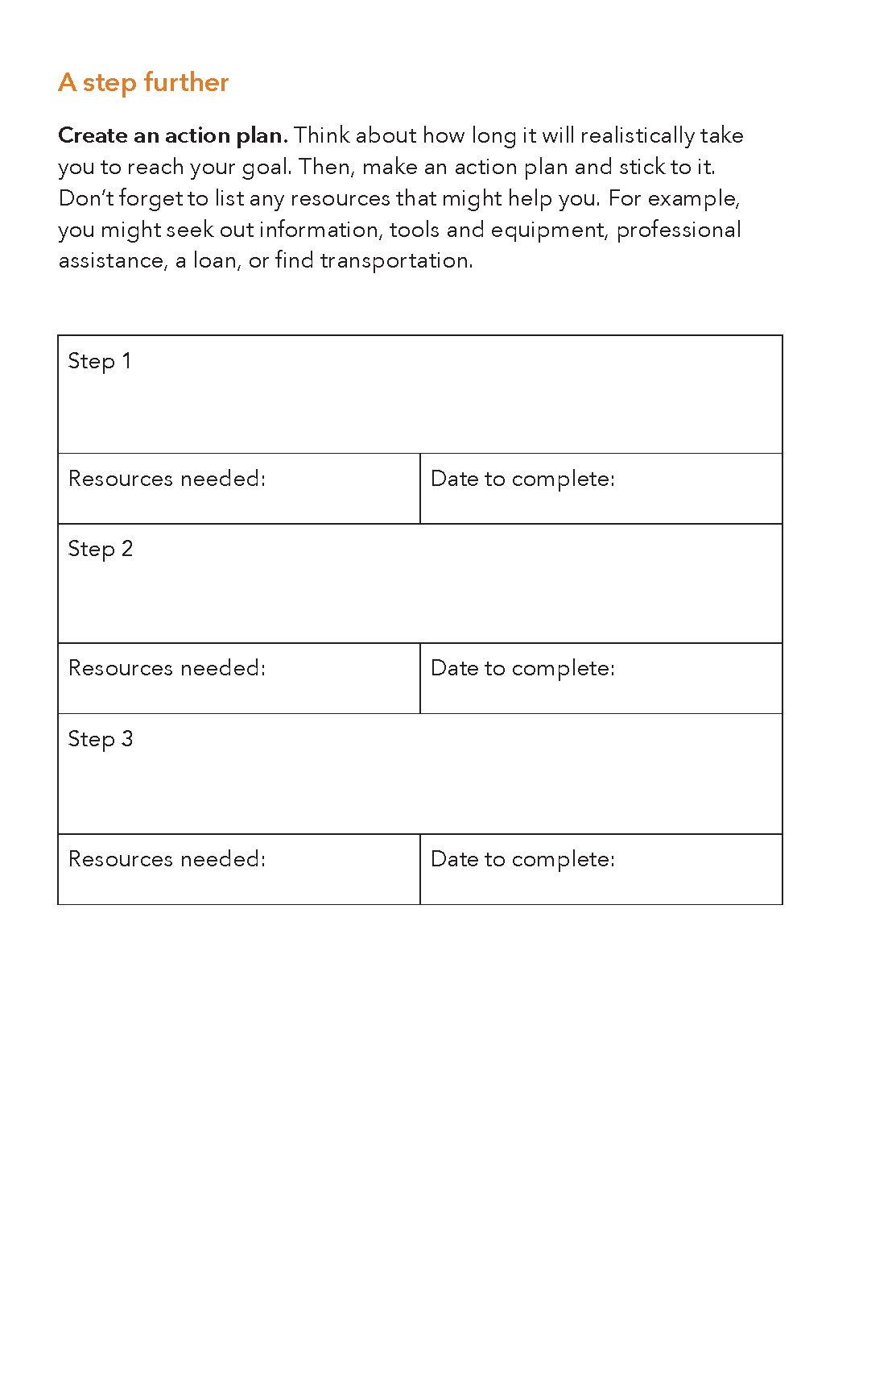
Tool structure
Unfold…
…refold and turn page
Tool description
Worksheet
A step further
Notes:
Behind on bills? tools have three parts.
When you turn to a tool, the first thing you see is the tool description. Below the title and cover illustration for the tool, you will find information that helps you and the people you work with to put the tool into context and prepare to use it. From this part of the tool, you will learn what the tool is designed to do, what is needed to complete the tool, and a question that you can use to open the conversation around this tool.
To get to the worksheet portion of the tool, unfold the tool description from its left-hand edge. This is what the person you’re meeting with completes on their own or with your help. Consider making photocopies of this page to use with clients, as needed.
When you refold the worksheet and then turn the page, you will see the portion of the tool entitled a step further. This portion of the tool includes some additional information, referral ideas, questions, or activities that help consumers reflect on the subject of the tool and take action.

Slide 17
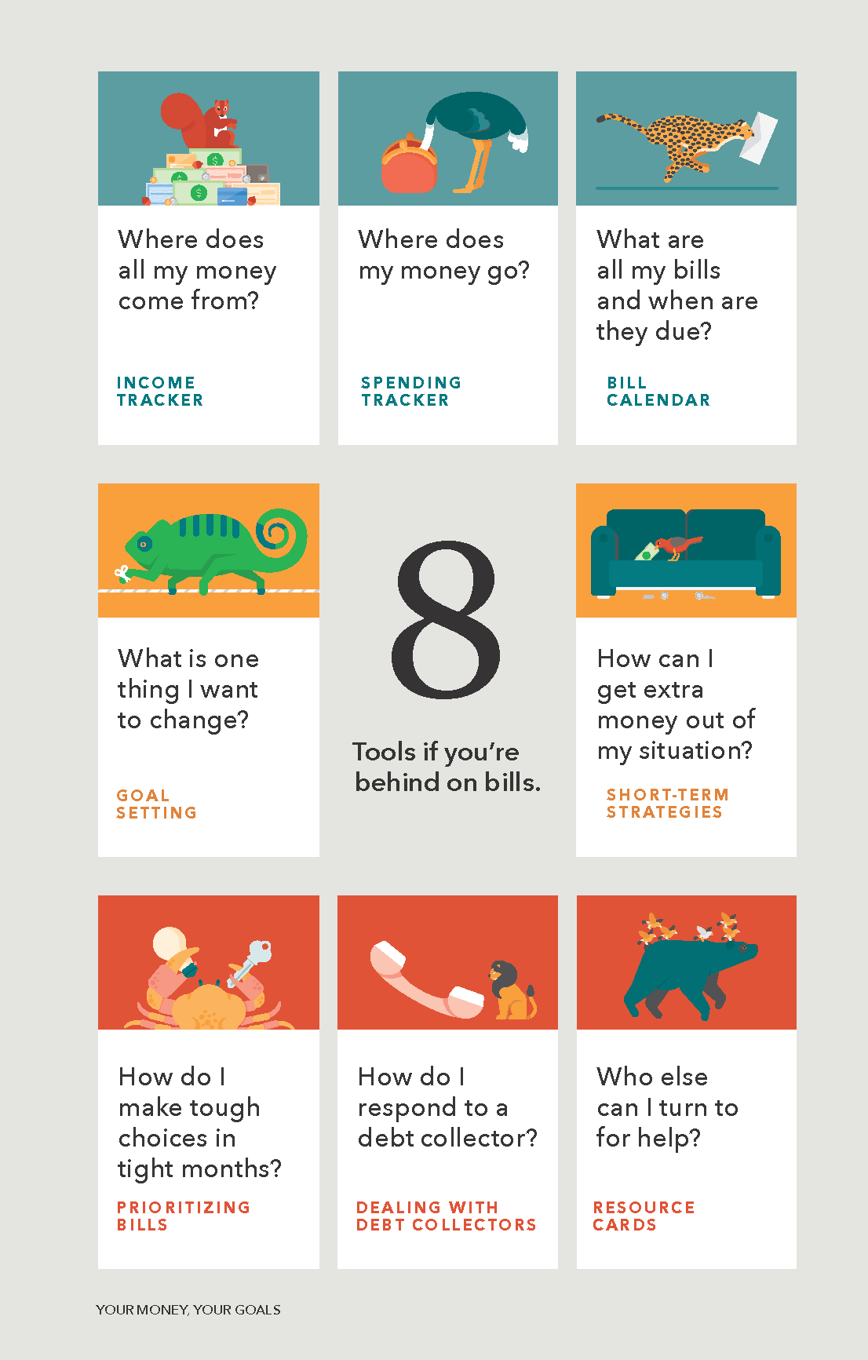
Table of contents
Eight tools if you are behind on bills
Blue-Green – can be used to help people build a clear picture of their income and spending
Yellow – can be used to think about goals and identify ways to increase income and other resources and cut expenses
Red – can be used for immediate challenges and needs
Notes:
Behind on bills? is structured as a mini-toolkit, rather than as a financial education curriculum. Because it’s a toolkit, the aim isn’t for you to cover all of its tools with everyone you serve. Instead, it’s to help you share the tools that are best suited to help someone on a specific financial challenge and reaching their goals. And, when they want or need additional help, the aim is to help you refer them to the right resource.
The table of contents shows the eight tools that make up Behind on bills? They are color-coded.
The blue-green tools can be used to help people build a clear picture of their income and spending. Those tools include an income tracker, spending tracker, and bill calendar.
The yellow tools can be used to think about goals and identify ways to increase income and other resources and cut expenses. They include a goal setting tool and a tool on short-term strategies for getting extra money.
The red tools can be used for immediate challenges and needs. This category includes tools on prioritizing bills, dealing with debt collectors, and finding resources for additional help with being behind on bills.
Some practitioners use this table of contents as a quick needs assessment tool. They ask the people they work with to read the questions associated with the eight tools and the circle one or more tools that they would like to explore.
In this training, we are going to explore the tools in a different order than the arrangement you see in your printed copy. That reflects the toolkit-style design of booklet. You access tools as you and the people you work with need them, not necessarily in order from front-to-back.

Slide 18
Goal setting
Identify the things that really matter to you
Work toward a future that includes those things
Track your progress
Take pride in making life better for you and your family
Notes:
Let’s look at the goal setting tool, the tool with the picture of a chameleon. Goal setting is often a key activity in social services programs. As a result, this tool is easy for the people you serve to try independently and experience using it firsthand.
Note: For use in a webinar, shorten the time allotted for filling out the tool and have people post their responses to the discussion questions in the chat function if it is not feasible to open the line for discussion.
Introduce the tool using this slide and the next two slides (3 min)
Paraphrasing the information on its cover, the questions in the tool, and the action plan
Ask participants to fill out the tool for themselves (5-8 min)
As a facilitator, you can loosely demonstrate how they could use it by providing verbal prompts as they complete it.
Discussion (5 min)
Ask how they felt responding to the questions.
What question felt the most useful for you?
Review usage ideas on sticky notes (5 min)
Explain that you’ve provided sticky notes they can use to jot down ideas about situations or moments that they could use the tool in their meetings with the people they serve.
Explain that there’s no right or wrong way to use these tools. They know the way they provide services and can adapt how they use it.
If people are having a hard time with generating ideas for sticky notes, you can share that some staff who tested it used it as part of their required goal-setting and action planning; some used it as part of motivational interviewing; others used it to kick off a counseling session.
Explain that during this training, individual participants won’t do this for each tool because they will work on some tools in groups. Writing down usage ideas on the tools they use will give others a quick sense of how a tool they haven't reviewed can be useful to them.

Slide 19
Notes:
Unfold the tool so that you see this worksheet.
People reflect on the four prompts written across the top of the tool and fill in:
One thing that they are proud of
One promise to themselves
One thing they would like to change and
A dream that they have for themselves
The positive orientation of the questions may be particularly helpful for clients in need of encouragement. And you can choose what portions of the tool to use. You may find that it works best with some people to ask them to choose and respond to only one or two of the sections of this tool.
The “who can help me” prompt at the bottom of the tool is a great place to name a friend, family member, community based organization, or other source of support that is relevant to the person’s goals. The “date to complete” prompt challenges people to give themselves a deadline for concrete action.

Slide 20
Goal setting
Notes:
The reverse side of the goal setting tool contains the part of the tool entitled A step further. For this tool, A step further involves identifying concrete steps toward the aspirations that were identified on the worksheet part of the tool. For each, step, there is space to write the resources needed and a date to complete the step.
If your work involves a series of meetings with a single individual or family, consider revisiting these steps in follow-up meetings as a way to support progress toward goals.
How and when would you use this tool with the people you serve? Practitioners who have used the tool have shared ideas that included using it with clients that were making a major change in their lives such as a change in jobs. Other practitioners suggested using the tool in the first of a series of meetings with emergency services clients to start the process of thinking long-term.
Think about the people you work with and the various interactions that you and others have with them. What are some specific situations where you could use the Goal setting tool? Ask participants to jot down those ideas on sticky notes and stick them on this tool.

Slide 21
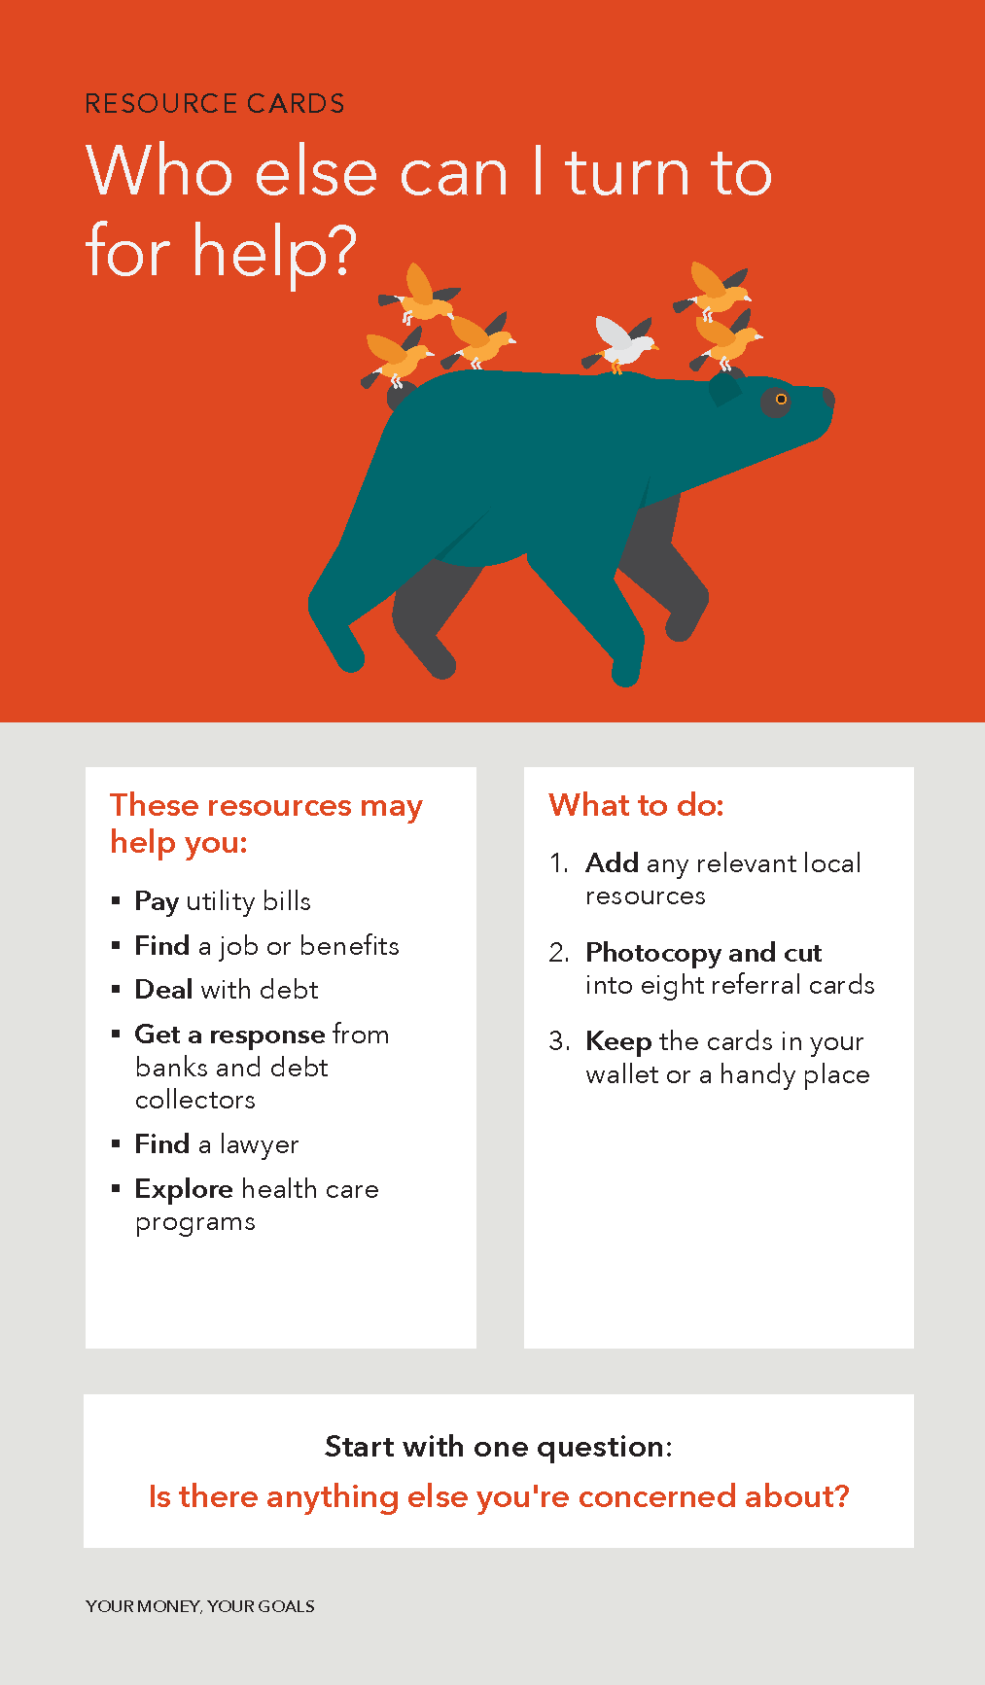
Resource cards
Connect to resources and referrals for
  Paying utility bills
  Finding a job or benefits
  Dealing with debt
  Getting a response from banks and debt collectors
  Finding a lawyer
  Exploring health care programs
Notes:
Training goal
Sharing resources is commonplace in many organizations. Simply demonstrating this tool will familiarize participants with its content and discussing how to customize it for their organization will prepare them to use it.
Getting started
Explain that the tool includes digital resources and space where participants can write in local referral information.
Some people may need more help than you or your organization are equipped to provide. That is where connecting people to the right resources or making smart referrals can make a big difference in people’s lives. The Resource cards tool is designed to help you do just that. Using this tool, you can connect people with resources related to:
Paying utility bills
Finding a job or benefits
Dealing with debt
Getting a response from banks and debt collectors
Finding a lawyer and
Exploring heath care programs

Slide 22
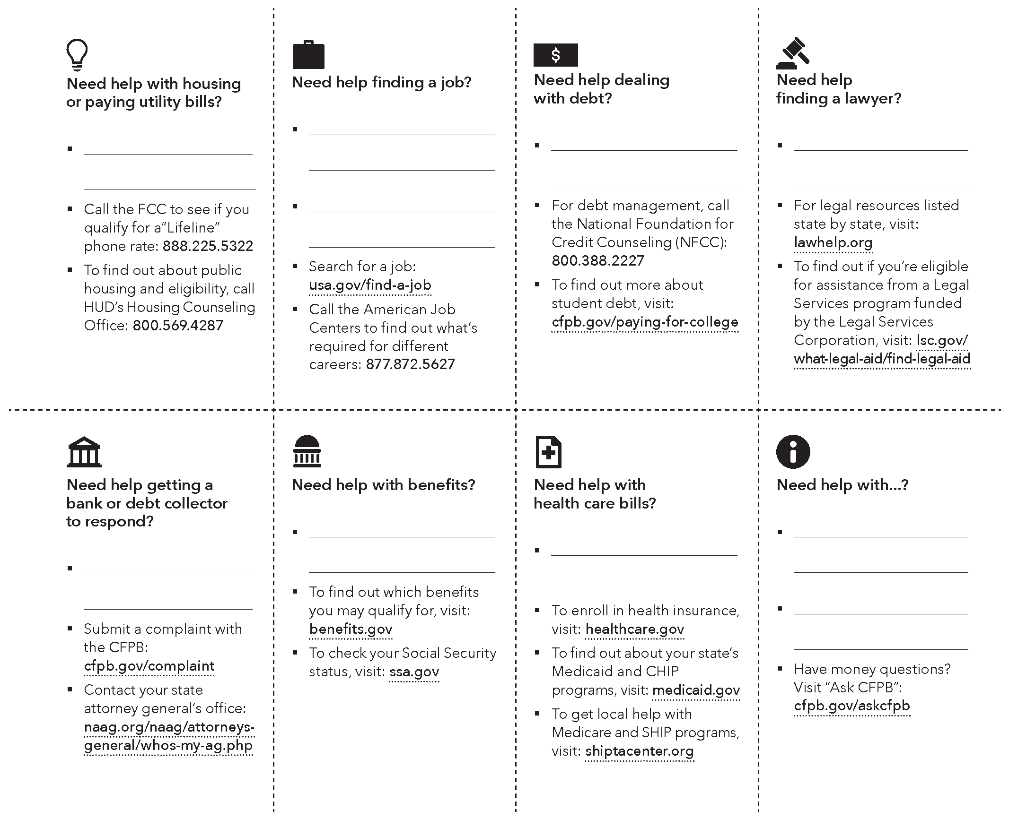
Notes:
This tool can help you create eight resource cards on topics that are important to the people you serve. Each includes both blank spaces for your local resource and referral ideas and some pre-filled resources with the relevant web addresses or phone numbers.
Your organization or community may already have a written resource and referral network, which will give you a head start on adding websites and local organizations to these resource cards. Referral partners in your community may include certified non-profit credit counselors, certified housing counselors, financial counselors and coaches, free volunteer tax assistance sites sponsored by the IRS, and financial education programs.
Once completed, this worksheet can ben photocopied and cut into eight referral cards. Consider keeping them in your wallet or another handy place so that you have them ready when you have an opportunity to share them with the people you serve.
How and when would you use these cards with the people you serve? Ideas from other practitioners include:
Training volunteers that mentor community members on using the cards and
Keeping the cards or sheets at the intake desk so that people can peruse the resource and referral options while they wait

Slide 23
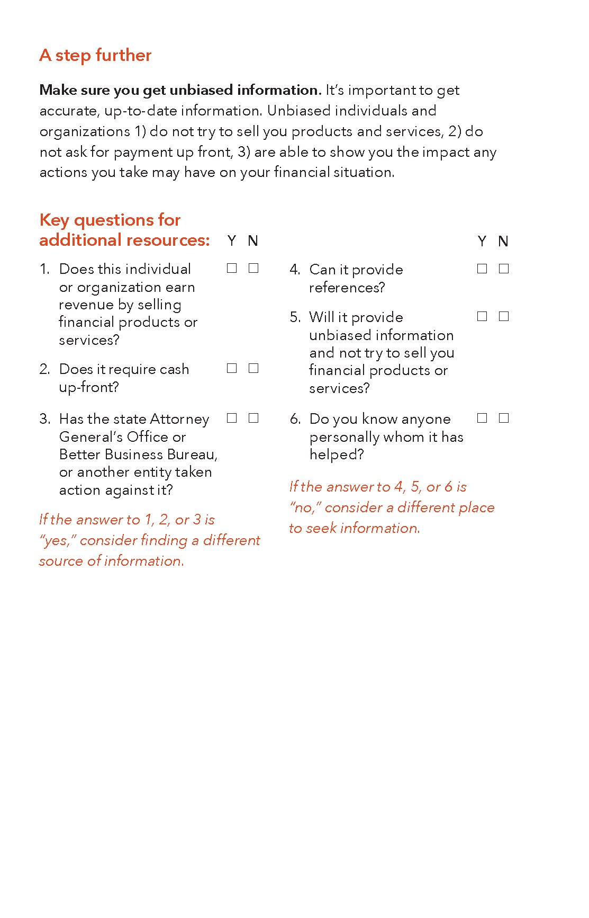
Resource cards
Notes:
It is important to ensure that the resources and referrals that you share are sources of unbiased and high-quality support. The questions found on the reverse side of this tool can be used to help you vet resources and potential referral partners.
These questions can also help the people you work with to evaluate organizations or individuals that friends, family, or advertising recommend.
Reflect on how participants might use this tool.
Think about the people you work with and the various interactions that you and others in your organizations have with them. What are some specific situations where you would use these resource cards? Jot down those ideas on sticky notes and stick them on this tool.
Note: For webinars, ask people to post their ideas in the chat function.

Slide 24
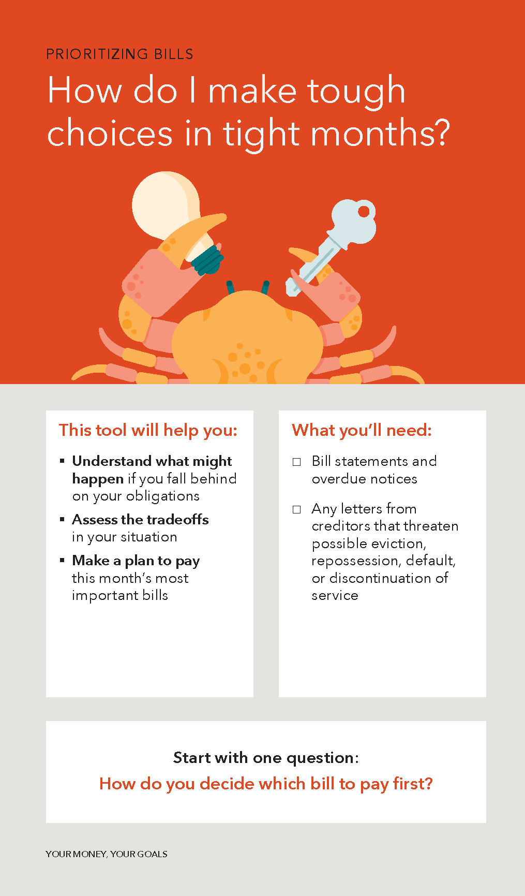
Prioritizing bills
Understand what might happen if you fall behind on your obligations
Assess the tradeoffs in your situation
Make a plan to pay this month’s most important bills
Notes:
Consider using the following role play activity for participants to familiarize themselves with the Prioritizing bills tool and the Bill calendar. Note; For webinar trainings, role playing will not be feasible. Instead, take time to model introducing the tools to a client. Consider completing a “sample” based on the people you serve and screenshare that completed tool.
Training goal
In this portion of the training, participants will explore the tools for themselves and discover its features through the role play. A discussion allows them to reflect on what they discovered about the tools and reflect on how they might use them with the people they serve.
Getting started (3-5 min)
Ask participants to take a moment to look at both tools.
Have participants break into pairs for role play (3 min)
Assign each pair one of the tools so that half of the participants use Prioritizing Bills and the other half the Bill Calendar. In each pair one person will play the staff member or volunteer and the other will play the person who is receiving services. Urge them to utilize scenarios that reflect the financial lives of the people they serve.
Role play (10 min)
Highlight the tools using the slides for each of these tools (5-7 min)
Ask participants to describe the tools. Highlight these features during the discussion:
The Prioritizing Bills tool can help people consider how to approach each bill if they cannot make all of the payments on time.
It includes four categories of bills and obligations to consider. Choose one to read aloud.
As users identify their priorities, they can write them on the diagram, with the top-priority bill on the first line
A step further provides additional information and potential options you can share.
The Bill Calendar tool helps people visualize when their bills are due and when other expenses will occur. It can also help build a picture of their “cash flow” – how the timing of their income lines up with the timing of their bills.
A step further includes prompts you can use and the opportunity to identify a strategy to use in the next month.
Reflection (3-5 min)
As a group, brainstorm scenarios in which these tools could be used. Reflect on highlights or challenges and write ideas on sticky notes.

Slide 25
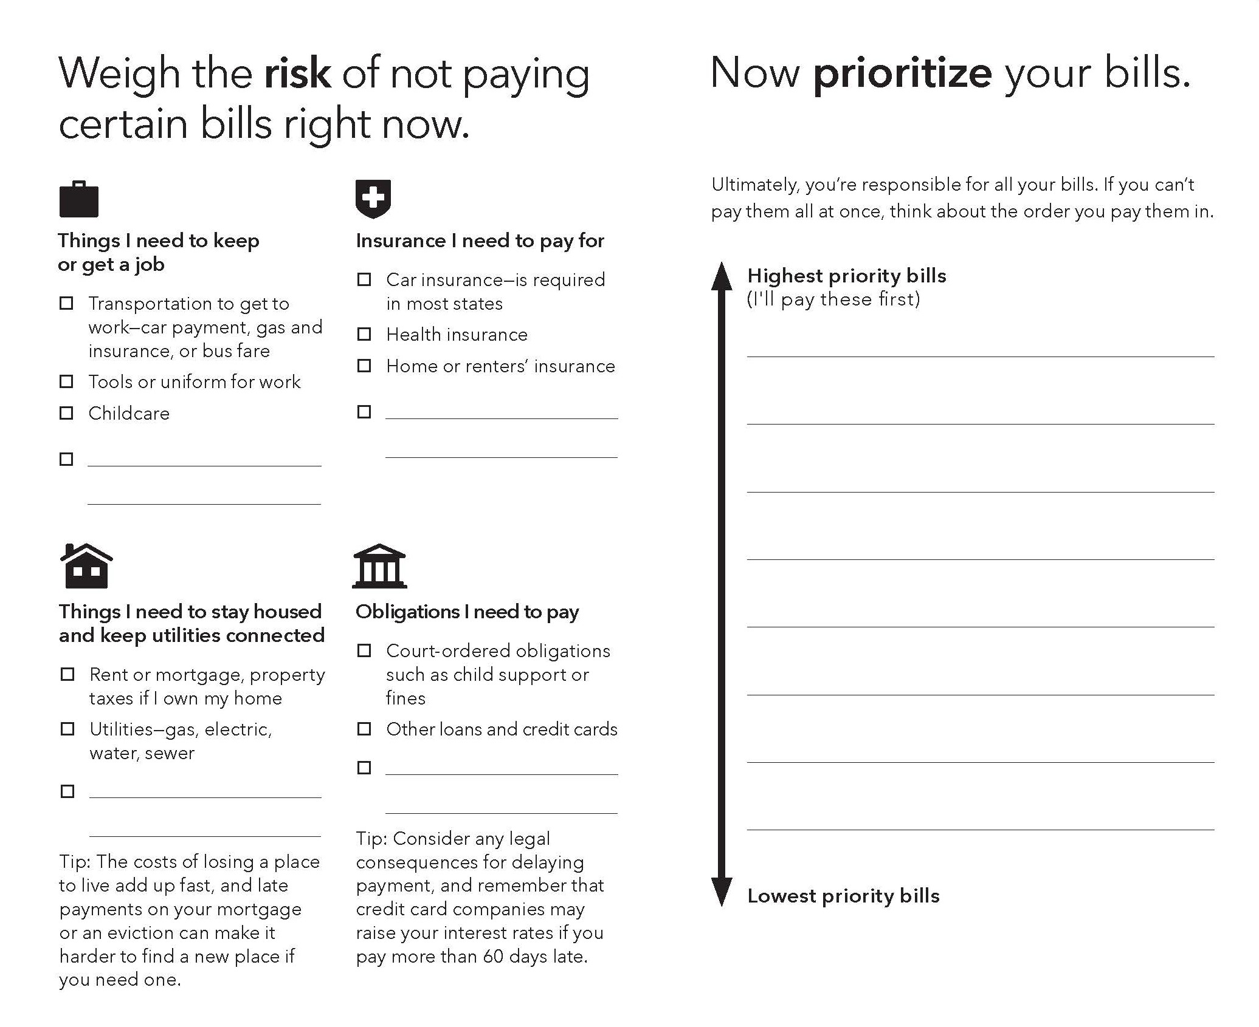
Notes:
People complete this tool in two basic steps. On the left-hand side of the page, the consumer inventories the bills they anticipate. The tool organizes bills around four categories:
Things I need to keep or get a job
Insurance I need to pay for
Things I need to stay housed and keep utilities connected and
Obligations I need to pay
The tips below those last two categories point out some special concerns related to late payments on certain bills.
Having listed their bills, consumers can then move on to the second step of using this tool. They reflect on their bills, whether they can cover them all, and the consequences of late payment for certain bills. They can then use the lines on the right-hand side of the page to prioritize bills, listing the those they want to pay first on top.

Slide 26
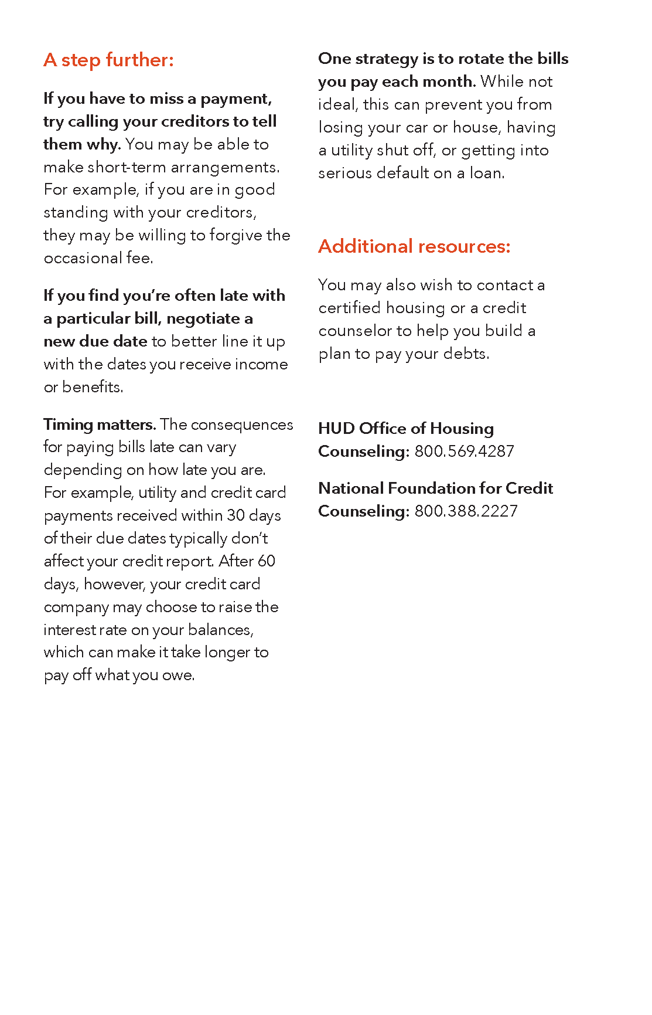
Prioritizing bills
Notes:
For this tool, A step further features practical strategies for prioritizing bills. Familiarize with yourself with these strategies, and the additional resources that are listed, so that they can be part of the problem-solving conversations you have with people about prioritizing when there is not enough money to pay all of their bills.
How and when would you use this tool with the people you serve?
You may want to use the tool to open a conversation about cash flow management and follow up by using the cash flow tools in the Your Money, Your Goals toolkit. Another idea is to use the tool to help clients to cope with an unexpected event, such as a health emergency, that puts pressure on their finances.
What are some specific situations where you would use this tool? Ask people to jot down those ideas on sticky notes and stick them on the tool.

Slide 27
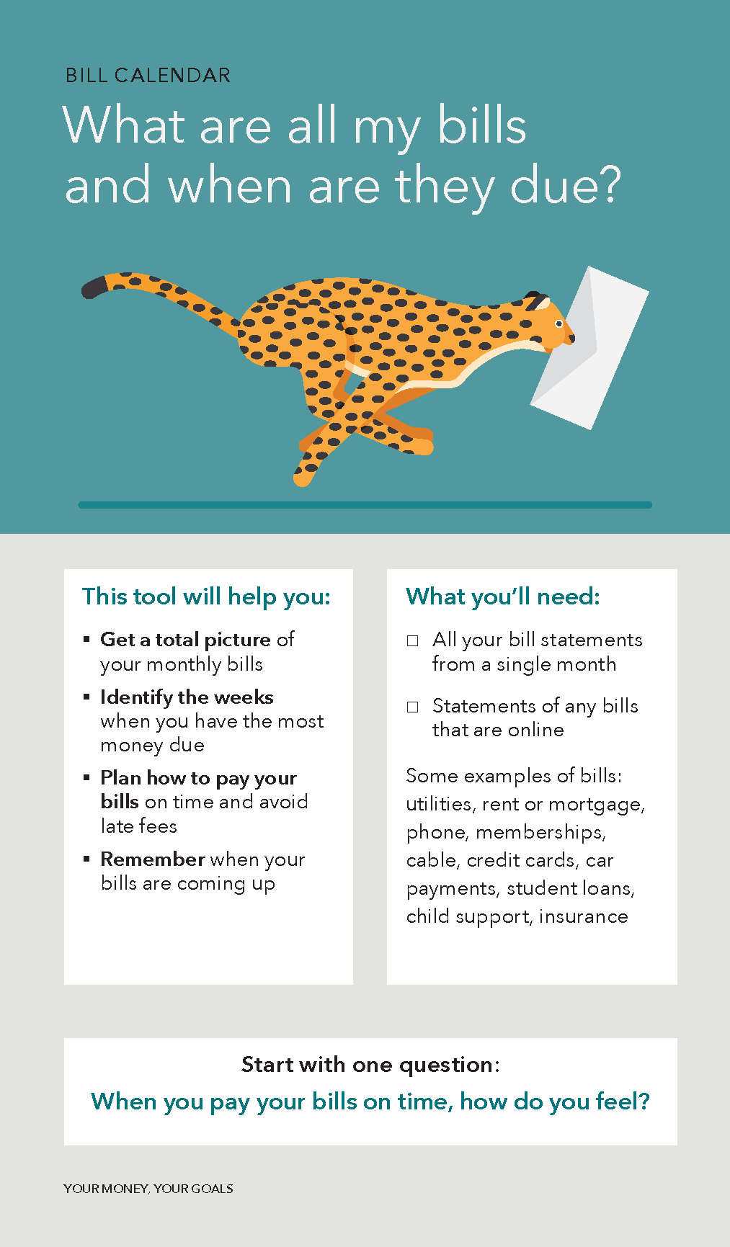
Bill calendar
Get a total picture of your monthly bills
Identify the weeks when you have the most money due
Plan how to pay your bills on time and avoid late fees
Remember when your bills are coming up
Notes:
NOTE: Activity notes included on Slide 25.
The bill calendar helps people to:
Get a total picture of their monthly bills
Identify the weeks when they have the most money due
Plan how to pay their bills on time and avoid late fees and
Remember when their bills are coming up

Slide 28
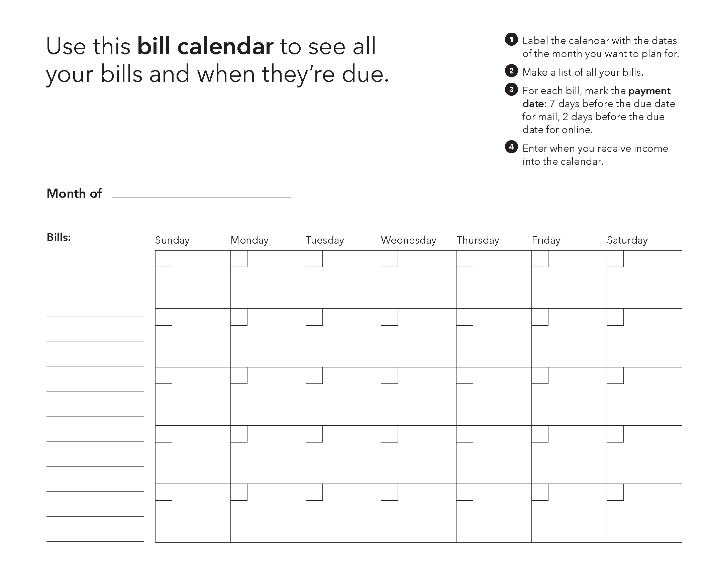
Notes:
The worksheet part of this tool helps people visualize when their bills are due and when other expenses will occur. Steps one through three help people take stock of their bills and then mark up the calendar to show the payment date for each. Now they can see all of their bills and when they are due.
If you work with people to also add their income to the calendar, this tool can also help build an initial picture of their cash flow – how the timing of their income lines up with the timing of their bills.

Slide 29
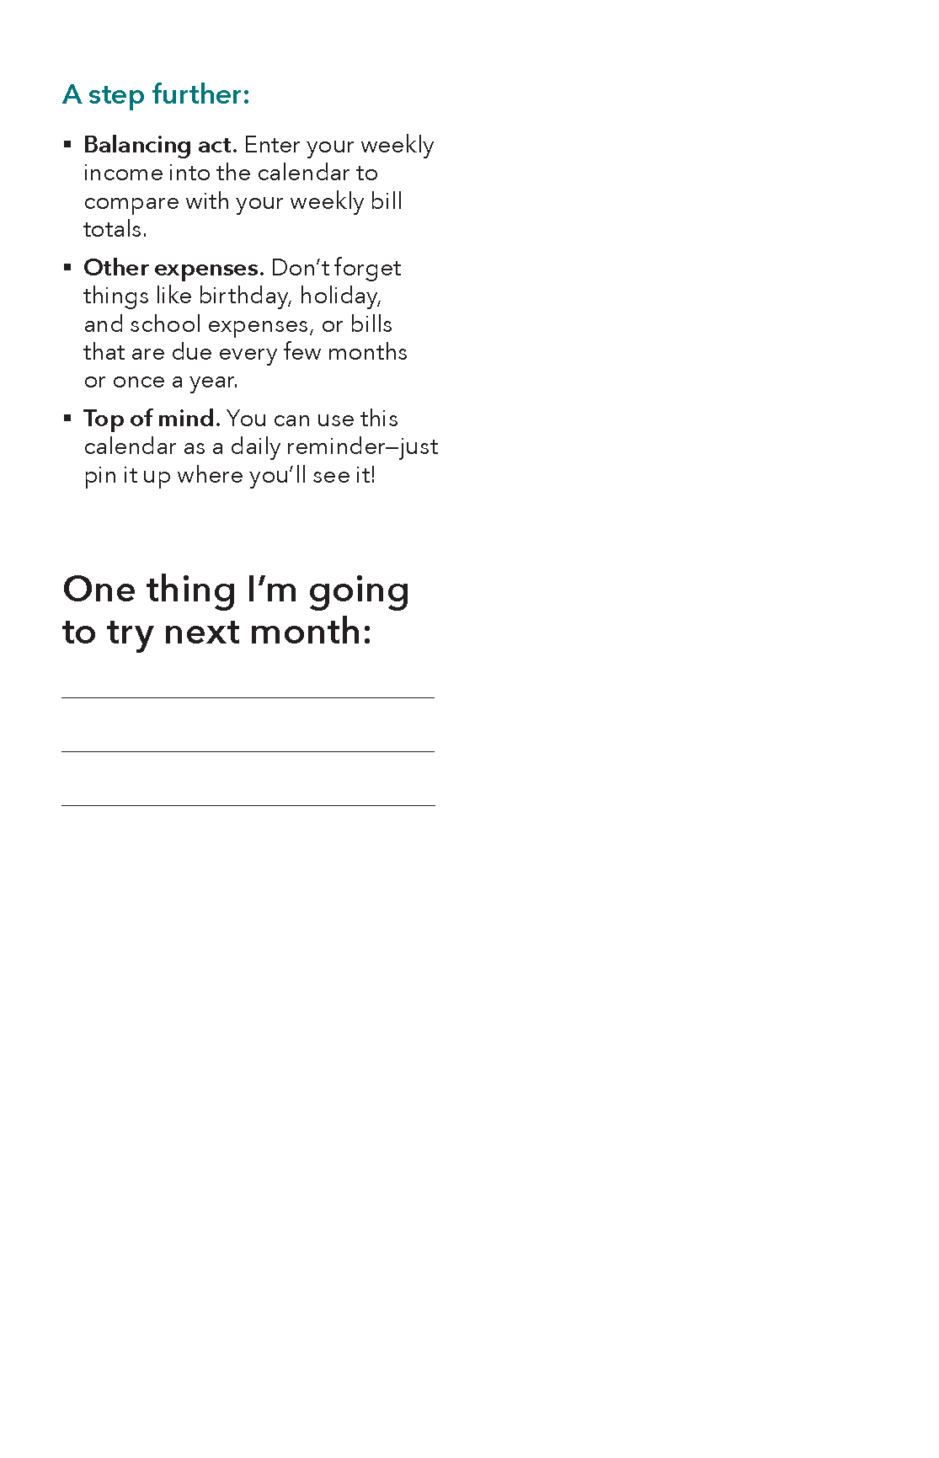
Bill calendar
Notes:
A step further for this tool provides some additional ideas for using the bill calendar as a money management tool. The prompt for “one thing I’m going to try next month” provides an opportunity for the people you work with to challenge themselves to improve how they manage bills.
How and when would you use the Bill calendar with the people you serve? Just like they may use a similar tool in the full Your Money, Your Goals toolkit, legal aid attorneys may find it useful in connection with bankruptcy and debt cases. In a workforce development setting, it could be useful in workforce readiness discussions and workshops.

Slide 30
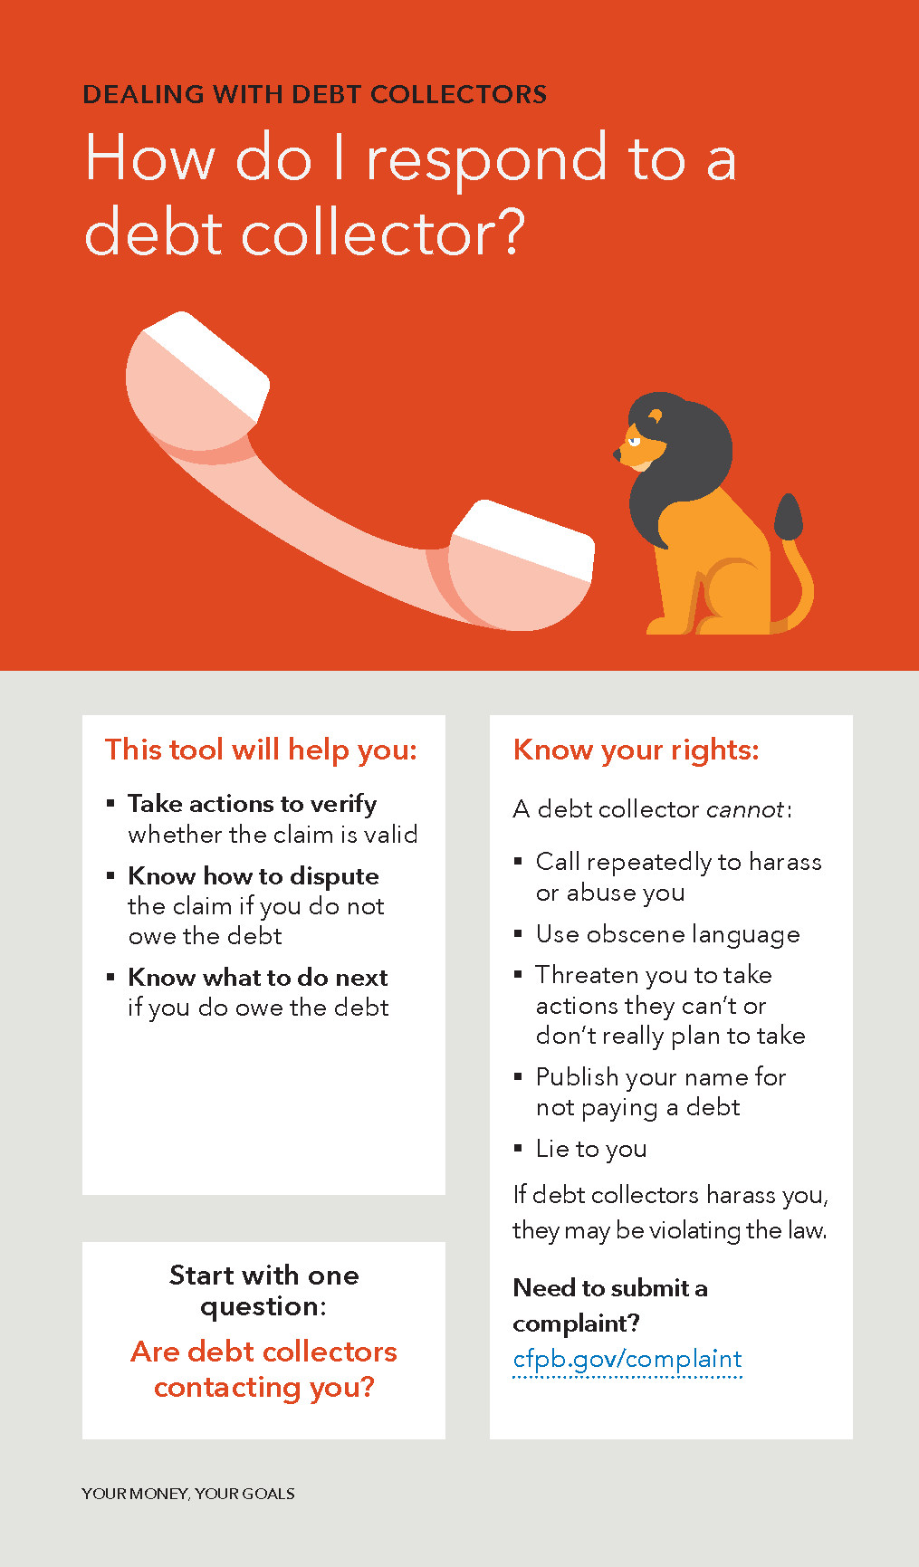
Dealing with debt collectors
Take action to verify whether the claim is valid
Know how to dispute the claim if you do not owe the debt
Know what to do next if you do owe the debt
Notes:
Tool discussion: Dealing with debt collectors & Short-term strategies
Introduce the tools using the slides (15 min)
Dealing with Debt Collectors helps people understand their rights and steps they can take. Because debt collectors sometimes use pressure to get people to send in money, it’s important that people understand those rights.
Highlight the rights listed on the cover. A debt collector cannot:
Call repeatedly to harass or abuse you
Use obscene language
Threaten you that they will take actions that they can’t or don’t really plan to take
Publish your name for not paying a debt or
Lie to you
If you have access to the internet and a speaker, show the video on avoiding debt collection scams at https://www.consumerfinance.gov/consumer-tools/fraud/debt-collection-scams-video/
Paraphrase the stages of action steps and show participants the tear-off that users can mail to the collector
Highlight the additional resources on the back of the tool.
If you have additional time and have access to the internet, consider showing participants where to find the debt collection portal (https://www.consumerfinance.gov/consumer-tools/debt-collection/) and the sample verification and dispute letters.
The Your Money, Your Goals toolkit contains additional detail on the regulations underlying these consumer rights. The link under “Need to submit a complaint” is an important resource. If the person you work with submits a complaint or you do so on their behalf, the CFPB will forward your complaint to the company and work to get a response from them.
Short-term Strategies can help facilitate discussions about ways to increase income or access additional resources as well as ways to decrease spending.
Briefly summarize the categories and one or two suggestions
Point out the additional suggestions in A Step Further and the opportunity for users to set a goal.
Activity
Break into two table discussion groups (3 min)
Ask participants to discuss these questions: (10 min)
Consider scenarios in which you might use these tools
Discuss how you would introduce them to your client
How would you explain this tool to a colleague?
Reflection
Ask participants to write usage ideas on sticky notes

Slide 31
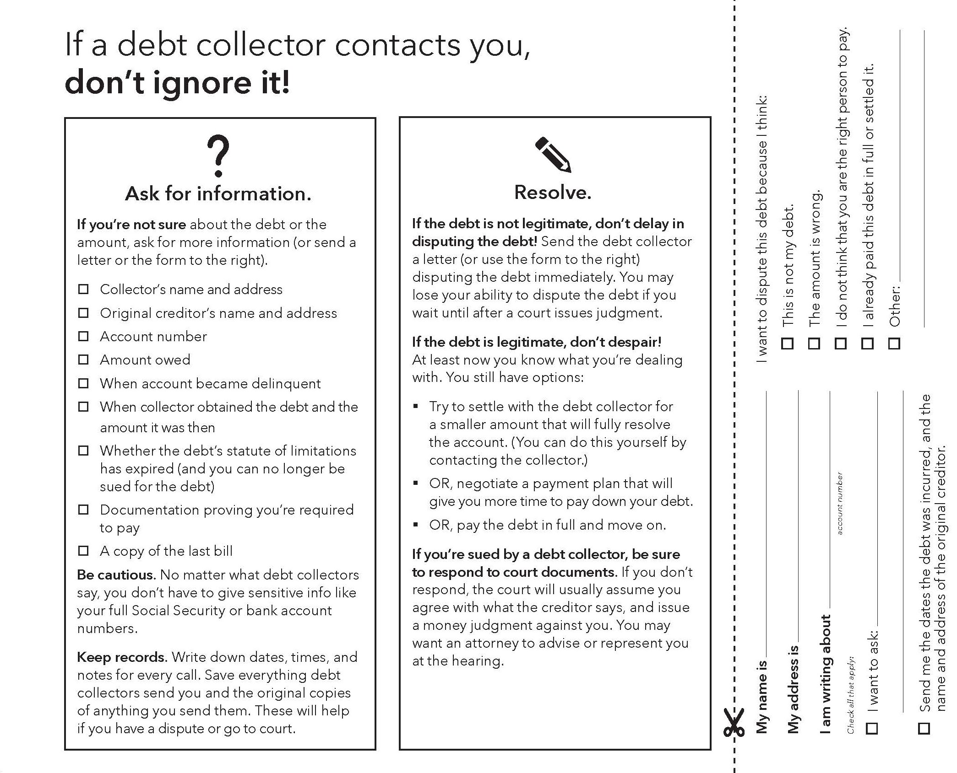
Notes:
The worksheet portion of this tool provides guidance for dealing with debt collectors in three stages: Be sure, ask questions, and resolve.
The tips under the heading “Ask for information” reflect the importance of confirming that you actually owe the debt, and protecting yourself against erroneous and fraudulent debt collection.
The tips under resolve help people make the most of their options when claims are legitimate.
The tear-off can be used to verify the debt or to initiate a dispute.

Slide 32
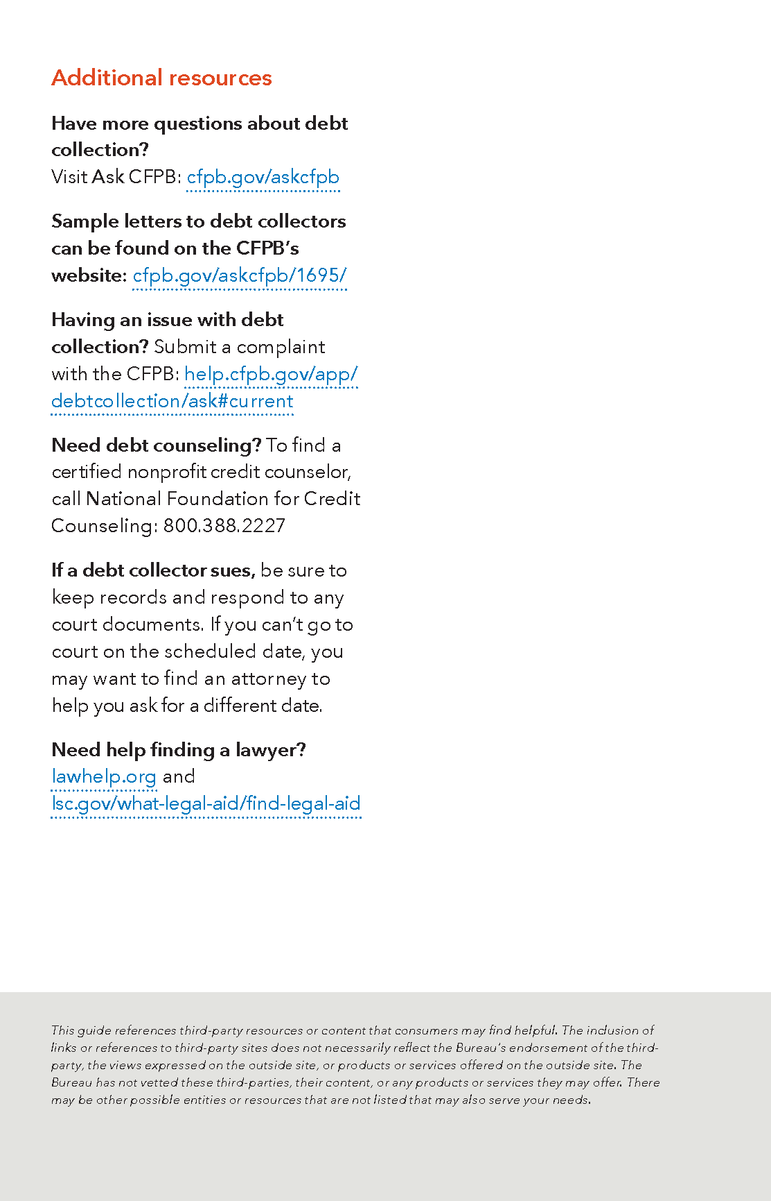
Dealing with debt collectors
Resources:
Ask CFPB
Sample letters to debt collectors
Submit a complaint
Debt counseling
Finding a lawyer
Notes:
The reverse side of this tool lists practical resources available to people that are dealing with debt collectors.
Ask CFPB answers new consumer questions and includes a database of answers to past questions.
The CFPB’s sample letters to debt collectors can be used by consumers to respond to common challenges related to debt collectors.
Submitting a complaint starts the CFPB’s process for investigating and resolving consumer issues
Debt counseling is available through nonprofit credit counselors.
Consumers can find a lawyer through trusted networks that serve economically vulnerable clients.
As soon as you hear that a person is being contacted by a debt collector, use this tool to help them through the phases of being sure, asking questions, and resolving the claim. To identify people that need this information, frontline staff members and volunteers may want to ask the people they serve, “Are debt collectors contacting you?” You may also find that if you show the table of contents to someone as you start the conversation, they may identify this tool themselves as one they want to use.
How do you plan to use this tool?

Slide 33
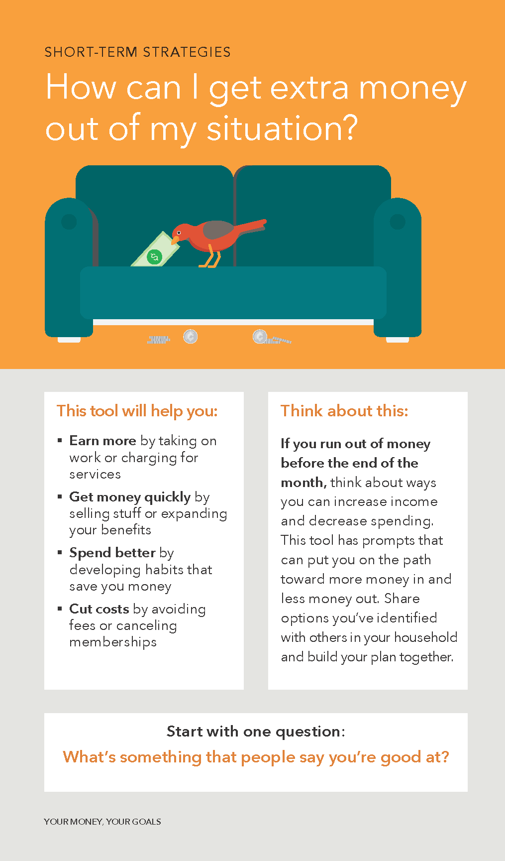
Short-term strategies
Earn more by taking on work or charging for services
Get money quickly by selling stuff or expanding your benefits
Spend better by developing habits that save you money
Cut costs by avoiding fees or canceling memberships
Notes:
NOTE: Training activity notes are included on Slide 31.
This tool on Short-term strategies can help facilitate discussions with the people you serve about ways to increase income or access additional resources, as well as ways to decrease spending. The suggested opening question: “What’s something that people say you’re good at?” is a great way to start this discussion on a creative and positive note.

Slide 34
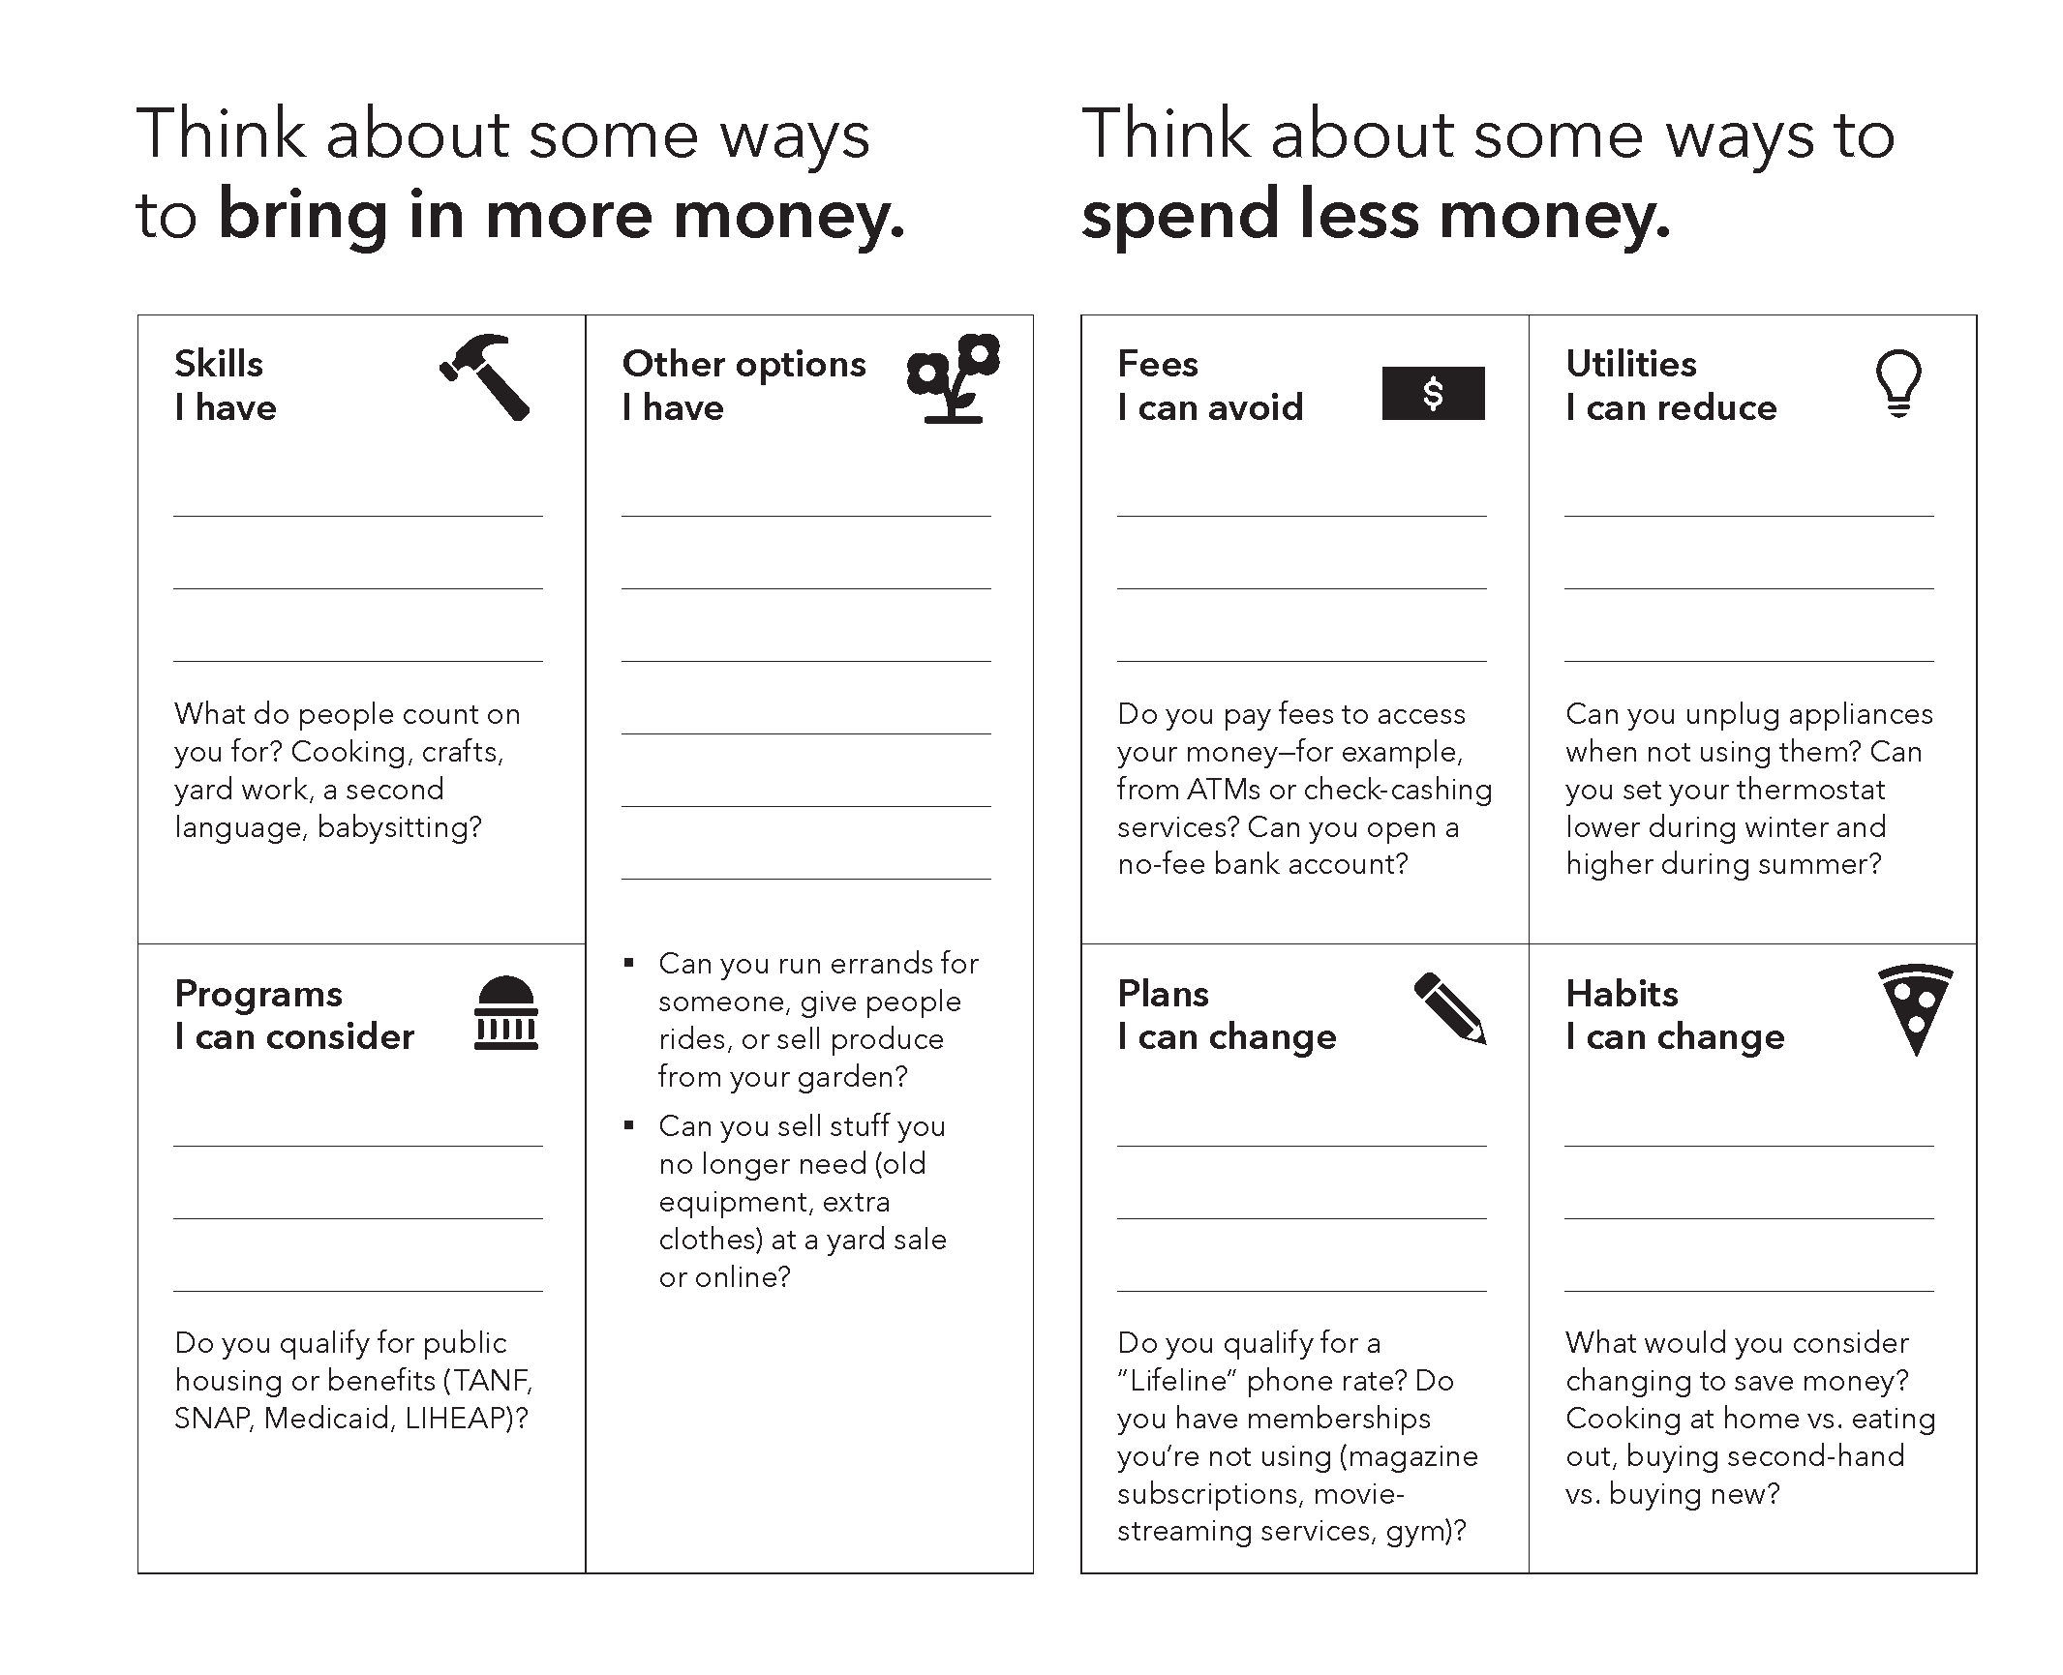
Notes:
The worksheet portion of this tool helps put people on the path to more money in and less money out.
The left-hand side is about income, bringing in more money. The prompts are open ended, inviting people to list skills that they have, programs that they can consider, and other options for generating income. You can help people that complete this tool make the connection between their skills and ways to bring in more money. For example, a person who can sing and play the guitar could earn money by entertaining at children’s birthday parties. A person with a pickup truck could haul stuff for a fee if local laws permit.
The right-hand side is about expenses, spending less money. People identify fees they can avoid, utilities they can reduce, plans and memberships they can change or cancel, and habits they can change. The questions in each section help people to reconsider expenses that add to the strain on their finances.

Slide 35
Short-term strategies
Notes:
For this tool, A step further involves identifying concrete steps toward the aspirations that were identified on the worksheet part of the tool. For each, step, there is space to write the resources needed and a date to complete the step.
If your work involves a series of meetings with a single individual or family, consider revisiting these steps in follow-up meetings as a way to support progress toward goals.
How and when would you use this tool with the people you serve? Some practitioners find this tool especially relevant for people that live on a fixed income. People participating in matched savings or financial coaching programs could use the tool to find ways to free up funds for their goals. Other practitioners said that they would use the tool with apprentices that are just getting started in their careers and with people in foreclosure.

Slide 36
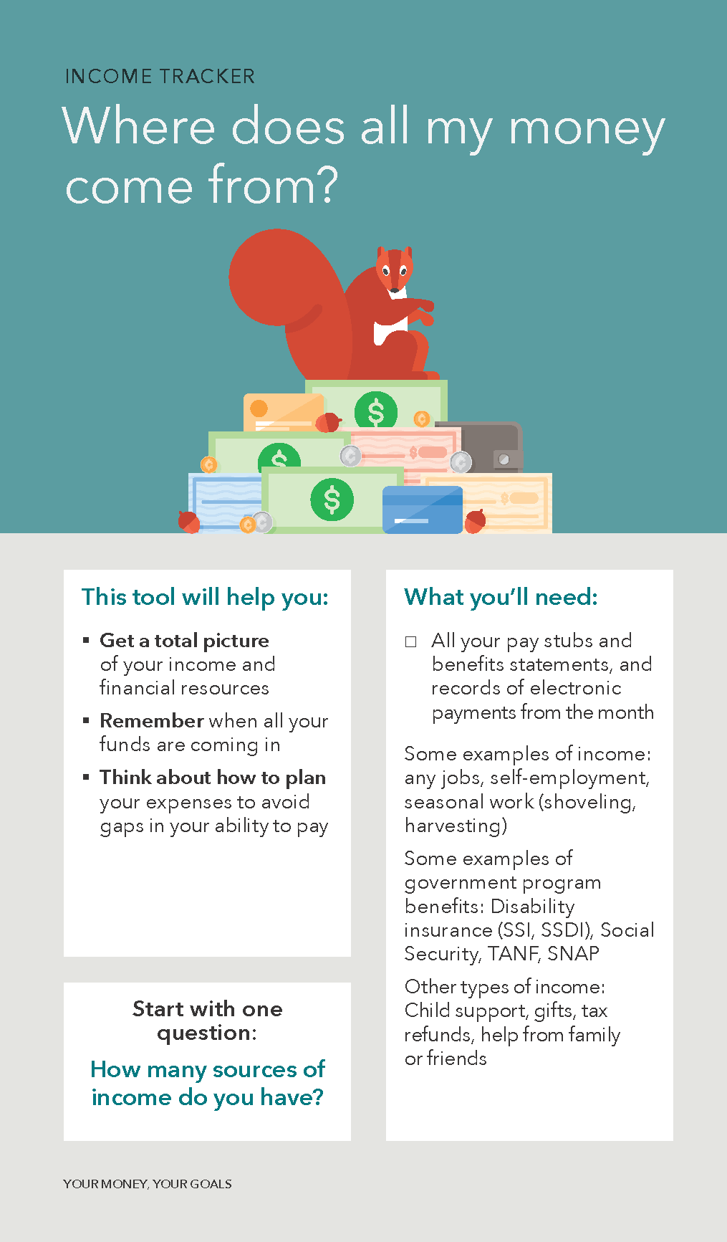
Income tracker
Get a total picture of your income and financial resources
Remember when all your funds are coming in
Think about how to plan your expenses to avoid gaps in your ability to pay
Notes:
Tool role play: Income tracker & Spending tracker: 30 minutes
Note: for webinars, introduce the tools individually and discuss. Consider modeling ways to introduce the tools to clients and screensharing examples of completed tools.
Introduce the tools using the slides (5 min)
The Income Tracker can help people categorize their sources of income and resources and build a picture of the timing and amounts.
Many individuals and families have income that varies from week to week or may be received infrequently.
Note that “Financial Support” is included to represent assistance that they may receive from friends and family or other sources.
People can use the tool to identify the amounts that they can “count on.”
A Step Further includes prompts for additional discussion.
The Spending Tracker can help people build a picture of where their money goes. It can be used in a meeting to get an estimate of spending and as “homework” that can help users monitor their spending “real time.”
It includes space for five weekly totals for each category.
A Step Further can help users identify areas where they may want to decrease spending.
Activity (5 min)
As a group, brainstorm scenarios in which they could be used
Have participants break into pairs for role play (3 min)
Assign each pair one of the tools so that half of the participants use the Income Tracker and the other half use the Spending Tracker
Role play (10 min)
Reflection (5 min)
Discuss as a group and write ideas on sticky notes

Slide 37
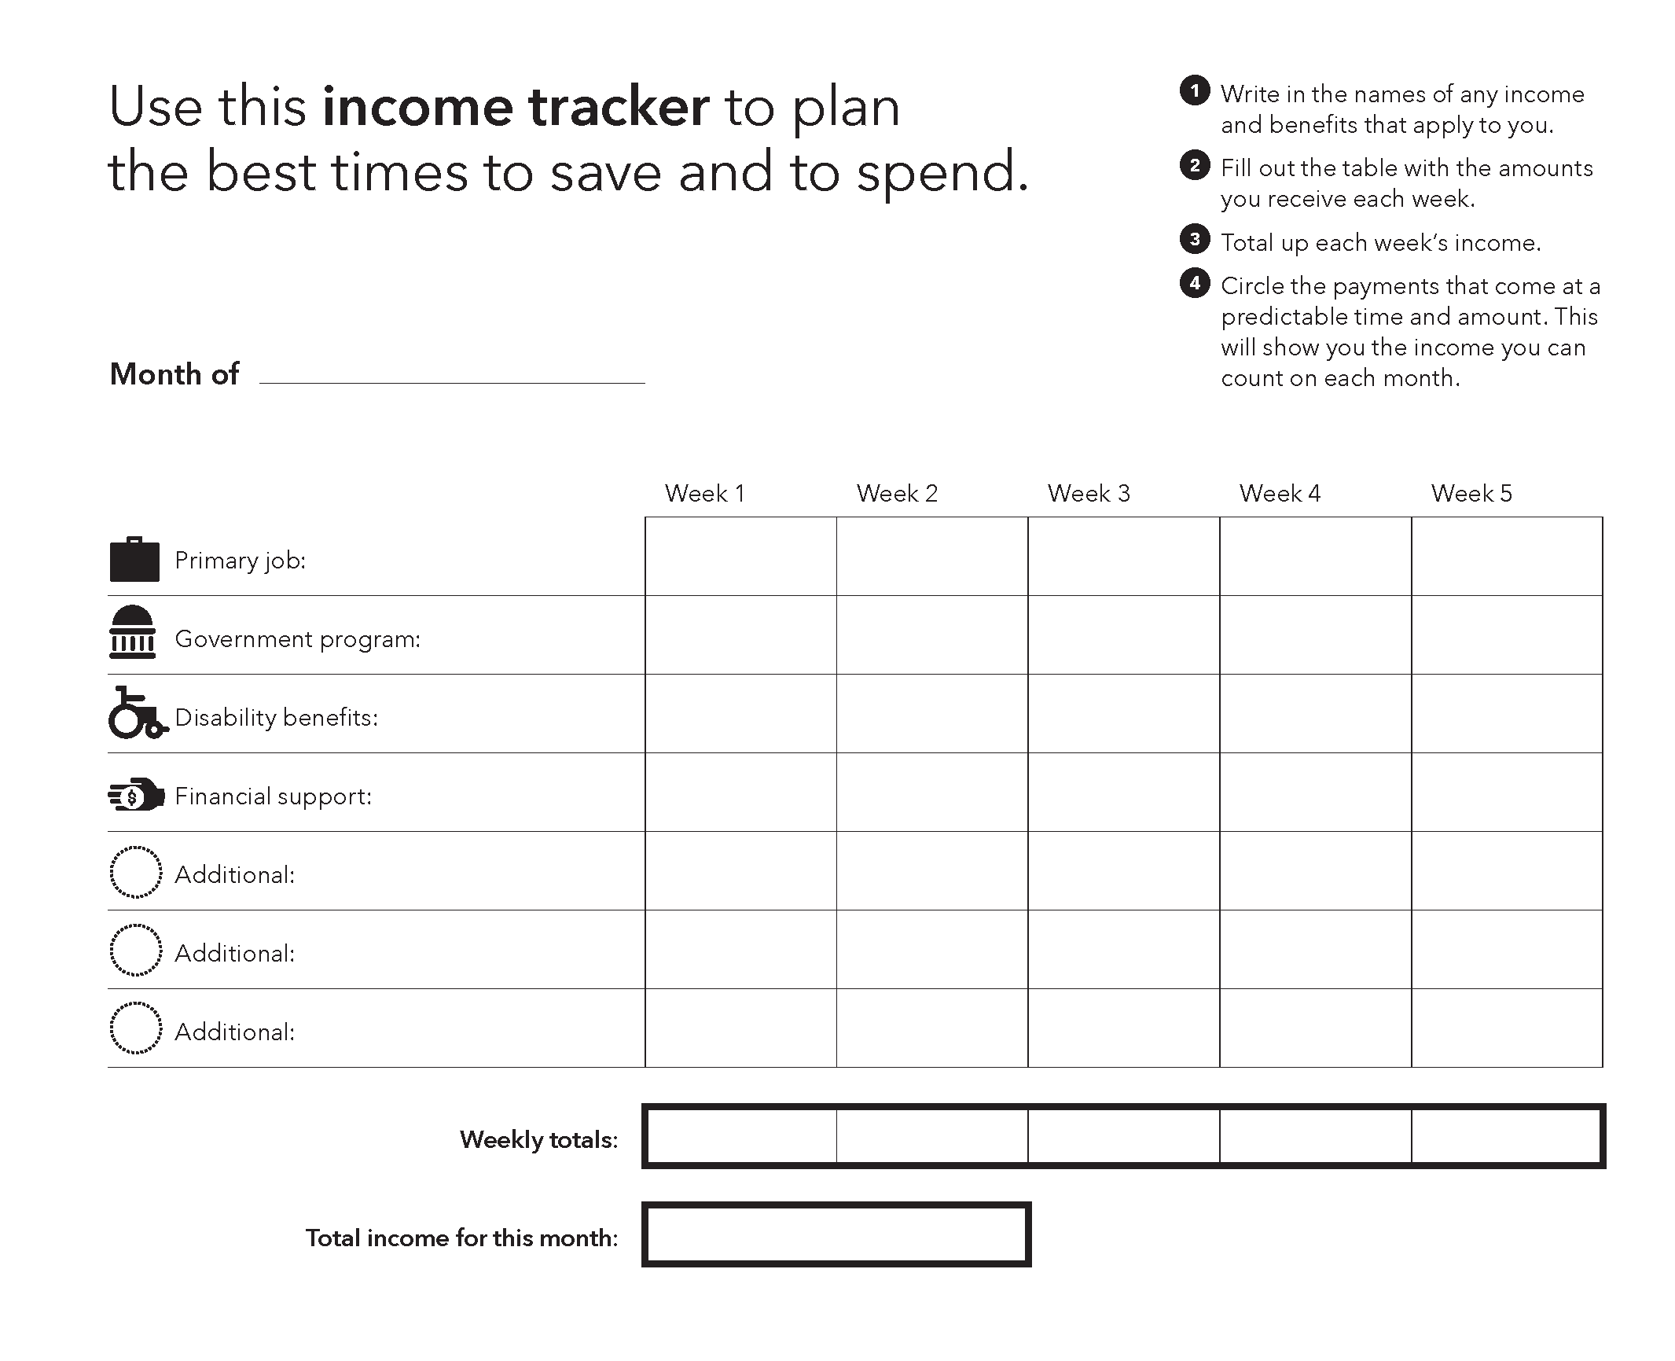
Notes:
Many individuals and families have income that varies from week to week or may be received infrequently. This worksheet allows for tracking income over the course of a month to make that variability easier to manage.
People fill out the table with the amounts they received from their primary job, a government program, disability benefits, financial support, and other sources that they identify themselves, such as child support or tribal benefits and payments. After filling in the amounts expected from each source, they can total up the each week’s income and circle the payments that come at predictable times and in predictable amounts. That is income they can count on.
Note that “Financial Support” is included to represent assistance that people may receive from friends and family or other sources.

Slide 38
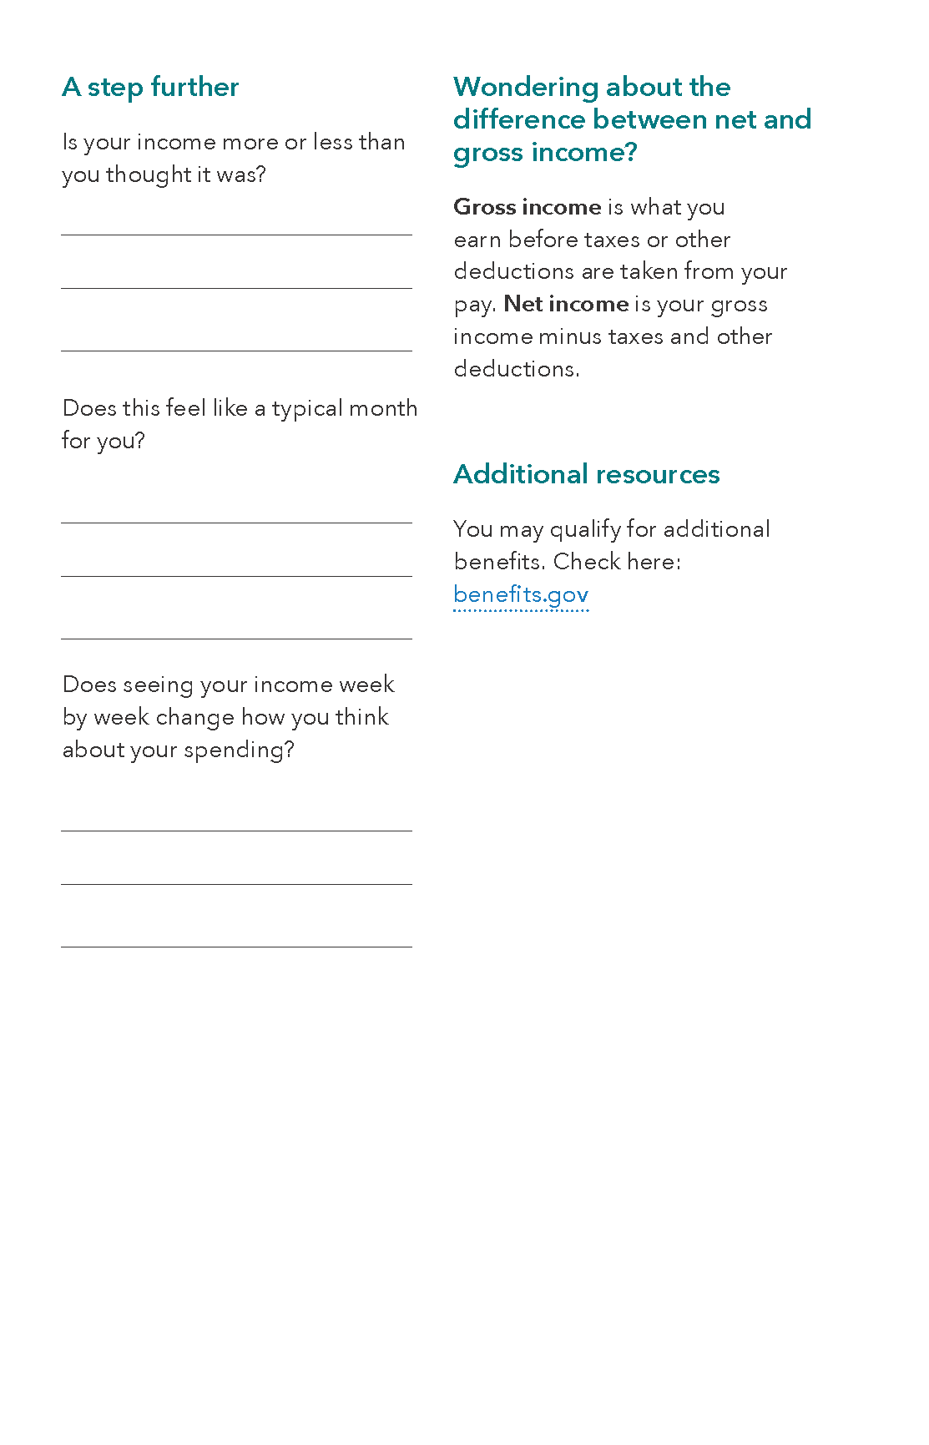
Income tracker
Notes:
A step further for this tool includes prompts for using the tool as a springboard for conversation about income, spending, and cash flow. That conversation might lead nicely into using other tools in Behind on Bills? or the Your Money, Your Goals toolkit.
Some practitioners find this to be an ideal tool to use in connection with conversations around financial goals. Because getting a total picture of your income is so fundamental, the tool can be used in highly specific settings, such as work with people on credit repair, as well as in general financial education settings.
How do you plan to use the Income tracker with the people you serve? Pause this training to jot down those ideas on sticky notes and stick them on this tool.

Slide 39
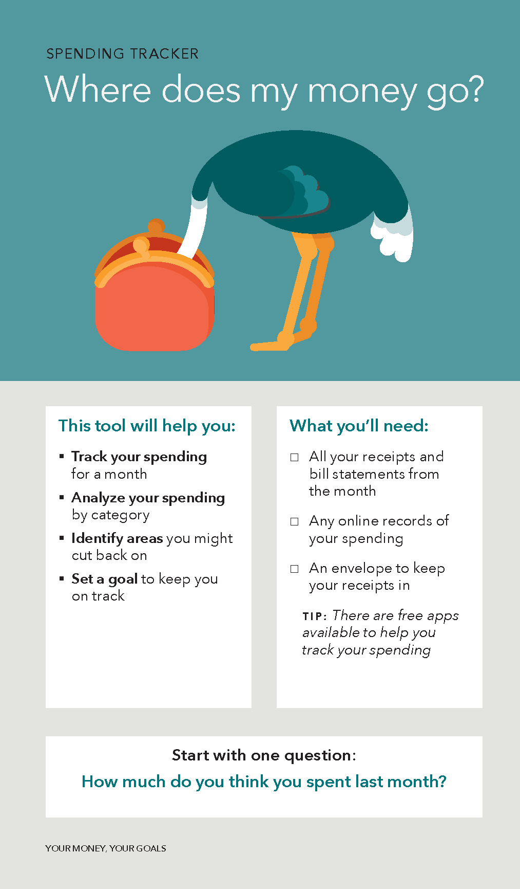
Spending tracker
Track your spending for a month
Analyze your spending by category
Identify areas you might cut back on
Set a goal to keep you on track
Notes:
NOTE: Training activity notes are included on slide 37.
The Spending tracker can help people build a picture of where their money goes.
You use this tool to help people:
Track their spending for a month
Analyze their spending by category
Identify areas they might cut back on and
Set goals to keep them on track
Open the conversation with the question, “How much do you think you spent last month?” Many people that complete a Spending tracker have “aha” moments not only about the amounts they spend, but also about what they spend it on.
The Spending tracker can be used in a meeting to get an estimate of spending and as “homework” that can help people monitor their spending in “real time.” You can point out that there are also free apps that help people track their spending.
As stated in the “What you’ll need” box, you may want to ask the people you serve to collect their receipts and online records of their spending prior to jumping into the worksheet portion of this tool.

Slide 40
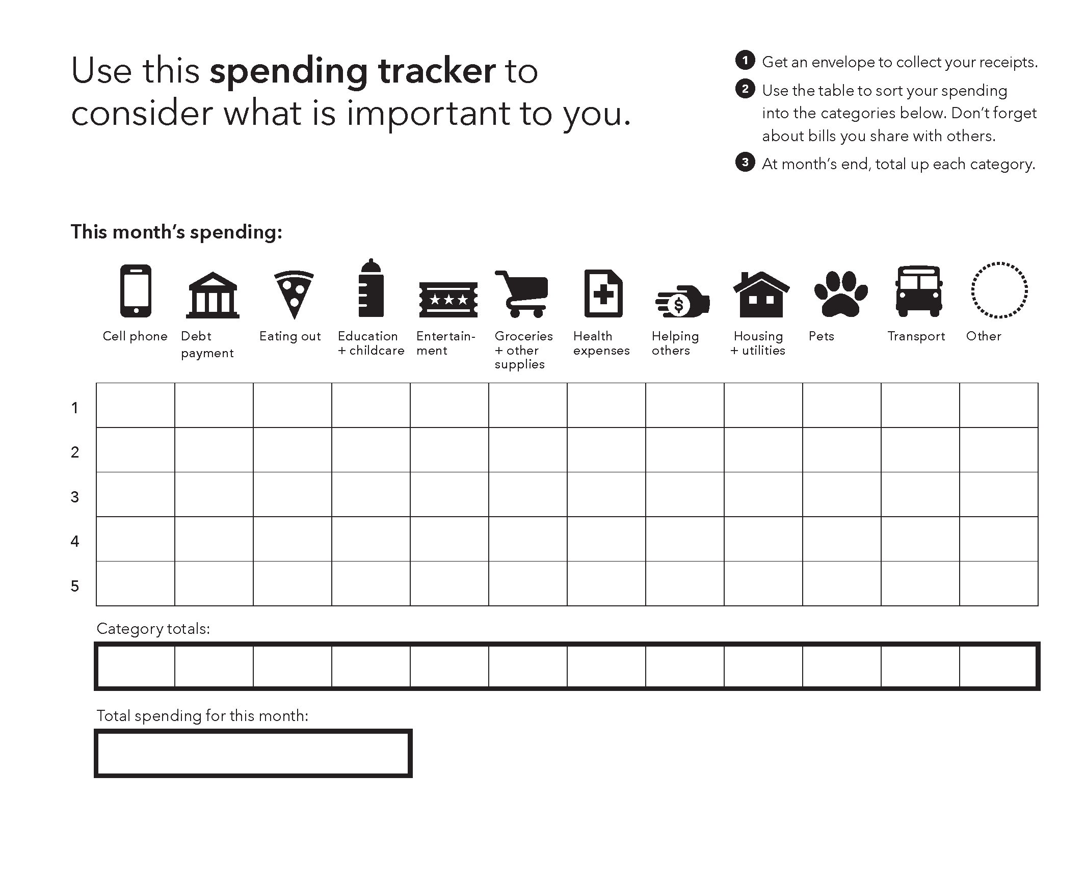
Notes:
The worksheet portion of the Spending tracker provides twelve categories for spending, including an “other” category. Sort the receipts and other documentation of spending into the categories. The rows of the table are the weeks in the month.
Once a person has filled in the week-by-week table, total the costs by category and for total spending during the month. Ask the person what surprises them about the category totals. Does the spending align with their personal priorities?

Slide 41
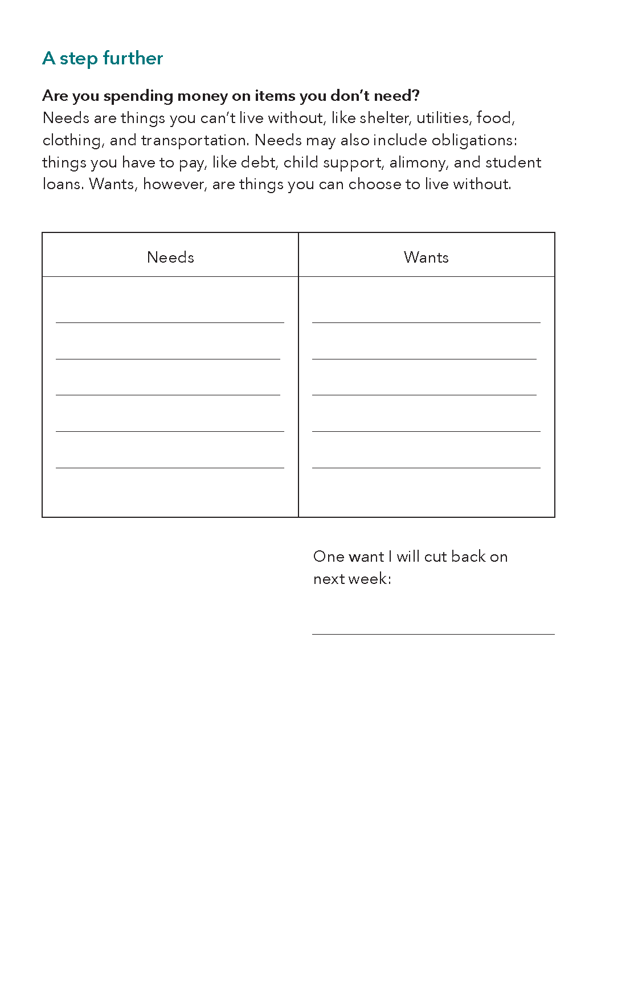
Spending tracker
Notes:
A step further for this tool can help users identify areas where they may want to decrease spending. Classifying expenses as needs and wants is a great way for people to identify where they could cut back.
This tool can be an entry point into a larger budgeting conversation.

Slide 42
Closing

Slide 43
How will you use the tools?
Throughout the training you have attached sticky notes to your booklet
Place the sticky notes on the appropriate flip chart page
Work together to categorize the notes placed by the group
Report out the similarities and differences in potential usage
Notes:
Sharing how we could use the tools: 30 minutes
During a break in the training, write the name of each tool (Including the My money picture bonus tool) on individual flip chart pages, one tool per page.
Place sticky notes (5 min)
Ask participants to place their sticky notes on the areas designated for each tool.
Categorize (10 min)
Create pairs/small groups and ask each pair/group to look for groupings or categories of the ideas captured on the sticky notes.
Each group reports back (15 min)
If you identify potential usages that haven’t been identified, ask questions to facilitate idea generation.
Ask participants to place dots on the three tools that they’re going to try during the next month.

Slide 44
Wrapping up
How will our organization share this resource with our staff and volunteers?
How will they share it with the people we serve?
Notes:
Consider leading a discussion of how your organization can continue to share ideas and track usage of the tools, encouraging participants to keep in touch with each other and share ideas. Exchange contact information if necessary.
Share that the CFPB will be hosting training webinars on key topics and promoting best practices in using the toolkit and Behind on Bills?
Invite them to sign up for updates by circulating the CFPB’s approved sign in sheet or by asking them to use their smartphones and go to www.consumerfinance.gov/your-money-your-goals and scrolling to the middle of the page (right sidebar) to enter their e-mail.
If you circulate the sign-up sheet that follows, please scan and e-mail it to YourMoneyYourGoals@cfpb.gov .
Answer any remaining questions and thank them for participating.

Slide 45
Training others in Behind on bills?

Slide 46
Varying training methods tool-by-tool
Demonstrate and apply
Experience and reflect
Role play (in-person trainings)
Notes:
Throughout this training, we explained each tool’s purpose and demonstrated how it works. Then we asked you to consider how the tool could be applied in your work. That is the demonstrate and apply method of introducing a tool.
There are two other methods of sharing tools that you can use when you train others in using Behind on bills? with the people they serve.
The experience and reflect method is letting participants complete the tool first on their own. They can complete tools with information from their own financial lives or based on the financial situations that are common among the people they work with. Once participants have experienced the tool for themselves, prompt them to reflect on the tool’s purpose and how they can use the tool in their work.
There is a third method of introducing tools: the role play method. The role play works best in an in-person setting. Participants pair up, with one person in the role of frontline staff member or volunteer and another in the role of the person they are serving. In those roles, they simulate using the tools in real life.
Varying which of these three methods you use throughout your training can boost engagement.

Slide 47
Materials needed
Training outline for Behind on bills? (for you the trainer)
One copy of Behind on bills? for each participant
Photocopies of each tool (In a folder or clipped together)
Pens or pencils
Markers
Sticky notes (15-20 per participant)
Sticky dots for voting (3 per participant)
Flipchart(s) to use as “parking lot”
Notes:
To train others in Behind on bills? in a classroom-style setting you will need these supplies:
A training outline for you the trainer
One copy of Behind on bills? for each participant
Photocopies of the eight tools and the My money picture bonus card, so that participants can fill in the tools without marking up their bound hardcopy of the resource
Pens or pencils
Markers for you, the trainer, and for the participant tables
15-20 sticky notes per participant
Three sticky dots per participant for a voting exercise in the training outline
And a flipchart to use as “parking lot.” A parking lot is where you can list questions and ideas that are important but best addressed at the end of the training or afterward.

