Slide 1
Awareness of Low Self-Control: Theory and Evidence from a Homeless Shelter
Elif Incekara-Hafalir (Carnegie Mellon University)
Sera Linardi (University of Pittsburgh)
2016 CFPB Research Conference

Slide 2
Survey measures of self-control: How informative are they?
Self-control, the ability to follow one’s ideal plan depite of temptations, is a central concept in behavioral science (Laibson (1997), Gul and Pesendorfer (2001)).
Important in financial decision making (Bryan et al. 2010)
Measuring self-control accurately is crucial
Incentivized experiments
Surveys
Notes:
Self-control, the ability to follow one’s ideal plan despite of temptations, is an important concept in many different areas including in financial decision making (Strotz (1956), Laibson (1997), Gul and Pesendorfer (2001), Bryan et al . 2010). It affects
How much people save
And peoples’ demand for commitment savings account
Therefore, measuring self-control accurately is crucial
There are two main ways to measure self-control
Incentivized experiments in which people are asked whether they prefer sooner-smaller vs later-larger reward
This is preferred by economists, but these are generally expensive and complex to use
Surveys, on the other hand, provides a low-cost and easy to implement alternative

Slide 3
Survey measures of self-control: Are they measuring awareness in addition to self-control?
Self Control Scale (Tangney, et al. 2004)
“I’m good at resisting temptation”
Expected Deviation (Ameriks et al 2007)
Ideal behavior: “How much would you ideally like to save?”
Predicted behavior: “How much do you think you would save if you were to give into your temptation?”
Ideal=$100, Predicted=$99
Expected Deviation (ED)=$1
Notes:
For example, in the SCS, a questions asks people whether they are good at resisting temptation
As a subject, when I say that I am good at resisting temptation, it may be because either I have high self-control or because I am not aware of my low self-control problem
Another example is the Expected Deviation measure of Ameriks, in which people are asked about “their ideal behavior” and “their predicted behavior” if they give into temptation, and the difference is used as a measure of self-control
As a subject, if I state that ideally I would like to save $100, but I think I will only save $99 because of self-control problems, this $1 difference, may indicate either a minor self-control problem, or an underestimation of a big self-control problem.
These two examples demonstrate that survey measures of self-control may be measuring awareness in addition to self-control

Slide 4
We investigate a specific survey measure of self-control: Expected Deviation (ED)
Expected Deviation (ED)= ideal behavior-predicted behavior
Evidence on ED so far:
ED is negatively correlated with desirable outcome (such as savings)
This is consistent with this survey measure capturing self-control problem
What if ED captures awareness of self-control as well?
Theoretically explore how
Expected Deviation (ED) and savings change with self-control and awareness
Correlation between ED and savings depends on the study population
Empirically explore a setting where awareness is likely to matter
The commitment savings of homeless shelter residents
ED is positively correlated with savings
Not consistent with the idea that ED captures self-control alone
But, meaningful if ED captures awareness in addition to self-control
Notes:
In this paper we investigate…
ED is calculated as a difference between ideal and predicted behavior
The evidence on ED so far is from academically and financially successful populations
And shows negative correlation between this measure and desirable outcomes
This is consistent with this survey measure capturing self-control
The intuition is that the higher the self-control problem is, the larger the difference between ideal and predicted behavior, which results in smaller savings
What if ED captures awareness of self-control as well?
In order to answer that question, we theoretically explore how
Expected Deviation (ED) changes with self-control and awareness
Savings change with self-control and awareness
Correlation between them depends on the study population
Empirically explore settings where awareness of self-control is likely to matter
We look at the commitment savings of a homeless shelter residents
We find that ED is positively correlated with savings as opposed to previous findings
Which is opposite to the findings in the previous literature
But makes sense if ED measures awareness in addition to self-control

Slide 5
Self-control and Awareness
We use well-known $β$-δ model (Laibson (1997), O’Donoghue & Rabin (2001, 2003))
Actual: $\left\{1, βδ, βδ^{2}, …\right\}$
Believes: $\left\{1, β^{′}δ, β^{′}δ^{2}, …\right\} with 0≤β≤β′≤1$
We introduce a parameter for awareness of self-control ($α$)
By reparametrizing $β^{′}=1−α\left(1−β\right) with 0≤α≤1$
Awareness of self-control ($α$): captures the accuracy of one’s perception of self-control
Notes:
In our theory, we use well-known beta-delta model in which
Consumer receives a stream of utility from current period onward and discounts them by {1, βδ, βδ²,…}
But, he incorrectly believes that he will discount future periods with {1, β’δ, β’δ²,…} instead
Here beta captures the self-control problems.
And, beta prime captures the perception of beta
We introduce a parameter for awareness of self-control (alpha)
By reparametrizing beta’
Awareness of self-control ($α$) captures the accuracy of one’s perception of self-control
$α$=0, complete unawareness (naive)
$α$=1, complete awareness (sophisticated)
From this formulation, you can see that
Alpha has a little impact on the difference between beta’ and beta when beta is high.
This will be important in our predictions

Slide 6
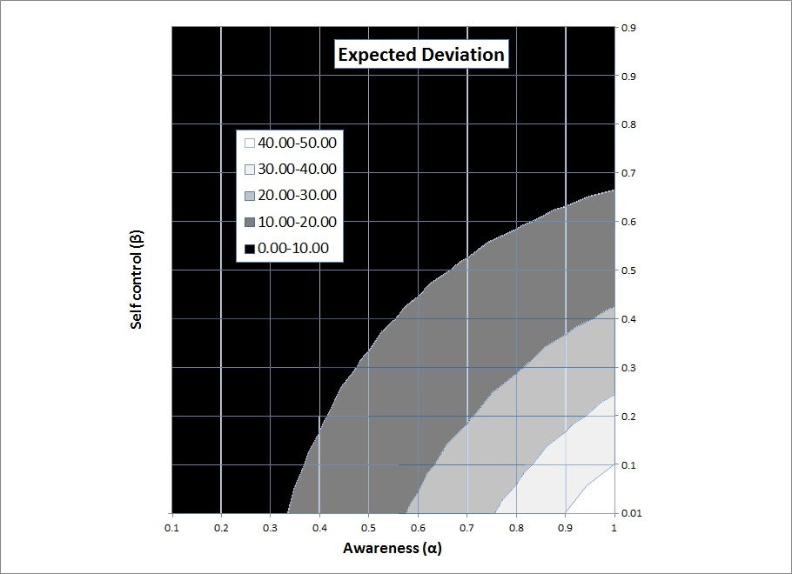
Expected Deviation (ED)
ED=Ideal saving-Predicted saving
$\frac{∂\left(ED\right)}{∂β}<0$
$\frac{∂\left(ED\right)}{∂α}>0$
$\frac{∂}{∂β}\left(\frac{∂ED}{∂α}\right)<0$
Notes:
Recall that ED is used as a measure of self-control alone.
Here, I will first show how ED changes with awareness as well as with self-control
I will explain the predictions of our model on graphs from this point on.
I will always put awareness on the x-axis and self-control on the y-axis.
This graph shows the level curves of ED, increasing from darker regions to lighter ones.
On the vertical axis, as self-control decreases, we see that ED increases.
On the horizontal axis, ED increases with awareness.
This is quite intuitive.
between two people with similar awareness, the lower self-control one will predict a larger difference between ideal and predicted behavior.
with parallel reasoning, between two people with similar self-control, the one who is more aware will predict a larger difference between ideal and predicted behavior.
Also note that the colors change much quickly at the bottom of this graph, indicating that awareness effects ED strongly for low self-control people compared with high self-control people.
In all of my graphs, I will use these arrows to show the direction in which the variable of interest increases, and fat arrows will indicate a stronger effect compared to skinny ones.

Slide 7
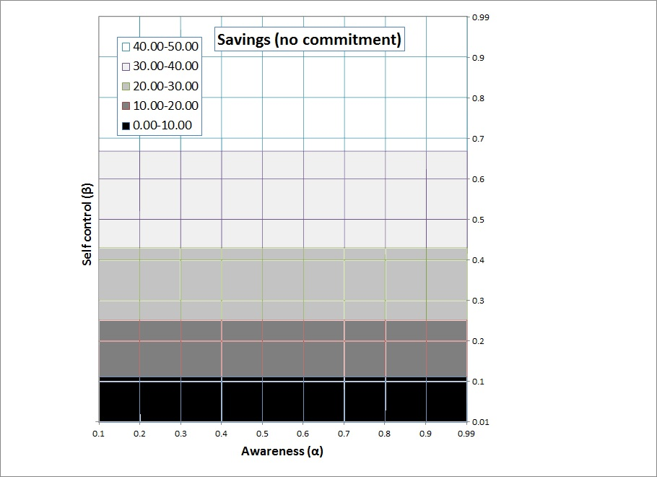

Savings without available commitment device
Savings without commitment, $s^{t}$
$\frac{∂\left(s^{t}\right)}{∂β}>0$
$\frac{∂\left(s^{t}\right)}{∂α}=0$
Notes:
Let us see how savings without available commitment devices change with self-control and awareness
Higher self-control increases savings as expected
but awareness does not have an effect. Because even if the person is aware of his self-control problem, he cannot do anything about it without commitment devices.

Slide 8
A high awareness population varying in self-control
A high self-control population varying in awareness
Strong negative correlation
No correlation
A low awareness population varying in self-control
A low self-control population varying in awareness
Weak negative correlation
No correlation
Notes:
Recall that the previous papers find a negative correlation between ED and savings
This was the evidence suggesting that ED captures self-control
Now, I will show theory predictions in terms of correlation between ED and savings for different study populations
If I have a high awareness population varying in self-control, we are looking at the right hand side of these two graphs.
Theory predicts a negative correlation between ED and savings for this population
For a low awareness population varying in self-control, we are looking at the left hand sides of these graphs
Theory predicts a weak negative correlation between ED and savings
For a high self-control population varying in awareness
Theory predicts no correlation
For a low self-control population varying in awareness
Again, theory predicts no correlation
Note that it is not possible to see the effect of awareness on savings when there are no commitment devices

Slide 9
Commitment Devices
We model Withdrawal-side commitments (e.g. 529 education account, the SEED commitment savings account (Ashraf et al. (2006b), physical lockboxes (Shipton, 1992))
Restrict the withdrawal
Requires an initial costly effort (E.g. get a friend to walk me to the lockbox everyday after work to deposit money)
People spend this effort only if they think that it is needed
Notes:
Withdrawal-side commitments such as physical lockboxes
These commitment devices
restrict the withdrawals from the account or the box
but you have to put the money into the account in the first place, which requires an initial costly effort.
These initial efforts can be wide-ranging and non-financial such as (E.g. get a friend to walk me to the lockbox everyday after work to deposit money)
Since effort is costly, people will spend that effort only if they think that it is needed, in other words, only if they are sufficiently aware of their self-control problems.

Slide 10
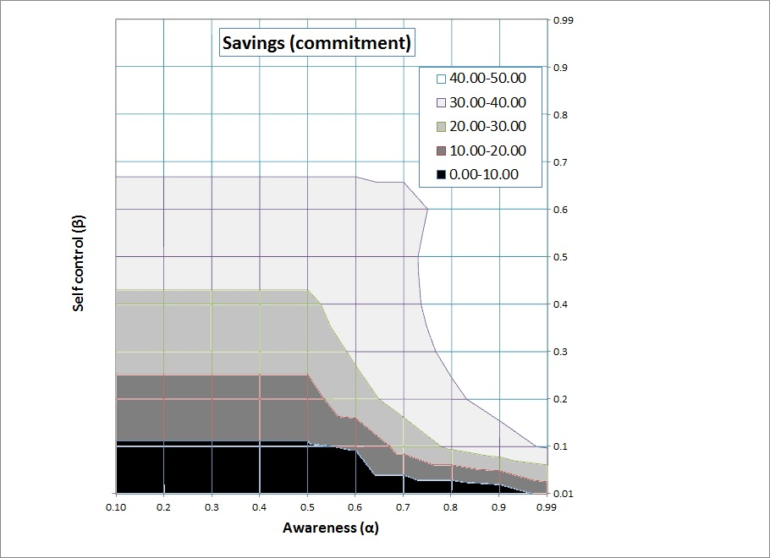
Savings with commitment
At low awareness,
Savings are identical to the savings w/o commitment
As awareness increases, savings starts to increase
Start spending effort
Awareness affects savings more for low self-control populations
In general, self-control increases savings
Notes:
Now let us see how the commitment savings depend on self-control and awareness
Here are the level curves of savings with commitment
At low awareness, savings are identical with and w/o commitment
Because you are not aware enough to spend the costly initial effort to increase savings
As awareness increases, savings starts to increase because people start spending effort
We see the colors change much quickly at the bottom of this graph, indicating that awareness affects savings more for low self-control populations
Now I will put ED and savings with commitment graphs side by side to see to see the correlation for different populations

Slide 11
A high awareness population varying in self-control
A high self-control population varying in awareness
Weak negative correlation
Weak positive correlation
A low awareness population varying in self-control
A low self-control population varying in awareness
Weak negative correlation
Strong positive correlation
Notes:
Now, I want to see the theory predictions in terms of correlation between ED and savings when there are commitment devices available
As I did before, I will give theory predictions for different study populations.
Among all these populations I presented, we are most likely to see the effect of awareness for this population when there is a costly commitment device available for a low self-control population.
To test our theory predictions, we study how ED correlates with lockbox savings of homeless shelter residents.
This complements previous studies which were done with academically and financially successful populations.

Slide 12
Setting: Homeless shelter
We worked with Central Arizona Shelter Services
 | Mean | Std. Dev.
Age | 41.66 | 10.45
Female | 0.16 | 0.37
Education | 12.01 | 2.27
Black | 0.38 | 0.49
Reason for homelessness: addiction | 0.37 | 0.48
Reason for homelessness: jail | 0.20 | 0.40
High school dropout | 0.37 | 0.48
First time homeless | 0.44 | 0.50
Month homeless | 11.68 | 12.70
$β>$0.85 for standard populations (Frederick et al (2002) )
$β$=0.6 estimated for a subset of this population (Linardi & Tanaka (2013))
Notes:
We worked with Central Arizona Shelter Services
Conducted the ED survey
Tracked the finances of working homeless shelter residents
The rate of addiction and incarceration and high school drop outs, which are commonly associated with low self-control, is high in this population.
Moreover, although estimated beta values in standard populations are higher than 0.85, it is only 0.6 in this population.
Suggesting this to be a low self-control population

Slide 13
Setting: Homeless shelter
Shelter setting
Shelter covers almost all residential expenses (room, board)
Residents need to report income & savings to the financial manager.
Residents save in shelter lockbox, can take it out when they leave shelter.
$1000/month income expectation (Linardi and Tanaka, 2013)
ED survey at the shelter
Ideal: “How much would you ideally like to save in the next 4 weeks?” ($776.15)
Predicted: “How much do you think you will actually save in the next 4 weeks?” ($650.48)
9% ED<0, 35% ED=0, 56% ED>0, average ED $115 (15%)
Income much lower than expected (economic crisis in 2009)
Among those who earn average earning is $473.37 and saving is $301.
Reporting rate initially low
Residents making $0 income did not make reports at first.
Overall 76% report
Shelter coded missing reports as $0 income and $0 savings.
Notes:
Shelter lockbox serve as a withdrawals-side commitment device

Slide 14
 | (1) | (2) | (3) | (5) | (6)
Variables | Ideal saving ($100) | Predicted saving ($100) | ED ($100) | Income | Savings
Age | -0.01 | 0.04 | -0.05* | 9.25*** | -0.95
 | (0.05) | (0.05) | (0.03) | (3.27) | (0.81)
Female | -4.28** | -4.03* | -0.25 | -66.54 | -17.83
 | (2.09) | (2.06) | (0.90) | (76.56) | (19.08)
Black | -2.15* | -1.97 | -0.18 | -146.67** | -24.55
 | (1.10) | (1.24) | (0.78) | (67.38) | (21.26)
Education | 0.11 | 0.05 | 0.06 | 2.49 | 6.47
 | (0.22) | (0.26) | (0.20) | (19.31) | (5.98)
First time homeless | 4.95* | 5.02* | -0.07 | 141.90* | -8.65
 | (2.77) | (2.89) | (0.79) | (77.30) | (18.66)
Months homeless | 0.01 | 0.01 | -0.00 | -0.00 | 0.02
 | (0.01) | (0.01) | (0.00) | (0.09) | (0.02)
Reason: addiction | -1.61 | -2.44 | 0.83 | -28.86 | -9.77
 | (1.88) | (1.88) | (0.78) | (101.72) | (19.94)
Reason: jail | -1.40 | -1.05 | -0.35 | 12.53 | 18.51
 | (1.25) | (1.30) | (0.92) | (100.98) | (26.77)
Days since employed | 0.02 | 0.02 | -0.00 | -0.87 | 0.28
 | (0.02) | (0.02) | (0.01) | (1.07) | (0.26)
income |  |  |  |  | 0.56***
 |  |  |  |  | (0.07)
Time control
Summer 2009 | 4.91 | 4.71 | 0.19 | 1.36 | -16.20
 | (3.27) | (3.36) | (1.38) | (119.93) | (28.23)
Spring 2010 | 1.45 | 1.39 | 0.06 | 61.76 | 22.32
 | (1.27) | (1.28) | (0.46) | (87.06) | (21.61)
No incentive | -1.66 | -1.82 | 0.16 | -114.58 | -49.29**
 | (1.10) | (1.23) | (0.54) | (86.42) | (24.51)
Constant | 8.40** | 5.56 | 2.84 | -146.15 | -26.09
 | (3.97) | (4.98) | (4.57) | (312.05) | (92.40)
Observations | 95 | 95 | 95 | 95 | 95
R-squared | 0.27 | 0.24 | 0.08 | 0.20 | 0.85
Adjusted R-squared | 0.159 | 0.125 | -0.0546 | 0.0870 | 0.827
Notes:
First we look at the effect of demographics and homelessness characteristics on ideal and predicted savings, and on ED
Stated ideal and predicted savings are higher for people who are homeless for the first time
They are lower for female and black residents.
These variables are echoed in income (Column 5), suggesting that ideal and predicted savings are based on income projections.
We see that most of these demographic-driven differences are netted out in ED (Column 3).
Apart from the effect of age on ED, neither gender, race nor reasons for homelessness are significant predictors of ED.
All of this suggests that ED is netting out demographic and other factors that affect income and capturing something more specific to the individual.

Slide 15
 | (1) | (2) | (3) | (4) | (5) | (6)
Variables | Ideal saving ($100) | Predicted saving ($100) | ED ($100) | Submit Report | Income | Savings
Age | -0.01 | 0.04 | -0.05* | 0.00 | 9.25*** | -0.95
 | (0.05) | (0.05) | (0.03) | (0.00) | (3.27) | (0.81)
Female | -4.28** | -4.03* | -0.25 | 0.03 | -66.54 | -17.83
 | (2.09) | (2.06) | (0.90) | (0.10) | (76.56) | (19.08)
Black | -2.15* | -1.97 | -0.18 | -0.11 | -146.67** | -24.55
 | (1.10) | (1.24) | (0.78) | (0.08) | (67.38) | (21.26)
Education | 0.11 | 0.05 | 0.06 | 0.03* | 2.49 | 6.47
 | (0.22) | (0.26) | (0.20) | (0.02) | (19.31) | (5.98)
First time homeless | 4.95* | 5.02* | -0.07 | 0.21*** | 141.90* | -8.65
 | (2.77) | (2.89) | (0.79) | (0.08) | (77.30) | (18.66)
Months homeless | 0.01 | 0.01 | -0.00 | -0.00 | -0.00 | 0.02
 | (0.01) | (0.01) | (0.00) | (0.00) | (0.09) | (0.02)
Reason: addiction | -1.61 | -2.44 | 0.83 | -0.02 | -28.86 | -9.77
 | (1.88) | (1.88) | (0.78) | (0.13) | (101.72) | (19.94)
Reason: jail | -1.40 | -1.05 | -0.35 | -0.15 | 12.53 | 18.51
 | (1.25) | (1.30) | (0.92) | (0.11) | (100.98) | (26.77)
Days since employed | 0.02 | 0.02 | -0.00 | -0.00 | -0.87 | 0.28
 | (0.02) | (0.02) | (0.01) | (0.00) | (1.07) | (0.26)
income |  |  |  |  |  | 0.56***
 |  |  |  |  |  | (0.07)
Time control
Summer 2009 | 4.91 | 4.71 | 0.19 | -0.58*** | 1.36 | -16.20
 | (3.27) | (3.36) | (1.38) | (0.15) | (119.93) | (28.23)
Spring 2010 | 1.45 | 1.39 | 0.06 | 0.06 | 61.76 | 22.32
 | (1.27) | (1.28) | (0.46) | (0.08) | (87.06) | (21.61)
No incentive | -1.66 | -1.82 | 0.16 | -0.07 | -114.58 | -49.29**
 | (1.10) | (1.23) | (0.54) | (0.08) | (86.42) | (24.51)
Constant | 8.40** | 5.56 | 2.84 | -0.09 | -146.15 | -26.09
 | (3.97) | (4.98) | (4.57) | (0.35) | (312.05) | (92.40)
Observations | 95 | 95 | 95 | 95 | 95 | 95
R-squared | 0.27 | 0.24 | 0.08 | 0.45 | 0.20 | 0.85
Adjusted R-squared | 0.159 | 0.125 | -0.0546 | 0.367 | 0.0870 | 0.827
Notes:
First we look at the effect of demographics and homelessness characteristics on ideal and predicted savings, and on ED
Stated ideal and predicted savings are higher for people who are homeless for the first time
They are lower for female and black residents.
These variables are echoed in income (Column 5), suggesting that ideal and predicted savings are based on income projections.
We see that most of these demographic-driven differences are netted out in ED (Column 3).
Apart from the effect of age on ED, neither gender, race nor reasons for homelessness are significant predictors of ED.
All of this suggests that ED is netting out demographic and other factors that affect income and capturing something more specific to the individual.

Slide 16
The effect of ED
 | (1) | (2) | (3)
VARIABLES | Report | Income | Savings
ED | -0.01 | -7.37 | 7.20*
 | (0.02) | (11.94) | (3.79)
Income |  |  | 0.57***
 |  |  | (0.06)
Observations | 95 | 95 | 95
AdjR2 | 0.277 | -0.01 | 0.84
Robust standard errors in parentheses. *** p<0.01, ** p<0.05, * p<0.1, +p<0.11. Time FE included.
Notes:
Commitment devices were offered for savings alone; therefore, awareness of self-control can only improve savings but not income or submission of financial reports.
Columns 1 and 2, we see that a respondent’s ED does not affect his likelihood of submitting reports or his income
However, ED has a positive effect on the amount saved in the commitment savings account: an extra $100 in ED translates to about $7.20 in extra savings (Column 3)

Slide 17
 | (1) | (2) | (3) | (4) | (5) | (6)
VARIABLES | Report | Income | Savings | Savings | Savings | Savings
ED | -0.01 | -7.37 | 7.20* |  | 6.70+ | 9.27**
 | (0.02) | (11.94) | (3.79) |  | (4.12) | (4.63)
Ideal Savings |  |  |  | 8.12**
 |  |  |  | (3.94)
Predicted Savings |  |  |  | -6.91*
 |  |  |  | (3.70)
Income |  |  | 0.57*** | 0.57*** | 0.55*** | 0.57***
 |  |  | (0.06) | (0.06) | (0.07) | (0.06)
Demographic controls | N | N | N | N | Y | N
Observations | 95 | 95 | 95 | 95 | 94 | 72
AdjR2 | 0.277 | -0.01 | 0.84 | 0.847 | 0.82 | 0.83
Notes:
Table 2 Columns 1-4 explore all three dependent variables in the entire sample using OLS, treating the shelter’s coding of missing reports as 0. In all columns we include seasonal effects dummies to control for time varying unobservables, and robust standard error. In Columns 1 and 2, we see that a respondent’s ED does not affect his likelihood of submitting reports or his income, two outcomes for which there are no commitment devices. However, ED has a positive effect on the amount saved in the commitment savings account: an extra $100 in ED translates to about $7.20 in extra savings (Column 3).27 The significance drops to 0.11 when we add demographic controls and variables capturing experience with homelessness (Column 4), but an F-test reveals that these additional control variables have very little explanatory power (F(9, 79)=1.13, Prob > F =0.3541) and are hence dropped from future regressions

Slide 18
Heckman Selection Model
 | (1) | (2) | (3) | (4) | (5) | (6) | (7) | (8)
VARIABLES | Saving | Selection | Saving | Selection | Saving | Selection | Saving | Selection
ED | 9.82** | -0.03
 | (4.17) | (0.05)
Ideal savings |  |  | 3.50 | 0.01 |  |  | 10.90** | -0.02
 |  |  | (2.57) | (0.02) |  |  | (4.39) | (0.05)
Predicted savings |  |  |  |  | -0.08 | 0.01 | -8.86** | 0.03
 |  |  |  |  | (2.56) | (0.02) | (4.31) | (0.05)
Income | 0.56*** |  | 0.56*** |  | 0.56*** |  | 0.56***
 | (0.03) |  | (0.03) |  | (0.03) |  | (0.03)
Summer 2009 |  | -1.63*** |  | -1.72*** |  | -1.72*** |  | -1.69***
 |  | (0.34) |  | (0.36) |  | (0.35) |  | (0.36)
Constant | 34.77 | 1.31 | 18.53 | 1.22*** | 43.14* | 1.21*** | 20.98 | 1.24***
 | (18.73) | (0.23) | (26.15) | (0.26) | (24.98) | (0.25) | (25.55) | (0.27)
Observations |  | 95 |  | 95 |  | 95 |  | 95
Robust standard errors in parentheses. *** p<0.01, ** p<0.05, * p<0.1, +p<0.11. Time FE included.
Notes:
Because 24% of subjects did not submit a report, especially in the beginning (summer 2009), we run a Heckman selection model to check whether those who did not submit reports are systematically different from those who submitted reports in a way that would bias our estimate of ED. (treat those not reporting income as missing.)
We exploit the differential rate of reporting in Summer 2009 for the selection equation.
individuals in Summer 2009 are less likely to submit reports, but are similar in survey responses, earnings and savings as individuals from other cohorts.
The effect of ED on savings is actually larger when estimated with the Heckman selection model, suggesting that $100 in ED translates to about $9.82 in extra savings beyond the 56 cents saved per $1 earned

Slide 19
Heckman Selection Model
 | (1) | (2) | (3) | (4) | (5) | (6) | (7) | (8)
VARIABLES | Saving | Selection | Saving | Selection | Saving | Selection | Saving | Selection
ED | 9.82** | -0.03
 | (4.17) | (0.05)
Ideal savings |  |  | 3.50 | 0.01 |  |  | 10.90** | -0.02
 |  |  | (2.57) | (0.02) |  |  | (4.39) | (0.05)
Predicted savings |  |  |  |  | -0.08 | 0.01 | -8.86** | 0.03
 |  |  |  |  | (2.56) | (0.02) | (4.31) | (0.05)
Income | 0.56*** |  | 0.56*** |  | 0.56*** |  | 0.56***
 | (0.03) |  | (0.03) |  | (0.03) |  | (0.03)
Summer 2009 |  | -1.63*** |  | -1.72*** |  | -1.72*** |  | -1.69***
 |  | (0.34) |  | (0.36) |  | (0.35) |  | (0.36)
Constant | 34.77 | 1.31 | 18.53 | 1.22*** | 43.14* | 1.21*** | 20.98 | 1.24***
 | (18.73) | (0.23) | (26.15) | (0.26) | (24.98) | (0.25) | (25.55) | (0.27)
Observations |  | 95 |  | 95 |  | 95 |  | 95
Robust standard errors in parentheses. *** p<0.01, ** p<0.05, * p<0.1, +p<0.11. Time FE included.
Notes:
The general disadvantage of survey measures is that respondents may interpret the measure in ways not intended by the researcher. For our survey question, this disadvantage can appear in three ways. First, while subjects’ responses to the second question (“How much do you think will you actually save?”) is reflective of their current financial standing, the first question (“How much would you ideally like to save?”) may have cued subjects to imagine savings in an “ideal world” with an “ideal income” unbounded by reality. However, we think this is highly unlikely given the very high correlation between ideal and predicted savings (ρ=0.92, pval=0.00). Second, ideal savings might be a reflection of ambition or aspirations that then drives the correlation between ED and savings. Third, subjects might respond to ideal and predicted savings questions without recognizing possible future shocks to their future outcome. However, income mispredictions would not cause a correlation between ED and the actual savings since the mispredicted income would increase both ideal and predicted savings compared to the actual income but would not alone create a positive ED. In Table 3 we will investigate this closer by decomposing ED into its separate elements of ideal and predicted savings.
In Table 3 we investigate the role of ideal savings and predicted savings in the correlation between ED and actual savings. We replace ED in the Heckman selection model earlier with Ideal Savings in Columns 1-2, Predicted Savings in Columns 3-4, and both variables in Columns 5-6. Columns 2, 4, and 6 show that neither of the survey response variables predict submission of financial reports. Column 1 shows that Ideal Savings on its own does not have a significant effect in predicting Actual Savings; we would expect this to be true if Ideal Savings has captured other factors such as higher aspiration and the ED savings correlation was driven by higher aspiration. Similarly, Predicted Savings (Column 3) also do not predict Actual Savings. It is only when the two are included (Column 5) that we see an effect. This suggests that the correlation of ED and higher Actual Savings is driven by the unique deviation of predicted from ideal, in other words, awareness or self-control.

Slide 20
Heterogeneity
Effect of $100 of ED on additional savings ($) | Coef. | Std. Err. | P>z
Panel A:
Not homeless due to addiction | 4.16 | 9.2 | 0.65
Homeless due to addiction | 11.3 | 4.68 | 0.02
Panel B:
Did not drop out of high school | 9.39 | 5.82 | 0.11
Dropped out of high school | 11.49 | 5.99 | 0.06
Panel C:
Not homeless due to incarceration | 5.09 | 3.41 | 0.14
Homeless due to incarceration | 18.89 | 10.01 | 0.07
Notes:
Lincom ED+ED*addicted (gives us the difference between ED and ED*Addiction)
This table summarizes the regression results by displaying the linear combinations of ED and its interaction with three variables commonly associated with low self-control.
Addiction has been used as a proxy for low-control in the literature
Incarceration and high school drop outs are also sometimes used as a proxy.
The first one shows that $100 difference in ED translates to $11.30 (p=0.02) in savings for shelter residents who are homeless due to substance addiction and $4.16 (p=0.65) for those who are not. Even though the difference between the two is not statistically significant, the increase in savings is only significant for those who were addicted.

Slide 21
Conclusion
Positive correlation between a survey measure of self-control and savings in a homeless shelter with lockbox.
The correlation is stronger among those who have worse self-control problem
This suggest that the survey might be capturing awareness in addition to self-control
We suggest more tests of self-control surveys among non-standard populations
Notes:
We find a positive correlation between a survey measure of self-control and savings in a homeless shelter with lockbox.
Within this population, the correlation is stronger among those who are likely to have worse self-control problem – those who are homeless due to addiction.
This suggest that among those with low self-control the questionnaire may be measuring awareness alongside actual self-control problem, thus underestimating self-control problems.
We suggest more tests of self-control surveys among non-standard populations that are likely to have big self-control problems (e.g. addicts) to better understand how these measures deal with awareness of self-control.

