Slide 1
The Quest for Parsimony in Behavioral Economics: New Methods and Evidence on Three Fronts CFPB Research Conference December 2016
Victor Stango, UC Davis GSM
Joanne Yoong, NU Singapore
Jonathan Zinman, Dartmouth

Slide 2
Behavioral Economics & its Successes
We now know that insights from psychology can improve on classical economic models of decision-making
Preferences: present-bias, loss aversion, preferences over certainty/ambiguity, choice (in)consistency
Beliefs: overconfidence, gambler’s fallacies, non-belief in law of large numbers
Problem-solving limitations: exponential growth bias, narrow-bracketing, limited attention/memory
Big, growing impact on practice and policy

Slide 3
Behavioral Economics and its Proliferation Problems
Mismatch between what’s known and what’s needed, for optimal treatment design and welfare analysis
Proliferation problem. Manifold potentially behavioral factors (“B-factors”)
Often observationally equivalent effects on choices/outcomes
But with different welfare implications
Little sense of which are most prevalent and/or important
Little sense of how they fit together at the level of the individual
Little sense of whether/how they collectively impact– or even correlate with– choices/outcomes in financial and other domains

Slide 4
Behavioral Economics and its Proliferation Problems
We’ve been here before in research on consumer decision making, decades ago
Cognitive skills (intelligences -> intelligence)
Non-cognitive skills (personality psychology)
(How) can we achieve parsimony in behavioral economics?

Slide 5
Quest for Parsimony: 3 Approaches
“Survey parsimony”
Can one usefully elicit a rich suite of behavioral factors (“B-factors) from a large representative sample at low(-er) cost?
“Summary Statistic Parsimony”: “B-stats”
Across B-factors, within-person…
Is a summary/cumulative measure of “being behavioral” empirically relevant for outcomes (e.g., financial condition)?
Do different B-factors have reinforce or counteract each other?
“Common factor parsimony”
Are B-factors tied to each other (correlated), within-person?
If so, do they derive from an underlying and lower-dimensional “behavioral common factor” that links B-factors and outcomes?

Slide 6
Planning the Quest: Our Research Design
Step 1: adapt/abbreviate recent and high-profile direct elicitation techniques for each of a broad “suite” of behavioral factors.
Present-biased discounting, deviations from GARP, loss aversion, gambler’s fallacy, limited attention, exponential growth bias, etc.
17 in all
Step 2: administer in nationally representative survey panel
Step 3: combine B-factor data with rich data on controls, outcomes
Demographics, numeracy, attention, risk aversion, patience, cognitive ability, survey effort => financial condition
Step 4: use data to implement tests/explorations of the three approaches to parsimony
Survey parsimony
Summary statistic parsimony
Common factor parsimony

Slide 7
Sample and Elicitation
RAND American Life Panel
Takes great pains to obtain nationally representative sample
Online surveying
Hundreds of modules on various topics
Our modules
Per RAND’s advice, divided our elicitations and other questions into two 30-minute modules
Unincentivized tasks on the margin, with one exception
1,400 working age adults respond to both modules
High response rates, few missing responses to questions

Slide 8
Measuring & Summarizing Behavioral Factors
1/0 indicators of deviations from neoclassical norm
1/0 measure for each B-factor
Some B-factors bi-directional: “standard” v. “non-standard” biases (e.g., present- vs. future-bias; over- v. under-confidence)
Aggregate across B-factors, within-individual=== “B-count”
Percentile of deviation from neoclassical norm
Percentile units for each B-factor
Rescale & aggregate across these, within-individual===“B-tile”
(Absolute deviations are interesting too, and this is doable in our data if one imposes additional assumptions)

Slide 9
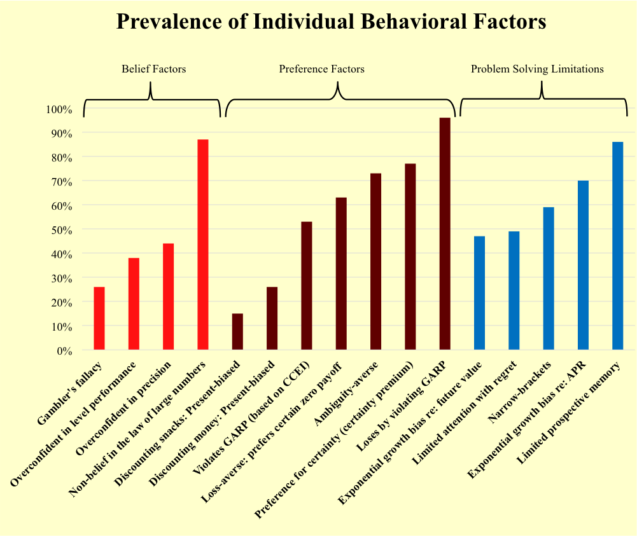

Slide 10
Summary Statistics: B-counts and -tiles

Slide 11
Linking B-factors and –stats to Outcomes
Key component of our survey parsimony and sufficient statistic parsimony tests are cross-section regressions of form:
Outcome, in this paper, is index of 9 indicators of financial condition
i indexes individuals (one obs per person)
Bfactor is a measure of single B-factor, (with a vector of all other B-factors), or one or more of our behavioral summary statistics (B-count or B-tile)
Bmiss is the count of B-factors for which we are missing data
X is vector of control variables for demographics (including income, education, state, etc.), other classical inputs including various measures of cognitive skills and classical preferences, measures of survey effort…

Slide 12
Outcome(s): Financial Condition
Elicited in our survey instrument, nine components, each 0/1:
Positive net worth
Positive retirement assets
Owning stocks
Spending less than income in the last 12 months
Financial satisfaction (above the median in our data)
Self-assessing retirement savings as “adequate” or better
Self-assessing non-retirement savings as “adequate” or better
Not experiencing severe financial distress in the last 12 months
Having self-assessed financial stress below the sample median
In primary model, use average of these at the level of the individual (mean=0.43)

Slide 13
Other Covariates: Demographics
Collected as a matter of course by ALP:
Age
Education
Income
Gender
Household size
Employment
Race/ethnicity
State of residence (FEs)
We include these as categorical, for flexibility
Have also used interactions

Slide 14
Still More Covariates: Other Classical Inputs
Risk aversion: Several measures, both inferred and self-assessed
Patience: Savings rate from the discounting questions
Cognitive skills: 4 short tests/quizzes
Fluid intelligence (number series)
Executive function (Stroop)
Numeracy (from Banks et al)
Financial knowledge/literacy (Lusardi-Mitchell “Big 3”)
In some empirics, use summary measure of “cognitive ability”

Slide 15
Still More Covariates: Survey Effort
We measure time spent on each survey question, “click to click”
Calculate total time spent on each set of b-factor question
Include decile indicators as controls for survey effort
Empirical patterns:
Survey time is highly correlated with “missing”
Conditional on non-missing, prevalence of some factors falls with time spent
Survey time is essentially uncorrelated with things like age, income, education

Slide 16
Survey Parsimony? Results encouraging
Prevalence and distributions match up well with prior work
High response rate, good data quality per standard checks
B-factors tend to be quite distinct from demographics and other classical decision inputs, in terms of fit
B-factors conditionally correlate with financial condition
5 of 16 coefficients on “standard” biases negative & stat sig
15 of 16 coefficients on standard biases negative
No strong pattern on “non-standard” biases

Slide 17
Summary Statistic Parsimony? Encouraging conditional correlations
B-counts & B-tiles strongly conditional correlate with outcomes
Driven by standard B-factor biases, not by non-standard ones
1 SD increase in B-count <-> 15% decrease in financial condition
Magnitude comparable to financial literacy measure, education, gender, age
Larger/more robust than coefficients on other classical inputs: patience, risk, fluid intelligence

Slide 18
Summary Statistic Parsimony? Encouraging R-squareds
B-counts & B-tiles help fit outcomes
R-squared of 0.11 on their own
Comps
Cognitive skills measures: 0.12
Income: 0.29
Non-income demographics: 0.22
Time spent on survey: 0.00
Classical measures of risk attitudes and patience: 0.00

Slide 19
Summary Statistic Parsimony? Encouraging robustness
Some key robustness checks
Omit cognitive skills (a la Altonji et al)
Math vs. non-math factors
“Hard” vs. “soft” outcomes
Splits by decile of time spent on survey (survey effort)

Slide 20
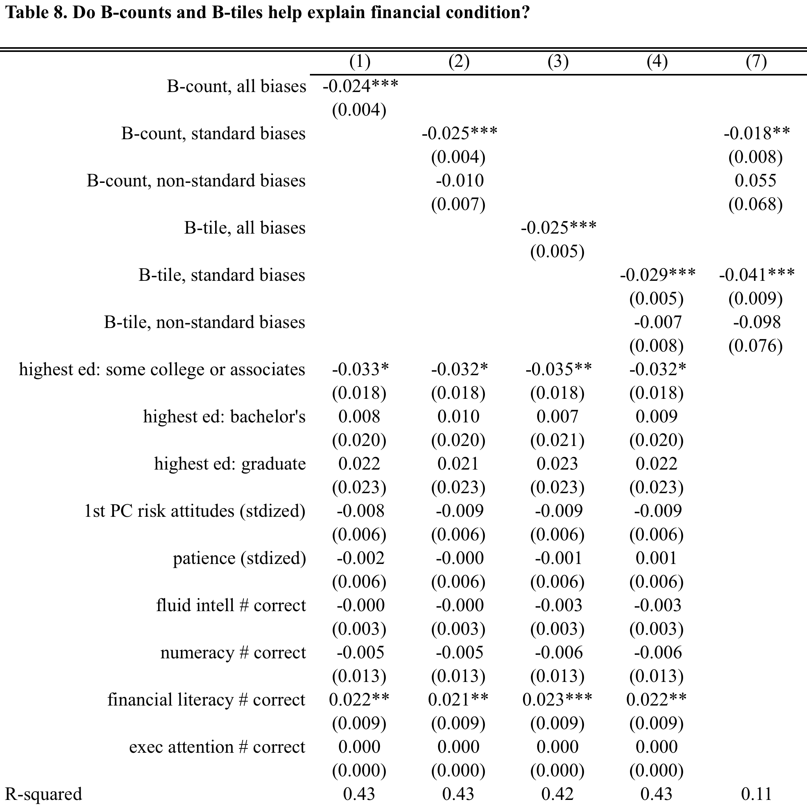

Slide 21
Common Factor Parsimony: Methods
Step 1: examine within-individual correlations between B-factors
Step 2: exploratory factor analysis to identify number of common factors
Step 3: confirmatory factor analysis using factors from Step 2, using Structural Equation Modeling (SEM)

Slide 22
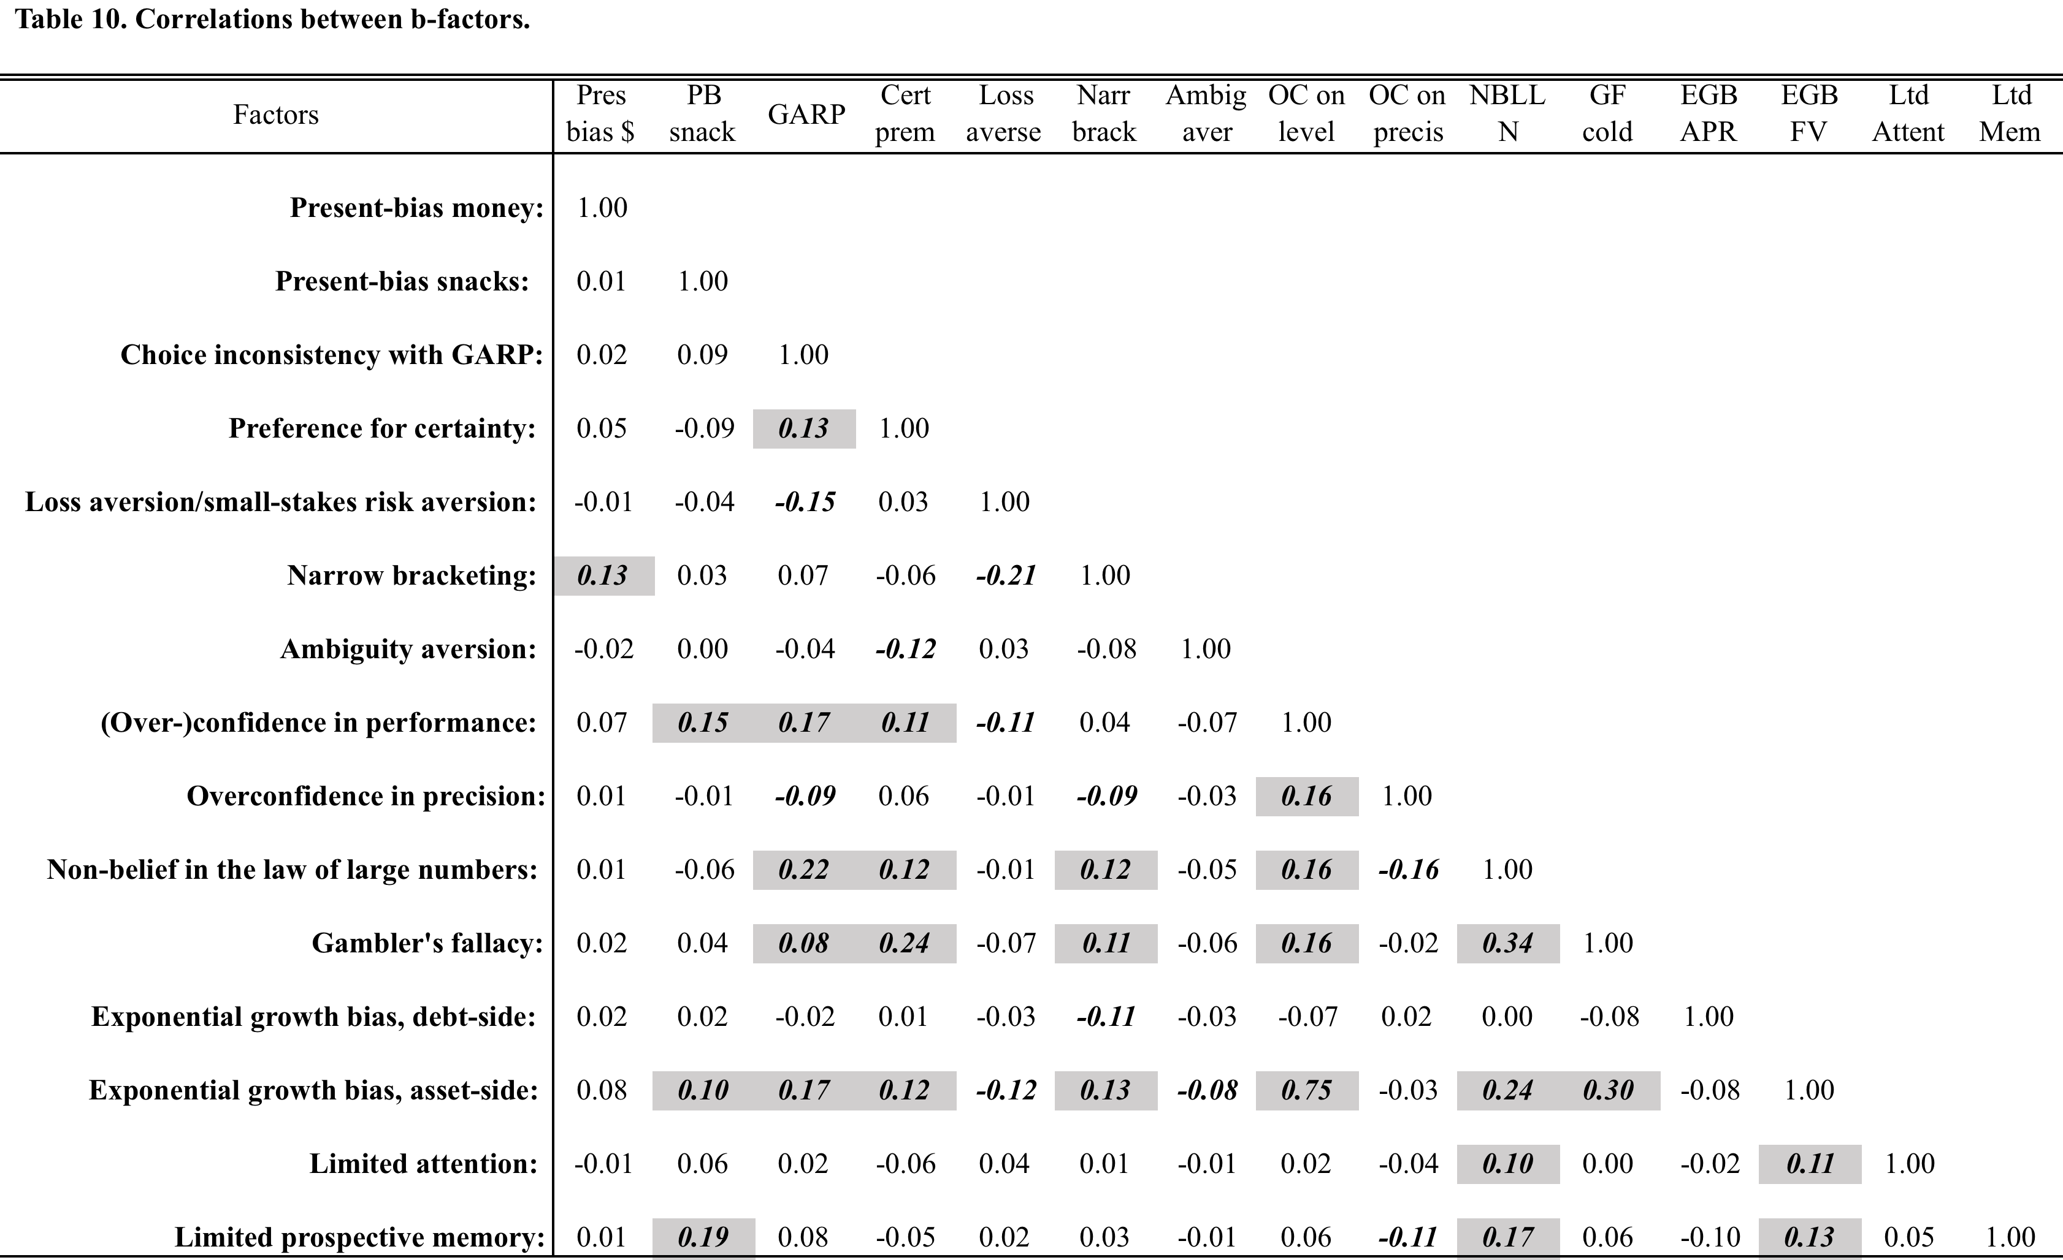

Slide 23
Common Factor Parsimony: Results
B-factors are positively correlated within individual, but
Not always (even between intuitively/theoretically linked factors)
Magnitudes modest for most part
Evidence of a common factor (or at most 3), but
Common factor does not correlate with outcomes conditional on other covariates (in contrast to the B-count and B-tile)
Common factor instead seems to pick up what’s already captured by cognitive skills measures (again in contrast to our B-stats)
=> B-factors are distinct decision inputs, rather than different manifestations of one or a few latent constructs
B-stats capture cumulative influence, not a measurement error correction

Slide 24
Summary of key findings
Survey parsimony? Yes.
Our lower-cost, lighter-touch elicitations yield informative measures of B-factors, of comparable quality to prior work
Summary statistic parsimony? Yes.
Two new summary measures of behavioral tendencies (the “B-count” and “B-tile”) are strongly and robustly negatively correlated with a multi-dimensional metric of financial condition
Common factor parsimony? Limited.
B-factors are (weakly) correlated with each other within-person
But unable to identify a lower-dimensional common factor that usefully correlates with financial condition
B-factors are relatively distinct decision inputs, as opposed to “different parts of the elephant”
At least with respect to the outcomes we’ve tested so far…

Slide 25
What it means, focusing on good news
Measuring behavioral inputs: new, cheaper methods
Modeling implications of behavioral factors.
Our results supports the two leading current approaches
Considering B-factors in relative isolation
Summarizing them using reduced-form statistics
Our methods provide new data, tools for building them out
Applying behavioral economics. Can use our elicitations, B-stats for:
Targeting (e.g., typing)
Policy/welfare analysis

