Slide 1
Your Money, Your Goals
A Financial Empowerment Toolkit
February 2017
Notes:
THIS SLIDE DECK SUPPORTS THE DECEMBER 2016 VERSION OF YOUR MONEY, YOUR GOALS, TRAINING OF TRAINERS VERSION.
INTRODUCTION TO YOUR MONEY, YOUR GOALS TRAINING MATERIALS
This PowerPoint presentation was created to train people to provide training to potential users of Your Money, Your Goals. Potential users of Your Money, Your Goals include anyone who works directly with people that have low-income or are economically vulnerable. They generally come from non-profit, community-based, or private sector organizations or city, county, or tribal government agencies. This packet includes the visual aids (PowerPoint slides) and facilitation guide (notes section of slides) necessary to conduct a total of 6 – 8 hours of training of trainers on Your Money, Your Goals.
Following a Your Money, Your Goals training of trainers, individuals will:
Understand the organization of Your Money, Your Goals: A financial empowerment toolkit,
Have strategies for providing training and using Your Money, Your Goals with the people they serve, and
Have the tools, knowledge, and confidence to provide basic financial empowerment services to the people they serve.
They will be know how to use the toolkit and train others on how to use the toolkit.
This training may be used without modification, but you may add activities that they feel are more relevant for the people you are training.
The training is organized into sections or activities associated with specific content modules. Each new section of the training begins with:
Estimated Time for the Section or Module
Section or Module #
Section or Module Title
Methodology or Description of the Type of Activities Used in the Section or Module (opener, facilitated discussion, small group exercise, role play, scenario analysis, etc.)
Corresponding Section in Your Money, Your Goals
Instructions for Facilitating the Activity
The facilitation instructions found in the notes section correspond to the visual aid presented on the slide.
NOTE: Individuals who facilitate this training should be experienced financial educators with practical experience and knowledge on a wide variety of financial education topics and training methodologies.
MATERIALS NEEDED FOR THE TRAINING
Following is a list of what will be minimally needed to facilitate the training:
A Training Space (more information on room set up follows)
Computer
LCD Projector
Projection Screen or Wall
Small Table for Projector and Computer
Extension Cords
Easel
Flip Chart Pad
Tape
Markers for Facilitator and Participants
Large Self-adhesive Notes (4” X 6” or 5” X 8”)
Need, Want, Obligation signs placed around room for group activity (Module 4)
Prepared flip chart for group exercises. See the following:
Introduction activity (Training Section 1)
Referral conversation (Training Section 4)
Protecting your identity carousel (Module 9, Tool 2)
Planning for large events (Module 1, Tool 2)
Savings and benefits (Module 2, Tool 2)
Copies of Managing cash flow scenario slides for participants (Rafael activity, Module 5)
Copies of Debt-to-income calculation activity slide for pairs of participants (Shawna DTI activity, Module 5, Tool 2)
One copy each banking service slide following Money services and banking basics slides for pairs of participants (See activity notes in Money services and banking basics slide for instructions)
Copies of the toolkit for each participant – Trainers will need to ensure copies are received from CFPB, or copies are printed, in advance of the training for each participant, or provide a link to each participant with instructions for downloading and printing or accessing electronically during the training.
Copies of Resource and Referral List (Use the Creating a Referral Guide resource to create this prior to the training)
Pre- and Post- Training Survey for each participant
If this is a training-of-trainers, also provide each attendee with a copy of the Trainer survey
Pre-, Post, and Trainer surveys, Implementation Guide, and other CFPB-created training resources can be downloaded at www.consumerfinance.gov/your-money-your-goals
ROOM SET UP
Room set up may be a function of the space trainers are able to secure for the training. Ideally, participants will be seated in groups of 4 – 7 participants around tables so they can work in teams or small groups. If at all possible, avoid theater style seating or arrangements that do not include a table for participants to work on.
TIPS FOR TRAINING PREPARATION
Tips for training preparation are included in the Your Money, Your Goals Implementation Guide. This document is available at www.consumerfinance.gov/your-money-your-goals.

Slide 2
DISCLAIMER
This presentation is being made by a Consumer Financial Protection Bureau representative on behalf of the Bureau. It does not constitute legal interpretation, guidance or advice of the Consumer Financial Protection Bureau. Any opinions or views stated by the presenter are the presenter’s own and may not represent the Bureau’s views.
This document includes links or references to third-party resources. The inclusion of links or references to third-party sites does not necessarily reflect the Bureau’s endorsement of the third-party, the views expressed on the third-party site, or products or services offered on the third-party site. The Bureau has not vetted these third-parties, their content, or any products or services they may offer. There may be other possible entities or resources that are not listed that may also serve your needs.

Slide 3
Your Money, Your Goals
Opening Activity
Notes:
Training Section 1: Intro Part 4: Money and Me
NOTE: BEFORE STARTING THIS ACTIVITY, DISTRIBUTE THE PRE-TRAINING ASSESSMENT.
EXPLAIN THE FOLLOWING:
After today, you will be prepared to conduct training to staff in your organization, network, or community.
To help the CFPB demonstrate changes in confidence and other results of your training, you will administer a pre-training and post-training assessment; you will also complete a trainer survey.
To ensure you are familiar with the surveys, we’re going to have you complete them today, too.
Give participants 2 – 4 minutes to complete the surveys.
ASK: Do you have any questions about the Pre-Training Survey?
NOTE: If you have another activity that is participatory and helps uncover emotional and cultural influences on financial decisions, you can feel welcome to substitute that activity for the one described in this training.
Having an activity prior to introductions is intentional in the design of the training. Having participants reflect on attitudes and feeling about money and emotional and cultural influences on financial decisions makes them more open to understanding those decision-making influences on the people they serve. In addition, they may become more open to applying Your Money, Your Goals to their own lives.

Slide 4
Money and me: Opening activity
List all of the words, phrases, sayings, songs, or other associations you have with the word money.
Notes:
Training Section 1: Intro Part 4: Money and Me CONTINUED
Estimated Time: 20 Minutes
Methodology: Opener—Contest
Corresponding Section in toolkit: Introduction Part 4: Emotions, values, and culture: What’s behind our money choices? (Page 53)
Instructions for Facilitator:
Instruct participants to work in small groups.
Give each group a flip chart and marker.
Instruct them to brainstorm all of the associations they have with money per the PowerPoint slide on their flip chart paper.
Tell them the winning group is the one with the most associations.
Give them 2.5 to 3 minutes.
Call time and ask groups to count up the total items listed and write the number on their flip charts.
Congratulate winning team.
Hang up their flip chart.
Ask other teams to add items they feel are missing from the list.
Go through many of the ideas (not all) and ask the large group to indicate whether the association is positive or negative with a thumbs up or thumbs down, respectively.
Based on majority vote, write “+” or “-” next to each entry on the flip chart.
If there is a lot of disagreement about an entry, facilitate a short discussion about the disagreement and write “?” next to those about which there does not seem to be agreement.

Slide 5
Money and me: Opening activity
money
any generally accepted medium
of exchange
Notes:
Training Section 1: Intro Part 4: Money and Me CONTINUED
Opener (Introduction Part 4)
Show and read the definition of “Money.”
Contrast the definition of money to the list of associations generated by the team by asking: “How did we get from this simple definition of money to all of these positive and negative associations?”

Slide 6
Money: What does it mean?
Where do associations about money come from?
How do these associations reflect attitudes and feelings about money?
How are attitudes and feelings related to behaviors and actions?
What does this mean when we are working with the people we serve?
Notes:
Training Section 1: Intro Part 4: Money and Me CONTINUED
Opener (Introduction Part 4)
Ask some or all of the questions listed to facilitate a discussion.
Where do associations about money come from?
Be sure to add the following if not contributed by participants: family, peers, school, media, government, businesses, communities of faith, social and service organizations. Ask people for specificity including examples of how family or peers or media, for example, may create lasting associations about money for people.
How do these associations reflect attitudes and feelings about money?
Be sure to add the following if not contributed by participants: Our attitudes and feelings about money may be rooted in some of these associations.
How are attitudes and feelings related to behaviors and actions?
Be sure to add the following if not contributed by participants: Our behaviors and actions are often driven by our attitudes and feelings. This is part of the reason our knowledge—what we know is good practice with money—and our actions do not line up.
So what does this mean when we are working with the people we serve?
Be sure to add the following if not contributed by participants: While it’s easy to think about financial empowerment as providing people with information and opportunities to develop financial management knowledge and skills, financial empowerment must also consider and help people understand some of the underlying attitudes and feelings about money and how these impact practices and behaviors today. Attitudes and feelings may drive practices and actions. Understanding the origins of attitudes and feelings about money can help people understand the reasons behind some of their actions and makes changes if they want to make changes.
Be sure to highlight cultural differences based on socio-economic status, ethnicity, region, and age.
Summarize by sharing:
Attitudes and beliefs about money may drive behavior. Understanding origins of these attitudes and beliefs can help you better understand what influences some productive and unproductive money practices. It is also important to understand your own attitudes or biases around money and financial issues—this can help ensure you do not judge someone for their:
Financial situations
Current financial practices
Past financial decisions
Their current financial goals

Slide 7
Your Money, Your Goals
Overview of the training and introductions

Slide 8
Training purpose
To provide you with:
An orientation to Your Money, Your Goals, a financial empowerment toolkit;
An overview of the training for service providers;
Strategies for using the toolkit, and
The tools, knowledge, and confidence to use the toolkit and provide training on the use of the toolkit to your staff or partners in your community or state.
Notes:
Training Section 2: Overview of the Training and Introductions
Estimated Time: 10 Minutes
Methodology: Presentation / Icebreaker (Introduction Activity)
Corresponding Section in toolkit: Introduction Part 1: Introduction to the toolkit (Page 9)
Instructions for Facilitator:
Review training purpose: To provide you with an orientation to Your Money, Your Goals, an overview of the training, strategies for using the toolkit, and the tools, knowledge, and confidence to provide financial empowerment services to the people you serve and provide this training in your community.

Slide 9
Training objectives
By the end of the training, you will be able to:
Describe ways to approach integration of Your Money, Your Goals into your work including how to use the toolkit as a complementary resource to other financial capability training and materials.
Describe the purpose of the Consumer Financial Protection Bureau (CFPB) and its rationale for developing Your Money, Your Goals.
Explain the overall organization and content of Your Money, Your Goals.
Explain the tools and resources you have to plan and implement the training for Your Money, Your Goals.
Describe the overall flow of the training, including key activities and methodologies used throughout the Your Money, Your Goals training.
Notes:
Training Section 2: Overview of the Training and Introductions
Presentation (Introduction Part 1)
Explain that the purpose of the training is like the mission—overall what the training is trying to do.
Explain that objectives are the specific things they will know or be able to do as a result of the training.
Review objectives. Be sure to paraphrase, not read.

Slide 10
Training objectives
By the end of the training, you will be able to:
Increase your knowledge about effective and engaging ways to deliver training.
Explain key financial empowerment concepts presented in Your Money, Your Goals.
Access and use tools and materials available at www.consumerfinance.gov.
Take action to equip frontline staff and volunteers with Your Money, Your Goals through your own trainings and one-on-one instruction, so that they can use the toolkit in their work.
Notes:
Training Section 2: Overview of the Training and Introductions
Presentation (Introduction Part 1)
Review objectives. Be sure to paraphrase, not read.

Slide 11
Introduction activity
Share name
Organization
“What do you expect or hope to get from this training?”
Notes:
ACTIVITY: Training Section 2: Overview of the Training and Introductions
Icebreaker
Invite participants to introduce themselves to the group by sharing their name, their organization, and sharing: “What do you expect or hope to get from this training?”
Write their expectations or hopes on flip chart paper. Revisit these at the end of the training to check in as to whether the training met their expectations or hopes for the training.
NOTE: Try to encourage people to be brief and avoid sharing the details of their roles and responsibilities at work as well as details about what their organization does – otherwise you will have difficulty keeping on the training schedule. It is important NOT TO SKIP introductions because you are concerned about time. Participants are accustomed to some level of introduction in convenings. This is even more important if the group represents a heterogeneous mix of participants and organizations.
Alternative Approaches to the Introductions:
Meet and Mix at the Table—An Alternative for Large Groups (more than 25 to 30 participants)
Ask participants to share their names, organizational affiliations, and training expectations to the other participants sitting at their table.
Ask the group to find one thing all of them have in common. You can ask them to identify a common characteristic around one topic area (money) or leave it wide open to facilitate rapid sharing within the tables.
Provide teams with about 7 – 9 minutes to work in groups—share name, etc. and work to find an item they have in common.
Ask each table to share the item they have in common.
Write these on flip chart.
After the sharing is complete, write ”the ability to use Your Money, Your Goals with the people we serve” on the list of items they have in common and explain that they will all have this in common by the end of the training.
Vote with Your Body (for smaller groups—less than 20 to 25 participants)
Develop a list of questions that have four answers to them. For example:
What season does your birthday fall within? Spring, Summer, Fall, Winter
What is the most important financial empowerment topic for the people you serve? Budgeting, Credit, Debt Management, Consumer Protection
How long have you worked with your organization? I just started, Less than 1 year, 1 – 3 years, more than 3 years
You can include questions about sports teams people may support in your area, local food that is their favorite, favorite book or movie genre, the item they would want with them if stranded on a desert island, etc.
Write the answers for the questions on flip charts. Be sure that the answers to one question are written on four different flip charts. Then add one answer from the next question on each flip chart and so on. For the activity, ask people to stand under the flip chart that best represents their answer to the question you read. Then, have the smallest grouping of individuals introduce themselves by sharing their name and organizational affiliation. Then read the next question and repeat the process. If someone is in the group introducing themselves that has already shared their information, you can skip them to ensure everyone has a chance to introduce themselves.
With the final question, be sure to have anyone who has not introduced themselves share their information whether they are in the group that is introducing themselves or not.

Slide 12
Training presenter
The Consumer Financial Protection Bureau created the Your Money, Your Goals toolkit for consumers, as well as the training materials presented today. These materials are being presented to you by a local organization. The organizations or individuals presenting these materials are not agents or employees of the CFPB, and their views do not represent the views of the Bureau. The CFPB is not responsible for the advice or actions of these individuals or entities. The Bureau appreciates the opportunity to work with the organizations that are presenting these materials.
Notes:
Training Section 2: Overview of the Training and Introductions
Presenter
Paraphrase this disclaimer for the group and briefly share information on the organization with which you are associated.
Note: Even though this slide has a lot of text, the entire disclaimer should be included visually during the training.

Slide 13
Your Money, Your Goals
Introduction to the CFPB and financial empowerment

Slide 14

Introduction to the CFPB
Consumer Financial Protection Bureau
The CFPB’s mission is to make markets for consumer financial products and services work for Americans.
Notes:
Training Section 3: Introduction to the CFPB and Financial Empowerment
Estimated Time: 30 - 40 Minutes
Methodology: Presentation/Facilitated Discussion / Debate or Large Group Brainstorm / Carousel
Corresponding Sections in toolkit: About the Consumer Financial Protection Bureau (Page 1)
Instructions for Facilitator:
Introduce key facts about the CFPB using information from Introduction Part 1 and the slides.
Share additional information about the CFPB: The CFBP is working to ensure that consumers get the information they need to make financial decisions they believe are best for themselves and their families – that prices are clear up front, that risks are visible, and that nothing is buried in fine print.
Explain that a key goal of the training is to connect frontline staff to CFPB resources, including Consumer Response.

Slide 15



CFPB’s work
Empower
Enforce
Educate
Notes:
Training Section 3: Introduction to the CFPB and Financial Empowerment
Use the following information to explain the CFPB:
To achieve this vision, the CFPB works to:
Empower: The CFPB creates tools, answers common questions, and provides tips that help consumers navigate their financial choices and shop for the deal that works best for them.
Enforce: The CFPB takes action against predatory practices and companies that violate the law and have already returned billions of dollars to harmed consumers.
Educate: The CFPB encourages financial education and capability from childhood through retirement, publish research, and educate financial companies about their responsibilities.
In a market that works, the prices, risks, and terms of the deal are clear upfront so that consumers can understand their options and comparison shop.
Companies all play by the same consumer protection rules and compete fairly on providing quality and service.

Slide 16
Office of Financial Empowerment
Part of the CFPB’s Division of Consumer Education and Engagement
Serves populations who lack full, affordable access to financial services
  Low- to moderate-incomes
  Low wealth
  Otherwise financially underserved or vulnerable
Notes:
Training Section 3: Introduction to the CFPB and Financial Empowerment
Use the following information to explain the CFPB:
The Office of Financial Empowerment serves the variety of populations who lack full, affordable access to financial services, including people with low- to moderate-incomes; low wealth, and people who are in other ways financially excluded or vulnerable. By any measure, the numbers of consumers whose income level contributes to financial fragility constitutes a significant portion of the U.S. population.
According to 2013 data from the U.S. Census Bureau, some 45.3 million people, including children, live in households that have incomes below the federal poverty level, while another 87.5 million live between 100 and 200 percent of their poverty threshold.
The CFPB created Your Money, Your Goals to reach these consumers by empowering those that serve them: frontline nonprofit or tribal social service staff, community volunteers, staff in legal aid organizations, and people that serve workers. By providing these intermediaries with high quality information, they have the tools and resources to start the financial conversation with the individuals they already serve. And the training provides them the confidence to use these tools and resources. The training that you will ultimately provide to them.

Slide 17
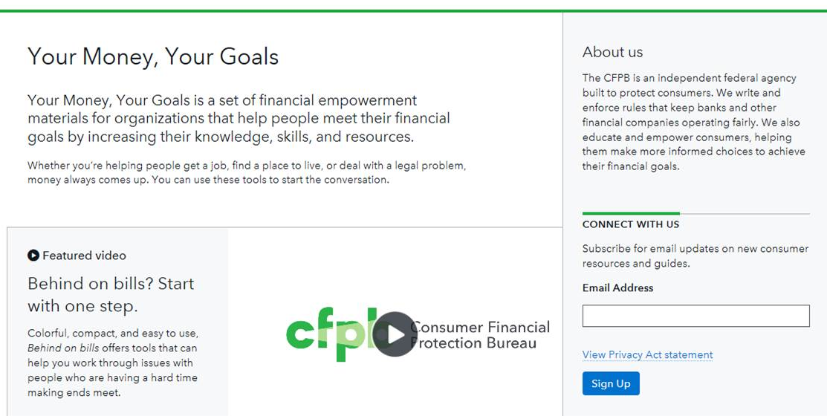
Your Money, Your Goals
Notes:
Training Section 3: Introduction to the CFPB and Financial Empowerment
Facilitated Discussion and Presentation (About the Consumer Financial Protection Bureau)
Review where to find Your Money, Your Goals
http://www.consumerfinance.gov/your-money-your-goals/
Review signing up for the mailing list, which will include updates to Your Money, Your Goals, additional training opportunities, and other important and helpful information from the CFPB.

Slide 18
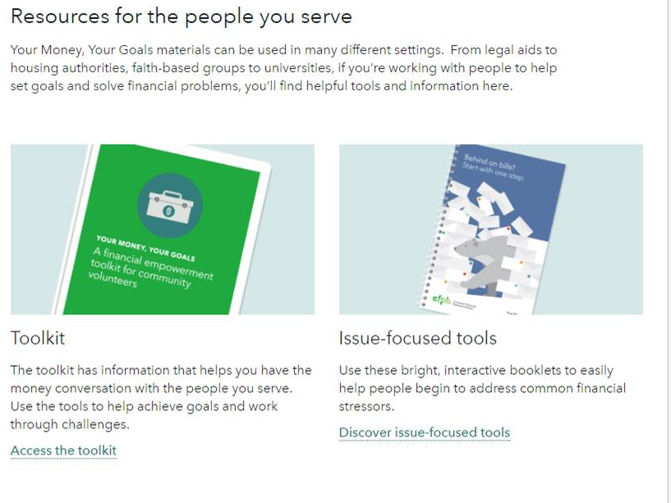
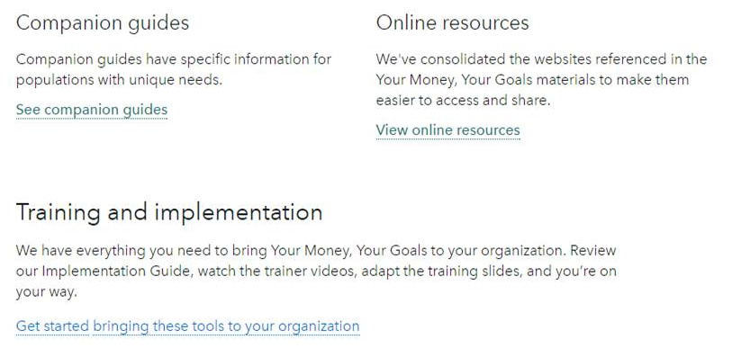
Getting the toolkit
Notes:
Training Section 3: Introduction to the CFPB and Financial Empowerment
Facilitated Discussion and Presentation (About the Consumer Financial Protection Bureau)
Review each resource or tool on the Your Money, Your Goals landing page using the following:
First you have the toolkit. This document contains all of the narrative information and tools for service providers to use with the people they serve. This is a PDF file that you can download. You can print the whole toolkit or just the sections or individuals tools you need by referring to the table of contents. The toolkit is also available in Spanish.
Under the Training section, you will find all of the material you need to plan and deliver the training. The training guide is a PPT presentation with all of the facilitation instructions in the notes section of the PPT.
Contextualization and customized information and tools for specific populations is provided in shorter companion guides. The one of these guides, Your Money, Your Goals: Focus on Native Communities is shown in this screenshot.
Review the Implementation and the Creating a Referral Guide.
Review the Follow-up Resources
NOTE: If you have access to an Internet connection during the training, it can be useful for participants to see you move through the website to the complaint and show some of the features of this section of the CFPB’s website live.

Slide 19
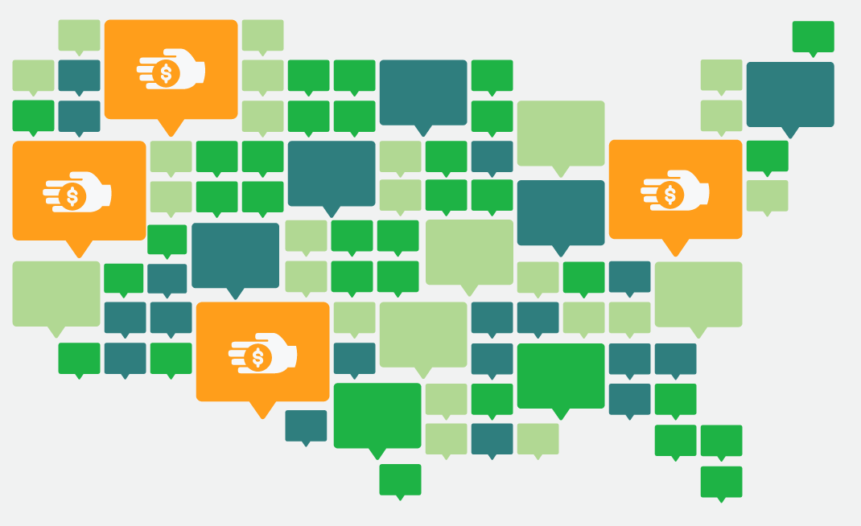
Debt Collection Stories
Tell your story.
The more we hear from you, the more insight we gain into what’s happening in the financial world and how it’s affecting you. Your experience will help inform how we work to protect consumers to create a fairer marketplace.
Both consumers dealing with debt collection, and front-line staff that work with them to help solve issues, are invited to share their stories and add their voice.
Tell your story today ➔

Slide 20
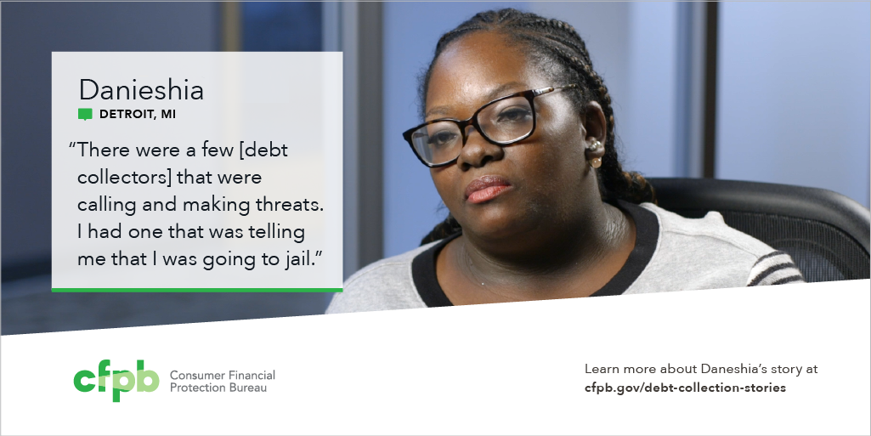
Debt Collection Stories
After losing her job, Danieshia explains that she was unable to pay her debts and soon found herself being threatened with jail by a debt collector.
Watch Danieshia’s Story

Slide 21
Financial empowerment
What is financial empowerment?
How is it different than financial education, financial literacy, financial capacity, or other commonly used terms?
Skill and confidence to use knowledge
Financial empowerment
Financial literacy
=
Notes:
Training Section 3: Intro Part 1: Introduction to the CFPB and Financial Empowerment
Facilitated Discussion and Presentation (Introduction Part 1, Page 9)
NOTE: Use the animations in this slide to guide the questions and discussion
Transition by reminding participants that an informed consumer is the best defense and that Your Money, Your Goals was developed by CFPB’s Office of Financial Empowerment.
ASK: What is financial empowerment?
Write their ideas on flip chart paper.
ASK: How is it different from financial education, financial literacy, financial capability, or other commonly used terms?
Ask them how financial empowerment is different from other commonly used terms: financial education, financial literacy, financial capability, financial fitness, financial coaching, and so on.
NOTE: It may be helpful to differentiate strategy terms (financial education, financial coaching, financial counseling) from outcome-based terms (financial literacy, financial capability, financial fitness).
Share definition of financial empowerment using the slide and information from the Introduction Part 1
Financial empowerment includes financial education and financial literacy, but it focuses both on building your skills at managing money and using financial services and on helping to access products that work for you.
When you are financially empowered, you are both informed and skilled. You know where to get help with your financial challenges and can access and choose financial products and services that meet your needs. This sense of empowerment can build confidence that you can effectively use your financial knowledge, skills, and resources to reach your goals.
NOTE: Consider writing this definition on a flip chart and leaving it posted throughout the training.
Share the relationship of financial empowerment to financial education and financial literacy using the slide and information.
Explain that financial education, which is inclusive of other strategies, such as coaching, counseling, technology-based approaches, and so on, leads to financial literacy and that financial literacy plus confidence—the confidence to make decisions and use knowledge, skills, and tools including financial products and services—is financial empowerment.

Slide 22
Financial empowerment and service providers
Trust
Opportunities for providing financial empowerment
Access
=
‘’
Notes:
Training Section 3: Intro Part 1: Introduction to the CFPB and Financial Empowerment
Presentation (Introduction Part 1) (Page 9)
Explain rationale for Your Money, Your Goals using slide and information from Introduction Part 1: Introduction to the toolkit.
Be sure to highlight that:
As a trusted source of information and resources, you are in a good position to provide financial empowerment services to the people you serve. You have access to and the trust of many people that would benefit from financial empowerment services.
Review the intended audience of Your Money, Your Goals using slide and definition in text box in Introduction Part 1.
This toolkit is designed for anyone who works directly with people that have low-income or are economically vulnerable that are served by a wide range of organizations and on a broad range of issues.
Users of this toolkit may have different titles, but you generally come from non-profit, community-based, or private sector organizations or city, county, or tribal government agencies, and are generally responsible for working with people to:
Conduct needs assessments
Develop action plans
Provide resources and referrals needed to implement action plans
Monitor progress and evaluate results
After reviewing intended audience for the toolkit, ask participants: “Given this explanation, are you within the target audience for this toolkit?” Instruct participants to raise their hands if the answer to this question is “yes.”
Facilitate a dialogue with those participants who do not see themselves reflected in this definition using questions such as:
“How is your job fundamentally different from the functions described?”
“How do you feel this kind of toolkit may benefit your work even though you see yourself as outside the target audience for the toolkit?”
NOTE: In all likelihood, participants may not identify as being within the target audience if they have a supervisory role to staff that provide direct service, or they see their job as encompassing more than the broad functions listed here. It is important to help them identify how they are within the target audience for the toolkit.

Slide 23
Debate
Team 1
As service providers, we
should provide financial empowerment information and tools to the people we serve.
Team 2
As service providers, we
should not provide financial empowerment information and tools to the people we serve.
Notes:
Training Section 3: Intro Part 1: Introduction to the CFPB and Financial Empowerment
NOTE: Prior to the training, select either Option A (Debate ) or Option B (Benefit/Cost Analysis )—not both—for use in your workshop.
OPTION A: Debate (Introduction Part 1)
Give half of the room time to discuss the reasons they think they SHOULD provide financial empowerment services to the people they serve
Give the other half of the room time to discuss the reasons they think they SHOULD NOT provide financial empowerment services to the people they serve.
They should each elect one person to provide a 2 minute presentation of key points defending their positions. Instruct them to use visual aids (flip chart) to highlight key points.
Have each group present.
Summarize pros and cons to service providers taking on the role of providing financial empowerment to the people they serve.
NOTE: If you have more than 20 people in your training, consider two teams for each “side” of the debate.

Slide 24
Benefit / Cost analysis
What are the benefits of financial empowerment
For you?
For the people you serve?
For your program?
What are the costs of financial empowerment
For you?
For the people you serve?
For your program?
Notes:
ACTIVITY: Training Section 3: Intro Part 1: Introduction to the CFPB and Financial Empowerment CONTINUED
OPTION B: Benefit/Cost Analysis in Large Group or Small Groups (Introduction Part 1)
Using flip charts (one for benefits, one for costs), have participants brainstorm the benefits and costs of providing financial empowerment.
Summarize benefits and costs to this role.
NOTE: This can be done as a large group with facilitator writing or in small groups with each group completing its own benefit/cost analysis.
NOTE: This can also be set up as a carousel. Set up 6 flip charts throughout the room. Have one question written on each flip chart as follows:
Flip Chart 1: What are the benefits of financial empowerment for you?
Flip Chart 2: What are the costs of financial empowerment for you?
Flip Chart 3: What are the benefits of financial empowerment for the people you serve?
Flip Chart 4: What are the costs of financial empowerment for the people you serve?
Flip Chart 5: What are the benefits of financial empowerment for your program/organization?
Flip Chart 6: What are the costs of financial empowerment for your program/organization?
Instruct participants to count off to six and assemble based on their numbers. Have group 1 start at flip chart 1, group 2 at flip chart 2, and so on with one marker per group. Give them 1 minute to brainstorm all the responses they can think of to the question on the flip chart. After 1 minute (adjust this as necessary), call time and instruct groups to rotate to the next flip chart (group 1 goes to flip chart 2, group 2 goes to flip chart 3, and so on). Instruct teams to ADD TO the ideas contributed before them. Continue until each group has visited each flip chart. Review contributions.

Slide 25
Your Money, Your Goals
An orientation to the toolkit and the training

Slide 26
Organization of Your Money, Your Goals
Introductory modules
  Introduction Part 1: Introduction to the toolkit
  Introduction Part 2: Understanding the situation
  Introduction Part 3: Starting the money conversation
  Introduction Part 4: Emotions, values, and culture: What’s behind our money choices?
Notes:
Training Section 4: Intro Part 1: An Orientation to the toolkit and the Training
Estimated Time: 60 Minutes
Methodology: Presentation / Scavenger Hunt / Large Group or Small Group Discussion
Corresponding Sections in toolkit: The entire toolkit will be used in this section of the training.
Instructions for Facilitator:
Review organization of the toolkit using slide and information in the Table of contents.
Explain that About the Consumer Financial Protection Bureau starts on page 1 of the toolkit and precedes the Table of contents and Introduction Modules.
Review the purpose of the toolkit: The goal of Your Money, Your Goals is to improve outcomes by making it easier for you to help the people you serve become more financially empowered.

Slide 27
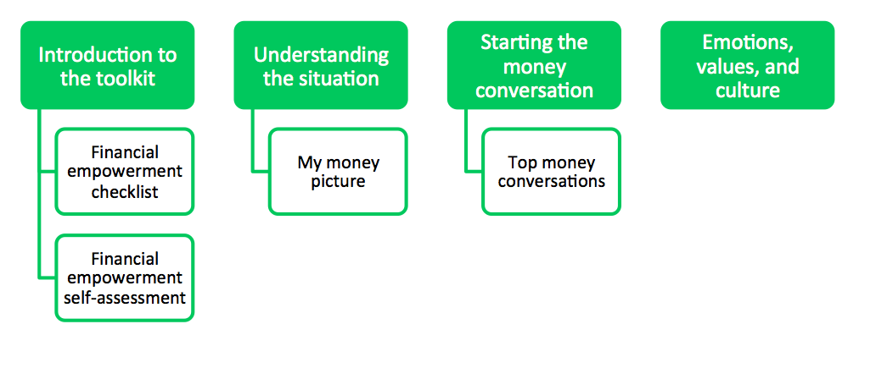
Organization of Your Money, Your Goals
Notes:
Training Section 4: Intro Part 1: An Orientation to the toolkit and the Training
Estimated Time: 60 Minutes
Methodology: Presentation / Scavenger Hunt / Large Group or Small Group Discussion
Corresponding Sections in toolkit: Table of contents
Instructions for Facilitator:
Review organization of the toolkit using slide and information in the Table of contents.
Review the purpose of the toolkit: The goal of Your Money, Your Goals is to improve outcomes by making it easier for you to help the people you serve become more financially empowered.

Slide 28
Organization of Your Money, Your Goals
Content modules
  Module 1: Setting goals and planning for large purchases
  Module 2: Saving for the emergencies, bills, and goals
  Module 3: Tracking and managing income and benefits
  Module 4: Paying bills and other expenses
  Module 5: Getting through the month
  Module 6: Dealing with debt
  Module 7: Understanding credit reports and scores
  Module 8: Money services, cards, accounts, and loans: Finding what works for you
  Module 9: Protecting your money
Resources
Notes:
Training Section 4: Intro Part 1: An Orientation to the toolkit and the Training
Presentation (Table of contents)
Review organization of the toolkit using slide and information in the Table of contents.
Review the purpose of the toolkit: The goal of Your Money, Your Goals is to improve outcomes by making it easier for you to help the people you serve become more financially empowered.
Explain the following key points:
Do not treat the toolkit like a curriculum.
Provide the right content and tools at the right time.
Use individual discussions or assessments to figure out where to start.

Slide 29
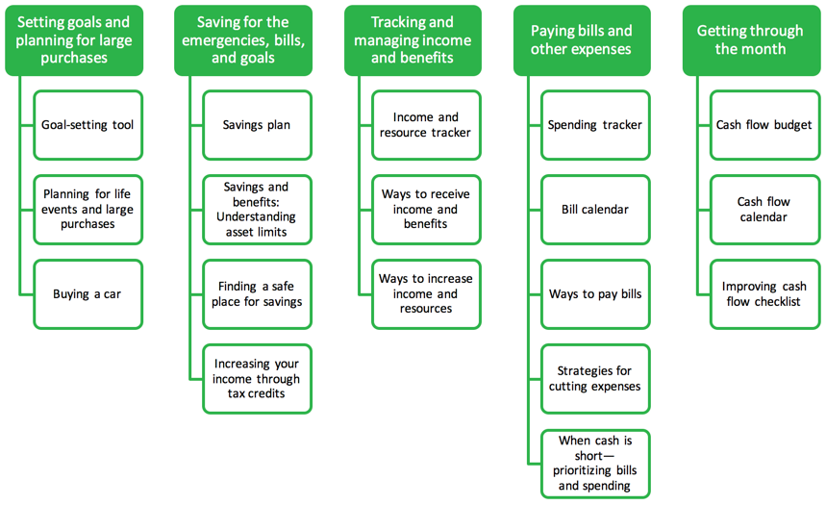
Organization of Your Money, Your Goals
Notes:
Training Section 4: Intro Part 1: An Orientation to the toolkit and the Training
Presentation (Table of contents)
Review organization of the toolkit using slide and information in the Table of contents.
Review the purpose of the toolkit: The goal of Your Money, Your Goals is to improve outcomes by making it easier for you to help the people you serve become more financially empowered.

Slide 30
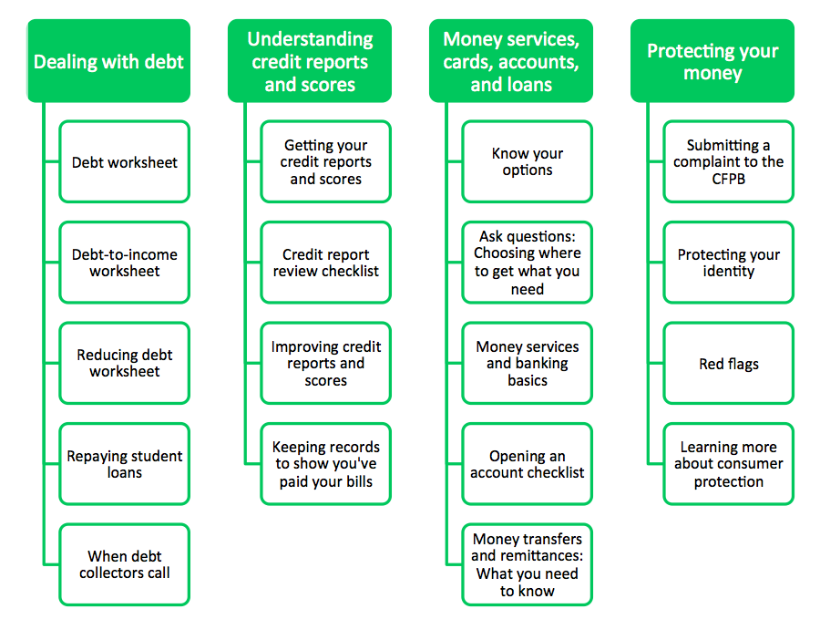
Organization of Your Money, Your Goals
Notes:
Training Section 4: Intro Part 1: An Orientation to the toolkit and the Training
Presentation (Table of contents)
Review organization of the toolkit using slide and information in the Table of contents.
Review the purpose of the toolkit: The goal of Your Money, Your Goals is to improve outcomes by making it easier for you to help the people you serve become more financially empowered.

Slide 31
Where would you start if someone...
Felt overwhelmed by debt?
Felt like she couldn’t make ends meet?
Wants to buy a car and get the best rate she can for the money she must borrow?
Wants to understand direct deposit and payroll cards?
Has used high-cost credit products in the past and wants to avoid these in the future?
Wants to make changes but does not have clear goals?
Has no savings but wants to start?
Wants to open an account but doesn’t know what kind of account or where?
Notes:
Training Section 4: Intro Part 1: An Orientation to the toolkit and the Training
Scavenger Hunt (Entire toolkit)
Explain that they will be going on a scavenger hunt through the toolkit.
Instruct small groups to review each question and to locate the module and specific tools within the module that address each question.
Instruct participants to write their answers to each question on a flip chart using markers.
Provide teams 15 - 20 minutes to complete.
Ask participants to share answers; use answer key (below) to augment their solutions.
Following answers, ask participants to share reactions or questions they may have regarding the toolkit, given the scavenger hunt through it.
NOTE: Answer key follows. Participants may have answers that vary. If they do, ask them to explain the reason they chose the module and tool.
1. Felt overwhelmed by debt?
Module 6: Dealing with debt and Tool 3: Reducing debt worksheet (Page 211)
2. Felt like she couldn’t make ends meet? (ANY OF THESE ANSWERS IS ACCEPTABLE)
Module 3: Tracking and managing income and benefits and Tool 3: Ways to increase income and resources (Page 133)
Module 4: Paying bills and other expenses and Tool 1: Spending tracker, 4: Strategies for cutting expenses, and 5: When cash is short (Pages 143, 155, 161)
Module 5: Getting through the month and Tool 1: Cash flow budget, 2: Cash flow calendar, and 3: Improving cash flow checklist (Pages 165, 175, 179)
3. Wants to buy a car and get the best rate she can for the money she must borrow?
Module 1: Setting goals and planning for large purchases and Tool 3: Buying a car (Page 79)
Module 7: Understanding credit reports and scores, and Tool 3: Improving your credit reports and scores (Page 259)
4. Wants to understand direct deposit and payroll cards?
Module 3: Tracking and managing income and benefits and Tool 2: Ways to receive income and resources (Page 127)
5. Has used high-cost credit products in the past and wants to avoid these in the future? (ANY OF THESE ANSWERS IS ACCEPTABLE)
Module 2: Saving for emergencies, bills, and goals and Tool 1: Savings plan (Page 99)
Module 5: Getting through the month and Tool 1: Cash flow budget or 2: Cash flow calendar (Page 165 and 175)
Information on avoiding debt traps and alternatives to high-cost credit in Module 6: Dealing with debt (Pages 191 and 192)
6. Wants to make changes, but does not have clear goals?
Module 1: Setting goals and planning for large purchases, Tool 1: Goal-setting tool (Page 69)
7. Has no savings but wants to start?
Module 2: Saving for emergencies, bills, and goals and Tool 1: Savings plan (Page 99)
8. Wants to open an account but doesn’t know what kind of account or where?
Module 8: Money services, cards, accounts, and loans and Tools 1: Know your options, 2: Ask questions, 3: Money services and banking basics, or 4: Opening an account checklist (Pages 281, 287, 291, 299)

Slide 32
What would you do if someone...
Wants to file for bankruptcy?
Wants to know how to respond to a creditor’s threat to sue?
Is facing eviction?
Is facing foreclosure?
Is not able to provide enough food for herself and other members of her household?
Is in danger of losing her car due to nonpayment?
Wants to take out a debt consolidation loan?
Wants to know how to finance her child’s college?
Notes:
Training Section 4: Intro Part 1: An Orientation to the toolkit and the Training
Large Group or Small Group Discussion (Introduction Part 1)
Have participants determine what they would do in each situation using one of two approaches:
Discuss as a large group. Write their ideas for each question on a flip chart (this will begin the process of them seeing their resource and referral network as well as when they should refer on).
Discuss as a small group and report out to the large group. Instruct groups to write their ideas on a flip chart using markers. Have each team report out on one of the questions. Have other groups add to their reports based on their own small group discussions.
NOTE: If you are pressed for time, consider covering this quickly by asking for discussion about one, two or three of the questions on the slide. This would probably be enough for most people to understand that many financial empowerment topics require specialized knowledge and expertise to properly address and still provide a great segue into a discussion about a resource and referral guide.

Slide 33
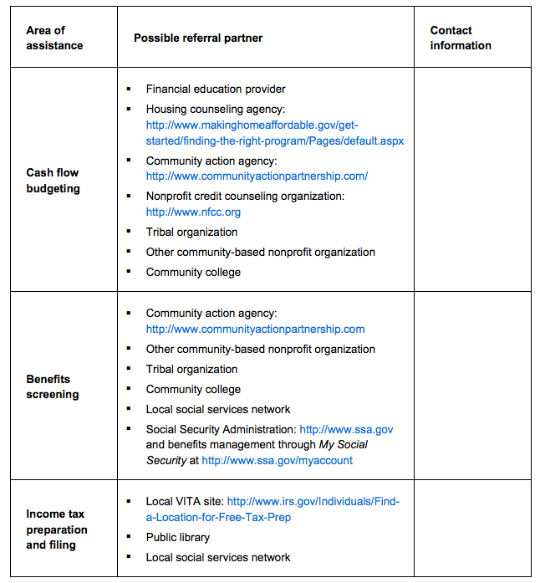
Creating a Referral Guide
Notes:
Training Section 4: Intro Part 1: An Orientation to the toolkit and the Training
Large Group or Small Group Discussion (Introduction Part 1)
Review the template included in the supplemental “Creating a Referral Guide.”
Summarize by sharing:
People may look to you or others in your organization for quality information on a variety of topics.
But some people may need more help—help you may not feel comfortable providing—because it is technical, beyond what you feel comfortable addressing, or not available within your organization.
Because the people you serve trust you, they look to you for quality information and referrals on topics. This is where a high quality resource and referral network will be essential to your work in the community.
NOTE: The financial educator providing this training should work with the organization being trained ahead of time to create the Referral Guide. They are either the primary person responsible for creating a relevant resource and referral list or should assist the organization in creating an effective guide. For more help on this, see the special module on Creating a Referral Guide. A financial empowerment-specific resource and referral list is important because general resource lists may result in frustration for people—some organizations that say they provide financial education, counseling, and coaching may not have adequate experience or staffing to handle referrals.

Slide 34
Financial empowerment checklist
The goal is not to cover all of the tools with each person.
Instead, find the right module or tools based on:
  Their most pressing financial empowerment problem
  The area in which they’ve expressed an interest in getting more help
Notes:
Training Section 4: Intro Part 1: An Orientation to the toolkit and the Training
Presentation (Introduction Part 1, Tool 1)
Explain that the purpose of this tool is to provide you with a tracking template to use with people—it’s a simple way to keep track of the tools or information shared with a particular person, collect output level data, and connect one meeting to the next.
Ask participants to open their toolkits to the tool and review it with the participants.

Slide 35
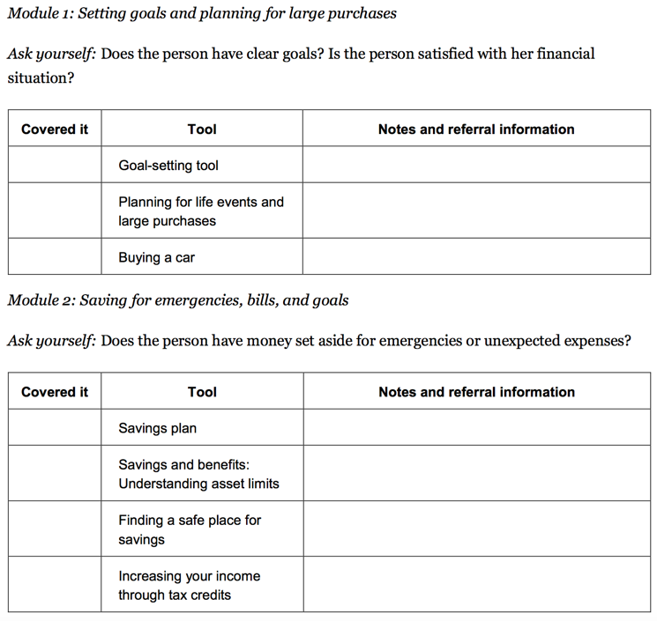
Intro Part 1, Tool 1: Financial empowerment checklist
Print off and keep with an individual’s file if appropriate
Use to connect meetings you’ve had
Notes:
Training Section 4: Intro Part 1: An Orientation to the toolkit and the Training
Presentation (Introduction Part 1, Tool 1)
Explain the Financial Empowerment Checklist. Point out:
Question related to financial empowerment issue addressed in module
Space to write notes regarding information or tools provided
Space to check or write date tool used
Explain the rationale for this tool :
It is designed to help identify the financial empowerment information and tools to share
Keep track of the information you have shared including any referrals
Be sure to follow your organization’s policy on storing and safeguarding people’s personal information.

Slide 36
Train-the-trainer model
During the training of trainers today, you will learn:
1. Organization and content of the toolkit
2. How the training is organized
3. Tools that can help you plan & deliver the training
Starting today, you develop a plan to train other staff or community members to use the toolkit in their day-to-day work—the organization and content of the toolkit as well as how to use the toolkit with people.
Then you will:
You deliver trainings on Your Money, Your Goals to frontline staff in your organization and community.
You administer and submit pre- and post-training surveys as well as trainer surveys
Notes:
Training Section 4: An Orientation to the toolkit and the Training
Presentation
Explain the train-the-trainer model as further introduction to the orientation to the materials to plan and deliver training.

Slide 37
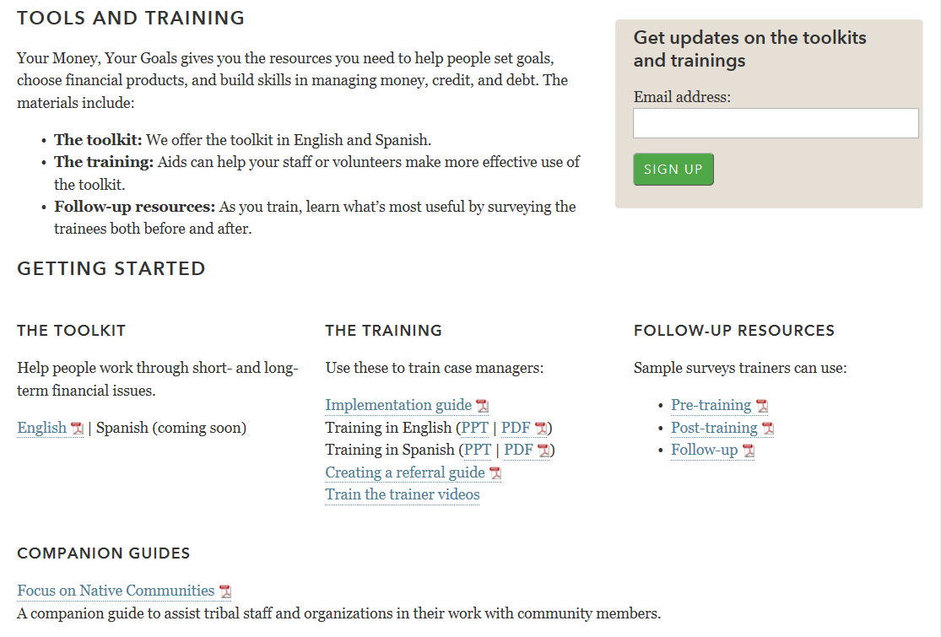
Tools for implementation
Notes:
Training Section 4: An Orientation to the toolkit and the Training
Facilitated Discussion and Presentation
Review each resource or tool available to help with planning and implementing the training.
End with the training slides and transition into organization of the training using the following slides.
NOTE: If you have access to an Internet connection during the training, it can be useful for participants to see you move through the website to the complaint and show some of the features of this section of the CFPB’s website live,

Slide 38
Instructions for facilitator or trainer
Facilitation instructions can be found in the “notes” section of the training PowerPoint presentation.
This training may be used without modification, but trainers may feel welcome to add activities that they feel are more relevant for the attendees.
Notes:
Training Section 4: An Orientation to the toolkit and the Training
Presentation
NOTE: Before covering the next section, you may want to explain that this is geared to those individuals in the training that will be providing training to others on the use of the toolkit. Recognize that not everyone in the room will be fulfilling this role, but that since this is a training for trainers, covering this information during the training today is essential.
Review the organization of the instructions for facilitation in the training guide.
The PPT slides will contain the visual aids for the training.
The instructions for leading the training—the facilitator instructions—can be found in the notes section of the PPT presentation. To find this, go to the view function, select notes page few
This training may be used without modification, but trainers may feel welcome to add activities that they feel are more relevant for the people they are training.
The goal is to try to cover as many of the tools as possible in a way that is engaging and increases their ability to use the tools with the people they serve.

Slide 39
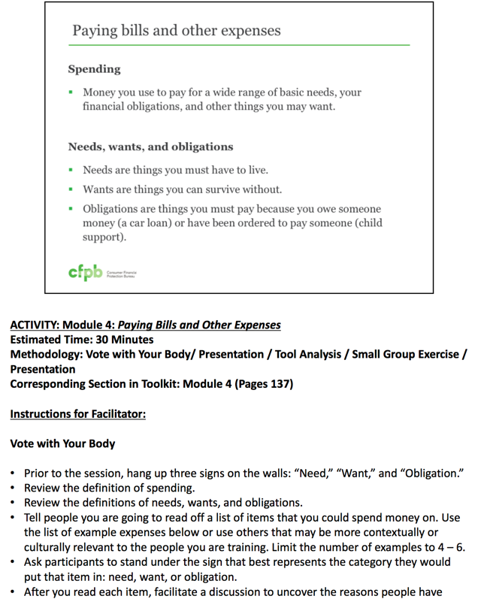
Instructions for facilitator or trainer:
Go to view and select “notes page
Notes:
Training Section 4: An Orientation to the toolkit and the Training
Explain that in order to see the notes, you must be in Notes Page View under the View Function Tab in PowerPoint.
Explain that if printing off of the website, to use the PPT version not the PDF version. The PDF version will cut off notes that exceed one page.
Share this excerpt of what a PPT slide in notes pages view looks like.

Slide 40
Instructions for facilitator or trainer
Module 4: Paying Bills and Other Expenses
Estimated Time: 30 Minutes
Methodology: Vote with Your Body / Presentation / Tool Analysis / Small Group Exercise
Corresponding Section in toolkit: Module 4 (Pages 137)
Notes:
Training Section 4: An Orientation to the toolkit and the Training
Review the organization of the instructions for facilitation in the training guide.
Explain that time estimates assume that you will do all of the exercises for each activity area. If you cut some of exercises out of the training, the activity will take less time.

Slide 41
Instructions for facilitator or trainer
Instructions for Facilitator:
Vote with Your Body
Prior to the session, hang up three signs on the walls: “Need,” “Want,” and “Obligation.”
Review the definition of spending.
Review the definitions of needs, wants, and obligations.
Tell people you are going to read off a list of items that you could spend money on. Use the list of example expenses below or use others that may be more contextually or culturally relevant to the people you are training. Limit the number of examples to 4 – 6.
Ask participants to stand under the sign that best represents the category they would put that item in: need, want, or obligation.
Notes:
Training Section 4: An Orientation to the toolkit and the Training
Explain that the instructions for the facilitator include everything they will need to plan for and facilitate the training including:
Set up instructions including visual aids, training props, or other important notes
Instructions to give participants for group activities
Question prompts for facilitated discussions
Answers to exercises that are a part of the training
Scripted narrative to provide clear and concise definitions and summaries

Slide 42
Effective training
To be effective, the training needs to be engaging.
Every section of the training has at least one activity built into it.
Minimally, follow the instructions in the training, and you will create an interactive experience.
Lecture alone or lecture and discussion is not engaging and not effective.
Notes:
Training Section 4: An Orientation to the toolkit and the Training
Review the principles of effective training as per the slide above.

Slide 43
Methodologies used in training
Opener—contest
Icebreaker
Presentation
Facilitated discussion
Brainstorming
Individual activity
Large group activity
Small group exercise
Exercise in pairs
Carousel
Contest
Scavenger hunt
Role play
Skit
Tool analysis
Vote with your body
Notes:
Training Section 4: An Orientation to the toolkit and the Training
Review the training methodology used and how some of the methodologies work using examples from the training in the order listed on the slide above.

Slide 44
Interactive exercises
Opening activity—Money and me
  Small group brainstorming set up as a contest and large group facilitated discussion
Financial empowerment and service providers
  Debate OR cost benefit analysis
Orientation to the toolkit
  Scavenger hunt in small groups
Creating a referral guide
  Build a chart
Notes:
Training Section 4: An Orientation to the toolkit and the Training
Briefly review the interactive exercises for each section of the training/for each module.
NOTE: You can skip “Interactive exercises” list slides in training. They are here primarily for reference purposes and for train-the-trainer webinar presentations.

Slide 45
Interactive exercises
Understanding the situation and starting the money conversation
  Individual exercise (financial empowerment self-assessment)
  Small group brainstorm
  Top 10 Money Conversations—instead of scavenger hunt
Setting goals and planning for large purchases
(Module 1)
  Scenarios in small groups
Notes:
Training Section 4: An Orientation to the toolkit and the Training
Briefly review the interactive exercises for each section of the training/for each module.

Slide 46
Interactive exercises
Saving for emergencies, bills, and goals (Module 2)
  Small group brainstorm and analysis
  Discussion in pairs using example (spark plug example)
  Completing the asset limits chart
Tracking and managing income and benefits (Module 3)
  Individual tool review
Paying bills and other expenses (Module 4)
  Vote with your body (needs, wants, obligations)
  Individual tool review (bill calendar)
  Small group exercise (strategies for cutting expenses)
  Small group exercise (consequences of skipping bills)
Notes:
Training Section 4: An Orientation to the toolkit and the Training
Briefly review the interactive exercises for each section of the training/for each module.

Slide 47
Interactive exercises
Getting through the month (Module 5)
  Scenario analysis (Raphael)
  Small group brainstorm (improving cash flow checklist)
Dealing with debt (Module 6)
  Stand up, sit down (good debt, bad debt)
  Exercise in pairs (Shawna DTI)
Notes:
Training Section 4: An Orientation to the toolkit and the Training
Briefly review the interactive exercises for each section of the training/for each module.

Slide 48
Interactive exercises
Understanding credit reports and scores (Module 7)
  Credit report scavenger hunt
  Large group exercise (keeping records)
Money services, cards, accounts, and loans (Module 8)
  Individual exercise (know your options)
  Exercise in pairs / large group discussion (money services)
Protecting your money (Module 9)
  Skits (red flags)
  Teach back (learning about consumer protection)
Notes:
Training Section 4: An Orientation to the toolkit and the Training
Briefly review the interactive exercises for each section of the training/for each module.

Slide 49
Keys to interactive training
Read the facilitator’s guide and be sure you understand how to facilitate the activity.
  This generally takes more than one reading.
Make notes to personalize the activity.
Prepare, prepare, prepare.
Understand that it may take you longer to facilitate an activity that you are unfamiliar with.
Better to cover less content using interactive approaches than all of the content using presentation or lecture only.
Notes:
Training Section 4: An Orientation to the toolkit and the Training
Briefly review the interactive exercises for each section of the training/for each module.
Transition using the following: Now that you are familiar with both the toolkit and the training, you are going to look at another kind of question that service providers can face when they offer financial empowerment services.

Slide 50
Your Money, Your Goals
Understanding the situation and starting
the money conversation

Slide 51
Financial empowerment self-assessment
Complete Tool 2: Financial empowerment self-assessment
Reflection Questions
How did you feel about completing this assessment?
Were there topics you knew more about than you thought you would?
What topics would you like to learn more about?
How can you learn more about them?
Notes:
Training Section 5: Intro Part 2 and 3: Understanding the Situation and Starting the Money Conversation
Methodology: Presentation / Individual Activity and Discussion in Pairs / Role Play / Skit or Large Group Brainstorm
Corresponding Section in toolkit: Introduction Part 1 (Tool 2: Financial Emp. Self-Assessment only), Introduction Part 2: Understanding the Situation and Introduction Part 3: Starting the Money Conversation
Estimated Time: 45 Minutes (Note: If role play is skipped, then this section will take less time.)
Instructions for Facilitator:
Individual Activity and Discussion in Pairs (Introduction Part 1, Tool 2: Financial Emp. Self-Assessment) (Page 23)
Provide rationale for Tool 2: Financial empowerment Self-Assessment.
Tool 2: Financial empowerment self-assessment in the Introduction Part 1 is a three-part tool designed to help you understand how much financial knowledge you already have. Learning more will not only benefit the people you serve, but it may also benefit you as you apply what you learn to your own life.
This tool will help you see how much you know and where you may need to learn more.
Invite participants to complete this assessment tool. Provide 7 minutes.
Review the answers in a participatory way.
NOTE: Answer key is in the toolkit immediately following the tool. Be sure to ask participants to not look ahead when completing this assessment.
Ask participants to get into pairs and discuss the reflection questions—be sure to review one question at a time.

Slide 52
Situation assessment
A picture of conditions today used
to inform and plan for actions to
change conditions in the future
Notes:
Training Section 5: Intro Part 2 and 3: Understanding the Situation and Starting the Money Conversation
Presentation (Introduction Part 2)
Define situation assessment using slide and explanation from the toolkit:
Assessment gives you a picture of what is going on now so you can better target information and skill building opportunities for yourself or the people you serve.
Assessment involves gathering information to understand conditions today, as well as what someone knows, can do, or feels about a specific topic.
This information is used to inform and plan for actions to change conditions, knowledge, abilities, behaviors, or beliefs.

Slide 53
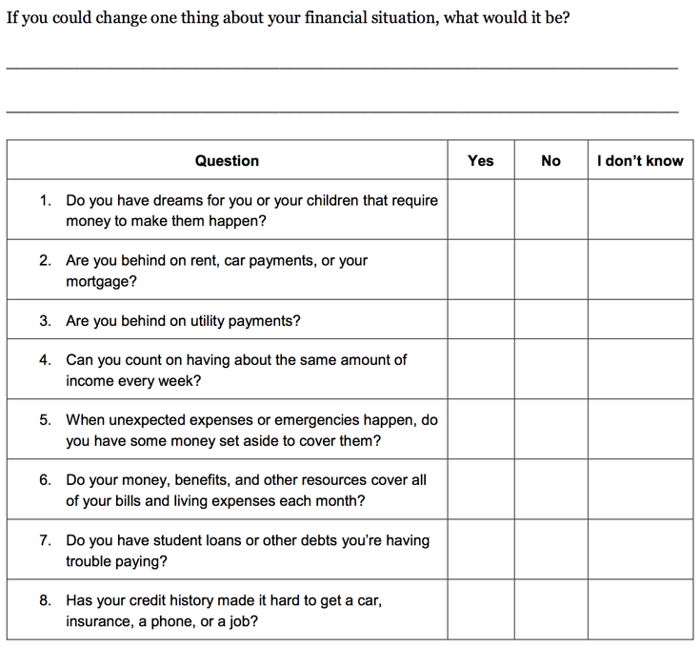
Introduction Part 2, Tool 1: My money picture
Notes:
Training Section 5: Intro Part 2 and 3: Understanding the Situation and Starting the Money Conversation
Presentation (Introduction Part 2, Tool 1: My money picture) (Page 35)
Review the purpose of Tool 1: My Money Picture assessment using the excerpt from the Tool in the toolkit.
Tool 1: My money picture is designed to help service providers understand each person’s goals and financial situation. This information can help them target the right module of the toolkit for each person.
For example, if a person you’re working with has a goal to buy a car or a home, learning about how to improve her credit history and scores may help them qualify for a lower cost loan. You can target Module 7: Understanding Credit Reports and Scores.
If you are working with someone that is unable to make ends meet, you can target Module 5: Getting through the Month.
This tool will help you match each person’s goals and financial situation with specific modules and tools within the toolkit.
Briefly review the contents of and analysis procedure for My money picture.
Be sure to state that using this assessment is NOT MANDATORY. It is a tool they can use to more effectively and efficiently match a person’s needs with information and tools in the toolkit.
Share options for using the assessment:
When the person fills out intake paperwork for your organization or program
When meeting with them for an initial assessment
When they are waiting for other services (such as waiting to have their tax returns prepared at a Volunteer Income Tax Assistance site)
OR
Send this home with them to fill out privately
Use it as a guide to ask questions in a conversational style to better understand their financial concerns and goals
Ask the questions over several sessions

Slide 54
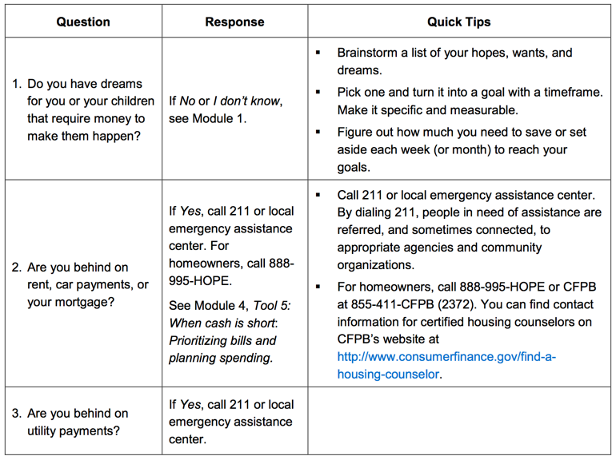
Introduction Part 2, Tool 1: My money picture
Notes:
Training Section 5: Intro Part 2 and 3: Understanding the Situation and Starting the Money Conversation
Presentation
Excerpt from the answer key for My money picture, which is Tool 1 in Introduction Part 2: Understanding the situation.

Slide 55
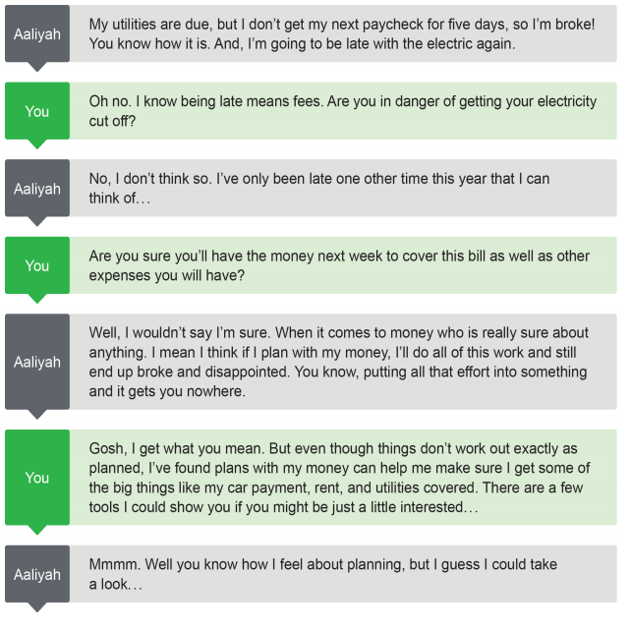
Make the most of short-term contacts
Broaden the conversation
Respond when people initiate - directly or indirectly
Notes:
Training Section 5: Intro Part 2 and 3: Understanding the Situation and Starting the Money Conversation
Group Discussion
ASK: What challenges do you anticipate in starting the money conversation?
Write these on a flip chart.
Share this slide and the information contained in the Introduction Part 3 – Starting the Money Conversation.
Highlight the three overarching strategies for starting the conversation: 1) Make the most of short-term contacts, 2) Broaden the conversation you have—find the intersection between what you are doing and the information and tools in the toolkit, and 3) Respond when people initiate with financial concerns directly or indirectly.
Highlight the example scripts in the toolkit.
Transition to next discussion.

Slide 56
Other strategies for starting the conversation
Brainstorm with your group specific opportunities for beginning the financial empowerment conversation.
Notes:
Training Section 5: Intro Part 2 and 3: Understanding the Situation and Starting the Money Conversation
NOTE: Select Option A: Brainstorm or Option B: Skit in advance of the training
Option A: Brainstorm (Introduction Part 3) (Page 43)
Instruct participants to brainstorm a list of ways they can initiate the financial empowerment discussion.
NOTE: This can be done as a large group or in small groups with a large group report out.
Option B: Skit (Introduction Part 3) (Page 43)
Invite pairs of participants to “read” and act out scripts provided in the toolkit (Pages 46 – 49).
Solicit feedback from participants about what worked well and how they would change the discussion.
Introduce participants to Tool 1 in the Introduction Part 3, Top money conversations (Page 51). Explain that this is just another way to help them see how to use questions as the starting point for use of the toolkit.
Summarize and Transition
Now that you have been introduced to the CFPB and each other, the toolkit, and ways to introduce the toolkit to the people you serve, we’re going to focus on the content modules.
Because the toolkit is not a curriculum, the modules don’t have to be introduced in order.
This goes for training, too.
Because we want to make sure you know about submitting a complaint and some of the key resources in this section, we are starting with Protecting Your Money, Module 9—the module that focuses on people knowing some of their rights when it comes to financial products and services.

Slide 57
Your Money, Your Goals
Module 1: Setting goals and planning for large purchases
Notes:
Note: Training sections for content modules are labeled by their module number (ex: Module 1), rather than by training section number.

Slide 58
SMART goals
Specific
Measurable
Able to be reached
Relevant
Time-framed
Notes:
Module 1: Setting Goals and Planning for Large Purchases
Estimated Time: 45 Minutes
Methodology: Presentation / Facilitated Discussion / Scenarios in Small Groups / Presentation
Corresponding Section in toolkit: Module 1 (Page 61)
Instructions for Facilitator:
Presentation (Module 1)
Encourage participants to follow along in Module 1 in the toolkit.
Explain the qualities of strong goals using the following:
Specific
When setting a goal, ask yourself the questions: Who? What? Why?
A specific goal has a much greater chance of being met than a general goal.
Measurable
You should be able to track your progress toward meeting the goal.
Ask yourself questions like: How much? How many? How will I know when it is done?
Able to be reached
Is this goal something that you can actually reach?
You might want to get rid of credit card debt tomorrow or become a millionaire in a year, but for most of us, that's a totally impossible goal!
That doesn't mean that your goals should be easy. Your goal may be a stretch for you, but it should not be extreme or impossible.
Relevant
Set goals that matter to you and are a priority in your life.
Ask yourself the questions: Is this something that I really want? Is now the right time to do this?
Time-framed
Goals should have a clearly defined time frame, including a target or deadline date.

Slide 59
Hopes, wants, and dreams vs. strong goal
I’d like to buy a new television.
I want to get out of
credit card debt.
I will save $400 and purchase a new television in six months.
I will pay down $1,000 of my debt over the next 18 months.
Hopes, wants, and dreams
Strong goal
Notes:
Module 1: Setting Goals and Planning for Large Purchases
Facilitated Discussion (Module 1)
Review examples by asking: “Why is a hope, want or dream NOT a goal?” “What makes this strong goal strong?”
Ask participants to list the things someone needs to reach goals. Write their responses on flip chart paper. Be sure to add the following:
Every goal requires commitment and time. To reach goals, you may also need:
Information
Tools
Transportation
Money
Other resources
An action plan—small steps needed to reach a goal
Assistance from a professional
For goals that require money to reach, you will want to know: How much do I need to set aside every week (or month) to meet my goal?
This applies to both debt reduction and savings goals.

Slide 60
Goal-setting tool
Brainstorm list of hopes, wants, and dreams
Figure out weekly savings target
Action plan
SMART goals
Becomes part of cash flow budget
May become the purpose for the cash flow budget
Notes:
Module 1: Setting Goals and Planning for Large Purchases
Presentation
The Goal-setting tool in Your Money, Your Goals actually has 4 parts:
Step 1: Brainstorm a list of the hopes, wants, and dreams for yourself or your family. Fill in the chart with the hopes, wants, and dreams: place items that are achievable in less than six months in the short-term column, and those that are achievable in more than six months in the long-term column.
Step 2: Use your list of hopes, wants, and dreams to create SMART goals. Use the checklist to make sure your goals are specific, measurable, able to be achieved, relevant, and time bound.
Step 3: Create an action plan to reach your goals. For long-term goals, your action plan may be long and involve many steps. For other goals, you may only need to take a few steps to reach your goal. Remember to include resources you may need to reach your goals.
Step 4: Finally, for goals that require money, figure out how much you need to set aside each week (or month) to reach your goal using the final section of the worksheet.

Slide 61
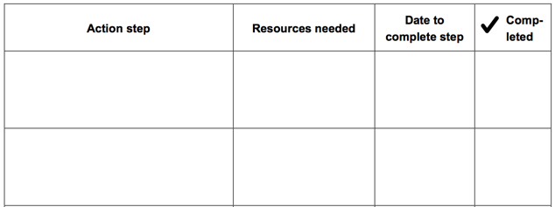
Action plan
Goal: _______________________________
Notes:
Module 1: Setting Goals and Planning for Large Purchases
Presentation (Module 1, Tool 1: Goal-setting tool) (Page 69)
Explain how to use this tool using the following example or another example.
Remind participants that while some goals require setting money aside to reach, they may also require more information, help from a professional, use of a new tool, or an action plan. For example, a goal may be:
I want to pay my bills on time every month starting August 1.
Assuming lack of money is not the primary reason bills are not being paid on time, here are some steps you could take to reach that goal:
Collect credit card statements, loan payment statements, utility bills, phone bills, and documentation of other payments made each month.
Highlight payment amounts and due dates.
Fill in the bill paying calendar tool.
Consider using automatic payment methods for some recurring bills or online bill payment.
NOTE: You could write these steps in the action plan format on a flip chart or fill in the chart on the PPT with this example or another.
Explain that goals generally need to be reset or revised when:
The goal has been achieved.
Emergency savings are used and need to be replenished.
Circumstances change.
Values change and a goal no longer feels relevant.

Slide 62
Calculating weekly savings target
Number of weeks to reach goal
Amount to set aside each week
Total amount needed
Notes:
Module 1: Setting Goals and Planning for Large Purchases
When figuring out how much to set aside every week to meet the goal, two pieces of information are needed: the total amount needed to reach the goal and the number of weeks to reach the goal.
Explain how to get a monthly amount—multiply the weekly amount by 4 or divide the total amount needed by 12 months.
Go through an example on a flip chart using a participant’s goal, the one in the toolkit, or one you create.
Discuss how this weekly set-aside can be used in developing a budget or cash flow.

Slide 63
Calculating weekly savings target
Number of weeks to reach goal
Amount to set aside each week
Total amount needed
$300
For end of the year holidays
12 weeks
$25 per week
Notes:
Module 1: Setting Goals and Planning for Large Purchases
When figuring out how much to set aside every week to meet the goal, two pieces of information are needed: the total amount needed to reach the goal and the number of weeks to reach the goal.
Explain how to get a monthly amount—multiply the weekly amount by 4 or divide the total amount needed by 12 months.
Go through an example on a flip chart using a participant’s goal, the one in the toolkit, or one you create.
Discuss how this weekly set-aside can be used in developing a budget or cash flow.

Slide 64
Life cycle events and large purchases
What is a life cycle event likely to cost?
Everyone is different, but here are some estimates we have seen:
Out of pocket childbirth expenses for women with insurance coverage—$3,400
Out of pocket expenses associated with breast cancer—$712/month
Quinceañera—coming of age celebration for 15-year old girls in Latino families—$15,000 to $20,000
Typical cost for final expenses—$10,000
Notes:
Module 1: Setting Goals and Planning for Large Purchases
Facilitated Discussion (Module 1, Tool 2: Planning for life events and large purchases) (Page 75)
ASK: What is a life event?
Something that happens—may be planned or unplanned—that many people experience generally at specific life stages although this is not always the case.
ASK: What is a large purchase?
Something that is generally only purchased one or a few times in life that requires more money than most people have in disposable income from one paycheck. Examples include: large appliances, cars, and home repairs. These may be planned or unplanned.
Review costs of some life cycle events or large purchases. Solicit other examples from participants – like weddings, divorce, faith-based celebrations, education for you or your children, saving for a down payment for a home, training or tools for a new job, etc.

Slide 65
Planning for life events and large purchases
Group 1: 18-year old graduating from high school. Plans to attend trade school to become a skilled welder.
Group 2: 28-year old food services manager at a state university diagnosed with cancer. He is married and has an infant.
Group 3: 36-year old mother who is getting divorced. She has two children ages 4 and 8. Must find a job for the first time in 9 years; before having children she was a math teacher in the public school system.
Group 4: 45-year old man being downsized out of manufacturing job. Married with one child who is 15 years old. The child has plans to go to college out of state.
Group 5: 56-year old long-haul truck driver who would like to retire in 6 years. Has saved minimally for retirement. Children are grown and out of the house; however, one has lost his job and has plans to return home with his two preschool children.
Notes:
Module 1: Setting Goals and Planning for Large Purchases
Scenarios in small groups (Module 1, Tool 2: Planning for life events and large purchases) (Page 75)
ASK: What is a life event?
Something that happens—may be planned or unplanned—that many people experience generally at specific life stages although this is not always the case.
ASK: What is a large purchase?
Something that is generally only purchased one or a few times in life that requires more money than most people have in disposable income from one paycheck. Examples include: large appliances, cars, and home repairs. These may be planned or unplanned.
Show the slide above.
Divide the participants into small groups.
Give each group one of the scenarios.
Instruct participants to identify what life events the individual is likely to have already experienced, likely to experience one day as well as any large purchases you can see his or her incurring in the future.
On a flip chart, draw a path with a stick figure or star person in the middle of it. Label the bottom of the path “The Past” and label the top of the path “The Future.”
Instruct participants to copy this drawing on their own flip chart and then list the life events and large purchases as well as a guesstimate of the costs associated with each on the path and when they will occur (in the past or in the future) for the individual in their assigned scenario.
Each group should be prepared to present.

Slide 66
Planning for life events and large purchases
What are the reasons for thinking about and anticipating life events and large purchases?
Do most people do this? Why or why not?
How does an exercise like this empower individuals?
How can an exercise like this backfire?
What did you learn from this exercise?
Notes:
Module 1: Setting Goals and Planning for Large Purchases CONTINUED
Scenarios in small groups (Module 1, Tool 2: Planning for life events and large purchases) (Page 75)
Following the group presentations, process the exercise using the following questions (also on the PPT slide):
What are the reasons for thinking about and anticipating life events and large purchases?
Do most people do this? Why or why not?
How does an exercise like this empower individuals?
How can an exercise like this backfire?
What did you learn from this exercise?

Slide 67
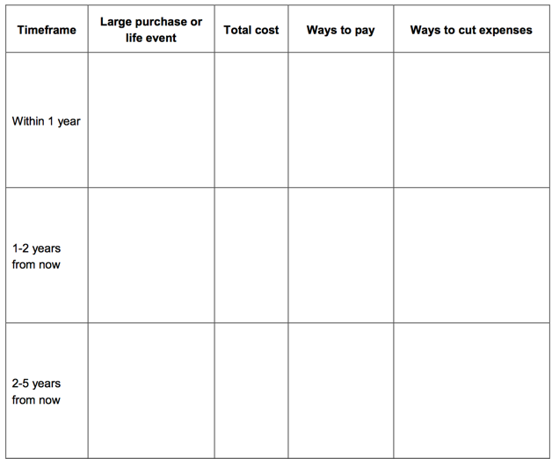
Tool 2: Planning for life events and large purchases
Notes:
Module 1: Setting Goals and Planning for Large Purchases
Presentation (Module 1, Tool 2: Planning for life events and large purchases) (Page 75)
Introduce Tool 2 and explain how to complete it using the following instructions from the tool:
Think about the life events you are likely to experience and the large purchases you might need to make. If you rely on a car to get to and from work, you will probably need to replace it at some point in the future. If you use tools in your trade, they may need to be updated or replaced periodically. Brainstorm a list of these types of expenses using the timeline chart below. Consider where you are now, and when you are likely to experience some life events (like a graduation party) or need to make large purchases. If your child is ten years old now, a high school graduation party will be in about eight years. If your car is five years old or has a lot of miles on it, you may need to replace it within the next five years or less.
Estimate the costs of these expenses. Research the costs of the large purchases you plan to make or costs associated with life events you are expecting. If the life event or purchase is likely to happen more than five years from now, remember that the cost of almost everything gradually increases over time.
Identify potential ways to pay for these expenses. For example, you can borrow money to buy a reliable used or new car. If you plan to borrow money, consider saving some money for a down payment to keep your monthly payments as low as possible. Many large purchases may require a combination of borrowing money and paying a portion up front to cover the cost.
Identify ways to keep the costs as low as possible. For example, for your daughter’s graduation party, can you save on the rental of a location by holding it in a rent-free or reduced-rent facility like a community center or a public park? Can you save on the meal by involving family and friends in helping you prepare food rather than hiring a catering company?

Slide 68
Tool 3: Buying a car
Be prepared before you shop for an auto loan
Know what you can negotiate
Avoid long-term loans if you can
Review your loan contract before signing
Notes:
Module 1: Setting Goals and Planning for Large Purchases
Presentation (Module 1, Tool 3: Buying a car) (Page 79)
Review Tool 3: Buying a car
Explain the rationale for this tool:
A vehicle may be a lifeline for you or your family if there are no local employment opportunities or inadequate public transportation options. For some access to affordable vehicle financing is necessary when it comes to stable employment, healthcare, and education opportunities. Even though your vehicle can help you access economic opportunities or achieve financial independence, it can quickly become a financial burden if you don’t learn how to protect yourself from getting stuck with an auto loan you can’t afford. This tool provides four ways you can protect yourself.
Explain that this tool is informational in nature, i.e., there is nothing for them to fill in.
Share highlights of the tool:
Be prepared before you shop for an auto loan
Not being prepared can potentially cost you hundreds or thousands of dollars over the life of the loan.
Check your credit score before shopping for an auto loan and make sure your credit report doesn’t have any errors, so you can negotiate the best rate.
Take the CFPB auto loan worksheet with you to the lender or auto dealership and use it to compare the total cost of different financing options.
2. Know what you can negotiate
Just like you can negotiate the price of the vehicle, you can also negotiate your loan terms.
You can negotiate for a better interest rate, how long you will be paying the loan, whether you buy and the price of optional add-ons, and some dealer fees.
3. Avoid long-term loans if you can
When comparing your offers and negotiating a loan, it’s important to know if you can afford the monthly payment, but be sure you look at the total cost of the loan.
A smaller monthly payment may mean the loan is extended over a longer period of time – 60 months, 72 months, or more, instead of 36 or 48 months.
If your income or job is not secure, having an extended loan is a risk as you could lose the ability to make monthly payments in the future.
For older vehicles, a longer loan could be a problem if the life of the loan is longer than the expected life of the vehicle.
4. Review your loan contract before signing
Before you sign your new loan contract, make sure everything matches what you agreed to during the negotiation. Consider reviewing with a friend or partner to help you review all of the paperwork before signing the loan documents.
Check the Annual Percentage Rate (APR), the amount financed, the finance charge, and the total of all your payments.
Before you drive away, make sure you and the lender have both signed all of the paperwork and that you have copies of each document.
Be prepared for your family, too.
CFPB resources will also help if you are asked to be a co-signer for an auto loan. You may be one of many people who want to help a family member or friend, but remember that being a co-signer would put you on the hook for monthly payments if the other borrower stops paying the loan.

Slide 69
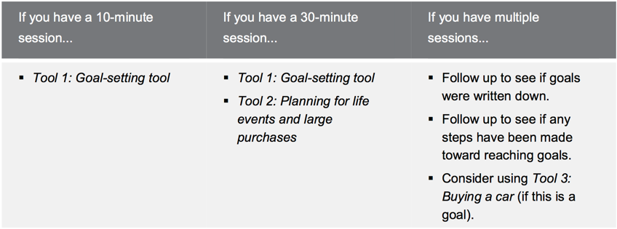
Module 1: Opportunities for Financial Empowerment
Notes:
Module 1: Setting Goals and Planning for Large Purchases
Presentation and Discussion (Module 1)
Highlight opportunities for introducing financial empowerment depending on the amount of time available:
If you have a 10-minute session…
Tool 1: Goal-setting tool
If you have a 30-minute session…
Tool 1: Goal-setting tool
Tool 2: Planning for life events and large purchases
If you have multiple sessions…
Follow up to see if goals were written down
Follow up to see if any steps have been made toward reaching goals
Consider using Tool 3: Buying a car (if this is a goal)
If you have time during the training:
ASK: What other ways could you introduce the financial empowerment tools from this module in your work?
WRAP UP
SMART goals can provide direction to financial plans.
SMART goals can help you plan for the money you need to reach your goals.
Action plans can help ensure you have the information and resources you need to reach your goals.
Anticipating life events and large purchases including cars can empower you to plan and save for them.
Use Tool 1: Goal-setting tool to set SMART goals, make plans, and figure out weekly savings target.
Use Tool 2: Planning for life events and large purchases to anticipate and plan for the expenses associated with these.
Use Tool 3: Buying a car to discuss key considerations before buying a car.

Slide 70
Your Money, Your Goals
Module 2: Saving for emergencies, bills, and goals
Notes:
Take time to acknowledge that for very low-income households, savings may not be their main goal.
Remember, Your Money, Your Goals is a toolkit, not a curriculum. The fact that we’re covering this before other modules isn’t meant to imply that it’s what you should use to begin financial conversations.
The concepts that are discussed in this module are applicable to other types of goals that require someone to “find” money in their budget that they use to address a financial issue or goal such as debt repayment.

Slide 71
Saving
What is savings?
Savings is money you set aside today from your income for use in the future
What are examples of unexpected expenses or emergencies?
Notes:
Module 2: Saving for the Emergencies, Goals, and Bills
Estimated Time: 60 Minutes
Methodology: Facilitated Discussion and Small Group Brainstorm / Presentation / Exercise in Pairs / Facilitated Discussion and Large Group Activity / Carousel / Presentation or Facilitated Discussion
Corresponding Section in toolkit: Module 2 (Page 83)
Instructions for Facilitator:
Facilitated Discussion and Small Group Brainstorm (Module 2)
Ask participants to share their definition of savings.
Share definition of savings using slide.
Have participants list examples of unexpected expenses or emergencies in small groups on flip chart paper using marker.
After 3 minutes, ask participants to circle those they think could be handled with $1,000 or less.
Instruct groups to post their flip charts and share cumulatively.
Make summary comments about the number of unexpected expenses that can be managed with $1,000. Contrast to the “conventional wisdom” advocating 3 - 6 months’ worth of living expenses.
Explain that $500 to $1,000 is a possible goal for most—they can imagine it and it can make a very, very big difference.
Explain that having $500 to $1,000 to cover emergencies and unexpected expenses can help avoid debt.
Also explain: Once people see they can save this much, then they can work toward 1 month’s living expenses, 3 months’, etc. over the longer term.

Slide 72
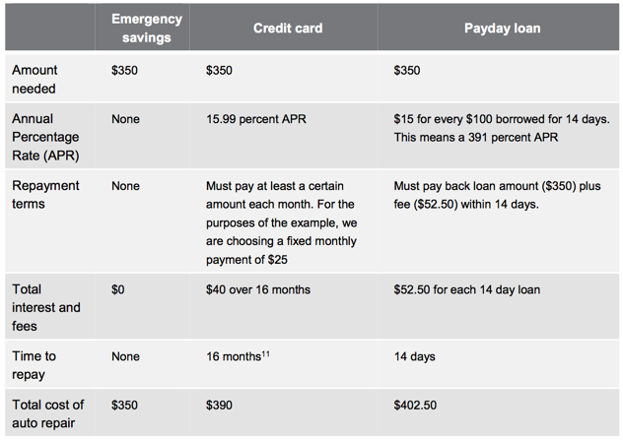
Cost of unexpected auto repair = $350
Notes:
ACTIVITY: Module 2: Saving for Emergencies, Bills, and Goals
Exercise in Pairs (Module 2) (Example on Page 90 in toolkit)
Ask people some of the benefits of having emergency savings. Write on flip chart.
Share that one benefit is that it can save you money—sometimes a lot of money.
Ask participants to review the table, in their toolkit or on this slide, in pairs. Explain that the terms of the two loan products are for example purposes only – that terms vary.
Have them list the costs of each approach to covering the unexpected auto repair cost (ex: replacing your spark plugs). Be sure to explain that there are direct costs—the additional money that each approach may require. But, there may be other costs, too such as stress of repaying a new debt.
Give pairs 5 minutes to complete.
Ask groups to share their thoughts.
Keep track of direct costs and other costs on flip charts.
ASK: How do you think the people you work with would respond to this information?
NOTE: Use the following answers as a guide for the discussion.
Emergency Savings
Direct costs: use of savings, decreased spending because income dedicated to savings, future savings to replenish the amount used for spark plugs
Other costs: discipline of regular savings to build and replenish emergency fund
Credit Card
Direct costs: interest paid on money borrowed—$40; obligation of future income until credit card balance is paid in full
Other costs: stress of credit card bill; could impact credit score positively or negatively depending on payment pattern
Payday Loan
14 days to repay:
Direct costs: origination and renewal fees—$52.50 = $402.50; obligation of future income until payday loan paid in full
Other costs: stress of payment and amount of total payment; lost opportunity to use the money paid to origination and renewal fees elsewhere.

Slide 73
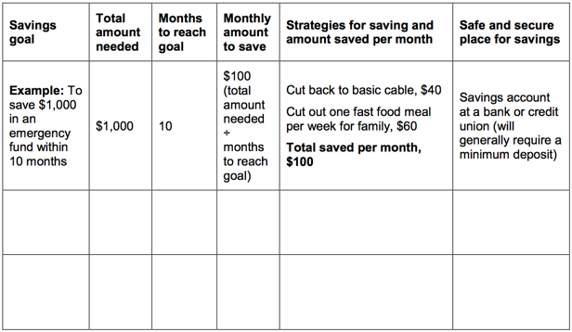
Tool 1: Savings plan
Notes:
Module 2: Saving for Emergencies, Bills, and Goals
Presentation (Module 2, Tool 1: Savings plan) (Page 99)
Share an excerpt from the savings plan tool.
Explain the components of the Saving Plan.
ASK: When could you see using this tool?

Slide 74
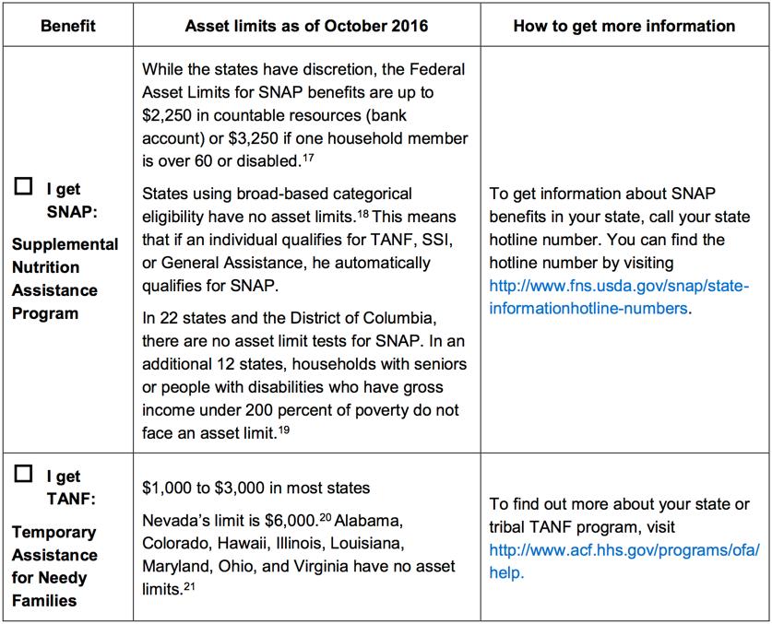
Tool 2: Savings and benefits
What are the reasons this tool is included?
Notes:
Module 2: Saving for Emergencies, Bills, and Goals
Facilitated Discussion and Large Group Activity (Module 2, Tool 2: Savings and benefits: Understanding asset limits) (Page 103)
Review tool by asking: “What are the reasons this tool is included?”
If there is time, complete the tool as much as possible with the group based on their own knowledge and experience.
You may also complete the tool with your state’s information, make copies, and share it with the group.
NOTE: Prior to training, make a copy of the tool using flip charts that can be filled in with the group during the training. Following the training, check the information. When the tool is completed, be sure to recognize the contributions of the group in a footnote.
Following the training, fill in their contributions and get copies of the completed chart to all of the attendees.

Slide 75
Tool 3: Finding a safe place for savings
Where can you keep money you save?
What are the benefits?
  A benefit is something that provides you with an advantage. A benefit is something that is good for you.
What are the risks?
  A risk is any chance for loss. Where there is risk, there is uncertainty in the outcome or result.
Notes:
ACTIVITY: Module 2: Saving for Emergencies, Bills, and Goals
Carousel (Module 2, Tool 3: Finding a safe place for savings) (Page 109)
NOTE: If you used the carousel for Identity Theft, do not use it here. Instead, just brainstorm a list and discuss the benefits and risks of each “safe” place for savings.
NOTE: This is an optional activity. If you are short for time, consider cutting this activity.
ASK: Where can you keep money you save?
Write each idea on its own flip chart. (Prior to session, hang flip charts throughout the room that have a “T” with benefits written on one side and risks on the other.)
NOTE: For all of those places that include keeping the money in the home, put these on one flip chart.
Have the group count off so small groups each have one flip chart to start with.
Have them visit each flip chart and brainstorm the benefits and risks of each place to save.
Give them 30 seconds at each flip chart—less as the exercise progresses; the idea is to make this a kinesthetic brainstorming session (carousel).
Once every group has visited each flip chart, review each flip chart briefly with the group.

Slide 76
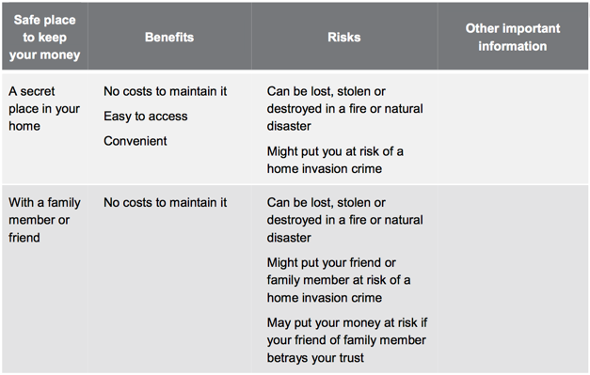
Tool 3: Finding a safe place for savings
Notes:
Module 2: Saving for Emergencies, Bills, and Goals
Presentation (Module 2, Tool 3: Finding a safe place for savings) (Page 109)
Share an excerpt of Tool 3 following the activity and have people find the toolkit in their toolkits.

Slide 77
Banking history reports
Information about prior accounts, such as routing transit number and account number
The date information was reported about an account
The reason for the report, such as an unpaid overdraft balance
Whether your prior banking institution suspected you of committing fraud
Information on returned checks from retailers and other businesses
Notes:
Module 2: Saving for Emergencies, Bills, and Goals
Presentation (Module 2) (Page 95)
Review how negative banking history reports can prevent people from opening a savings or checking account at banks and credit unions and what reports commonly include: information about how people manage their saving and checking accounts—overdrafts, unpaid fines, and fraud.
Highlight some of the common reporting systems: ChexSystems, TeleCheck, Early Warning, and others.
Explain that people can order their reports using information in the toolkit and that they are entitled to at least one free report per year:
You can order your own free ChexSystems report online at http://www.consumerdebit.com, call for more information at (800) 428-9623, or send a written request to: Chex Systems, Inc., 7805 Hudson Road, Suite 100, Woodbury, MN 55125.
You can request your annual file disclosure from TeleCheck Services by calling (800) 366-2425. You can order your TeleCheck Services Report by sending a written request and include a daytime phone number, a copy of your driver’s license, your Social Security number, and a copy of a voided check to: TeleCheck Services, Inc., Attention: Consumer Resolution – FA, P.O. Box 4514, Houston, TX 77210-4515.
To request your Early Warning report, call (800) 325-7775.

Slide 78
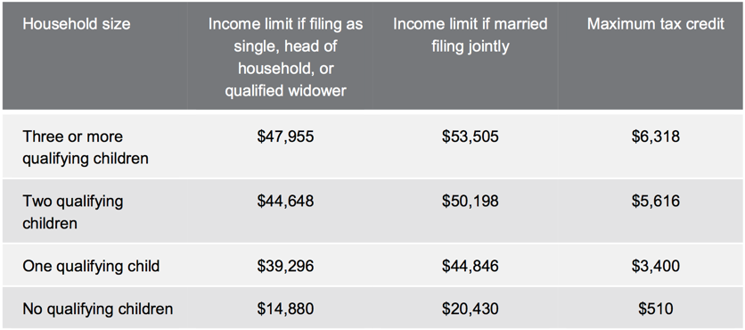
Tool 4: Increasing your income through tax credits
For the 2017 tax season, these income limits apply for the EITC.
All information regarding tax credits from the Internal Revenue Service at www.irs.gov.
Notes:
Module 2: Saving for Emergencies, Bills, and Goals
Facilitated Discussion (Module 2, Tool 4: Increasing your income through tax credits) (Page 111)
Review key points of the earned income tax credit as one way to increase income using information from Module 3, Tool 4 including:
Benefit for working people who have low to moderate income.
Reduces the amount of federal income tax owed and may result in a refund. (May be state or city EITC depending on where they live.)
Tax refund is based on income and filing status.
Explain that there are other tax credits, too, such as the Child Tax Credit.
Refer back to your resource and referral guide and highlight where people can get their taxes done free of charge (VITA and other free tax preparation sites).
Explain the advantages of using VITA preparers.
Explain that this information must be updated annually as it changes due to increases in the cost of living.

Slide 79
Tool 4: Increasing your income through tax credits
Note: Starting in 2017, the IRS will be required to do additional verification of information on tax returns claiming the EITC and the CTC. This may cause some delay in the receipt of refunds which include these tax credits.
For more information go to https://www.irs.gov/for-tax-pros/new-federal-tax-law-may-affect-some-refunds-filed-in-early-2017.
Notes:
Module 2: Saving for Emergencies, Bills, and Goals
Presentation (Module 2, Tool 4: Increasing your income through tax credits)
From IRS:
This change begins Jan. 1, 2017, and may affect some returns filed early in 2017. Additional information is listed below.
To comply with the law, the IRS will hold the refunds on EITC and ACTC-related returns until Feb. 15.
This allows additional time to help prevent revenue lost due to identity theft and refund fraud related to fabricated wages and withholdings.
The IRS will hold the entire refund. Under the new law, the IRS cannot release the part of the refund that is not associated with the EITC and ACTC.
Taxpayers should file as they normally do, and tax return preparers should also submit returns as they normally do.
The IRS will begin accepting and processing tax returns once the filing season begins, as we do every year. That will not change.
The IRS still expects to issue most refunds in less than 21 days, though IRS will hold refunds for EITC and ACTC-related tax returns filed early in 2017 until Feb. 15 and then begin issuing them.
https://www.irs.gov/for-tax-pros/new-federal-tax-law-may-affect-some-refunds-filed-in-early-2017

Slide 80
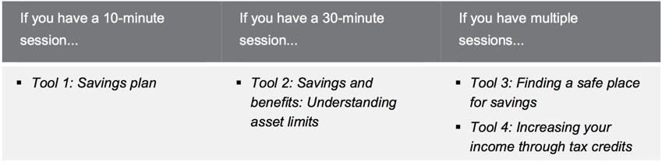
Module 2: Opportunities for financial empowerment
Notes:
Module 2: Saving for Emergencies, Bills, and Goals
Presentation and Discussion (Module 2)
Highlight opportunities for introducing financial empowerment depending on the amount of time available:
If you have a 10-minute session…
Tool 1: Savings plan
If you have a 30-minute session…
Tool 2: Savings and benefits: Understanding asset limits
If you have multiple sessions…
Tool 3: Finding a safe place for savings
Tool 4: Increasing your income through tax credits
If you have time during the training:
ASK: What other ways could you introduce the financial empowerment tools from this module in your work?
Summarize by sharing:
Savings is money you set aside today to use in the future. People save for many reasons. Reasons to save include emergencies and goals such as: their own goals - like a new TV, appliances, a home, their children’s education, and retirement
Why save for emergencies? Because they will happen.
When you save for emergencies in advance, you can handle them when they happen without having to skip your other bills or borrow money.
When you borrow money, you have to pay fees and sometimes interest. And on top of that, you will probably have to use some of your income going forward to pay back the money you borrow. So saving money now for unexpected expenses and emergencies can save you even more money later.
WRAP UP
You may want to set aside income for your goals, emergencies, and bills.
Many emergencies or unexpected expenses can be managed with $500 to $1,000 in an emergency fund.
Use Tool 1: Savings plan to help you plan for and build your savings.
Use Tool 2: Savings and benefits to better understand how benefits may impact ability to save.
Use Tool 3: Finding a safe place for savings to better understand the benefits and risks of different places to put your savings so you can make the best choice for you.
Use Tool 4: Increasing your income through tax credits to learn more about tax credits that may increase your income.

Slide 81
Your Money, Your Goals
Module 3: Tracking and managing income and benefits

Slide 82
Income, benefits, and wage garnishments
Income
Regular income
Irregular income
Seasonal
One-time occurrence
Benefits
Wage garnishments
Notes:
Module 3: Tracking and Managing Income and Benefits
Estimated Time: 30 Minutes
Methodology: Facilitated Discussion / Tool Analysis / Presentation
Corresponding Section in toolkit: Module 3 (Pages 115)
Instructions for Facilitator:
Facilitated Discussion (Module 3)
Note: Wage garnishment starts on Page 117 in toolkit
Define income.
Ask participants to differentiate regular, irregular, seasonal, and one-time income.
ASK: How do these different kinds of income impact budgeting and cash flow?
ASK: How are benefits (public) different from income?
Explain wage garnishment using the following from the materials in Module 3 if not covered during Module 2:
Wage garnishments give the government or creditors the right to collect money directly out of someone’s paycheck. This can generally only happen with a court order.
Common reasons for wage garnishment are:
Taxes owed to the IRS or the state
Money owed for child support
Money owed for delinquent student loans
Other unpaid or delinquent debts
With a wage garnishment order, only a certain percentage of the employee’s disposable earning can be withheld.
Federal law limits the amount that may be garnished.
Generally the amount must be the lesser of two figures: 25% of disposable income or the amount that the person earns each week over the federal minimum wage multiplied by 30. You may wish to direct participants to the example in the toolkit.
Some states provide additional protections that allow consumers to take home more pay than would be allowed using only the federal limits.
All mandatory deductions are protected outright from garnishment:
Federal, state and local taxes and
FICA contributions
Voluntary deductions are not protected.
Generally, Social Security, disability, retirement, child support, and alimony are protected from garnishment from regular creditors.
If you owe the federal government for student loans or back taxes, however, these sources may not be protected.
Finally, some states have additional protections. Find a legal aid organization in your community to learn more about protections from wage garnishment.

Slide 83
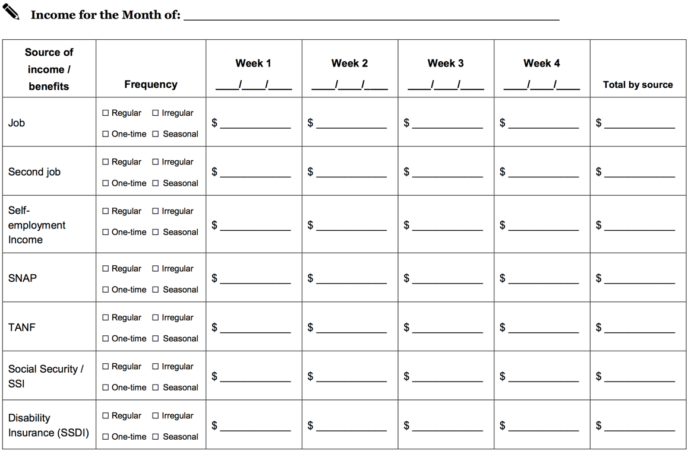
Tool 1: Income and resource tracker
Notes:
Module 3: Tracking and Managing Income and Benefits
Presentation (Module 3, Tool 1: Income and resource tracker) (Page 123)
Explain how to use the income and resource tracker.
Review the categories included.
Ask participants if they feel there are major categories missing. (Explain the tradeoff between many categories and utility of the form.)

Slide 84
Tool 2: Ways to receive income and benefits
Cash
Paychecks
Direct deposit
Payroll cards
EBT
Notes:
Module 3: Tracking and Managing Income and Benefits
Presentation (Module 3, Tool 2: Ways to receive income and benefits) (Page 127)
Review each method for receiving income as well as the benefits and risks of each.
Ask participants to share their feelings about the utility of this tool with the people that they serve.

Slide 85
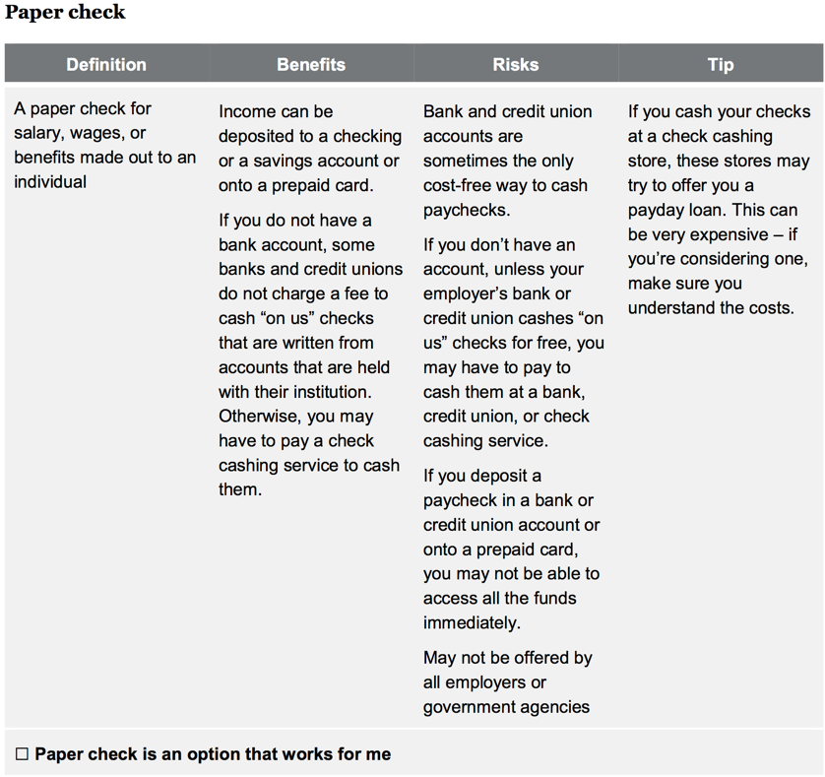
Tool 2: Ways to receive income and benefits
Notes:
Module 3: Tracking and Managing Income and Benefits
Presentation (Module 3, Tool 2: Ways to receive income and benefits) (Page 127)
Show excerpt from the tool.

Slide 86
Tool 3: Ways to increase income and resources
Review this tool on Pages 133 – 136
Think about the people that you serve.
Which strategies listed do you think are most feasible for them?
  Circle these.
What strategies are missing?
  Add these.
Notes:
Module 3: Tracking and Managing Income and Benefits
Tool Analysis (Module 3, Tool 3: Ways to increase income and resources) (Page 133)
NOTE: This activity can be done individually, in pairs, or in small groups.
Ask participants to think about the people they serve.
Ask them to analyze this form from the perspective of the people they serve.
Have them circle the strategies for increasing cash and other financial resources they think will be feasible for them.
Have them add strategies they feel are missing.
Solicit ideas from the group.
Write them on flip charts.
Consider adjusting the tool post-training and redistributing it based on participants’ insights.

Slide 87
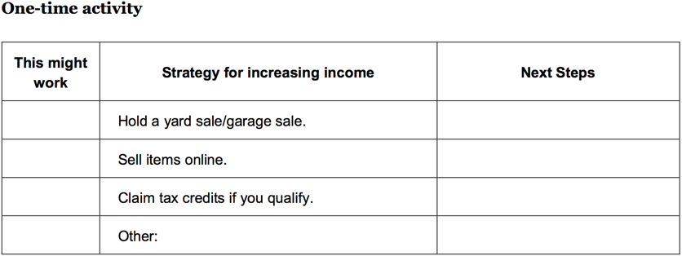
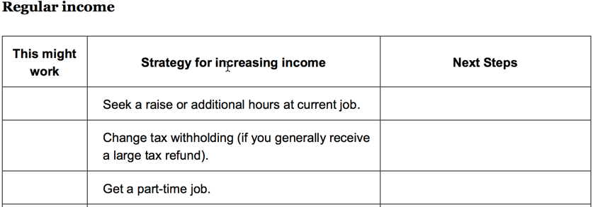
Tool 3: Ways to increase income and resources
Notes:
Module 3: Tracking and Managing Income and Benefits
Tool Analysis (Module 3, Tool 3: Ways to increase income and resources) (Page 133)
Show excerpt from the tool.

Slide 88
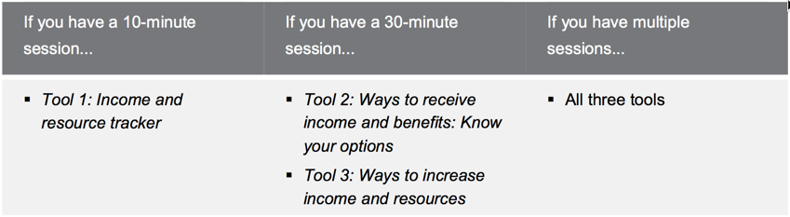
Module 3: Opportunities for financial empowerment
Notes:
Module 3: Tracking and Managing Income and Benefits
Presentation and Discussion (Module 3)
Highlight opportunities for introducing financial empowerment depending on the amount of time available:
If you have a 10-minute session…
Tool 1: Income and resource tracker
If you have a 30-minute session…
Tool 2: Ways to receive income and benefits: Know your options
Tool 3: Ways to increase income and resources
If you have multiple sessions…
All three tools
If you have time during the training:
ASK: What other ways could you introduce the financial empowerment tools from this module in your work?
Summarize by sharing:
Managing income and benefits is essential to financial empowerment. Many people do not think about their income beyond the amount they receive.
Understanding issues of timing and predictability can help you take control of your finances. And if you find you don’t have enough money, it’s important to identify strategies that can help you bring in more income or resources.
Finally, some ways of receiving income may be more beneficial to you than others. Understanding the benefits and risks of a paper paycheck versus direct deposit versus a payroll card can empower you to make a different choice that may benefit you and your family.
WRAP UP
Income is all of the money or financial resources that come into your household.
Managing irregular or seasonal income is challenging and hard to plan with.
Wage garnishments for debts or other unpaid obligations will reduce your take home income.
Use Tool 1: Income and resource tracker to help you understand when and how much income and benefits you receive.
Use Tool 2: Ways receive income and benefits: Know your options to better understand the benefits and risks of different ways of receiving income and benefits.
Use Tool 3: Ways to increase income and resources to identify ways to possibly increase your income or financial resources.

Slide 89
Your Money, Your Goals
Module 4: Paying bills and other expenses

Slide 90
Paying bills and other expenses
Spending
Money you use to pay for a wide range of basic needs, your financial obligations, and other things you may want.
Needs, wants, and obligations
Needs are things you must have to live.
Wants are things you can survive without.
Obligations are things you must pay because you owe someone money (a car loan) or have been ordered to pay someone (child support).
Notes:
Module 4: Paying Bills and Other Expenses
Estimated Time: 30 Minutes
Methodology: Vote with Your Body/ Presentation / Tool Analysis / Small Group Exercise / Presentation
Corresponding Section in toolkit: Module 4 (Pages 137)
Instructions for Facilitator:
Vote with Your Body
Prior to the session, hang up three signs on the walls: “Need,” “Want,” and “Obligation.”
Review the definition of spending.
Review the definitions of needs, wants, and obligations.
Tell people you are going to read off a list of items that you could spend money on. Use the list of example expenses below or use others that may be more contextually or culturally relevant to the people you are training. Limit the number of examples to 4 – 6.
Ask participants to stand under the sign that best represents the category they would put that item in: need, want, or obligation.
After you read each item, facilitate a discussion to uncover the reasons people have voted the way they have.
Be sure to ask questions like:
What are some of the reasons you see the item as a need? Want? Obligation?
What could be some of the reasons people see the same item so differently?
How does this relate to your work with people?
Link back to opening exercise related to attitudes and values about money and the influence of culture.
Example expenses:
Rent
Savings for vacation
Cell phone including data plan
Paper towels
Personal grooming related expenses
Bottled water
Coffee (the kind you make at home)
Pet food
Credit card payment
Home-based Internet connection
Baby formula
Cigarettes

Slide 91
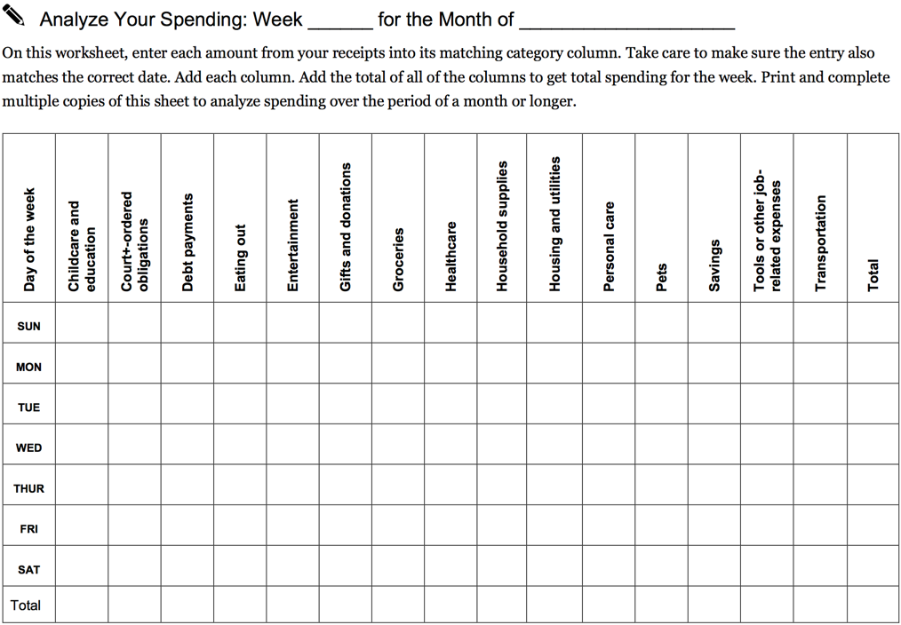
Tool 1: Spending tracker
Notes:
Module 4: Paying Bills and Other Expenses
Presentation (Module 4, Tool 1: Spending tracker) (Page 143)
While there are many approaches to doing this, this is the tool within Your Money, Your Goals.

Slide 92
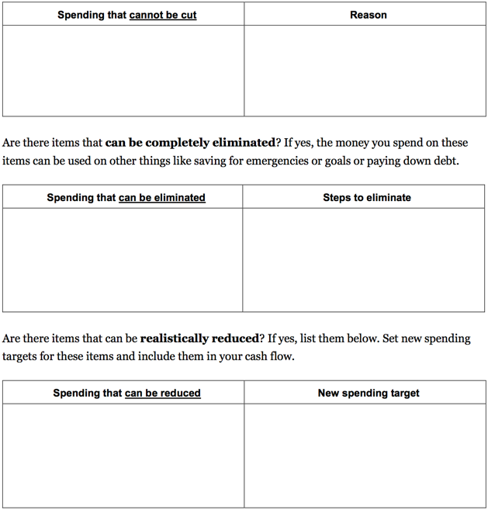
Analyze spending
Spending that cannot be cut
Spending that can be eliminated
Spending that can be reduced
Notes:
Module 4: Paying Bills and Other Expenses
Presentation and Discussion (Module 4, Tool 1: Spending tracker)
Review the analysis section of the spending tracker and discuss the benefits of doing this separately from creating a budget.

Slide 93
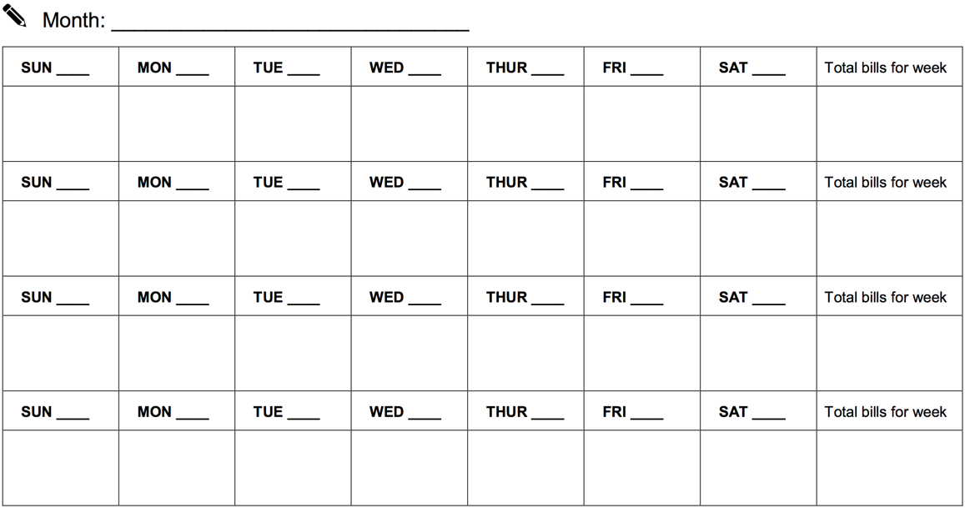
Tool 2: Bill Calendar
Notes:
Module 4: Paying Bills and Other Expenses
Presentation (Module 4, Tool 2: Bill calendar) (Page 149)
Review Tool 2: Bill calendar – with participants using the following instructions excerpted from the tool.
Print the bill calendar and fill in the name of the month and year.
Add numbers to represent the days of the month.
Gather all of the bills you pay in one month OR use the information from your spending tracker.
Write the due dates for these bills. Since due dates are when bills must arrive, write the date bills must be sent:
If paying by mail, mark the due date at least 7 days before it is due.
For in-person or automatic bill payment, mark one or two days before the due date to ensure you are not late.
Fill in the calendar with the business or person you owe the money to, the date the money must be sent to arrive on time, and the amount that is due.
Put this calendar somewhere you will see it every day to ensure you are not forgetting about important bills.

Slide 94
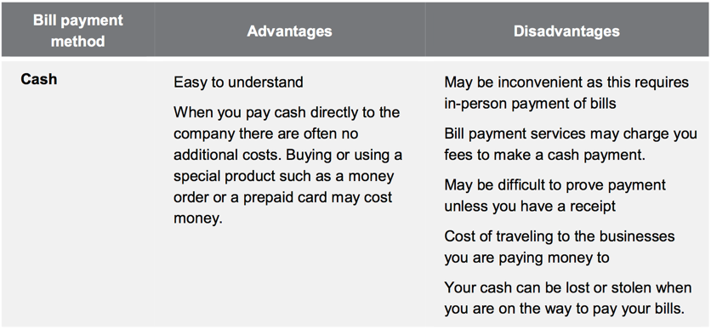
Tool 3: Ways to pay bills
Notes:
Module 4: Paying Bills and Other Expenses
Presentation (Module 4, Tool 3: Ways to pay bills) (Page 151)
Explain the advantages and disadvantages of different ways to pay bills using the information in Tool 3: Ways to pay bills: Know your options:
Cash
Money order
Check
Credit cards
Automatic debit from checking/savings accounts, prepaid card, or credit card
Online bill payment
Explain that with information about the advantages and disadvantages of each method of bill payment, individuals can make choices that may help them:
Save time
Save money
Avoid additional or unnecessary fees
Create a reliable record of bill payment

Slide 95
Tool 4: Strategies for cutting expenses
Review this tool on Pages 155 - 159.
Think about the people you serve.
Which strategies listed do you think are most feasible for them?
  Circle these.
What strategies are missing?
  Add these.
Notes:
Module 4: Paying Bills and Other Expenses
Tool Analysis (Module 4, Tool 4: Strategies for cutting expenses) (Page 155)
NOTE: This activity can be done individually, in pairs or in small groups.
Ask participants to think about the people they serve.
Ask them to analyze this tool from the perspective of the people they serve.
Have them circle the strategies for cutting spending and other uses of financial resources they think will be feasible for them.
Have them add strategies they feel are missing.
Solicit ideas from the group.
Write them on flip charts.
Consider adjusting the tool post-training and redistributing it based on your service providers’ insight from working with community members and the strategies they would add or remove from the tool.

Slide 96
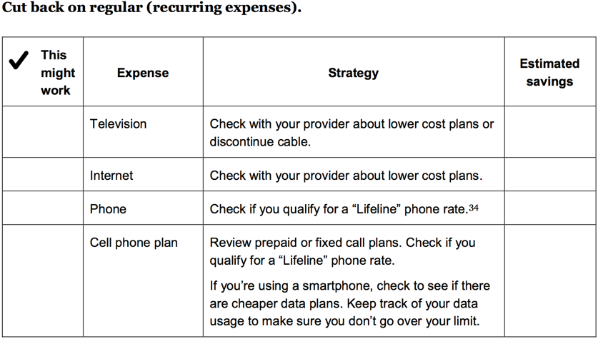
Tool 4: Strategies for cutting expenses
Notes:
Module 4: Paying Bills and Other Expenses
Tool Analysis (Module 4, Tool 4: Strategies for cutting expenses) (Page 155)
Show excerpt of the tool for reference.

Slide 97
Consequences of skipping bills
Group 1:
  a. Consequences of paying rent late.
  b. Consequences of missing multiple rent payments.
Group 2:
  a. Consequences of making car payment late.
  b. Consequences of missing multiple car payments.
Group 3:
  a. Consequences of being late with electricity bill.
  b. Consequences of multiple late electricity bill payments.
Group 4:
  a. Consequences of missing payday loan payment.
  b. Consequences of missing credit card payment.
Notes:
Module 4: Paying Bills and Other Expenses
Small Group Exercise (Module 4)
NOTE: This activity is optional.
Have participants count off into 4 groups.
NOTE: If there are more than 20 participants, consider have two group 1s, two group 2s, etc. as necessary.
Have each group list the consequences of both its “a” and “b” scenario on a flip chart.
Have groups share their lists after 7 minutes.
Add to list of consequences as appropriate.

Slide 98
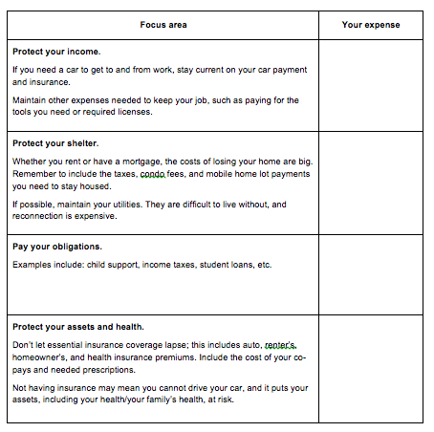
Tool 5: Prioritizing bills
Notes:
Module 4: Paying Bills and Other Expenses
Presentation (Module 4, Tool 5: When cash is short: Prioritizing bills and planning spending) (Page 161)
Review approach to prioritization and the rationale for this.
Be sure to emphasize that this is a short-term plan ONLY.
Explain that people often pay the creditors that complain the loudest. IF and only IF they truly cannot make their bills, they must come up with a short-term plan to avoid long-term consequences of not paying some bills or expenses that could lead to their losing their job, their shelter, key assets, or having legal consequence by not paying obligations, especially those that have been court-ordered.
ASK: When could you envision using this tool with the people you serve?
Summarize the module by sharing:
Understanding how you use your income and other financial resources is an essential step to financial empowerment.
Use the tools in this section to track and analyze how you use your financial resources. Use Tool 2: Bill calendar, to organize your regular payments. Once completed, this can serve as a visual reminder to pay your bills on time. There are online tools as well as apps that can help you do the same thing.
If you find you are spending too much, you can apply some of the strategies for cutting spending. But be sure you are clear about the items that are your needs, your obligations and your wants before you start cutting spending. Finally, sometimes you can’t cover all of your needs, wants and obligations in a month.
Use a conscious strategy if you are going to have to skip or delay payments. Consider protecting your income, shelter, and assets before sending a payment to the “squeakiest wheel”.
Often debt collectors and creditors that fall outside of this strategy will call demanding payment. It is always your responsibility to pay what you owe. But, for example, if you need your car to get to and from your job, in a month that your income is short, you may want to consider delaying a credit card payment and risking late fees instead of missing a car payment and risking repossession.
The tools from this module and Module 3 will help you create a cash flow budget, which is covered in Module 5.

Slide 99
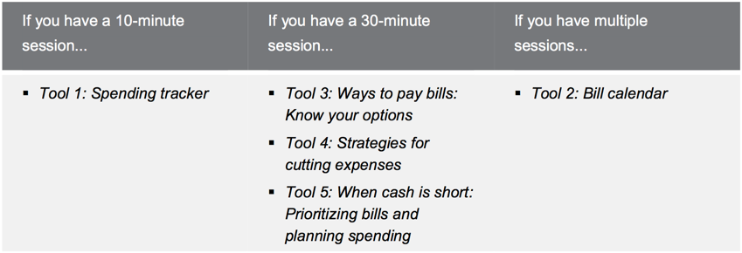
Module 4: Opportunities for financial empowerment
Notes:
Module 4: Paying Bills and Other Expenses
Presentation and Discussion (Module 4)
Highlight opportunities for introducing financial empowerment depending on the amount of time available:
If you have a 10-minute session…
Tool 1: Spending tracker
If you have a 30-minute session…
Tool 3: Ways to pay bills: Know your options
Tool 4: Strategies for cutting expenses
Tool 5: When cash is short: Prioritizing bills and planning spending
If you have multiple sessions…
Tool 2: Bill calendar
If you have time during the training:
ASK: What other ways could you introduce the financial empowerment tools from this module in your work?
WRAP UP
Making changes to how you spend means knowing the difference among your needs, wants, and obligations—changes can generally only be made to spending for wants.
Paying bills on time may help you avoid late fees, fines, increased costs of services, and decreases in your credit scores.
Use Tool 1: Spending tracker to understand how you use your money now.
Use Tool 2: Bill calendar to create a visual reminder of when your bills are due and how much is due.
Use Tool 3: Ways to pay bills: Know your options to better understand the advantages and disadvantages of different methods for paying bills.
Use Tool 4: Strategies for cutting expenses to identify ways to cut spending.
Use Tool 5: When cash is short—prioritizing bills and planning spending to help you develop a short-term plan to get through times when you do not have enough income to cover your needs, wants, and obligations.

Slide 100
Your Money, Your Goals
Module 5: Getting through the month
Notes:
Note: Training sections for content modules are labeled by their module number (ex: Module 1), rather than by Training Section #

Slide 101
Getting through the month
What is a cash flow budget?
How is it different from a regular budget?
What do you think may be the benefit of this approach?
Notes:
Module 5: Getting through the Month
Estimated Time: 45 Minutes
Methodology: Facilitated Discussion / Presentation / Scenario Analysis / Small Group Exercise / Presentation
Corresponding Section in toolkit: Module 5 (Page 163)
Instructions for Facilitator:
Facilitated Discussion
Explore what participants know about cash flow by asking: “What is a cash flow budget?”
After participants offer some ideas, share definition: A projection of how you will get and use your cash and other financial resources.
Contrast cash flow to regular budget by asking: “How is a cash flow budget different from a regular budget?”
After participants offer some ideas, share definition: A cash flow budget tracks the timing of income and spending. This is key.
ASK: What do you think may be the benefit of this approach?

Slide 102
Cash flow budget
 | Week 1 | Week 2
Beginning balance for the week | $37.00 | $122.37
Sources of cash and other financial resources
Income from job | $305.34 | $290.80
SNAP | $280.00
Public housing voucher | $650.00
Total sources of cash and other financial resources | $1,272.34 | $413.17
Uses of cash and other financial resources
Savings | $20.00 | $20.00
Housing | $650.00
Utilities | $59.97 | $95.50
Groceries | $180.00 | $80.00
Eating out (meals and beverages)
Transportation | $240.00 | $60.00
Total uses of cash and other financial resources | $1,149.97 | $255.50
Ending balance for the week | $122.37 | $157.67
Ending balance from previous week
To get a starting balance, total your cash, debit card , and account balances.
Notes:
Module 5: Getting through the Month
Presentation (Module 5)
Review the components of a cash flow.

Slide 103
Cash flow budget
 | Week 1 | Week 2
Beginning balance for the week | $37.00 | $122.37
Sources of cash and other financial resources
Income from job | $305.34 | $290.80
SNAP | $280.00
Public housing voucher | $650.00
Total sources of cash and other financial resources | $1,272.34 | $413.17
Uses of cash and other financial resources
Savings | $20.00 | $20.00
Housing | $650.00
Utilities | $59.97 | $95.50
Groceries | $180.00 | $80.00
Eating out (meals and beverages)
Transportation | $240.00 | $60.00
Total uses of cash and other financial resources | $1,149.97 | $255.50
Ending balance for the week | $122.37 | $157.67
Total sources minus total uses
This becomes your beginning balance for next week.
Notes:
Module 5: Getting through the Month
Presentation (Module 5)
Review the components of a cash flow.

Slide 104
Reading a cash flow budget: Scenario overview
Rafael is a single parent with two children.
He is often late with his rent and other bills, because he does not have the money when he needs it.
After tracking his spending, he developed a cash flow budget with an educator at a parenting class he takes through Cooperative Extension in his community.
Using the cash flow, make some recommendations to Rafael so he can make ends meet.
Notes:
Module 5: Getting through the Month
Scenario Analysis (Module 5)
Instruct participants to get into groups of three.
Review the introduction facts of the scenario they will analyze.
Give each group a copy of the next slide.

Slide 105
Managing cash flow scenario
Notes:
Module 5: Getting through the Month CONTINUED
Scenario Analysis (Module 5)
Make copies of this slide and distribute.
Additional information on the scenario
Rafael earns $14.65/hour and works 40 hours per week; he is paid every other week. (His net pay was calculated using an online calculator from ADP based on Oklahoma state tax laws. He is head of household, claims 3 federal exemptions, and has no voluntary deductions. The number was rounded up to $990.)
Credit card payment reflects minimum payment; personal loan is to grandmother (owes $2,000).
Rent includes utilities--electricity, gas, water, sewer, garbage pickup.
Part-time childcare is provided by family member at a big discount ($10/day to cover expenses for 7 days a week). This expense increases during the summer months when the kids are not in school (from $10/day to $25/day). However, during May, June, July, and August, the income from landscaping (his part-time job) doubles.

Slide 106
Cash flow analysis questions
When does Rafael run out of money?
What can he do (or try to do) to better match the timing of his income and his expenses?
  Develop a prioritized list.
How does the SNAP benefit factor into the cash flow?
The next month is not included in the example. What will Rafael’s situation be at the beginning of next month? How much cash will he have? What bills will he have? What should he do now to prepare for the following month?
Notes:
Module 5: Getting through the Month CONTINUED
Scenario Analysis (Module 5)
Instruct participants to analyze the cash flow and answer the first three questions above.
After 5 minutes, reveal the fourth question and instruct them to answer this within their groups.
Process as a large group:
When does Rafael run out of money? Answer: At the end of the first week.
What can he do (or try to do) to better match the timing of his income and his expenses?
Develop a prioritized list.
Possible Answers:
See if landlord will accept rent payment the second week instead of the first.
See if the landlord will take half of the payment the first week of the month and half the third week of the month.
See if student loan payment can be moved to final week of the month. Explore other payment plans depending on type of loan such as Income-based Repayment.
See if auto loan payment can be moved.
How does the SNAP benefit factor into the cash flow? Answer: SNAP is important because it covers food; However, it makes it look like he has more cash during the first week than he actually does because SNAP can only be used for food.
The next month is not included in the example. What will Rafael’s situation be at the beginning of next month? How much cash will he have? What bills will he have? What should he do now to prepare for the following month? Possible answers: His situation will be the same next month. He needs to get more income. First, he should make sure he is getting all of the benefits he and his family qualify for. Once this is done, he needs to consider getting more income from another part-time job.
ASK: Would a regular monthly budget highlight the shortfalls in cash?
Answer: No
Reason: Total income and benefits not including the starting cash balance is $3,272 for the month.. Total expenses for the month $3167.22. While the budget is tight, a typical static monthly budget would show that everything is covered with a surplus of $104.78. This is the problem with a regular, static monthly budget.
Be sure to ask participants:
What do you think about this approach to budgeting versus the traditional approach? Be sure to discuss the week-by-week nature of this tool rather than the overall monthly approach presented by most financial educators.
What do you think are the potential benefits of using this approach with people? For yourself?
How did your opinion of this approach change after the case study?
What additional information do you need to feel comfortable with this approach to budgeting?

Slide 107
Developing a cash flow budget
Use information from:
  Tool 1: Income and resource tracker from Module 3: Managing income and benefits
  Tool 1: Spending tracker from Module 4: Paying bills and other expenses.
  Spending analysis section of Tool 1: Spending tracker from Module 4: Paying bills and other expenses.
  to understand your current situation.
Notes:
Module 5: Getting through the Month
Presentation (Module 5)
Review the steps to creating a cash flow budget.

Slide 108
Developing a cash flow budget
Review your goals.
Review Planning for life events and large purchases worksheet if completed.
Choose format for cash flow. Tool 1: Cash flow budget or Tool 2: Cash flow calendar.
Write the following in the approximate week you expect each item to happen:
  Projected income, benefits, and others resources, and
  Spending that cannot be cut.
Notes:
Module 5: Getting through the Month
Presentation (Module 5)
Review the steps to creating a cash flow budget.

Slide 109
Developing a cash flow budget
Set targets for spending to help create savings for goals, life events, and large purchases.
  Spending that can be eliminated
  Spending that can be reduced
Fill in savings for goals, life expenses, and large purchases.
Notes:
Module 5: Getting through the Month
Presentation (Module 5)
Review the steps to creating a cash flow budget.

Slide 110
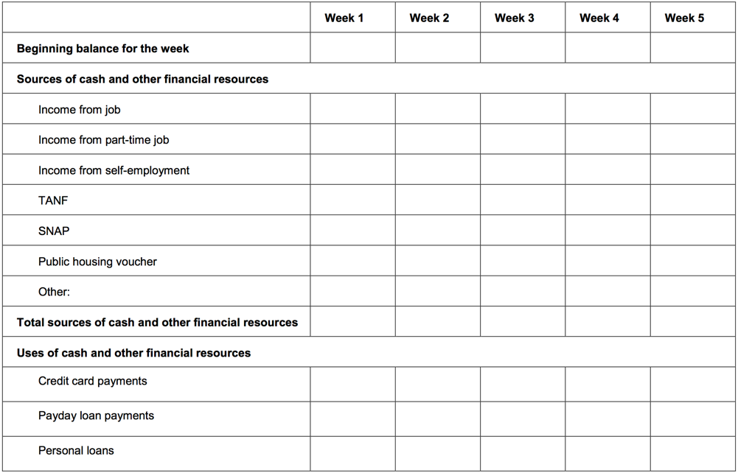
Tool 1: Cash flow budget
Notes:
Module 5: Getting through the Month
Presentation (Module 5, Tool 1: Cash flow budget) (Page 165)
Share excerpt of Tool 1.
Summarize steps for making a cash flow budget.

Slide 111
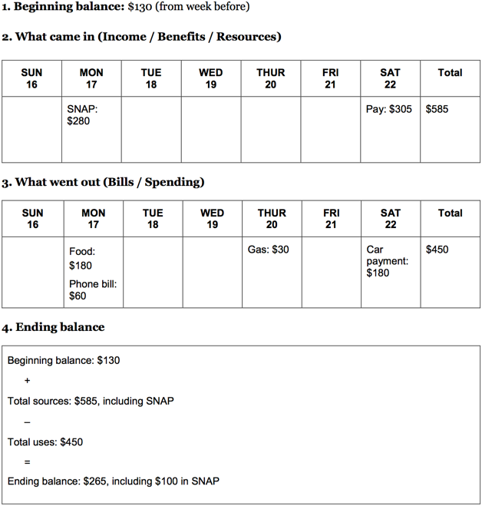
Tool 2: Cash flow calendar
Notes:
Module 5: Getting through the Month
Presentation (Module 5, Tool 2: Cash flow calendar) (Page 175)
Orient participants to the other format included for cash flow—Tool 2: Cash flow calendar.
Discuss the pros and cons of this format with participants.
Explain that they should feel free to introduce the one they think will work best for each person they work with.
Encourage participants to use these tools in their own households for a month or two to increase their familiarity with their use.

Slide 112
Tool 3: Improving cash flow checklist
    Increase sources of cash, income, or other financial resources, including accessing public benefits and applying for tax credits for which you qualify.
    Decrease your spending or uses of cash and other financial resources.
    Match timing of sources and uses of income where possible.
Notes:
Module 5: Getting through the Month
Presentation and Small Group Exercise (Module 5, Tool 3: Improving cash flow checklist) (Page 179)
Explain that there are basically three overall strategies to improving cash flow:
Increase sources of cash, income, or other financial resources, including accessing public benefits and applying for tax credits.
Decrease spending or uses of cash and other financial resources.
Match timing of sources and uses of income where possible.
Instruct small groups to brainstorm specific ways to smooth out cash flow. Encourage them to think about ways to increase income, decrease spending, and match timing.
Encourage the group to select one person to write the ideas on a piece of paper.
Give teams 3 minutes to brainstorm.
Have them report out cumulatively soliciting ideas using round robin format (one idea per team until all teams have contributed, then repeat until ideas are exhausted).
Write their ideas on flip charts organizing them by category.
Following exercise, instruct participants to review Tool 3. Encourage them to add ideas from the activity not included in the tool.

Slide 113
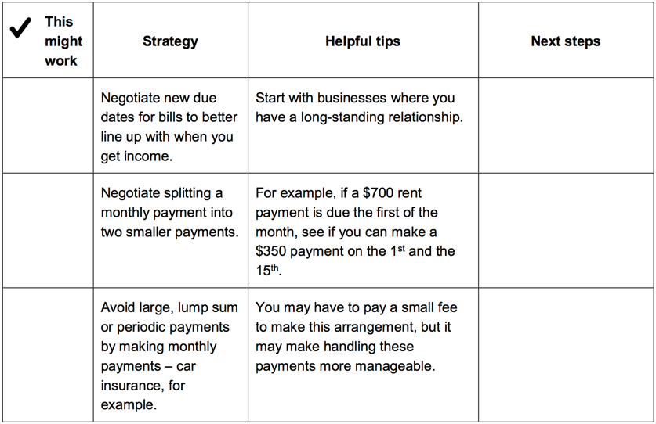
Tool 3: Improving cash flow checklist
Notes:
Module 5: Getting through the Month
Presentation (Module 5, Tool 3: Improving cash flow checklist) (Page 179)
Share excerpt of Tool 3.
Summarize by sharing:
A cash flow budget is a projection of how you will get and use your cash and other financial resources.
A cash flow budget is different from a regular budget, because it includes not only the amount for each budget item, but also the timing of your income and expenses.
This is important because people often find themselves flush with cash one week—and splurge on something fun—but come up short the next week for a necessity.
Timing matters. A cash flow budget will help an individual identify where she is falling short within the month. It can help her ensure she has the financial resources on hand to cover the most important expenses—so she doesn’t fall short covering the rent, for example. A cash flow budget can better help an individual target areas where they could consider cutting back.
Remember, sometimes there is not enough money to cover the month. In this case it is important to develop a short-term plan to prioritize bills and pay those that protect income, shelter, assets, and continue obligations. This can help responding in the moment to a high pressure debt collector collecting on a lower priority debt. But when making these decisions, people should be fully aware of the consequences and know money not paid today will become a debt in the future.

Slide 114
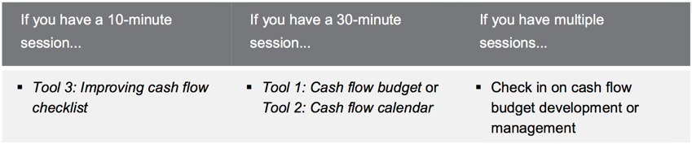
Module 5: Opportunities for financial empowerment
Notes:
Module 5: Getting through the month
Presentation and Discussion (Module 5)
Highlight opportunities for introducing financial empowerment depending on the amount of time available:
If you have a 10-minute session…
Tool 3: Improving cash flow checklist
If you have a 30-minute session…
Tool 1: Cash flow budget, or
Tool 2: Cash flow calendar
If you have multiple sessions…
Check in on cash flow budget development or management
If you have time during the training:
ASK: What other ways could you introduce the financial empowerment tools from this module in your work?
Remind participants that a cash flow budget helps someone UNDERSTAND how the timing of income and expenses may be causing shortfalls within a month; these shortfalls can be masked in a static monthly budget.
WRAP UP
The following steps can help you make a cash flow budget;
Keep track of everything you earn and spend money on for a week, two weeks, or one month. Tool 1: Income and resources tracker from Module 3 and Tool 1: Spending tracker from Module 4.
Analyze your spending. Tool 1: Spending tracker from Module 4.
Use this information to create a cash flow budget. Use Tool 1: Cash flow budget to complete this step or Tool 2: Cash flow calendar.
Remember to include savings for goals, large purchases, and life events, too!
Your cash flow budget is about setting targets for how you will use your income going forward.
Use Tool 3: Improving cash flow checklist to identify specific strategies for improving cash flow.

Slide 115
Your Money, Your Goals
Module 6: Dealing with debt

Slide 116

What is debt?
What is debt?
  Money you owe.
  Debt is a liability.
  Debt may obligate future income.
How is debt different from credit? For our purposes…
  Credit is the ability to borrow money.
  Debt is the result of using credit.
Notes:
Module 6: Dealing with Debt
Estimated Time: 45 Minutes
Methodology: Facilitated Discussion / Stand Up-Sit Down / Activity in Pairs / Presentation / Exercise in Small Groups / Personal Stories
Corresponding Section in toolkit: Module 6 (Page 183)
Instructions for Facilitator:
Facilitated Discussion (Module 6)
ASK: What is a debt?
After participants offer some ideas, share definition: Money you owe to another person or business. Debt is a liability. Debt may obligate future income.
ASK: How is debt different from credit?
After participants offer some ideas, share definition: Credit means you can borrow money. Debt is the result of using credit. Credit is not a liability. When you use it, though, you create a liability.
ASK: How is secured debt different from unsecured debt?
After participants offer some ideas, share definitions: Secured debt is debt that has an asset attached to it. When debt is secured, a lender can collect that asset if you do not pay.
Ask participants for examples of secured debt.
After participants offer some ideas, share examples:
A home loan—the debt is secured with the home you are buying. If you do not pay your loan, the lender will foreclose on your home, sell it, and use the money from the sale to cover your loan.
An auto loan—the debt is secured with your car. If you do not pay your loan, the lender will repossess (repo) your car and sell it to cover the loan.
A payday loan—the debt is secured with your post-dated check. If you do not renew the loan, the check will be cashed.
A pawn loan—the debt is secured with the item you have pawned. If you do not make payment when it is due, the pawned item is sold to the general public.
A rent-to-own lease—the debt is secured with the items (furniture, fixtures, electronics, appliances) you are making payments on. If you do not make your payments, the item is repossessed and made available to someone else to rent. You do not get back any rental payments you have made.
Unsecured debt does not have an asset attached to it.
Ask participants for examples of unsecured debt.
After participants offer some ideas, share examples:
Credit card debt
Department store charge card debt
Signature loans
Medical debt
Student loan debt
If these loans are not paid as agreed, they often go to collections.

Slide 117
Good debt, bad debt
Loan from friend or family member
Car loan
Student loan
Payday loan
Mortgage (loan for a home)
Car title loan
Pawn shop loan
Notes:
Module 6: Dealing with Debt
Stand Up, Sit Down Activity (Module 6) (Page 184)
Explain that some people think of some debt as good debt and some debt as bad debt.
Explain that as each type of debt appears on the screen, they should stand up if they think the debt is bad debt and stay seated if they think it is good debt.
Reveal the debts listed above one at a time.
Facilitate a discussion about the reasons people think the debt is good or bad.
NOTE: Be sure to challenge them a bit around “conventional wisdom.” For example, people have long believed student loan debt is “good debt.” Is this always the case? The same was true with mortgages in the past. Are pawn shop loans always bad? If someone is short of money, given a payday loan versus a pawn shop loan, do they think one is a better option than the other?
Use the following points to augment the discussion:
Loan from friend or family member
GOOD—Likely to have flexible terms; may be low or no interest; missed payments not reported to credit reporting agencies
BAD—Can create family conflict; cannot be used to build credit history
Car loan:
GOOD—Can help you get needed transportation for job, school, life; secured with the car so will likely not need additional collateral; regular payment can help build credit history
BAD—Depending on loan, terms can be unfavorable; borrowing full value of car can lead to being upside down in loan (owing more than the car is worth); missed payment can result in repossession—no transportation for job and negative entry on credit reports
Student loan:
GOOD—Can help you access postsecondary education or training, which can lead to a higher paying job; federal student loans have repayment options; regular payment can help build credit history
BAD—Borrowing more to pay for education than likely wages within career can support in terms of repayment; borrowing for education but not completing degree (created a liability without the benefit of a potentially higher paying job); terms and conditions misunderstood (allowing interest to accrue); likely to not be forgiven even in bankruptcy except under extreme circumstances
Payday loan:
GOOD—Can help you get needed cash quickly and with little hassle
BAD—High-cost; may not to be able to pay in full within initial term (generally 14 days) and may need to renew; often leads to repeat loans; if renewal not paid, post-dated check will be cashed and can deplete your accounts and/or overdraft them and lead to overdraft charges
Mortgage (loan for a home):
GOOD—Can help you get a home of your own; currently, interest rates are low, so the loan is less expensive than in decades past; secured with the house so will likely not need additional collateral; regular payment can help build credit history
BAD—Depending on loan, terms can be unfavorable; if you borrow the full value of the home and home values decrease, you could be upside down in the loan (owing more than the home is worth); missed payments can result in foreclosure—no home and negative entry on credit reports; selling the home can be difficult depending on the market and the condition of the home
Car title loan:
GOOD—Can help you get needed cash quickly and with little hassle
BAD—Can lead to loss of your car title if the loan not paid as agreed
Pawn shop loan:
GOOD—Can help you get needed cash quickly and with little hassle
BAD—Can lead to loss of asset pawned if loan not paid as agreed

Slide 118
Rent-to-own arrangements
Rent-to-own arrangements
Leasing consumer goods, typically with the option to purchase the item by continuing to make payments for some specified period of time
Typically more expensive than if purchased outright
Items can be confiscated if payments are not made as agreed
You have the option to return the item at any time
Notes:
Module 6: Dealing with Debt
Presentation (Module 6)
Explain:
In rent-to-own arrangements for consumer goods such as furniture, fixtures, electronics, or appliances, you lease the items and typically have the option to purchase the item by continuing to make payments for some specified period of time, or by paying off the balance during the term of the lease.
Items rented/purchased this way tend to be more expensive than items purchased outright.
If the payments are not made as agreed, the lessor/seller can take the item back.
You have the option to return the item at any time.
If you return the item or the lessor/seller takes it back, you do not get a refund of money already paid.
In most states, these transactions are treated as leases, but in some states they are considered credit sales under state law.

Slide 119
Co-signers: Agree to repay the loan
Co-signing on a loan
Means you have the same obligation to pay the debt as the borrower
Can result in you having to repay any missed payments
Can affect your credit score and ability to obtain a future loan
Before co-signing, read the terms of the loan and consider carefully before taking on the risk.
Notes:
Module 6: Dealing with Debt
Facilitated Discussion (Module 6)
Explain:
A co-signer is a co-borrower and has the same obligation to pay a debt as the borrower. In most cases a lender or creditor does not even have to first attempt to seek repayment of a debt from the borrower before seeking repayment from you as a co-signer. A co-signer is at risk of having to repay any missed payments. And, if the borrower defaults on the loan, you as a co-signer have generally agreed to repay the entire loan.
Your credit score may also be affected, for example, if the borrower is late with or fails to make any payments.
Co-signing a loan may also affect your ability to obtain a future loan because a creditor may take into account the increased amount of debt that you have as a result of co-signing for a loan.
Lenders sometimes ask for a co-signer when they are concerned that a prospective borrower will not be able to repay a loan. The co-signer helps decrease a lender’s concern about repayment. If you decide to co-sign for a loan, you should read the terms of the loan and consider carefully before taking on the risk of co-signing.

Slide 120
Medical debt
What are the factors that can lead to medical debt?
Medical debt is almost always the result of an unplanned event—someone becoming ill or injured.
The costs of the care are almost never fully known upfront.
Invoices and bills may be confusing
Uninsured individuals are generally charged more for services
Notes:
Module 6: Dealing with Debt
Facilitated Discussion (Module 6) (Page 197)
Ask participants to share some of the reasons people have medical debt.
If not shared, provide the following factors that lead to medical debt:
Medical debt is almost always the result of an unplanned event—someone becoming ill or injured. Even with health insurance, co-pays and deductibles can add up. This is one reason that emergency savings is important for building financial stability.
Secondly, the costs of the care are almost never fully known upfront. Unlike the cost of a house or car, where you should know what you will pay when you sign the loan agreement, when you accept responsibility for payment of your treatment at a hospital or other medical provider, you generally have no idea how much the treatment will cost. You may also not know your share of the cost.
Invoices and bills may be confusing. Rather than one itemized bill, you may receive several bills over a period of weeks or months with hospital stays or situations that involved multiple health care services providers. Because of this confusion, people may be more likely to not recognize the information contained on the invoice or hesitate or delay paying a medical bill. They may have questions about whether the amount was already paid by insurance, whether the correct amount was billed, or whether they actually received the billed treatment.
And without knowing how much the total cost should be, how much the insurer will cover, and how much of the cost will be passed on to you, it becomes difficult to determine whether you are being charged the right amount. That leaves consumers in a position where they need to review each medical bill carefully and contact providers or insurers when they have questions.
Uninsured individuals are generally charged more for services. Insurance companies negotiate discounts for services. This means that if you are uninsured, your bill will likely be higher than the bill that someone who has insurance receives for the same procedures and care.

Slide 121
Avoiding medical debt
Get cost estimates up front
Find out whether there is a prompt payment discount
Ask for a discount on the treatment
Ask about “charity care”
If you are asked to put a hospital bill on a credit card, be careful
Work with the health care provider to set up a reasonable repayment plan
Notes:
Module 6: Dealing with Debt
Facilitated Discussion (Module 6)
Review some ways to avoid medical debt. Be sure to ask participants for their ideas and suggestions.
Use the following information from the toolkit to add to the discussion:
Get cost estimates up front—then you can decide whether to proceed or delay elective procedures.
Find out whether there is a prompt payment discount, which can be substantial. This may mean cutting back in other areas for a few months in order to pay the bill and secure the discount.
Ask for a discount on the treatment.
Ask about “charity care” from the hospital and government before or immediately following treatment.
If you are asked to put a hospital bill on a credit card, watch out. Many hospitals have some obligation to provide for charity care for those who can’t afford treatment. Once you put your hospital bill on a credit card, you won’t be considered for a later write-down of your bill under the charity care program. Some medical providers even offer a credit card for you to use at the provider’s office. Healthcare credit cards can have tricky terms, so make sure you know what you’re getting into. For tips on healthcare credit cards see: http://www.consumerfinance.gov/blog/whats-the-deal-with-health-care-credit-cards-four-things-you-should-know/
If you can’t afford to pay for the care even after charity care and discounts have been applied, take steps to work with the provider to set up a reasonable repayment plan. As you negotiate, ensure that as long as you pay as agreed, reports made to credit reporting agencies will reflect that you are making payments as required by the plan. Be sure to get your repayment plan agreement in writing. Also, consider asking for the following terms:
No interest on the debt
Monthly statements showing the amount paid and the outstanding balance
Request that the debt not be turned over to a third party collection agency – that the debt servicing stays in-house
Be sure you do not sign an agreement that states you will make full payment of the debt if you are late or miss a payment on your plan.
Check your credit report to make sure resolved bills are reported accurately or any errors are removed from your credit history. If the credit reporting agency doesn’t respond, contact your state’s consumer protection agency, attorney general, or the Consumer Financial Protection Bureau.
If you do get sued by a medical service provider or hospital, respond. Get legal assistance from the legal aid organization in your community or a lawyer.
Be sure you do not jeopardize your ability to earn income or pay for your shelter or food because you have paid more income than you can afford to cover a medical debt.

Slide 122
Payday loans
Borrower visits payday lender.
Borrower gets loan.
Borrower gives lender 14-day post-dated check.
In 14 days, if the borrower doesn’t have the money, loan is renewed.
Every 14 days, the borrower must pay the loan or renew it.
The average borrower has 10 transactions per year. In this example, it would cost $525 to borrow $350.
Borrower must pay $52.50 to renew.
The amount borrowed + fees
$350 + 52.50 = 402.50
Median loan is $350 and fees range $10 - $30 for each $100 borrowed
No credit check or consideration of borrower’s ability to repay the loan
Notes:
Module 6: Dealing with Debt
Presentation and Discussion (Module 6)
ASK: What is a payday loan?
Augment participants’ responses with the following facts from the toolkit:
A payday loan, “cash advance”, or “check loan” – is a short-term loan, generally for $500 or less.
They generally come due on your next payday.
You must give the lender access to your checking account by electronic debit (ACH) or write a check for the full balance in advance that the lender has an option of depositing when the loan comes due.
Depending on your state law, other loan features can vary. For example, payday loans are often structured to be paid off in one lump-sum payment, but interest-only payments – "renewals" or “rollovers” – are not unusual.
In some cases, payday loans may be structured so that they are repayable in installments over a longer period of time. These installments are typically due on the consumer's payday and with the lender generally having the ability to automatically collect payments from the consumer's bank account by means of depositing post-dated checks or ACH authorizations. Loans like this are offered at a traditional storefront payday lender or online.
Some ways that lenders might give you the loan funds are providing cash or a check, loading the funds onto a prepaid card, or electronically depositing the money into your checking account.
The cost of the loan (finance charge) may range from $10 to $30 or more for every $100 borrowed.
A typical two-week payday loan with a $15 per $100 borrowed fee equates to an annual percentage rate (APR) of almost 400 percent. By comparison, APRs on credit cards can range from about 12 percent to 30 percent.
State laws and other factors can influence how much you can borrow and the fees you are charged.
Some state laws do not permit payday lending and in other states lenders may choose not to do business.
Be aware of common misunderstandings and the facts about payday loans:
Consumers only use payday loans for emergencies.
Fact: Most borrowers do not use their first loan for emergency expenses. The Pew Charitable Trusts’ Payday Lending in America found that 69 percent of first-time borrowers use the loan to pay for regular bills, while only 16 percent use them for emergencies such as a car repair.
Borrowers can pay back the loan without reborrowing.
Fact: While they may pay it back on time, many borrowers have to either immediately take a new loan or take another one in the same pay-period. The Pew Charitable Trust found on average, payday borrowers are in debt for five months out of the year and pay an average of $520 in fees on top of the money they have borrowed.
The Pew Charitable Trust State and Consumer Initiatives. Payday Lending in America. October 2013. http://www.pewtrusts.org/en/multimedia/data-visualizations/2012/payday-lending-in-america.
Special protection for active servicemembers:
There are special obligations on creditors under the Military Lending Act (MLA) for active duty servicemembers and their covered dependents.
For example, as of October 3, 2016, the MLA caps certain credit costs on most types of consumer loans to an annual rate of 36 percent (referred to as the Military Annual Percentage Rate or “MAPR”).
Included in the MAPR are costs like:
finance charges
credit insurance premiums or fees
additional fees associated with credit, such as application or participation fees, with some exceptions.
These restrictions apply to most types of consumer credit, such as:
credit cards (beginning October 3, 2017)
payday loans
deposit advance products.
There are some exceptions, such as residential mortgages and certain secured loans for the purchase of personal goods and vehicles.
Credit agreements that violate the MLA are void from the start.
Key point: While many states ban or severely limit rollovers/renewals, the Bureau has found that this has done little in practice to stop the debt trap. Rather, these bans/limits are evaded by giving the borrower a new loan right after the old loan is repaid or shortly thereafter.

Slide 123
Debt settlement services
What is debt settlement?
Should you use a debt settlement service to deal with your debt?
What are the consequences of using a debt settlement service?
What are some red flags to watch out for when deciding to do business with a debt settlement service?
Notes:
Module 6: Dealing with Debt
Facilitated Discussion (Module 6) (Page 201)
ASK: What is debt settlement?
Explain: Debt settlement companies say they can renegotiate, settle, or in some way change the terms of your unsecured debt to a creditor or a debt collector. That may include reducing the balance, interest rates, or fees you owe.
As a group discussion, or in small groups, discuss the following questions:
ASK: Should you use a debt settlement service to deal with your debt?
ASK: What are the consequences of using a debt settlement service?
Allow the group to discuss the pros and cons to using a debt settlement service.
If it is not mentioned, state:
Debt settlement companies often charge expensive fees, and some charge illegal up-front fees.
Some debt settlement companies advertise that they will help consumers, but they provide little or no assistance.
ASK: What are some red flags to watch out for when deciding to do business with a debt settlement service?
If it is not mentioned, state:
You should avoid doing business with any company that promises to settle the debt if the company:
Charges any fees before it settles your debts.
Touts a “new government program” to bail out personal credit card debt.
Guarantees to you that it can make the debt go away.
Tells you to stop communicating with the creditors.
Tells you it can stop all debt collection calls and lawsuits.
Guarantees that the unsecured debts can be paid off for pennies on the dollar.
Summarize the points made during the discuss
Include that you can try to do this yourself by contacting your creditors.

Slide 124
Tool 1: Debt worksheet
On the debt management worksheet, you will include:
The person, business, or organization you owe money to;
The amount you owe them;
The amount of your monthly payment; and
The interest rate you are paying and other important terms.
To complete this worksheet, you may need to get all of your bills together in one place and a copy of your credit report.
Notes:
Module 6: Dealing with Debt
Presentation and Facilitated Discussion (Module 6, Tool 1: Debt worksheet) (Page 203)
Explain how to use Tool 1.
ASK: How would you use this tool with the people you serve?

Slide 125
Tool 2: Debt-to-income worksheet
How much debt is too much?
Debt-to-income ratio
This simple calculation shows you how much of your income goes toward paying your debt.
The debt-to-income ratio is good measure of how much of your income is obligated to debt.
Notes:
Module 6: Dealing with Debt
Presentation (Module 6, Tool 2: Debt-to-income worksheet) (Page 207)
Explain what the DTI ratio is and how it is used.

Slide 126
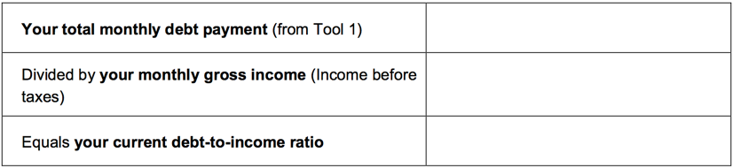
Tool 2: Debt-to-income worksheet
Notes:
Module 6: Dealing with Debt
Presentation (Module 6, Tool 2: Debt-to-income worksheet) (Page 207)
Explain how to calculate the debt-to-income (DTI) ratio.
Reference Tool 2 in toolkit.

Slide 127
Tool 2: Debt-to-income worksheet
Renters
Consider maintaining a debt-to-income ratio of .15 - .20, or 15% - 20%, or less.
Homeowners
Consider maintaining a debt-to-income ratio of .28, or 28%, or less for just the mortgage (home loan), taxes, and insurance.
Consider maintaining a debt-to-income ratio for all debts of .36, or 36%, or less.
Notes:
Module 6: Dealing with Debt
Presentation (Module 6, Tool 2: Debt-to-income worksheet) (Page 207)
NOTE: Summarize this slide on a flip chart if you are doing the Shawna activity described on “Activity in pairs” slide.
Explain how to interpret the DTI ratio.
Renters: Consider maintaining a debt-to-income ratio of .15 - .20, or 15% - 20%, or less.
This means that monthly credit card payments, student loan payments, auto loan payments, and other debts should take up 20% or less of your gross income.
Homeowners: Consider maintaining a debt-to-income ratio of .28, or 28%, or less for just the mortgage (home loan), taxes, and insurance.
This means that if you have a mortgage, the mortgage alone should take up no more than 28% of your income.
This includes the monthly principal, interest, taxes, and insurance (called PITI).
Homeowners: Consider maintaining a debt-to-income ratio for all debts of .36, or 36%, or less.
This means that if you have a mortgage and other debts—credit card payments, student loan payments, auto loan payment, and payday loan payments–your debt-to-income ratio should be below 36%.
Some lenders will go up to 43% or higher for all debt.
If you have court-ordered, fixed payments, such as child support, count these as debt for this purpose.

Slide 128

Debt-to-income
$.50 is going to debt
$.50 for everything else:
Taxes
Utilities
Cell phone
Gasoline
Food
Clothing
School fees
Gifts
Savings
Car repairs
Home repairs
Appliances
Furniture
Household supplies
Pet food and supplies
And so on
Notes:
Module 6: Dealing with Debt
Presentation (Module 6)
Discuss DTI in real terms using the following:
If someone’s DTI is 50% that means that $.50 out of every dollar they earn goes towards his/her debt.
That leave $.50 out of every dollar to pay for everything else.
What is everything else?
Taxes
Utilities
Cell phone
Gasoline
Food
Clothing
School fees
Gifts
Savings
Car repairs
Home repairs
Appliances
Furniture
Household supplies
Pet food and supplies
And so on

Slide 129
Debt-to-income calculation activity
Shawna has just graduated, completing her associates degree in nursing. She has already landed a full-time job earning $17.50 per hour. She works full time (160 hours per month). She will be working at a hospital 21 miles from her home and public transportation is not a viable option for her.
She found a good used car, but she can’t afford to buy it without a loan. Her monthly payments on that loan would be $158.
Every month she also pays the following debts:
School loan $205.00
Credit card #1 $90.00; Credit card #2 $55
Mortgage $625.00
What is the debt to income ratio without car loan? With the car loan?
Based on her DTI, do you think she can afford the loan?
Notes:
Module 6: Dealing with Debt
Activity in Pairs (Module 6)
Instruct participants to complete the DTI in pairs.
Have them determine whether the individual should take on more debt.
Instruct them to calculate the DTI without the proposed new debt and with the proposed new debt.
Provide about 3 minutes for participants to calculate the answers.
Consider writing the answers on a flip chart.
Answers
Gross income = 160 hours x $17.50/hour = $2,800
Monthly debt before car loan = $975/month
DTI = .35 or 35%
Monthly Debt with car loan = $1,133
DTI with car loan = .40 or 40%
Instruct participants to share their answers and whether they felt the individual should get the new loan.
Explain that if Shawna gets the loan, that $.40 out of every $1 she earns will be committed each month to cover her debts.
Explain that this leaves $.60 out of every dollar to cover everything else. Ask participants what everything else includes. Write their ideas on a flip chart.
Be sure to add the following if not shared by the participants:
Savings
Taxes
Insurance – Car and Health
Utilities
Food
Clothing
Childcare
Health care (that has not turned into debt)
Child support
Charitable contributions and gifts and
Other family expenses
ASK: What can Shawna do to lower her DTI?

Slide 130

Tool 3: Reducing debt worksheet
The two primary methods for reducing debt are:
  Highest interest rate method
  Snowball method
Consider the pros and cons of each.
Notes:
Module 6: Dealing with Debt
Presentation (Module 6, Tool 3: Reducing debt worksheet) (Page 211)
Review two primary methods for reducing debt outlined in Tool 3:
Highest Interest Rate Method
List your debts from highest rate to lowest rate.
In the column labeled Extra Payment, list the extra payment you will dedicate to the payment of debts with the highest interest rate until you have it paid off.
When this debt is paid off, allocate the entire payment (monthly payment + extra payment) to the next debt on the list.
Focus on the debt with the highest rate of interest, and eliminate it as quickly as possible, because it is costing you the most. Once it is paid off, focus on the next most expensive debt.
PRO
You eliminate the most costly debt first. In the long-run, this method can save you money.
CON
You may not feel like you are making progress very quickly, especially if this debt is large.
Snowball Method
List your debts from smallest to largest in terms of the amount you owe.
In the column labeled Extra Payment, list the extra payment you will dedicate to the smallest debt until you have it paid off.
When this debt is paid off, allocate the entire payment (monthly payment + extra payment) to the next debt on the list.
Focus on the smallest debt. Get rid of it as soon as possible. Once you have paid it off in full, continue with the payment, but now dedicate it to the next smallest debt. This is called the “snow ball method.” You create “a snow ball of debt payments” that keeps getting bigger as you eliminate each debt. How? You keep making the payments, but you are redirecting them to the next debt as each debt is paid off.
PRO
You may see progress quickly, especially if you have many small debts. For some people, this creates momentum and motivation.
CON
You may pay more in total because you are not necessarily eliminating your most costly debt.

Slide 131
Tool 4: Repaying student loans
Federal student loans versus private student loans
Options for federal student loan repayment include:
  Standard payment
  Income-Based Repayment (IBR)
  Pay As You Earn (PAYE)
  Revised Pay As You Earn (REPAYE)
  Graduated payment
  Extended payment
Notes:
Module 6: Dealing with Debt
Personal Stories and Presentation (Module 6, Tool 4: Repaying student loans) (Page 213)
Discuss student loan debt with the participants using information from Tool 4.
Ask participants to share stories from their work with people (without naming them) or their own student loan stories.
Keep track of themes from stories.
Share how many seem to stem from not understanding terms completely or not matching borrowing level with earning potential.
Explain the difference between Federal Student Loans and Private Student Loans.
Federal student loans are loans that are funded by the federal government. Private student loans are nonfederal loans made by a lender such as a bank, credit union, state agency, or a school. With both federal and private student loans, delinquent payments will impact your credit report and may result in collections.
Private student loans do not offer the flexible repayment terms or borrower protections featured by federal student loans.
Explain the options for paying back federal student loans.
Standard repayment – Most borrowers start with this payment plan. This repayment plan has fixed payments of at least $50 per month for up to 10 years.
Income-based repayment (IBR) – Payment is limited to 10 or 15 percent of discretionary income, which is the difference between your adjusted gross income and 150 percent of the Federal Poverty Guidelines. Payments change as income changes, but will never be higher than the standard payment amount. The length of repayment can last up to 25 years. After 20 or 25 years of consistent payment (you have missed no payments or caught up with payments), the loan will be forgiven. You may have to pay income tax on the portion of the loan that is forgiven. To qualify for this repayment plan, you must be able to show partial financial hardship.
A similar IBR plan is available to borrowers who received their first Direct Loans on or after July 1, 2014. The monthly payment cannot exceed 10 percent of your discretionary income, and the maximum repayment term is 20 years. This option is available only for borrowers with federal Direct Loans.
Pay As You Earn (PAYE) – Payment is limited to 10 percent of discretionary income, but will never be higher than the standard payment amount. Payments change as income changes, and the length of repayment can last up to 20 years. After 20 years of payments, the loan is forgiven, and taxes may be owed on the amount forgiven. To qualify for PAYE, you must be able to show partial financial hardship. PAYE is only available for borrowers with federal Direct Loans.
Revised Pay As You Earn (REPAYE) – Payment is limited to 10 percent of discretionary income, but may be higher than the standard payment. Payments change as income changes, and the length of repayment can last up to 20 or 25 years. After 20 or 25 years of payments, the loan is forgiven, and taxes may be owed on the amount forgiven. REPAYE is only available for borrowers with federal Direct Loans.
Graduated repayment – The payment is lower the first year and then gradually increases every 2 years for up to 10 years.
Extended repayment – The payment is fixed or graduated for up to 25 years. The monthly payments are lower than the standard or graduated repayment plans, but you will pay more interest over the life of the loan(s). You must have at least $30,000 in outstanding Direct Loans to qualify for extended repayment.
Be sure to state the following:
Do not ignore student loan paperwork—nonpayment and delinquency reduces options for payment plans as many require loans in good standing to qualify.
Explain deferment and forbearance.
In deferment, payment of both principal and interest is delayed.
If you have a subsidized federal loan, the government pays your interest during the deferment.
Otherwise you must pay interest or it accrues, which means builds up. When interest accrues on student loans, it becomes part of what you owe. This means you ultimately end up paying interest on the interest.
Deferments are only granted for specific circumstances including: enrollment in college, a trade school, a graduate fellowship, or a rehabilitation program for individuals with disabilities; during unemployment; during military services; and during times of economic hardship, including Peace Corps service.
Forbearance means that you stop paying or pay a lesser amount on your loan for a 12-month period. Interest accrues during forbearance.
When applying for a repayment option, be sure to continue making your loan payments until you receive written notification that you have been approved for IBR or forbearance, for example. This ensures your loan continues to be in good standing.
Explain the situations where loan forgiveness, cancellation, or discharge may be an option:
Total and permanent disability
Death (someone would apply on your behalf)
Closed school
Teacher loan forgiveness—you may be eligible for this if you are a teacher working in certain educational settings.
Public services loan forgiveness—you may be eligible for this if you work in a public service sector and have made 120 loan payments
Except for the above circumstances, it is nearly impossible to eliminate federal student loan debt even in bankruptcy. And your wages and bank accounts can be garnished for nonpayment.

Slide 132
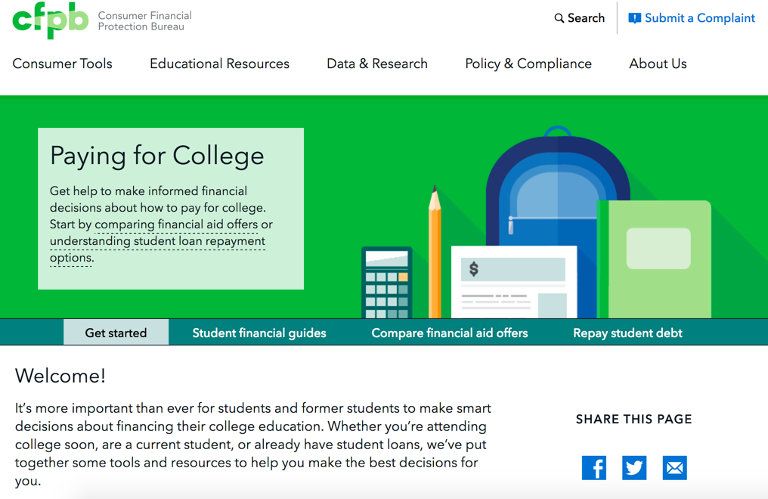
Student loan debt
Visit http://www.consumerfinance.gov/paying-for-college
Notes:
Module 6: Dealing with Debt
Presentation (Module 6)
Review CFPB’s “Paying for College” online tool:
Researching schools
Filling out the Free Application for Federal Student Aid (FAFSA), a first step in figuring out how to pay for college
Choosing a loan
Comparing financial aid packages and college costs across more than one school
Managing your money while in college
Repaying your student loans
NOTE: If you have a live Internet link, go to the site and show it to people you are training.

Slide 133
Tool 5: When debt collectors call
If you have questions about the debt, do not send money or even acknowledge the debt the first time you are contacted. Why?
  You want to make sure you actually owe the debt, and
  You want to make sure the individual contacting you really has the authority to collect the debt
Also, ask for the name, number and address for the debt collector and request information about the debt in writing.
Notes:
Module 6: Dealing with Debt
Presentation (Module 6, Tool 5: When debt collectors call) (Page 217)
Review Tool 5 with participants.
In addition to information, it contains sample letters people can send to debt collectors to verify the debt or to request that they stop contacting them.
Remember, however, that stopping contact does not erase the debt.
Explain:
Debt collectors use persuasive techniques to get you to send in money to pay your debt. Before you send in money, you should confirm that you actually owe the debt. You should also confirm that the collection isn’t fraudulent and is legitimate.
You may be able to confirm this information during an initial or follow-up discussion with the debt collector, but be careful of fraudulent debt collectors. Make sure that you recognize the debt, and confirm that you have not already paid it.
When the phone rings:
Sometimes it’s hard to know if a caller is really a debt collector. To avoid falling victim to a scam, ask for the name, number, and address for the debt collector and request information about the debt in writing.
Be wary of sharing your personal information by phone. If a stranger asks for your Social Security number, date of birth, or bank account information, this can be a red flag.

Slide 134
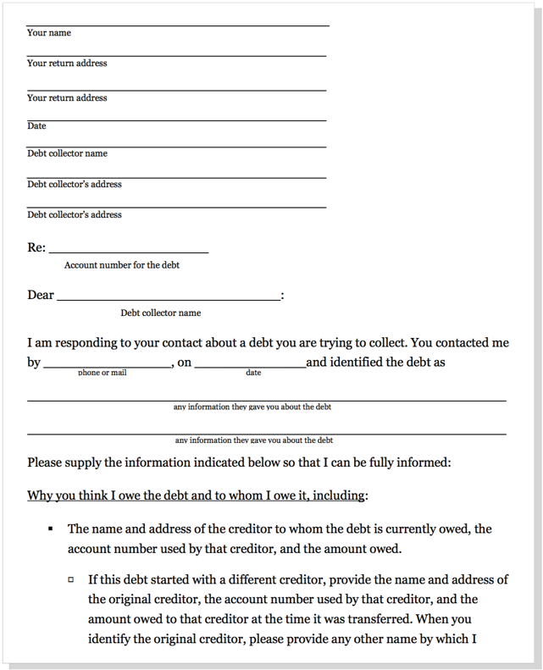
Verify the debt
Notes:
Module 6: Dealing with Debt
Presentation (Module 6)
Review the debt verification letter.
Explain why it is important to ask for more information:
If you have questions about the debt, ask the debt collection agency for specific information before you send money or acknowledge the debt. You can do this by sending a “verification letter,” asking the debt collector to provide you with certain information regarding the debt. The letter you receive from the debt collector should contain a notice about your right to request more information about the debt.
Send this letter as soon as you can.
If you ask in writing before 30 days have passed, a debt collector has certain legal responsibilities to give you some information.
You can use the sample letters in the toolkit to respond to a debt collector. You can also find additional sample letters for disputing a debt, specifying how you wish to be contacted, or requesting that the collector contact you through your lawyer, at http://www.consumerfinance.gov/askcfpb/1695/.
A debt collector may not have a legal obligation to provide some or all of the information you seek, even if you request it within the 30-day period. If the collector doesn’t give you what you request, that doesn’t necessarily mean the debt collector has broken any laws or has given up a legal right to collect from you.

Slide 135
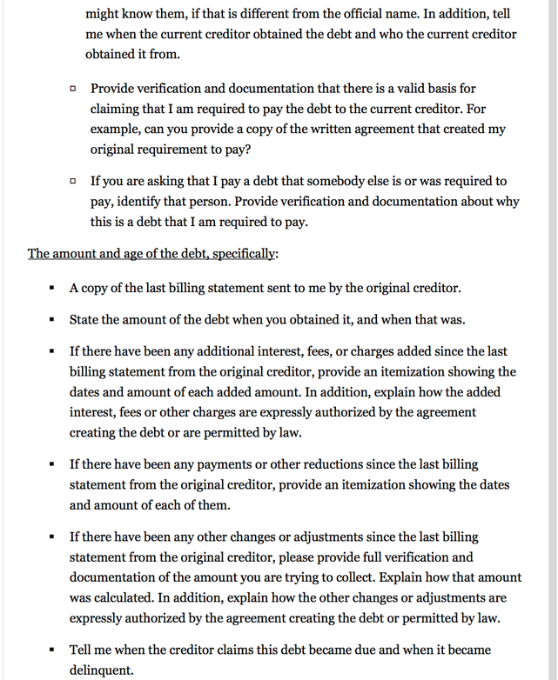
Verify the debt
Notes:
Module 6: Dealing with Debt
Presentation (Module 6)
Review the debt verification letter.

Slide 136
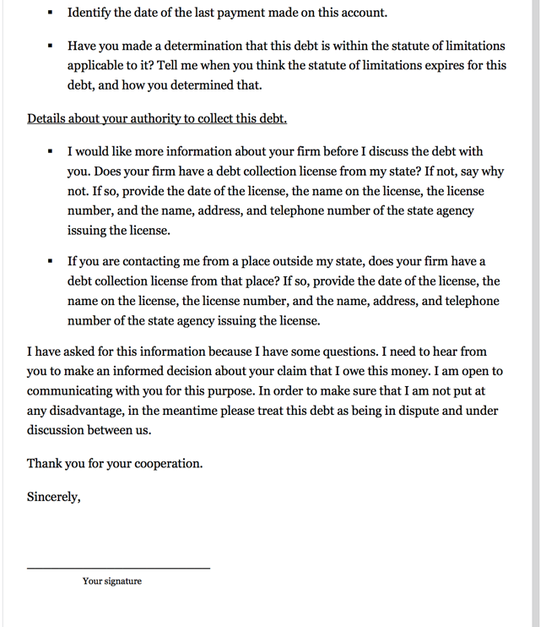
Verify the debt
Notes:
Module 6: Dealing with Debt
Presentation (Module 6)
Review the debt verification letter.

Slide 137
Know your rights
The Fair Debt Collection Practices Act protects consumers from harassment:
Repeated phone calls intended to annoy, abuse, or harass
Obscene or profane language
Threats of violence or harm
Publishing lists of people who refuse to pay their debts
Calling you without telling you who they are
Using false, deceptive, or misleading practices
Notes:
Module 6: Dealing with Debt
Presentation and Facilitated Discussion (Module 6)
Explain highlights of the Fair Debt Collection Practices Act.
The Fair Debt Collection Practices Act (FDCPA) says what debt collectors can and cannot do.
This law covers businesses or individuals that collect the debt of other businesses. These are often called “third party debt collectors.”
This law does not apply to businesses trying to collect their own debts.
The law states that debt collectors may not harass, oppress, or abuse you or any other people they contact. Some examples of harassment are:
Repeated phone calls that are intended to annoy, abuse, or harass you or any person answering the phone
Obscene or profane language
Threats of violence or harm
Publishing lists of people who refuse to pay their debts (this does not include reporting information to a credit reporting company)
Calling you without telling you who they are
The law also says debt collectors cannot use false, deceptive, or misleading practices. This includes misrepresentations about:
The debt, including the amount owed
That the person on the phone is an attorney (unless they are an attorney)
Threats to have you arrested
Threats to do things that cannot legally be done
Threats to do things that the debt collector has no intention of doing
Keep a file of all letters or documents a debt collector sends you and copies of anything you send to a debt collector.
Write down dates and times of conversations along with notes about what you discussed. These records can help you if you have a dispute with a debt collector, meet with a lawyer, or go to court.
Show the example letters in Tool 5.
ASK: When could you see using this tool? What obstacles do you anticipate in using this information?
Summarize by sharing:
After lack of income, debt is likely to be the most common concern the people you serve share.
Understanding what debt is, how to manage debt, and how to reduce it not only improves individual and family financial stability (less income is being eaten up by debt every month), but also reduces stress.
Understanding rights around debt collection and dealing with special debts like medical debt and student loans is also important.
As with reaching a goal, however, getting out of debt takes time and commitment.
The people you serve often have many things going on in their lives, so if this is their biggest concern, focusing on this area can make a big difference in their lives.
Dealing with debt today gives people more options tomorrow.

Slide 138
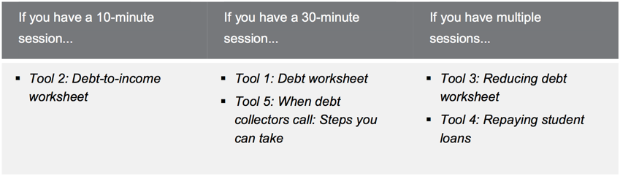
Module 6: Opportunities for financial empowerment
Notes:
Module 6: Dealing with Debt
Presentation and Discussion (Module 6)
Highlight opportunities for introducing financial empowerment depending on the amount of time available:
If you have a 10-minute session…
Tool 2: Debt-to-income worksheet
If you have a 30-minute session…
Tool 1: Debt worksheet
Tool 5: When debt collectors call: Steps you can take
If you have multiple sessions…
Tool 3: Reducing debt worksheet
Tool 4: Repaying student loans
If you have time during the training:
ASK: What other ways could you introduce the financial empowerment tools from this module in your work?
WRAP UP
Debt is money you owe. You generally have to use future income to make payments on your debt.
Debt is different from credit—credit is the ability to borrow money.
Secured debt is debt that has an asset attached to it in case you don’t pay the loan—a home loan or auto loans are examples.
Unsecured debt is debt that does not have an asset attached to it—credit card debt and student loan debt are examples of unsecured debt.
Use Tool 1: Debt worksheet to make a list of your debts and the details associated with each debt—this is the foundation of a debt reduction plan.
Use Tool 2: Debt-to-income worksheet to figure out how much of your income is going to cover your debts on a monthly basis.
Use Tool 3: Reducing debt worksheet to identify a strategy for reducing or eliminating your debts.
Use Tool 4: Repaying student loans to understand some of the key terms related to student loans as well as repayment options.
Use Tool 5: When debt collectors call: Steps you can take to help you understand your rights in debt collection.

Slide 139
Your Money, Your Goals
Module 7: Understanding credit reports and scores

Slide 140
Why do credit reports and scores matter?
Get and keep a job
Get and keep a security clearance for a job, including a military position
Get an apartment
Get insurance coverage
Get lower deposits on utilities and better terms on cell phone plans
Get a credit card
Get better loan terms
Notes:
Module 7: Understanding Credit Reports and Scores
Estimated Time: 45 Minutes
Methodology: Facilitated Discussion / Exercise in Groups of Three / Presentation / Large Group Brainstorming
Corresponding Section in toolkit: Module 7 (Page 227)
Instructions for Facilitator:
Facilitated Discussion and Presentation (Module 7)
ASK: What is a credit report?
After people share their ideas, explain:
A credit report is a consumer report that is a written history of some of your bill paying history, public record information, and a record of how often you have applied for credit. Your credit reports contain information about how you have used credit.
Review the reasons credit reports and scores are important:
A good credit history can help you:
Get and keep a job. A potential employer may use your reports to determine whether you will get a job. (Note: According to the credit reporting agencies, scores are not used by employers; a special version of the credit reports is used by employers.)
Get and keep a security clearance for a job, including a military position.
Get an apartment. A landlord may use your reports or scores to determine whether to rent an apartment to you.
Get insurance coverage. An insurance company may use your reports or scores to determine whether to give you insurance coverage and the rates you will pay for coverage. This depends on the state you live in.
Get lower deposits on utilities and better terms on cell phone purchase plans. Service providers, like cell phone companies and utility companies, may use them to screen you for deposit levels and cost of service.
Get a credit card.
Get better loan terms– all of the information used to calculate your credit scores comes from credit reports. A bank or credit card company will use them to decide whether to give you a loan, and what interest rate you will pay for the loan if you are approved.
If any of these things are important to you, improving your credit report can help you get them.
Having a positive credit history and good credit scores can open doors for you.
Not having a positive credit history or good credit scores can create obstacles for you and end up costing you more money in terms of the price you will pay for loans, credit cards, and other services.
Explain that some people say credit reports and scores don’t matter to them because they never plan to get a loan. But the information in your credit report is also used to make a lot of other decisions about you.
That’s why it’s important to pay bills on time and pay attention to what’s in your credit report. Scores are calculated based on the information in the report – so at least once a year, take the time to make sure the information in your report is accurate. You can get one free copy of your report every 12 months at: https://www.annualcreditreport.com.

Slide 141

Understanding credit reports & scores
Header/identifying information
Public record information
Collection agency account information
Credit account information
Inquiries made to your account
Notes:
Module 7: Understanding Credit Reports and Scores
Presentation (Module 7)
Explain that credit reports are divided into sections:
Header/identifying information—This includes your name and current address, as well as other information that can be used to distinguish or trace your identity, either by itself, like your Social Security number, or when combined with other personal information, including date and place of birth.
This information may not be complete—all of the jobs you have held, for example, may not be listed. But what is listed should be accurate. A credit report does not include some personal information such as race or ethnicity.
Public record information—This section includes public record data of a financial nature, including consumer bankruptcies, judgments, and state and federal tax liens.
Records of arrests and convictions generally do not appear in credit reports from the 3 largest consumer reporting companies, but other types of consumer reporting agencies, such as employment background screening agencies, often include them.
Other public records that usually do not appear in credit reports are marriage records, adoptions, and records of civil suits that have not resulted in judgments.
Collection agency account information—This section will show if you have any accounts with a collection agency and the status of those accounts.
Credit account information—This section may include accounts, also referred to as tradelines, you have now (open accounts) or that you had before (closed accounts) with creditors.
This may include:
Company name
Account number
Date opened
Last activity
Type of account and status
Whether you are a co-signor, authorized user, or guarantor
Date closed, if the account is no longer open
Credit limit
Items as of date (any amount currently owed and whether you are current or late with payments) and the balance
Whether you have a past due amount and the number of payments that were 30, 60, and 90 days late
Whether the account was charged off
The date information was reported to the credit bureau.
Some accounts may not be listed, especially older accounts or those you have closed, or accounts for which information was not provided to that specific credit reporting company. So there may be inconsistencies across credit files and credit reporting companies in the contents of this section. It is important to make sure that the accounts listed do, or did at one time, belong to you.
Inquiries made to your account—Companies look at your credit report when you apply for credit or when they review your account. There are two types of inquiries – hard and soft.
Hard inquiries result when you apply for credit and a lender reviews your credit report, which is listed as an “inquiry” on your report.
Soft inquiries result from marketing offers, reviews of your credit history by one of your existing creditors, and your requests for a copy of your credit history when you obtain your own report.
Only hard inquiries are listed as an “inquiry” when your report is provided to others – they do not see soft inquiries.

Slide 142
Negative information
Negative information can be reported to those who request your credit report for only a specified period of time—seven years for most items.
Bankruptcy can stay on your credit report for 10 years.
Civil suits and judgments can be reported on your credit report for seven years or until the statute of limitations has expired, whichever is longer.
There is no time limit to the length of time that positive information can stay on your credit report.
Notes:
Module 7: Understanding Credit Reports and Scores
Presentation (Module 7)
Review how long negative information can be reported to someone who requests (because they are legally able to) someone’s credit report.

Slide 143
Negative information
Consumer reporting companies cannot include information that is beyond the limits provided in the Fair Credit Reporting Act (FCRA) in most consumer credit reports, but they may continue to keep the information in your file. That’s because there is no time limit in terms of reporting information (positive or negative) when you are:
  Applying for credit of $150,000 or more
  Applying for life insurance with a face value of $150,000 or more
  Applying for a job with an annual salary of $75,000 or more
Notes:
Module 7: Understanding Credit Reports and Scores
Presentation (Module 7)
Review how long negative information can be reported to someone who requests (because they are legally able to) someone’s credit report.

Slide 144
Reading a credit report
Who does this credit report belong to?
Where does this person live?
Where does he work? How long has he worked there?
Does he have public records? If yes, describe it (them).
Is he late on any of his accounts? If yes, describe.
Are any of his accounts in good standing? If yes, describe.
What are the balances of his accounts in the account information section?
Does he have accounts in collection? What is the balance owed in collections?
What do his inquiries tell you?
What is your opinion of this person’s credit history. Is it positive or negative?
Notes:
Module 7: Understanding Credit Reports and Scores
Exercise in Groups of Three (Module 7) (Example credit report - Page 233)
Instruct participants to get into groups of 3.
Instruct them to answer the questions on the slide using the example credit report in the toolkit.
Explain that the credit report is an example and is not based solely on any one of the formats used by the three major credit reporting agencies.
After 7 – 10 minutes, solicit answers from participants.
Who does this credit report belong to? Miguel Simon Smith
Where does this person live? 457 First Street, Littleton, MI 90876
Where does he work? How long has he worked there? Riveria Restaurants; 6 years and 4 months
Does he have public records? If yes, describe it (them). Yes. Chapter 7 Bankruptcy and Civil Judgment
Is he late on any of his accounts? If yes, describe. Yes. He is 30 days late on his auto loan with Littletown Community Bank
Are any of his accounts in good standing? If yes, describe. Yes. His credit card payment.
What are the balances of his accounts in the account information section? Auto loan balance is $14,680; Credit card balance is $3,626
Does he have accounts in collection? What kind of debt was sent to collections? Yes. $1,000.
What do his inquiries tell you? He explored an auto loan and likely a store credit/debit card.
What is your opinion of this person’s credit history. Is it positive or negative?
NOTE: If time allows, cover some of the key terms used in credit reporting found in the toolkit immediately following the credit report example.
Ask participants if they know the definition before providing the explanation. Focus specifically on:
Authorized User
Delinquent
Default
Charge Off
Discharge

Slide 145
National credit-reporting agencies
Equifax
Experian
TransUnion
www.annualcreditreport.com
Notes:
Module 7: Understanding Credit Reports and Scores
Presentation (Module 7)
Review the three largest companies that create credit reports.
Explain FACT Act and www.annualcreditreport.com. Be sure to inform people to be aware of imposter websites.
Explain how credit reporting agencies get their information—from information furnishers and to whom they sell the information once compiled.

Slide 146
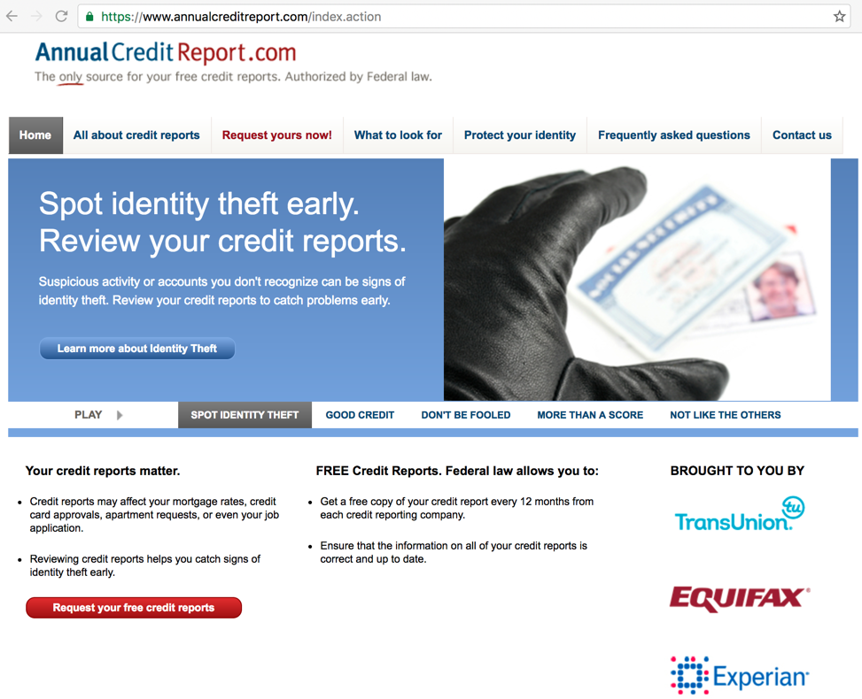
Getting free, annual credit reports
Notes:
Module 7: Understanding Credit Reports and Scores
Presentation (Module 7)
Review using Annualcreditreport.com.

Slide 147
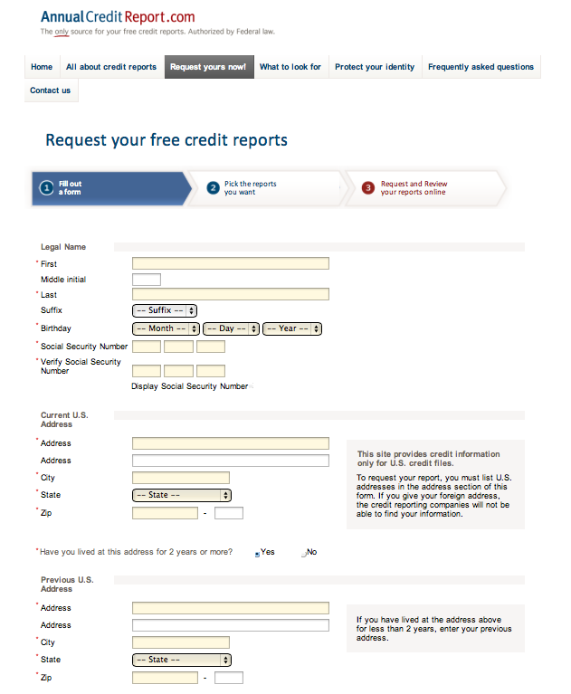
Getting free, annual credit reports
Notes:
Module 7: Understanding Credit Reports and Scores
Presentation (Module 7)
Review using Annualcreditreport.com.
To order through the website, visit: https://www.annualcreditreport.com
Complete a form with basic information (name, Social Security number, address, etc.).
Select the report(s) you want—Equifax, Experian, and/or TransUnion.
Answer security questions: former addresses, amount of a loan you have, phone numbers that have belonged to you, counties you may have lived in, etc.
If you are unable to answer these questions, you will have to use another method.
You will save a PDF version of your report, print the report, or both.
Be sure you do this in a safe and secure location. Avoid doing this on public computers (library).
There are other types of “specialty” reports and scores, e.g., for checking accounts. Visit consumerfinance.gov for a list.

Slide 148
Getting free, annual credit reports
Online: Get a free copy of your credit report at AnnualCreditReport.com
By mail: Download and complete the Annual Credit Report Request Form and mail it to:
Annual Credit Report Request Service
P.O. Box 105281
Atlanta, GA 30348-5281
Notes:
Module 7: Understanding Credit Reports and Scores
Presentation (Module 7)
Review using Annualcreditreport.com.

Slide 149
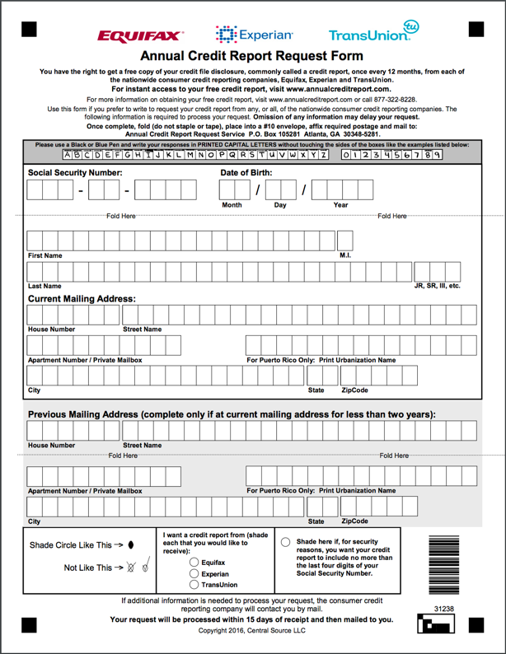
Getting free, annual credit reports https://www.annualcreditreport.com/manualRequestForm.action
Notes:
Module 7: Understanding Credit Reports and Scores
Presentation (Module 7)
Review using Annualcreditreport.com.
Mail:
Download the request form from https://www.annualcreditreport.com/manualRequestForm.action
Print and complete the form
Mail the completed form to:
Annual Credit Report Request Service
P.O. Box 105281
Atlanta, GA 30348-5281
Your credit report will be mailed to you within 15 days.

Slide 150
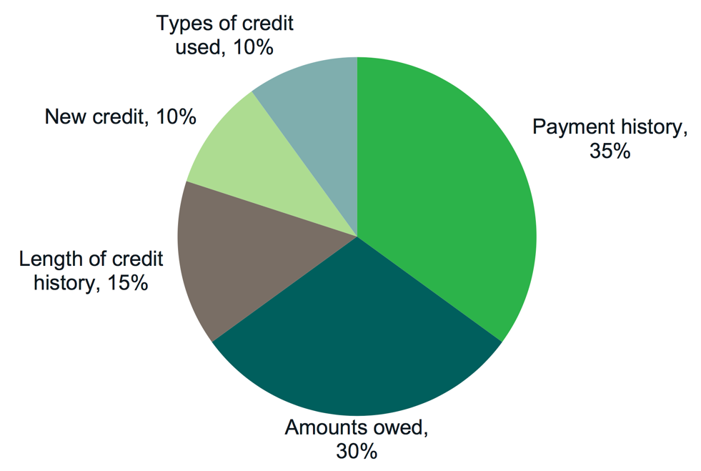
Credit scores: Example based on FICO score
These percentages reflect how much each category determines a typical FICO score.
Notes:
Module 7: Understanding Credit Reports and Scores
Presentation (Module 7)
Note: Only present this information if you have time. (see Page 240 - 245 for more information).
Explain: Credit scores are calculated based on the information in your credit report. Even though different credit scores have different mathematical formulas, they all use the information from your credit report. So, while some pieces of information in your credit reports may be more important or less important, depending on which company is calculating your score, the key is to understand the information in your credit reports
Use the following information from the toolkit to explain the composition of the FICO Scores. Be sure to explain that this is general information; FICO produces many scores.
“Payment history” tracks whether you are paying your bills on time and as agreed. This is the biggest factor in your FICO Scores.
Paying bills late, not paying bills at all, and having bills that go to collections will cause your scores to drop.
The older this information is, the less impact it has on your scores.
“Amounts owed” includes whether you are paying down your loan balances as agreed.
It also includes your credit utilization rate. Your credit utilization rate is how much of your available credit you are using.
If you use more than 20 - 30% of your credit limits, your scores may drop. The lower your credit utilization rate, the better from the perspective of scoring models.
“Length of credit history” is the next factor that impacts your scores. Your score increases the longer you have a credit history.
“New credit” tracks your inquiries. If you have too many inquiries, the model interprets this to mean you have a high demand for credit, which may be an indicator of risk, and your scores may drop.
When you are shopping for a loan, however, most models give you a short window of time (generally 14-45 days) when multiple inquiries can be made for some types of credit without causing your score to drop.
Finally, “types of credit used” is considered.
Your FICO scores increase if you have both credit cards (revolving credit) and loans (installment credit such as a mortgage or car loan).
Generally, it is considered a positive to have a mortgage, an auto loan, and not too many credit cards.
Source: FICO website: www.myfico.com.

Slide 151

Credit utilization rate example
$5,000 credit limit
$3,500 charged
$3,500 (amount charged) ÷ $5,000 (credit limit) = 0.7 or 70%
Notes:
Module 7: Understanding Credit Reports and Scores
Presentation (Module 7)
Explain: The amount of credit you’re using compared to the amount you’ve been given is your “credit utilization rate”.
Credit scoring formulas penalize you for using too much of the credit you have available to you
For example:
If someone has one credit card with a $5,000 credit limit, and she has charged $3,500 on this card, her credit utilization rate is calculated as follows:
$3,500 (amount charged to credit card) divided by $5,000 (credit limit) = 0.7 or 70%
To figure out the maximum that she should charge on this card if she sets a goal of a 25% utilization rate, she should not revolve more than:
$5,000 (the credit limit) multiplied by 0.25 (25%) = $1,250

Slide 152

Factors that influence credit scores: VantageScore example
Notes:
Module 7: Understanding Credit Reports and Scores
Presentation (Module 7) (Page 244)
Share the VantageScore model. Explain it’s slightly different from the FICO scoring models.
Scores may also be provided by VantageScore, another score provider. Like the FICO scores, the method used to calculate VantageScore credit scores is not public. Similar to FICO, VantageScore explains generally how your credit history, credit usage, and other actions can influence the scores it calculates.
“Recent behavior” refers to recent credit behavior and inquiries. “Age of credit” refers to the length of time accounts have been open.

Slide 153
Tool 1: Getting your credit reports and scores
To order through the website, visit: https://www.annualcreditreport.com
  Complete a form with basic information (name, Social Security number, address, etc.).
  Select the report(s) you want—Equifax, Experian, and/or TransUnion.
  Answer security questions: former addresses, amount of a loan you have, phone numbers that have belonged to you, counties you may have lived in, etc.
If you are unable to answer these questions, you will have to use another method.
  You will save a PDF version of your report, print the report, or both.
Be sure you do this in a safe and secure location. Avoid doing this on public computers (library).
Notes:
Module 7: Understanding Credit Reports and Scores
Presentation (Module 7, Tool 1: Getting your credit reports and scores) (Page 247)
Explain how to order credit reports using Tool 1.
Explain alternative methods for getting a report from AnnualCreditReport.com in case the online report cannot be accessed (security questions are answered wrong or cannot be answered if generated by fraudulent information on the report).
Explain the other times you can get an additional free report. IF:
Are unemployed and plan to look for employment in the next 60 days
Are receiving public assistance
Have reason to believe that your credit file is inaccurate due to fraud
Have had a consumer reporting agency place a fraud alert on your credit file (based on your good faith suspicion that you have been the victim of fraud, including identity theft)
Have had a consumer reporting agency place a fraud alert on your credit file after submitting an identity theft report
Have had adverse action taken (you have been denied credit, employment, insurance, etc.) because of information in your credit report – In this case, you have 60 days to request your report.
BUT, you must request these reports. They don’t just show up for you.
If you are under 18, you should not have a credit report unless:
You are an authorized user or joint owner on an account
You are an emancipated minor
Your state law allows you to enter contracts below the age of 18, and you have done so
You have student loans
You have been the victim of identity theft or credit or financial fraud
Use the following notes from the toolkit to explain getting credit scores:
Free credit scores are offered online.
Will most likely differ from the credit score used by a bank, lender, or other third-party to assess your creditworthiness.
These are approximations of your scores. They are not the actual scores businesses will use to make decisions about you.
Some people find they can be useful for education because you can see if your credit scores are generally moving up or down.
The actual number may not reflect your actual FICO Scores - so this may be confusing for some people.
There are a variety of credit scores you can purchase in the marketplace. The type of credit score most used by lenders is a FICO score. Another score also used by lenders if the VantageScore which you can purchase through Experian or TransUnion.
Explain that while credit scores are important and used, the most important thing to focus on is their credit report.
Ask participants why focusing on the credit report is more important than the credit score?
Following some discussion, if not shared, explain that the score is calculated using information from credit reports.
If the information in the report is strong (and error-free), the scores will reflect this.

Slide 154

Tool 2: Credit report review checklist
Notes:
Module 7: Understanding Credit Reports and Scores
Presentation (Module 7, Tool 2: Credit report review checklist) (Page 253)
Review Tool 2.

Slide 155
Filing a dispute
To correct mistakes, it can help to contact both the credit reporting company and the source of the mistake.
You may file your dispute online at each credit reporting agency’s website.
If you file a dispute by mail, your dispute letter should include:
  Your complete name, address, and telephone number;
  your report confirmation number (if you have one); and
  the account number for any account you may be disputing.
In your letter, clearly identify each mistake, state the facts, explain why you are disputing the information, and request that it be removed or corrected.
You may want to enclose a copy of the portion of your report that contains the disputed items and circle or highlight the disputed items.
Send your letter of dispute to credit reporting companies by certified mail, return receipt requested.
Notes:
Module 7: Understanding Credit Reports and Scores
Presentation (Module 7)
Review how to file a dispute.

Slide 156

Tool 3: Improving credit reports and scores
Notes:
Module 7: Understanding Credit Reports and Scores
Presentation (Module 7, Tool 3: Improving your credit reports and scores) (Page 259)
Go through each point on Tool 3. Ask participants if they have any tips to add.
If relevant to the audience, provide brief overview of the new rule around young people in foster care—service providers must review credit reports each year starting at age 16 and until they turn 18.
Explain that young people in most cases cannot enter into a credit contract under the age of 18; therefore, if a young person under 18 has a credit file, there is a chance identify theft and financial fraud have been committed. Note the exceptions to this.
Discuss challenges related to credit reporting and young people in general.

Slide 157
Tool 4: Keeping records to show you’ve paid bills
When repairing or building credit – or managing finances more generally – it is important to create a paper trail.
What does this mean?
It means you must keep records so you can prove that you have:
  Paid a bill on time that a creditor has reported late.
  Paid a debt that a creditor has reported unpaid.
  Sent a letter to a debt collector who has claimed he did not receive it.
  Insurance coverage.
  A warranty for a cell phone.
  Paid your rent in cash (you have a receipt).
Notes:
Module 7: Understanding Credit Reports and Scores
Large Group Brainstorming (Module 7, Tool 4: Keeping records to show you’ve paid your bills) (Page 263)
Explain: When repairing or building credit – or managing finances more generally – it is important to create a paper trail.
ASK: What does this mean? (to create a paper trail)
Discuss the responses
ASK participants to brainstorm a list of financial records that they think someone should keep.
Advance the animation to show the answer on the slide and Review Tool 4.
Go back to brainstormed list and identify the category that each item belongs in based on this checklist.

Slide 158

Tool 4: Keeping records to show you’ve paid bills
Notes:
Module 7: Understanding Credit Reports and Scores
Large Group Brainstorming (Module 7, Tool 4: Keeping records to show you’ve paid your bills) (Page 263)
Review Tool 4.

Slide 159
Ordering, reviewing, and improving
Ordering = Use Tool 1
Reviewing = Use Tool 2
  Credit report review checklist
    Ensure ALL information is correct—personal information, public record information, account/trade information, collection account information.
    Make sure negative information is not being reported longer than it should be.
Improving = Use Tool 3
    Improving credit reports and scores
Proving = Use Tool 4
    Keeping records to show you have paid bills
Notes:
Module 7: Understanding Credit Reports and Scores
Presentation (Module 7)
Explain the tools listed on the slide above.
Explain the importance of filing a dispute if there are any errors on their credit reports and the reason for checking all three reports.
Review the dispute letter and process in the toolkit.
Discuss reasons to hold on to copies of all items sent in for dispute, records of when disputes sent in, and the reasons for sending disputes certified mail with return receipt.
Be sure to discuss the reasons to send to both credit reporting agencies and the information furnisher.

Slide 160

Module 7: Opportunities for financial empowerment
Notes:
Module 7: Understanding Credit Reports and Scores
Presentation and Discussion (Module 7)
Highlight opportunities for introducing financial empowerment depending on the amount of time available:
If you have a 10-minute session…
Tool 1: Getting your credit reports and scores
If you have a 30-minute session…
Tool 2: Credit report review checklist
If you have multiple sessions…
Tool 3: Improving your credit reports and scores
Tool 4: Keeping records to show you’ve paid your bills
If you have time during the training:
ASK: What other ways could you introduce the financial empowerment tools from this module in your work?
Summarize by sharing:
Taking care of your credit history is important. Why?
Because credit reports and scores are not only used to determine whether you will get a loan or credit card.
This information can be used to determine access to and costs of other services like utilities, insurance and cell phones, ability to rent apartments, and employment.
While there are laws ensuring the information that is reported about you is fair and accurate, it is your responsibility to ensure the information is accurate.
The best way to do this is to regularly review your credit reports—at least one time per year. Use these tools to get, review, and then improve your credit reports and scores.

Slide 161
Your Money, Your Goals
Module 8: Money services, cards, accounts, and loans: Finding what works for you

Slide 162
Financial service providers
Department stores—credit cards or charge cards
Automobile dealers—car loans
Retail superstores, convenience stores, grocery stores, and other stores—check cashing, bill payment, money orders, prepaid cards, and money transfers
Check cashers and payday lenders – check cashing, money transfers, bill payment, money orders, prepaid cards, and short-term loans
Online companies—money transfers, bill payment services, loans, financial management tools, online “wallets” or “accounts”
Mortgage companies—loans for homes
Commercial tax preparers—refund anticipation loans
Consumer finance companies—loans
U.S. Postal Service—money orders and money transfers
Notes:
Module 8: Money services, cards, accounts, and loans: Finding what works for you
Estimated Time: 45 Minutes
Methodology: Individual Activity / Exercise in Pairs, Presentation to Large Group, and Facilitated Discussion / Presentation and Facilitated Discussion
Corresponding Section in toolkit: Module 8 (Page 267)
Instructions for Facilitator:
Facilitated Discussion (Module 8)
Ask participants who provides financial services and products. Write their suggestions on a flip chart.
Then reveal the ideas listed on slide above.
Explain that financial services and products are provided by more than just banks.

Slide 163

Tool 1: Know your options: Money services, cards, accounts, and loans
Complete Tool 1 on Page 281.
Do not look ahead in your materials.
Notes:
Module 8: Money services, cards, accounts, and loans: Finding what works for you
Individual Activity and Facilitated Discussion (Module 8, Tool 1: Know your options) (Page 281)
Invite participants to complete Tool 1.
Instruct them not to look ahead in their materials.

Slide 164

Tool 1: Know your options: Money services, cards, accounts, and loans
Notes:
Module 8: Money services, cards, accounts, and loans: Finding what works for you
Individual Activity and Facilitated Discussion (Module 8, Tool 1: Know your options) (Analysis – Page 282)
After 3 minutes, instruct them to use the analysis section of Tool 1 to find the provider and tools that have products or services that meet their priorities.
ASK: What are the ways you would or could use this tool with the people you serve?

Slide 165
Tool 2: Ask questions: Choosing where to get what you need
What surprised you when using this tool?
Was the tool helpful? Do you think it will be helpful for your work?
What additional information do you need to select a financial service provider?
Notes:
Module 8: Money services, cards, accounts, and loans: Finding what works for you
Individual Activity and Facilitated Discussion (Module 8, Tool 2: Ask questions) (Page 287)
Use the following questions, also listed on the slide above to facilitate a discussion about the tool:
What surprised you when using this tool?
Was the tool helpful? Do you think it will be helpful for your work?
What additional information do you need to select a financial service provider?
Explain that this approach is a needs-first approach.
Explain that generally, people think of financial services or products as meaning a bank account.
Explain that this approach starts with what people want or need in terms of financial services, then provides guidance in terms of what products or services may address that want or need and where the product or service may be available.

Slide 166

Tool 2: Ask questions: Choosing where to get what you need
Notes:
Module 8: Money services, cards, accounts, and loans: Finding what works for you
Presentation (Module 8, Tool 2: Ask questions) (Page 287)
Review Tool 2
Identify the questions that are most important to you
The purpose is to compare financial product and service providers.
Explain that individuals may want to circle the top 5 criteria that are most important to them in making a decision about the right financial service provider. This can help them focus while using this tool and make it’s use a little easier.

Slide 167
Tool 3: Money services and banking basics
With your partner:
  Define the product or service.
  Brainstorm all of the places you can get this product or service.
  Brainstorm when you would use this product or service to manage your finances.
  List the benefits of this product or service.
  List the risks of this product or service.
Be prepared to present your product or service and your work to the rest of the group.
Notes:
Module 8: Money services, cards, accounts, and loans: Finding what works for you
Exercise in Pairs; Presentation to Large Group; Facilitated Discussion (Module 8, Tool 3: Money services and banking basics) (Page 291)
Get participants into groups of 2.
Distribute financial product/service cards to each pair.
NOTE: The next 10 slides are the cards. Print these prior to the training.
NOTE: If you have a small group, you may want to give two cards to each pair.
Instruct participants in groups of 2 to:
Define the product or service.
Brainstorm all of the places you can get this product or service.
Brainstorm when you would use this product or service to manage your finances.
List the benefits of this product or service.
List the risks of this product or service.
Instruct participants to use the material from Tool 3 and their own experiences to complete description.
After 6 – 8 minutes, ask participants to report to large group.
Ask each group to present their product/service to the rest of the group.
Using Tool 3, organize them by the type of product or service they are as groups present.
Transaction
Depository
Credit
Credit building
Other
Add to group presentations as appropriate.
Relate this information to Tool 2: Ask questions: Choosing where to get what you need.
Ask participants to share any questions or experiences they may have about these products or services or others from Tool 3 not covered.

Slide 168
Checking account
Definition
Where can you get this product/service
When would you use this product/service
Benefits
Risks
Notes:
PRINT PRIOR TO TRAINING.
PRINT ONE COPY FOR EVERY TWO PARTICIPANTS.
IF YOU HAVE 20 PARTICIPANTS, YOU WILL NEED ONLY ONE COPY EACH OF THE NEXT 10 SLIDES.
DO NOT DISPLAY THESE SLIDES IN YOUR PRESENTATION.

Slide 169
Prepaid debit card
Definition
Where can you get this product/service
When would you use this product/service
Benefits
Risks
Notes:
PRINT PRIOR TO TRAINING.
DO NOT DISPLAY IN PRESENTATION.

Slide 170
Money transfer
Definition
Where can you get this product/service
When would you use this product/service
Benefits
Risks
Notes:
PRINT PRIOR TO TRAINING.
DO NOT DISPLAY IN PRESENTATION.

Slide 171
Bill payment service
Definition
Where can you get this product/service
When would you use this product/service
Benefits
Risks
Notes:
PRINT PRIOR TO TRAINING.
DO NOT DISPLAY IN PRESENTATION.

Slide 172
Savings account
Definition
Where can you get this product/service
When would you use this product/service
Benefits
Risks
Notes:
PRINT PRIOR TO TRAINING.
DO NOT DISPLAY IN PRESENTATION.

Slide 173
Line of credit
Definition
Where can you get this product/service
When would you use this product/service
Benefits
Risks
Notes:
PRINT PRIOR TO TRAINING.
DO NOT DISPLAY IN PRESENTATION.

Slide 174
Car title loan
Definition
Where can you get this product/service
When would you use this product/service
Benefits
Risks
Notes:
PRINT PRIOR TO TRAINING.
DO NOT DISPLAY IN PRESENTATION.

Slide 175
Online banking
Definition
Where can you get this product/service
When would you use this product/service
Benefits
Risks
Notes:
PRINT PRIOR TO TRAINING.
DO NOT DISPLAY IN PRESENTATION.

Slide 176
Credit building loan
Definition
Where can you get this product/service
When would you use this product/service
Benefits
Risks
Notes:
PRINT PRIOR TO TRAINING.
DO NOT DISPLAY IN PRESENTATION.

Slide 177
Money order
Definition
Where can you get this product/service
When would you use this product/service
Benefits
Risks
Notes:
PRINT PRIOR TO TRAINING.
DO NOT DISPLAY IN PRESENTATION.

Slide 178
Tool 4: Opening an account checklist
Can anyone open an account at a bank or credit union?
Should everyone open an account at a bank or credit union?
What is needed
Money to open account
Identification
A Social Security Number or ITIN for interest-bearing account
Notes:
Module 8: Money services, cards, accounts, and loans: Finding what works for you
Facilitated Discussion and Presentation (Module 8, Tool 4: Opening an account checklist) (Page 299)
ASK: Can anyone open an account at a bank or credit union?
After getting some responses from participants, explain that the answer is “not necessarily.” They may not have the money, have negative information in consumer reports, and lack proper identification.
ASK: Should everyone open an account at a bank or credit union?
After getting some responses from participants, explain that this is an opinion question. While money in a bank or credit union may offer people protection of their money, if they do not understand how their accounts work, they could end up with more financial challenges.
Explain what is needed to open an account:
Money to open account (and maintain minimum balance to avoid fees)
Identification
A U.S. government- or state-issued form of identification with your photo on it, such as a driver’s license, U.S. Passport, or military identification.
And one of the following:
Social security card
A bill with name and address on it
Birth certificate
If someone does not have a U.S. government-issued form of identification, some banks and credit unions accept foreign passports and Consular IDs, such as the Matricula Consular card, which is an official Mexican identification document.
Other countries, such as Guatemala and Argentina have similar IDs.
Consulates in the United States offer them.
People can visit their country’s consulate for more information about how to get an ID card, and talk with the banks and credit unions about whether they accept it.
A Social Security Number or ITIN for interest-bearing account
Interest is considered income. If you earn interest, you must pay taxes on it.
To open an interest-bearing account, such as a savings account, you must have a Social Security number or an Individual Taxpayer Identification Number (ITIN).
Or, you must be able to show evidence that you have applied for an ITIN.
If you do not have a Social Security number, you do not have an ITIN, or you have not applied for an ITIN, you may be able to open a non-interest bearing account.
Also, address when someone has a negative bank system report
When you complete the application to open an account at a bank or credit union, the bank or credit union often contacts specialty consumer reporting agencies that have information on checking account history.
Banks and credit unions contact companies like ChexSystems, TeleCheck, Early Warning, and others like them to find out if you have had prior difficulties using a checking account, such as writing bad checks or you have been suspected fraud.
These agencies collect information about how consumers manage savings and checking accounts.
Financial institutions use the information to assess the risk of opening an account for a specific person based on his or her past history of managing similar accounts.
The report includes information about:
The accounts that have been reported (routing transit number and/or account number)
Date information was reported about an account
The reason for the report
The report also includes retail information, which refers to returned checks. Retailers and other businesses report this type of information to SCAN (Shared Check Authorization Network).
If you are denied a checking account based on a report from any of these specialty consumer reporting agencies, you have the right to a free disclosure of certain information in your file from the agency.
The notice you receive from the bank or credit union will give you the name, address, and phone number of the consumer reporting company and how you can contact it to obtain your free disclosure.
If you find mistakes, you can dispute these by sending a letter (you may choose to use certified mail) describing the mistake and including copies of any evidence.
Explain that some banks and credit unions review credit reports, too.
Review Tool 4 with participants.
Go over steps for opening an account at a bank or credit union.

Slide 179

Tool 4: Opening an account checklist
Notes:
Module 8: Money services, cards, accounts, and loans: Finding what works for you
Facilitated Discussion and Presentation (Module 8, Tool 4: Opening an account checklist) (Page 299)
Share excerpt of the checklist that is a part of the Tool 4.

Slide 180
Overdraft coverage
Overdraft = spending or withdrawing more money than is available in your account
Money advanced to cover overdraft = overdraft coverage (sometimes called “overdraft protection”)
Can be charged daily fees for this service
Notes:
Module 8: Money services, cards, accounts, and loans: Finding what works for you
Facilitated Discussion and Presentation (Module 8)
Review overdraft coverage from the toolkit (Page 271).
Review alternatives to overdraft coverage:
Keep track of your balances.
Sign up for low balance alerts at your bank or credit union.
Know when regular electronic transfers, such as rent payments or utility bills, will be paid.
Link your checking account to your savings account.
Link your checking account to a line of credit.

Slide 181
Tool 5: Money transfers and remittances
A “remittance transfer” is an electronic transfer of money from a consumer in the United States to a person or business in a foreign country.
The rules generally requires companies to give disclosures to consumers before they pay for the remittance transfers, requires companies to provide a receipt with specific information about the transfer, and creates error resolution and cancellation rights for consumers. The pre-payment disclosures must contain:
  The exchange rate
  Fees and taxes collected by the companies
  Fees charged by the companies’ agents abroad and intermediary institutions
  The amount of money expected to be delivered abroad, not including certain fees charged to the recipient or foreign taxes
  If appropriate, a disclaimer that additional fees and foreign taxes may apply
Notes:
Module 8: Money services, cards, accounts, and loan: Finding what works for you
Presentation (Module 8, Tool 5: Money transfers and remittances) (Page 305)
Review remittance rules using Tool 5.
Companies must also provide a receipt that repeats the information in the first disclosure or a proof of payment. The receipt must also tell a consumer the date when the money will arrive and how the consumer can report a problem with a transfer.
Review disclosures rules and consider adding:
Consumers must also receive information about when the money will arrive and how the consumer can report a problem with a transfer.
Companies must provide the disclosures in English. Sometimes companies must also provide the disclosures in other languages.
The right to cancel: After paying, you will typically have 30 minutes (and sometimes more) to cancel the transaction at no charge, unless the transfer has already been picked up or deposited into the recipient’s account.
The right to have errors resolved: Companies must investigate if a consumer reports a problem with a transfer. For certain errors, such as if the money never arrives, you may be able to get a refund or have the transfer sent again. You can learn more here: http://www.consumerfinance.gov/askcfpb/1765/.
The company may not be required to refund or resend the money if an error occurred because you provided incorrect information to the provider, such as the wrong account number.
The rules also contain specific provisions applicable to transfers that consumers schedule in advance and for transfers that are scheduled to recur on a regular basis.
The rules apply to most remittance transfers that are:
More than $15,
Made by a consumer in the United States, and
Sent to a person or company in a foreign country.

Slide 182

Module 8: Opportunities for financial empowerment
Notes:
Module 8: Money services, cards, accounts, and loans: Finding what works for you
Presentation and Discussion (Module 8)
Highlight opportunities for introducing financial empowerment depending on the amount of time available:
If you have a 10-minute session…
Tool 1: Know your options: Money services, card, accounts, and loans
If you have a 30-minute session…
Tool 2: Ask questions: Choosing where to get what you need
Tool 3: Money services and banking basics
If you have multiple sessions…
Tool 4: Opening an account checklist
Tool 5: Money transfers and remittances: What you need to know
If you have time during the training:
ASK: What other ways could you introduce the financial empowerment tools from this module in your work?
Summarize by sharing:
Financial products and services can help you more efficiently and effectively get, manage, and use your money.
Knowing the reasons you may need financial services and matching your needs with the right products and services can ensure you are getting what you need from this complex marketplace.
Learn the basic terms for financial products and services.
If information’s not clear, don’t be afraid to ask questions.
Finally, shop around for financial services.
Look at convenience, cost, and service provided before selecting a product, service or provider.
Be aware of debt traps—products that may not only get you into debt, but keep you there.
With all financial products there are lots of rules.
Do you best to understand the rules so you avoid fees and fines.
Finally, use the CFPB website’s Ask CFPB as a resource to learn more about the financial services industry and the product and services they sell.
WRAP UP
Financial products and services are provided by a broad range of providers from banks and credit unions to retail stores to the federal government.
Use Tool 1: Know your options: Money services, cards, accounts, and loans (Which financial product or services do you need?) to help you figure out which financial products or services will meet your needs
Use Tool 2: Ask questions: Choosing where to get what you need (Comparing financial service providers) to help you compare financial service providers based on their characteristics as well as the features and benefits of the products and service they offer.
Use Tool 3: Money services and banking basics (The basics of financial products and service) to help you learn about the different financial products and services offered at banks, credit unions, and other financial service providers.
Use Tool 4: Opening an account checklist to understand the specific steps for opening an account including information you may want to have before opening an account.
Use Tool 5: Money transfers and remittances: What you need to know to learn more about using these products and services.

Slide 183
Your Money, Your Goals
Module 9: Protecting your money
Notes:
Note: Training sections for content modules are labeled by their module number (ex: Module 1), rather than by training section number.

Slide 184

Tool 1: Submitting a complaint
Notes:
Module 9: Protecting Your Money
Methodology: Presentation and Facilitated Discussion / Skits / Teach back
Corresponding Section in toolkit: Module 9 (Page 307)
Estimated Time: 45 Minutes
Instructions for Facilitator:
Presentation and Facilitated Discussion (Module 9, Tool 1: Submitting a complaint) (Page 313)
NOTE: If you covered this earlier in the training, consider doing a quick review or asking participants questions about submitting a complaint to help them recall what you covered earlier in the training. Example questions include:
What kinds of complaints does the CFPB take?
What are the different ways someone can submit a complaint?
How many languages can the CFPB accept complaints in?
What happens to a complaint once it’s submitted?
How long do company’s have to respond to complaints?
How can consumers find out more about complaints in their communities?
Why is it t for service providers to know about the CPFB complaint portal and process?
NOTE: Do not cover the following if you covered it earlier in the training.
Refer participants to the CFPB complaint contact information on slide and in their toolkit, Module 9, Tool 1.
Explain the following:
An empowered consumer understands their rights. When you know you have rights, you can take steps to protect yourself. There are many laws that protect your rights when it comes to financial products and services. It is the CFPB’s job to enforce these laws and handle consumers’ complaints about financial products and services.
The CFPB has already handled over 1,000,000 of consumer complaints about:
Credit cards
Mortgages
Bank accounts and services
Student loans
Vehicle loans or leases
Payday loans
Other consumer loans (including installment loans, pawn loans, and title loans)
Debt collection
Money transfers or virtual currency
Credit reporting
Prepaid cards
Other financial services (including check cashing, money orders, cashier’s checks, credit repair, debt settlement, refund anticipation loans, foreign currency exchange, and traveler’s checks)
Every complaint the CFPB receives gives them insights into problems that people are experiencing in the marketplace and helps them to identify and prioritize problems for potential action.
Explain that you can submit a complaint on behalf of someone else following the directions on the site.
Explain that, you can also submit a complaint over the phone by calling the CFPB at 855-411-CFPB (2372), toll free. U.S.-based call centers can help you in over 180 languages and can also take calls from consumers who are deaf, have hearing loss, or have speech disabilities. Live operators in Spanish are available.
Explain what happens to a complaint submitted to the CFPB using the following slide.

Slide 185

Submitting a Complaint
Notes:
Module 9: Protecting Your Money
Presentation
Briefly review the initial information asked for when people want to submit a complaint.
Be sure to highlight that someone can submit a complaint on behalf of another.

Slide 186
Complaint process
Notes:
Module 9: Protecting Your Money
Facilitated Discussion and Presentation (Introduction Part 1)
Explain the process for submitting a complaint:
Complaint submitted: You will receive email updates and can log in to track the status of your complaint.
Review and route: The CFPB will forward your complaint and any documents you provide to the company and work to get a response from them. If they find that another government agency would be better able to assist, the CFPB will forward your complaint to them and let you know.
Company response: After your complaint is sent to the company, the company has 15 days to provide a substantive response to you and the CFPB. In some cases, companies have up to 60 days to provide a final response.
Complaint published: The CFPB publishes information about your complaint – such as the subject and date of the complaint – on their public Consumer Complaint Database at http://www.consumerfinance.gov/data-research/consumer-complaints/. With your consent they also publish your description of what happened, after taking steps to remove personal information.
Consumer review: The CFPB will let you know when the company responds. You can review that response and give feedback.

Slide 187
Tool 2: Protecting your identity
Identifying information is anything that is specifically unique to you, such as your:
Credit card and bank account numbers
Driver’s license number
Date, city, and state of birth
Social security number
Passwords or PIN numbers
Notes:
Module 9: Protecting Your Money
Presentation and Facilitated Discussion (Module 9, Tool 2: Protecting your identity) (Page 315)
NOTE: Prior to the training, choose option A or B.
Option A:
Before this activity, hang up flip charts around the room. Each flip chart should have one of the following questions on it:
How can you tell if your identity has been stolen?
What steps can you take if your identity has been stolen?
What can you do to prevent your identity from being stolen?
What question or questions do you have about identity theft?
Get the participants into groups of 4.
Have each group stand by one of the flip charts.
Make sure they take at least one marker with them.
Give them 1 minute to brainstorm responses and write them on the flip chart.
Then instruct them to rotate to the next flip chart going clockwise and ADD to the list.
Have them rotate until they end up at the flip chart at which they started.
Have the group chose someone to present that flip chart to the rest of the group.
As each team presents the flip chart—their ideas and those of other groups—add to them.
Option B:
Review key information about protecting identity using Tool 2.
Review the list of signs of identity theft (from the FTC):
There are mistakes on your bank, credit card, or other account statements
There are mistakes on the explanation of medical benefits from your health plan
Your regular bills and account statements don’t arrive on time
You get bills or collection notices for products or services you never received
You receive calls from debt collectors about debts that don’t belong to you
You get a notice from the IRS that someone used your Social Security number
You receive mail, email, or calls about accounts or jobs in your minor child’s name
You receive unwarranted collection notices on your credit report
Businesses turn down your checks and
You are turned down unexpectedly for a loan or job

Slide 188


Tool 2: Protecting your identity
Notes:
Module 9: Protecting Your Money
Presentation (Module 9, Tool 2: Protecting your identity) (Page 315)
Review identity theft checklist in Tool 2 in the toolkit.
Review primary strategies for dealing with identity theft using the list below and information from the module.
Place a fraud alert on your credit file
Place a credit freeze
Order your credit reports
Create an identity theft report

Slide 189

Tool 3: Red flags
Notes:
Module 9: Protecting Your Money
Skits (Module 9, Tool 3: Red flags) (Page 321)
ASK: What is a red flag?
Explain that a red flag is something to watch out for.
Explain that sometimes when shopping for or using consumer financial products, you may encounter a red flag.
Explain that this does not mean something illegal is going on, but that you should ask more questions and get help to ensure you are not being subjected to something that is not fair or right.
Give teams of 3 or 4 participants, red flags to turn into a skit (there are 3 skits on the following three slides, so not everyone will be able to act in a skit).
Explain that they should develop the products/services and use any props they feel may be necessary. Explain that they are to improvise the skit.
Instruct them to try to be specific to their red flag.
Instruct them to develop a short 1 to 3 minute skit that showcases the red flag(s).
Participants will have to guess the red flags using Tool 1: Red flags.
Thank skit performers and congratulate those who guess the red flags following each skit.
NOTE: Consider organizing skits during breaks to give teams time to think about scenarios for acting out red flags.

Slide 190
Skit 1: Identifying red flags
Steering and coercing
  Aggressive sales tactics are used to steer and coerce you toward a high-cost loan, even though you could have qualified for a regular prime loan.
Prepayment penalties
  Prepayment penalties are fees lenders require a borrower to pay if the borrower pays off a loan early.
Unexplained fees
  No one can explain what certain fees are for or why they are so high.
Incomplete paperwork
  You are asked to sign a contract with blank spaces to be filled in later
Notes:
PRINT 1 COPY FOR 1 TEAM.
HIDE FOR PRESENTATION.

Slide 191
Skit 2: Identifying red flags
Paperwork doesn’t match the sales pitch
  The promises made to you by a salesperson are not in the papers that you are asked to sign.
Confusing fine-print
  A good rule of thumb is to refuse to sign anything that you don’t understand.
Pressure sales tactics
  You are pressured to purchase things or to take out loans you don’t want or can’t afford.
Notes:
PRINT 1 COPY FOR 1 TEAM.
HIDE FOR PRESENTATION.

Slide 192
Skit 3: Identifying red flags
Additional insurance and other add-on products
  Some lenders may insist on, intimidate, or imply that borrowers must buy unnecessary items—additional insurance, unneeded warranties, monitoring services, etc. They get incorporated into the loan amount, and the borrower pays interest on them over the life of the loan.
Lack of uniformity
  Different staff or salespeople are telling you different things regarding pricing or other information.
Won’t put it in writing
  No one will give you clear information in writing—even when you ask for it.
Notes:
PRINT 1 COPY FOR 1 TEAM.
HIDE FOR PRESENTATION.

Slide 193
Tool 4: Learning more about consumer protection
Read your law.
Summarize it in your own words for presentation to the group.
Provide one specific example of the ways this law or regulation matters to the people you serve.
Share where to go if someone feels their rights protected under your law or regulation have been violated.
Notes:
Module 9: Protecting Your Money
Teach back Activity (Module 9, Tool 4: Learning more about consumer protection) (Page 323)
Give teams of two participants one or two of the laws outlined in Tool 4 to read, discuss, and teach back to the group in their own words.
Instruct them to use examples where possible.
Instruct them to develop their presentation to last two to three minutes.
Have each group present; add important elements of the law not covered.
NOTE: You may need to cut this out if you are out of time.
Summarize by sharing:
We hope this gave you an idea of how many laws and rules are in place to protect you.
While the laws summarize your rights, it is still your responsibility to learn about these laws and take steps to ensure your rights are not violated. For example, you have the right to a free credit report every year from the major consumer reporting agencies; however, it is your responsibility to order the reports, review them for accuracy, and get errors fixed.
Fortunately, there are many resources to help you understand your rights and take action should your rights be violated.
Visit the CFPB website often for information and updates regarding laws designed to protect you and your family in accessing and using financial products and services.

Slide 194

Module 9: Opportunities for financial empowerment
Notes:
Module 9: Protecting Your Money
Presentation and Discussion (Module 9)
Highlight opportunities for introducing financial empowerment depending on the amount of time available:
If you have a 10-minute session…
Tool 1: Submitting a complain to the CFPB
If you have a 30-minute session…
Tool 2: Protecting your identity
Tool 3: Red flags
If you have multiple sessions…
Reference Tool 4: Learning more about consumer protection on specific consumer protection issues
Follow up to make sure any identity theft issues or complaints are being addressed.
If you have time during the training:
ASK: What other ways could you introduce the financial empowerment tools from this module in your work?
WRAP UP:
Remember, you have many rights when it comes to consumer financial products and services.
If you do feel like you have a complaint with a financial product, service or provider submit a complaint with the CFPB using Tool 1. Submitting a complaint to the CFPB and visit: http://www.consumerfinance.gov/complaint/
Your identity is one of the most important assets you must protect. Use Tool 2: Protecting your identity to ensure you are taking all steps possible to keep your identity safe.
When applying for financial products or services, be aware of red flags. Use Tool 3: Red flags to become familiar with common red flags.
If you are interested in learning more about consumer protection laws, use Tool 4: Learning more about consumer protection.

Slide 195
Your Money, Your Goals
Resources

Slide 196
Resources
If you have a consumer complaint, visit: http://www.consumerfinance.gov/complaint/
For additional resources, visit the Consumer Financial Protection Bureau website: http://www.consumerfinance.gov/
This toolkit also includes links or references to third-party resources or content that consumers may find helpful.
Links are organized by topics corresponding to the content modules
  Example: Understanding credit reports and scores:
    If you would like help managing your debt or rebuilding credit, visit the National Foundation for Credit Counseling:
    https://www.nfcc.org/
Notes:
Resources
Estimated Time: 5 Minutes
Methodology: Presentation
Corresponding Section in toolkit: Resources
Instructions for Facilitator:
Provide a brief orientation to the additional resources listed in this section.

Slide 197
Your Money, Your Goals
Closing

Slide 198
Closing
What is the most important thing you are taking away from this training?
What is something you would like to learn more about?
Notes:
Closing
Estimated Time: 20 Minutes
Methodology: Closing / Individual Activity
Corresponding Section in toolkit: None
Instructions for Facilitator:
Ask each participant to share “the most important take away” from the training or “something they would like to learn more about.”
Write responses on flip chart.
Administer post-training assessment and evaluation.
Conclude with thanks to host and participants.

