Slide 1
Your Money, Your Goals
A FINANCIAL EMPOWERMENT TOOLKIT FOR COMMUNITY VOLUNTEERS
Community Volunteer Training
Notes:
THIS SLIDE DECK SUPPORTS THE OCTOBER 2015 VERSION OF YOUR MONEY, YOUR GOALS.
INTRODUCTION TO YOUR MONEY, YOUR GOALS (YMYG) TRAINING MATERIALS
This PowerPoint presentation was created to help financial educators provide training to potential users of Your Money, Your Goals—community volunteers that work in organizations that serve individuals and families with low income or limited resources. This packet includes the visual aids (PowerPoint slides) and facilitation guide (notes section of slides) necessary to conduct a total of 6 – 8 hours of training on Your Money, Your Goals.
Because YMYG is a comprehensive toolkit containing an extensive amount of information and more than three dozen tools, we encourage you to begin your planning by working with your organization to identify the topics that are most relevant to your workshop participants. You can then focus your workshop on a subset of YMYG topics or plan a series of workshops to cover additional topics and modules. Use the implementation guide to help you plan this training.
Following a YMYG training, community volunteers will:
Understand the organization of Your Money, Your Goals: A financial empowerment toolkit for community volunteers,
Have strategies for using Your Money, Your Goals with the people they serve, and
Have the tools, knowledge, and confidence to provide basic financial empowerment services to their the people they serve.
This training may be used without modification, but trainers may feel welcome to add activities that they feel are more relevant for community volunteers and others they may be training in their local communities.
The training is organized into a series of activities. Each new activity begins with:
Estimated Time for Activity
Activity #
Activity Title
Methodology or Description of the Type of Activity (opener, facilitated discussion, small group exercise, role play, scenario analysis, etc.)
Corresponding Section in Your Money, Your Goals
Instructions for Facilitating the Activity
The facilitation instructions found in the notes section correspond to the visual aid presented on the slide.
NOTE: Individuals who facilitate this training should be experienced financial educators with practical experience and knowledge on a wide variety of financial education topics and methodologies.
TRAINING ORGANIZATION
This outline covers the organization of the Your Money, Your Goals training and includes the estimated time each activity will take, the activities in the order in which they occur, and their titles. Remember, these are only estimated times and may vary depending on the number of individuals in the training as well as the participation and experience level of the group.
1: Money and Me. (20 Minutes)
Methodology: Opener—Contest
Toolkit Section: Introduction Part 4: Emotions, values, and culture: What’s behind our money choices? (Page 47)
2: Overview of the Training and Introductions. (10 Minutes)
Methodology: Presentation / Icebreaker
Toolkit Section: Introduction Part 1: Introduction to the toolkit (Page 1)
3: Introduction to the CFPB and Financial Empowerment. (30 to 40 Minutes)
Methodology: Presentation / Facilitated Discussion / Debate or Large Group Brainstorm / Carousel
Toolkit Section: Introduction Part 1: Introduction to the toolkit (Page 1)
4: An Orientation to the toolkit. (40 Minutes)
Methodology: Presentation / Scavenger Hunt / Large Group or Small Group Discussion
Toolkit Section: Introduction Part 1: Introduction to the toolkit (Page 1)
5: The Role of Referral. (30 Minutes)
Methodology: Facilitated Discussion / Large Group Brainstorm / Build a Chart
Toolkit Section: Introduction Part 1: Introduction to the toolkit (Page 1)
Special module on making referrals: Creating a strong resources and referral network (for financial educators only)
6: Understanding the Situation and Starting the Money Conversation. (60 Minutes)
Methodology: Presentation / Individual Activity and Discussion in Pairs / Role Play / Skit or Large Group Brainstorm
Toolkit Section: Introduction Parts 2 and 3: Understanding the Situation and Starting the Money Conversation (Pages 27 and 37)
7: Setting Goals and Planning for Large Purchases. (45 Minutes)
Methodology: Presentation, Facilitated Discussion, Scenarios in Small Groups, Presentation
Toolkit Section: Module 1 (Page 55)
8: Saving for Emergencies, Bills, and Goals. (60 Minutes)
Methodology: Facilitated Discussion and Small Group Brainstorm / Presentation / Facilitated Discussion / Exercise in Pairs / Facilitated Discussion and Large Group Activity / Carousel / Presentation or Facilitated Discussion
Toolkit Section: Module 2 (Page 77)
9: Tracking and Managing Income and Benefits. (30 Minutes)
Methodology: Facilitated Discussion / Tool Analysis / Presentation
Toolkit Section: Module 3 (Page 113)
10: Paying Bills and Other Expenses. (30 Minutes)
Methodology: Vote with Your Body/ Presentation / Tool Analysis / Small Group Exercise / Presentation
Toolkit Section: Module 4 (Page 137)
11: Getting Through the Month. (45 Minutes)
Methodology: Facilitated Discussion / Presentation / Vote with Your Body / Scenario Analysis / Tool Analysis/Small Group Exercise / Presentation
Toolkit Section: Module 5 (Page 169)
12: Dealing with Debt. (45 Minutes)
Methodology: Facilitated Discussion / Stand Up/Sit Down / Personal Stories / Presentation / Exercise
Toolkit Section: Module 6 (Page 193)
13: Understanding Credit Reports and Scores. (45 Minutes)
Methodology: Facilitated Discussion / Presentation
Toolkit Section: Module 7 (Page 2241)
14: Money Services, Cards, Accounts, and Loans: Finding What Works for You (45 Minutes)
Methodology: Individual Activity / Exercise in Pairs, Presentation to Large Group, and Facilitated Discussion / Presentation and Facilitated Discussion
Toolkit Section: Module 8 (Page 283)
15: Protecting Your Money. (45 Minutes)
Methodology: Facilitated Discussion / Skits / Teach Back / Presentation
Toolkit Section: Module 9 (Page 321)
16: Closing. (20 Minutes)
Methodology: Closing Activity / Individual Activity
Toolkit Section: None
MATERIALS NEEDED FOR THE TRAINING
Following is a list of what will be minimally needed to facilitate the training:
A Training Space (more information on room set up follows)
Computer
LCD Projector
Projection Screen or Wall
Small Table for Projector and Computer
Extension Cords
Easel
Flip Chart Pad
Tape
Markers for Facilitator and Participants
Large Self-adhesive Notes (4” X 6” or 5” X 8”)
Prepared flip chart for group exercises. See the following:
Slide 11-some introduction options
Slide 12-agenda
Slide 26-carousel option in the notes section
Slide 40-build-a-chart option
Copy of slide 22 so people can sign up for YMYG updates
Envelopes with Role Play roles for groups of 3 and copies of notes sheets for the observer (See slide 46)
Copies of Slide 103 for Participants (See slide 102.)
Copies of Slides 130 and 131 for Pairs of Participants. This is an optional exercise.
Copies of Slides 155 through 164 for Pairs of Participants (See slide 154 for instructions.)
One Copy Each of Slides 176 through 178 (See slide 175 for instructions.)
Copies of the toolkit for Each Participant—Financial Educators will need to ensure copies are made in advance of the training for each participant or provide a link to each participant with instructions for downloading and printing or accessing electronically during the training.
Copies of Resource and Referral List (Use the Special Module on making referrals: Creating a strong resources and referral network to create this resource for the training.)
Pre- and Post- Training Assessments for Each Participant.
If you would like to use CFPB-developed surveys, they can be downloaded at www.consumerfinance.gov/your-money-your-goals.
Training Evaluation for Each Participant
ROOM SET UP
Room set up may be a function of the space trainers are able to secure for the training. Ideally, participants will be seated in groups of 4 – 7 participants around tables so they can work in teams or small groups. If at all possible, avoid theater style seating or arrangements that do not include a table for participants to work on.
TIPS FOR TRAINING PREPARATION
Tips for training preparation are included in Your Money, Your Goals: An implementation guide. This document is available at www.consumerfinance.gov/your-money-your-goals.

Slide 2
Your Money, Your Goals
Introduction
Notes:
This exercise ties to material in “Introduction Part 4: Emotions, values, and culture: What’s behind our money choices?” You do not need to state this at this time.
Note: If you have another activity that is participatory and helps uncover attitudes, feelings, emotional and cultural influences on financial decisions, you can feel welcome to substitute that activity for the one described in this training.
The training has been specifically designed to begin with an activity prior to introductions.

Slide 3
Money and me: Opening activity
List all of the words, phrases, sayings, songs, or other associations you have with the word money.
Notes:
ACTIVITY #1: Money and Me
Estimated Time: 20 Minutes
Methodology: Opener—Contest
Corresponding Section in Toolkit: Introduction Part 4: Emotions, values, and culture: What’s behind our money choices? (Page 47)
Instructions for Facilitator:
Instruct participants to work in small groups.
Give each group a flip chart and marker.
Instruct them to brainstorm all of the associations they have with money per the PowerPoint slide on their flip chart paper.
Tell them the winning group is the one with the most associations.
Give them 2.5 to 3 minutes.
Call time and ask groups to count up total items listed and write the number on their flip charts.
Congratulate winning team.
Hang up their flip chart.
Ask other teams to add items they feel are missing from the list.
Go through many of the ideas (not all) and ask group to indicate whether the association is positive or negative with a thumbs up or thumbs down, respectively.
Based on majority vote, write “+” or “-” next to each entry on the flip chart.
If there is a lot of disagreement about an entry, facilitate a short discussion about the disagreement and write “?” next to those about which there does not seem to be agreement.

Slide 4
Money and me: Opening activity
money
any generally accepted medium
of exchange
Notes:
ACTIVITY #1: Money and Me CONTINUED
Opener
Show and read the definition of “Money.”
Contrast the definition of money to the list of associations generated by the team by asking: “How did we get from this simple definition of money to all of these positive and negative associations?”

Slide 5
Money: What does it mean?
Where do associations about money come from?
How do these associations reflect attitudes and feelings about money?
How are attitudes and feelings related to behaviors and actions?
What does this mean when we are working with the people you serves?
Notes:
ACTIVITY #1: Money and Me CONTINUED
Opener
Ask each question listed to facilitate a discussion.
Where do associations about money come from?
Be sure to add the following if not contributed by participants: family, peers, school, media, government, businesses, communities of faith, social and service organizations. Ask people for specificity including examples of how family or peers or media, for example, may create lasting associations about money for people.
How do these associations reflect attitudes and feelings about money?
Be sure to add the following if not contributed by participants: Our attitudes and feelings about money may be rooted in some of these associations.
How are attitudes and feelings related to behaviors and actions?
Be sure to add the following if not contributed by participants: Our behaviors and actions are often driven by our attitudes and feelings. This is part of the reason our knowledge—what we know is good practice with money—and our actions do not line up.
So what does this mean when we are working with the people you serves?
Be sure to add the following if not contributed by participants: While it’s easy to think about financial empowerment as providing people with information and opportunities to develop financial management knowledge and skills, financial empowerment must also consider and help people understand some of the underlying attitudes and feelings about money and how these impact practices and behaviors today. Attitudes and feelings may drive practices and actions. Understanding the origins of attitudes and feelings about money can help people understand the reasons behind some of their actions and makes changes if they want to make changes.
Be sure to highlight cultural differences based on socio-economic status, ethnicity, region, and age.
Summarize by sharing:
Attitudes and beliefs about money may drive behavior. Understanding origins of these attitudes and beliefs can help you better understand what influences some of the productive and unproductive money practices of the people you serve as well as yourself. As a community volunteer, it’s also important to understand your own attitudes or biases around money and financial issues—this can help ensure you do not judge your the people you serves for their:
Financial situations;
Current financial practices;
Past financial decisions; or
Their current financial goals.

Slide 6
Your Money, Your Goals
Overview of the training and introductions

Slide 7
Training purpose
To provide you with:
  An orientation to Your Money, Your Goals—the CFPB’s financial empowerment toolkit
  Strategies for using the toolkit
  The tools, knowledge, and confidence to provide financial empowerment services to the people you serve
Notes:
ACTIVITY #2: Overview of the Training and Introductions
Estimated Time: 10 Minutes
Methodology: Presentation / Icebreaker (Introduction Activity)
Corresponding Section in Toolkit: Introduction Part 1: Introduction to the Toolkit (Page 1)
Instructions for Facilitator:
Review training purpose: To provide you with an orientation to Your Money, Your Goals, strategies for using the toolkit, and the tools, knowledge, and confidence to provide financial empowerment services to your the people you serves.

Slide 8
Training objectives
By the end of the training, you will be able to:
Explain the ways outcomes of financial empowerment training align with your program and its desired outcomes.
Demonstrate increased confidence in your own knowledge about core financial management topics.
Assess the financial condition or situation of the people you serve.
Provide the right financial content at the right time in the context of your volunteer work based on assessment.
Notes:
ACTIVITY #2: Overview of the Training and Introductions CONTINUED
Presentation (Introduction Part 1)
Explain that the purpose of the training is like the mission—overall what the training is trying to do.
Explain that objectives are the specific things they will know or be able to do as a result of the training.
Review objectives. Be sure to paraphrase, not read.

Slide 9
Training objectives
By the end of the training, you will be able to:
Use specific tools to help people reach their own goals in different cultural and situational contexts.
Access and use tools and materials available at www.consumerfinance.gov.
Make appropriate and specific referrals to help people manage their financial challenges.
Know where to go for unbiased information or help.
Notes:
ACTIVITY #2: Overview of the Training and Introductions CONTINUED
Presentation (Introduction Part 1)
Review objectives. Be sure to paraphrase, not read.

Slide 10
Training presenter
The Consumer Financial Protection Bureau created the Your Money, Your Goals toolkit for consumers, as well as the training materials presented today. These materials are being presented to you by a local public or non-profit organization. The organizations or individuals presenting these materials are not agents or employees of the CFPB, and their views do not represent the views of the Bureau. The CFPB is not responsible for the advice or actions of these individuals or entities. The Bureau appreciates the opportunity to work with the organizations that are presenting these materials.
Notes:
ACTIVITY #2: Overview of the Training and Introductions CONTINUED
Presenter (Introduction Part 1)
Paraphrase this disclaimer for the group and briefly share information on the organization with which you are associated.
Note: Even though this slide has a lot of text, the entire disclaimer slide should be used during the training.

Slide 11
Introduction activity
Share name
Organization
“What do you expect or hope to get from this training?”
Notes:
ACTIVITY #2: Overview of the Training and Introductions CONTINUED
Icebreaker (Introduction Part 1)
Invite participants to introduce themselves to the group by sharing their name, their organization, and sharing: “What do you expect or hope to get from this training?”
Write their expectations or hopes on flip chart paper.
NOTE: Try to keep people from sharing the details of their roles and responsibilities at work as well as details about what their organization does. It is important NOT TO SKIP introductions because you are concerned about time. Participants are accustomed to some level of introduction in convenings. This is even more important if the group represents a heterogeneous mix of participants and organizations.
Alternative Approaches to the Introductions:
Meet and Mix at the Table—An Alternative for Large Groups (more than 30 to 35 participants)
Ask participants to share their names, organizational affiliations, and training expectations to the other participants sitting at their table.
Ask the group to find one thing all of them have in common. You can ask them to identify a common characteristic around one topic area (money) or leave it wide open to facilitate rapid sharing within the tables.
Provide teams with about 7 – 9 minutes to work in groups—share name, etc. and work to find an item they have in common.
Ask each table to share the item they have in common.
Write these on flip chart.
After the sharing is complete, write ”the ability to use Your Money, Your Goals with the people you serves” on the list of items they have in common and explain that they will all have this in common by the end of the training.
Vote with Your Body (for smaller groups—less than 25 participants)
Develop a list of questions that have four answers to them. For example:
What season does your birthday fall within? Spring, Summer, Fall, Winter
What is the most important financial empowerment topic for your the people you serves? Budgeting, Credit, Debt Management, Consumer Protection
How long have you worked with your organization? I just started, Less than 1 year, 1 – 3 years, more than 3 years
You can include questions about sports teams people may support in your area, local food that is their favorite, favorite book or movie genre, the item they would want with them if stranded on a desert island, etc.
Write the answers for the questions on flip charts. Be sure that the answers to one question are written on four different flip charts. Then add one answer from the next question on each flip chart and so on. For the activity, ask people to stand under the flip chart that best represents their answer to the question you read. Then, have the smallest grouping of individuals introduce themselves by sharing their name and organizational affiliation. Then read the next question and repeat the process. If someone is in the group introducing themselves that has already shared their information, you can skip them to ensure everyone has a chance to introduce themselves.
With the final question, be sure to have anyone who has not introduced themselves share their information whether they are in the group that is introducing themselves or not.

Slide 12
Training agenda
Money and me: opening activity
Overview of the training and introductions
Introduction to the CFPB and financial empowerment
Your Money, Your Goals: An orientation to the toolkit
The role of referral
Understanding the situation and starting the money conversation
Setting goals and planning for large purchases
Saving for the emergencies, bills, and goals
Tracking and managing income and benefits
Paying bills and other expenses
Getting through the month
Dealing with debt
Understanding credit reports and scores
Money services, cards, accounts, and loans
Protecting your money
Closing
Notes:
ACTIVITY #2: Overview of the Training and Introductions CONTINUED
Review the agenda for the training.
Correlate participant expectations with the agenda using flip chart from introduction activity.
Be sure to highlight those hopes or expectations that are likely NOT to be covered in the training.
Be sure to add breaks throughout the training, including one for lunch if doing an all day training. Considering timing lunch between Setting Goals and Planning for Large Purchases and Saving for the Emergencies, Goals, and Bills
NOTE: Consider transferring this to flip chart paper and keeping it posted throughout the training. If you put this on a flip chart, you can hide this slide during the training. Times are not included to provide flexibility in terms of timing during the training.
NOTE: You may delete from this slide any topics you will not be covering or re-order this list based on the order in which you will be presenting the information.

Slide 13
Your Money, Your Goals
Introduction to the CFPB and financial empowerment

Slide 14

Introduction to the CFPB
Consumer Financial Protection Bureau
The CFPB’s mission is to make markets for consumer financial products and services work for Americans.
Notes:
ACTIVITY #3: Introduction to the CFPB and Financial Empowerment
Estimated Time: 30 - 40 Minutes
Methodology: Presentation/Facilitated Discussion / Debate or Large Group Brainstorm / Carousel
Corresponding Sections in Toolkit: Introduction Part 1: Introduction to the Toolkit (Page 1)
Instructions for Facilitator:
Introduce key facts about the CFPB using information from Section 1 and the slides.
Share additional information about the CFPB: The CFBP is working to ensure that consumers get the information they need to make financial decisions they believe are best for themselves and their families – that prices are clear up front, that risks are visible, and that nothing is buried in fine print.
Explain that a key goal of the training is to connect frontline staff to CFPB resources, including Consumer Response.

Slide 15
Introduction to the CFPB
Education
Enforcement
Study
Notes:
ACTIVITY #3: Introduction to the CFPB and Financial Empowerment CONTINUED
Presentation (Introduction Part 1)
Introduce key facts about the CFPB using information from Introduction Part 1 and the slides:
Education. An informed consumer is the first line of defense against harmful practices.
Enforcement. CFPB supervises banks, credit unions, and other financial companies, and enforces federal consumer financial laws. Explain why these laws matter for their the people you serves. For example, some the people you serves may be stressed because of calls they may be receiving from debt collectors. The Fair Debt Collection Practices Act is one of these consumer financial laws, and it prohibits debt collection companies from using abusive, unfair or deceptive practices to collect past due debts.
Study. The CFPB gathers and analyzes available information to better understand consumers, financial services providers, and consumer financial markets.

Slide 16
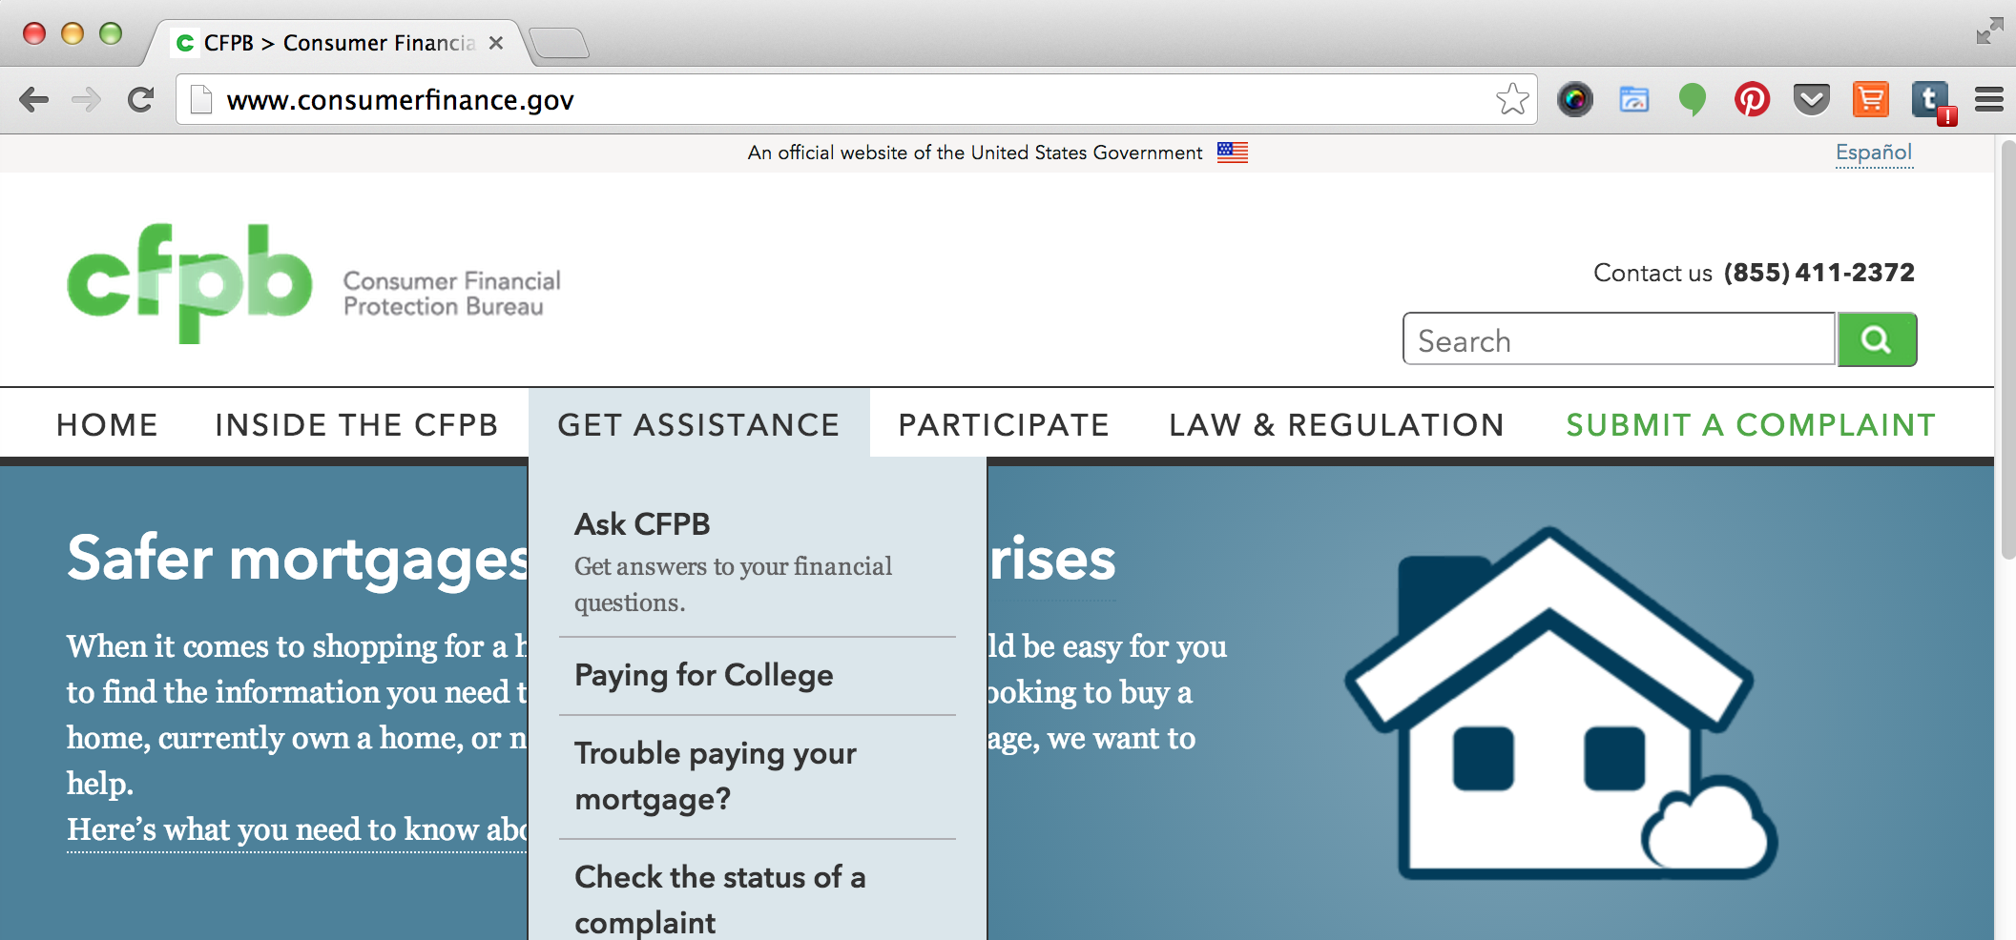
Submitting a complaint
(855) 411-2372
180+ languages, TTY/TDD
Check complaint status
www.consumerfinance.gov/complaint
Notes:
ACTIVITY #3: Introduction to the CFPB and Financial Empowerment CONTINUED
Facilitated Discussion and Presentation (Introduction Part 1)
Explain that even though the module on protecting your money is at the end of the toolkit, we want to underscore the importance of sharing this information early in the training. We know that sometimes people can't stay through a whole training or that trainers may run out of time if a discussion is longer than was originally planned.
Refer participants to the CFPB complaint contact information and use the following information to explain the complaint process. See Module 9: Protecting your money, Tool 1: Submitting a complaint to the CFPB on page 327 for more information.
Part of being a smart consumer is understanding your rights. When you know you have rights, you can protect yourself. There are many laws that protect your rights when it comes to financial products and services. It is the CFPB’s job to enforce these laws and handle consumers’ complaints about financial products and services.
The CFPB has already handled over 700,000 of consumer complaints about:
Credit cards
Mortgages
Bank accounts and services
Private student loans
Vehicle or consumer loans
Money transfers
Credit reporting
Debt collection
Payday loans
Prepaid cards, credit repair, debt settlement, and pawn and title loans
Virtual currency
Based on these complaints and research, the CFPB takes action to stop practices that are unfair, deceptive, or abusive or otherwise violate the law. In many cases, CFPB partners with other federal agencies and state officials to address these problems.
Through their enforcement actions, the CFPB can require companies to refund money to customers when their consumer rights have been violated.
Explain that someone else (a case manager, a community volunteer, legal aid attorney, or union representative, for example) can submit a complaint on behalf of someone else.
Explain that, if you don’t use a computer or need help in a language other than English, you can also submit a complaint over the phone by calling the CFPB at 855- 411-CFPB (2372), toll free. U.S.-based call centers can help you in over 180 languages and can also take calls from consumers who are hearing impaired or speech-disabled. Live operators in Spanish are available and the CFPB has received over 700,000 complaints as of October 2015.

Slide 17
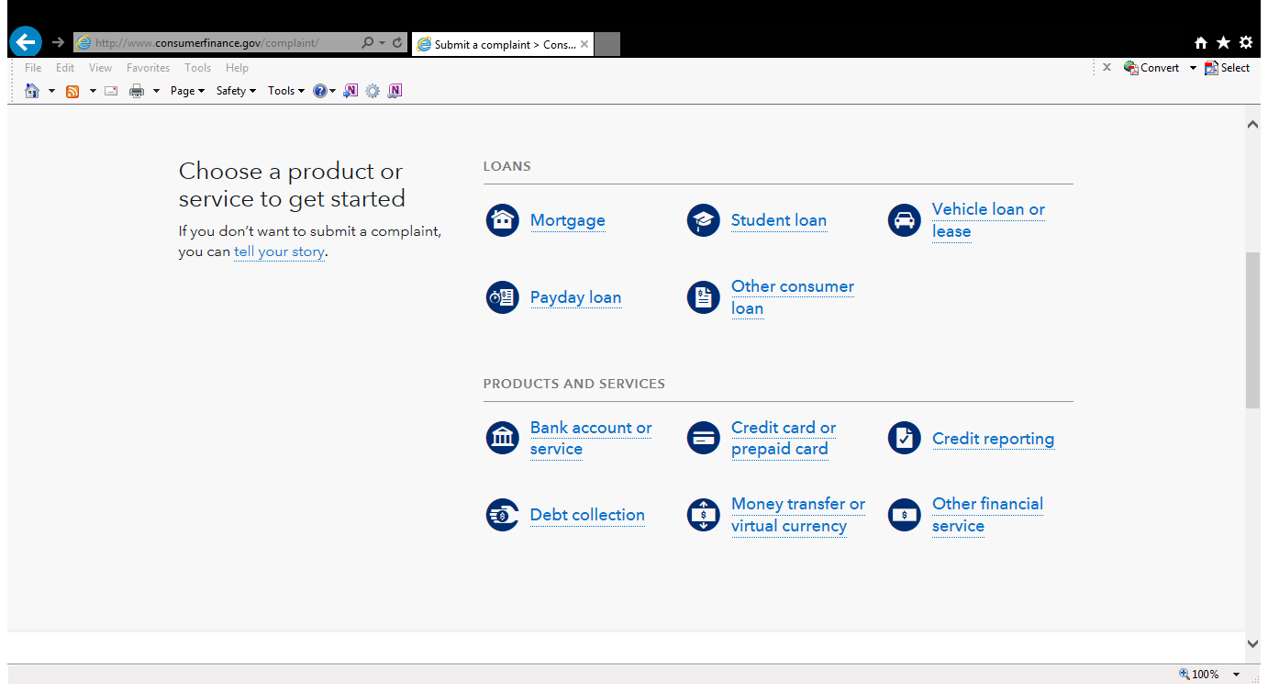
Submitting a complaint
Notes:
ACTIVITY #3: Introduction to the CFPB and Financial Empowerment CONTINUED
Facilitated Discussion and Presentation (Introduction Part 1)
Explain to get started, you click on the product or service about which you or your the people you serve has a complaint.
NOTE: If you have access to an Internet connection during the training, it can be useful for participants to see you move through the website to the complaint and show some of the features of this section of the CFPB’s website live

Slide 18
Complaint process
Notes:
ACTIVITY #3: Introduction to the CFPB and Financial Empowerment CONTINUED
Facilitated Discussion and Presentation (Introduction Part 1)
Explain the process for submitting a complaint:
Complaint Submitted: The CFPB will screen your complaint based on several criteria. These criteria include whether your complaint falls within the CFPB’s primary enforcement authority, whether the complaint is complete, and whether it is a duplicate of another complaint you have submitted.
Review and Route: If a particular complaint does not involve a product or market that is within the Bureau’s jurisdiction or that is currently being handled by the Bureau, the CFPB refers it to the appropriate regulator. Screened complaints are sent via a secure web portal to the appropriate company—the business you have the complaint with.
Company Response: The company reviews the information, communicates with you as needed. It then determines what action to take in response. The company reports back to you and the CFPB via the secure “company portal.” After your complaint is sent to the company, the company has 15 days to provide a substantive response to you and the CFPB. Companies are expected to close all but the most complicated complaints within 60 days.
Consumer Review: CFPB then invites you to review the response and provide feedback. Consumer Tracking: You can log onto the secure “consumer portal” available on the CFPB’s website or call a toll‐free number to receive status updates, provide additional information, and review responses provided to the you by the company.
Review and Investigate: The CFPB reviews your feedback about company responses, using this information along with other information such as the timeliness of the company’s response, for example, to help prioritize complaints for investigation.
Analyze and report. Complaints help with the CFPB’s work to supervise companies, enforce federal consumer financial laws, and write better rules and regulations. The CFPB also reports to Congress about the complaints we receive and posts consumer complaint data on the website in an easy-to-use format: www.consumerfinance.gov/complaint database/.

Slide 19
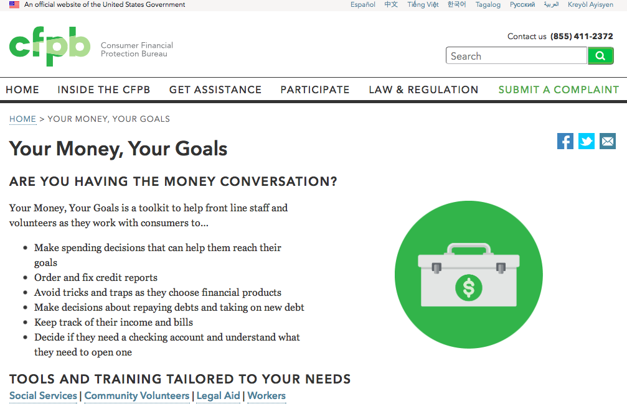
Notes:
ACTIVITY #3: Introduction to the CFPB and Financial Empowerment CONTINUED
Facilitated Discussion and Presentation (Introduction Part 1)
Review where to find Your Money, Your Goals

Slide 20
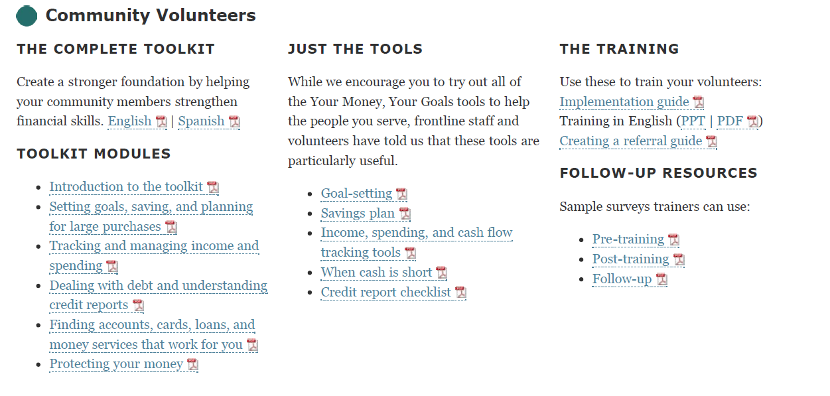
Getting the Community Volunteer toolkit
Notes:
ACTIVITY #3: Introduction to the CFPB and Financial Empowerment CONTINUED
Facilitated Discussion and Presentation (Introduction Part 1)
Review each resource or tool on the Your Money, Your Goals landing page using the following:
There are four versions of the TOOLKIT. We are going to focus on the Community Volunteers version, but there are also TOOLKITS for Social Services, Legal Aid Organizations, and Labor Unions.
First you have the TOOLKIT. This document contains all of the narrative information and tools for community volunteers to use with the people they serve. This is a PDF file that you can download. You can print the whole toolkit or just the sections or individuals tools you need by referring to the table of contents. The TOOLKIT is also available in Spanish.
Under the Training section, you will find all of the material you need to plan and deliver the training. The training guide is a PPT presentation with all of the facilitation instructions in the notes section of the PPT.
Review the Implementation and the Creating a Referral Guides.
Review the Follow-up Resources
NOTE: If you have access to an Internet connection during the training, it can be useful for participants to see you move through the website to the complaint section and show some of the features of this section of the CFPB’s website live

Slide 21
Sign up for YMYG updates
You will receive news of:
  Training and technical assistance opportunities
  Toolkit updates
Sign up today or visit the Your Money, Your Goals page to sign up.
  You can unsubscribe at any time.
Notes:
ACTIVITY #3: Introduction to the CFPB and Financial Empowerment CONTINUED
Facilitated Discussion and Presentation (Introduction Part 1)
Explain the following:
The CFPB can notify you via e-mail of opportunities to learn more about financial empowerment and the ways frontline staff and volunteers are sharing financial empowerment information and tools with the people they serve. You’ll also be notified when new content becomes available.
If you would like to allow participants to sign up at your workshop, print copies of the form on the next slide. There are 11 lines on the page.
If you prefer, you can encourage them to take a moment to use their phones to sign up.
Use your search function and type in “Your Money, Your Goals”.
Click on the link to the toolkit page.
Scroll to the bottom of the page and type your e-mail address into the box.

Slide 22
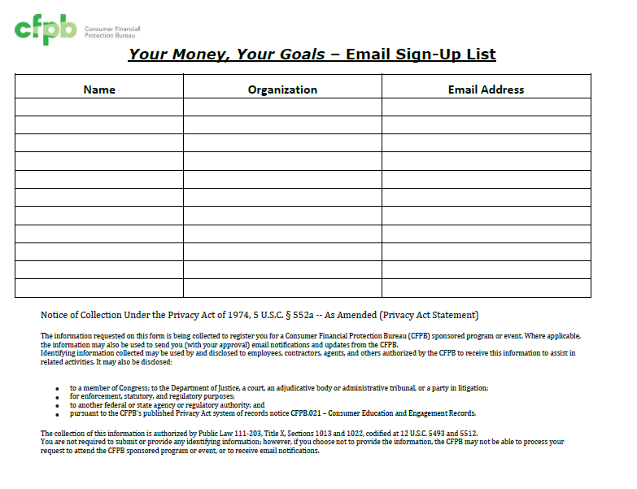
Notes:
ACTIVITY #3: Introduction to the CFPB and Financial Empowerment CONTINUED
Facilitated Discussion and Presentation (Introduction Part 1)
If you would like to offer participants the option of signing up via this sign-up sheet, print copies of this slide prior to the training. Following the training, please scan and send to: Empowerment@cfpb.gov or mail to:
Office of Financial Empowerment
Attn: Your Money, Your Goals
CFPB
1700 G St.
Washington, DC 20552
Remember to hide this slide during the presentation.

Slide 23
Financial empowerment
What is financial empowerment?
How is it different from financial education, financial literacy, financial capacity, or other commonly used terms?
Skills and Access
Financial empowerment
Financial literacy
Notes:
ACTIVITY #3: Introduction to the CFPB and Financial Empowerment CONTINUED
Facilitated Discussion and Presentation
Note: Do not advance to this slide until after the following two questions have been discussed by the participants.
ASK: What is financial empowerment?
Write their ideas on flip chart paper.
ASK: How is it different from financial education, financial literacy, financial capability, or other commonly used terms?
Ask them how financial empowerment is different from other commonly used terms: financial education, financial literacy, financial capability, financial fitness, financial coaching, and so on.
NOTE: It may be helpful to differentiate strategy terms (financial education, financial coaching, financial counseling) from outcomes-based terms (financial literacy, financial capability, financial fitness).
Share definition of financial empowerment using the slide and information from Introduction to the Toolkit and Module 1. Having the ability to use financial management knowledge, skills, and tools to access resources, products, and services to achieve your goals.
Empowerment is the process of increasing people’s capacity to make choices and transform those choices into actions and desired results, according to the World Bank. Financial empowerment is building the knowledge and capacity of individuals to manage money and use financial services products that work for them.
NOTE: Consider writing this definition on a flip chart and leaving it posted throughout the training.
Share the relationship of financial empowerment to financial education and financial literacy using the slide and information from Introduction Part 1.
Explain that financial education, which is inclusive of other strategies, such as coaching, counseling, technology-based approaches, and so on, leads to financial literacy and that financial literacy plus confidence—the confidence to make decisions and use knowledge, skills, and tools including financial products and services—is financial empowerment.
Emphasize that provision of financial empowerment also means delivery of this information in a nonjudgmental manner. Rather than telling someone what to do, the job of financial empowerment is providing options, the pros and cons of the options, and then supporting people in making decisions that make the most sense for themselves and their families.

Slide 24
Financial empowerment and community volunteers
Trust
==
Opportunities for providing financial empowerment
Access
What is financial empowerment?
How is it different than financial education, financial literacy, financial capacity, or other commonly used terms?
Notes:
ACTIVITY #3: Introduction to the CFPB and Financial Empowerment CONTINUED
Presentation (Introduction Part 1)
Explain rationale for Your Money, Your Goals for community volunteers.
Explain that community volunteer is used to refer to anyone who volunteers with a community- or faith-based organization that serves low-income or economically vulnerable community members. Your Money, Your Goals will be especially useful for volunteers that coach, counsel, mentor, or work directly with economically vulnerable individuals and families.
Explain that they often participate in activities like financial or career coaching, mentoring youth aging out of foster care, lay counseling in a faith-based organization, or welcoming people at a food bank or Volunteer Income Tax Assistance site.
Explain that finances affect nearly every aspect of life in the United States, but that many people feel overwhelmed by their financial situations, and they often don’t know where to go for help.
Describe how as a community volunteer, they are in a unique position to provide that help because the people they serve already know and trust them – and in many cases, they’re already sharing financial and other personal information with them.
Explain that community volunteers have unique opportunities to provide financial empowerment because they:
Meet with individuals that need high quality, unbiased financial information and tools to help them become financially empowered.
Have the trust of the people they work with
Explain how Your Money, Your Goals toolkit can help improve individuals’ and families’ financial stability using the following script:
The information and tools in the Your Money, Your Goals toolkit can help improve individuals’ and families’ financial stability by giving them a new understanding of financial concepts and financial tools they can apply to their own goals.
Depending on your volunteer role and the needs of the people you serve, you may be able to help them take the first steps to:
Set goals and calculate how much money they need to save to reach these goals
Save money
Establish an emergency savings fund
Access and use tax refunds
Track the specific ways they are using their money
Bring their cash flow budgets into balance
Make a simple plan to pay down debt
Get and review their credit reports
Fix errors on their credit reports
Evaluate financial products and services
Recognize when their consumer rights may have been violated and know how to take action

Slide 25
Debate
Team 1
As community volunteers, we
should provide financial empowerment services to
the people we serve.
Team 2
As community volunteers, we
should not provide financial empowerment services to
the people we serve.
Notes:
ACTIVITY #3: Introduction to the CFPB and Financial Empowerment CONTINUED
NOTE: Either Option A, Debate or Option B, Benefit/Cost Analysis should be selected in advance of the training.
OPTION A: Debate
Give half of the room time to discuss the reasons they think community volunteers SHOULD provide financial empowerment services to the people they serve.
Give the other half of the room time to discuss the reasons they think community volunteers SHOULD NOT provide financial empowerment services to the people they serve.
They should each elect one person to provide a 2 minute presentation of key points defending their positions. Instruct them to use visual aids (flip charts) to highlight key points.
Have each group present.
Summarize pros and cons to community volunteers taking on the role of providing financial empowerment services.
Use the opportunity to address some of the cons identified by the group and with the group, identify strategies for dealing with some of the reasons community volunteers shouldn’t providing financial empowerment in the context of their work. For example, someone may say that community volunteers don’t have either the knowledge or resources. The strategy to address this issue could be participating in a YMYG training and using the toolkit when they meet with people.
NOTE: If you have more than 20 people in your training, consider two teams for each “side” of the debate.

Slide 26
Benefit / cost analysis
What are the benefits of financial empowerment for:
You?
The people you serve?
The program you volunteer for?
What are the costs of financial empowerment:
You?
The people you serve?
The program you volunteer for?
Notes:
ACTIVITY #3: Introduction to the CFPB and Financial Empowerment CONTINUED
OPTION B: Benefit/Cost Analysis in Large Group or Small Groups
Using flip charts (one for benefits, one for costs), have participants brainstorm the benefits and costs of providing financial empowerment.
Summarize benefits and costs to this role.
NOTE: This can be done as a large group with facilitator writing or in small groups with each group completing its own benefit/cost analysis.
NOTE: This can also be set up as a carousel. Set up 6 flip charts throughout the room. Have one question written on each flip chart as follows:
Flip Chart 1: What are the benefits of financial empowerment for you?
Flip Chart 2: What are the costs of financial empowerment for you?
Flip Chart 3: What are the benefits of financial empowerment for the people you serve?
Flip Chart 4: What are the costs of financial empowerment for the people you serve?
Flip Chart 5: What are the benefits of financial empowerment for the program you volunteer for?
Flip Chart 6: What are the costs of financial empowerment for the program you volunteer for?
Instruct participants to count off to six and assemble based on their numbers. Have group 1 start at flip chart 1, group 2 at flip chart 2, and so on with one marker per group. Give them 1 minute to brainstorm all the responses they can think of to the question on the flip chart. After 1 minute (adjust this as necessary), call time and instruct groups to rotate to the next flip chart (group 1 goes to flip chart 2, group 2 goes to flip chart 3, and so on). Instruct teams to ADD TO the ideas contributed before them. Continue until each group has visited each flip chart. Review contributions.

Slide 27
Your Money, Your Goals
An orientation to the toolkit

Slide 28
Organization of Your Money, Your Goals
Introductory modules
  Introduction Part 1: Introduction to the toolkit
  Introduction Part 2: Understanding the situation
  Introduction Part 3: Starting the money conversation
  Introduction Part 4: Emotions, values, and culture: What’s behind our money choices?
Notes:
ACTIVITY #4: Your Money, Your Goals: An Orientation to the Toolkit
Estimated Time: 60 Minutes
Methodology: Presentation / Scavenger Hunt / Large Group or Small Group Discussion
Corresponding Sections in Toolkit: Introduction Part 1 and the entire Toolkit
Instructions for Facilitator:
Review organization of the toolkit using slide and information in Introduction Part 1.
Review the purpose of the toolkit: The goal of Your Money, Your Goals is to improve the people you serve outcomes by making it easier for you as a community volunteer to help the people you serves become more financially empowered.

Slide 29
Organization of Your Money, Your Goals
Content modules
  Module 1: Setting goals and planning for large purchases
  Module 2: Saving for the emergencies, bills, and goals
  Module 3: Tracking and managing income and benefits
  Module 4: Paying bills and other expenses
  Module 5: Getting through the month
  Module 6: Dealing with debt
  Module 7: Understanding credit reports and scores
  Module 8: Money services, cards, accounts, and loans: Finding what works for you
  Module 9: Protecting your money
Notes:
ACTIVITY #4: Your Money, Your Goals: An Orientation to the Toolkit CONTINUED
Presentation (Introduction Part 1)
Review organization of the toolkit using slide.
Review the purpose of the toolkit: The goal of Your Money, Your Goals is to improve the outcomes for the people and organizations you serve by making it easier for you as a community volunteer to help the people you serve become more financially empowered.

Slide 30
Organization of Your Money, Your Goals
Do not treat the Toolkit like a curriculum.
Provide the right content and tools at the right time.
Use discussions with the people you serves or assessments to figure out where to start.
Notes:
ACTIVITY #4: Your Money, Your Goals: An Orientation to the Toolkit CONTINUED
Presentation (Introduction Part 1)
Review key principles of using the toolkit.
Do not treat the Toolkit like a curriculum—the goal is not to get through all of the materials in the order they are presented.
Provide the right content and tools at the right time. Access only those parts of the toolkit that match your the people you serves’ needs.
Use discussions with the people you serves or assessments to figure out where to start.
Explain in particular the difference between the toolkit and a financial education/coaching curriculum.
A toolkit has tools in it.
It can be used in any order based on the problem trying to be fixed. If you are hanging a picture, you may only use a hammer. But if someone is trying to build a house, she/he will use a hammer, saw, and so on.
As with any toolkit, a community volunteer may only use one tool or many depending on the magnitude of the issue being addressed.
A curriculum is generally designed to help people develop specific competencies.
Often has the expectation that all or most of the curriculum will be taught and that one concept builds on another.
The toolkit is designed to help community volunteers match content with the specific needs of the the people you serves or individuals they serve on a just-in-time basis.
If someone needs to build their credit to qualify for an auto loan, you can go to the module on building credit without going through the modules on goal setting, saving, managing cash flow, and dealing with debt that come before it.
It’s not that these topics are not important, it’s just not what the person needs at that time.
Explain that to make the best use of the toolkit, it’s best not to give the people you serves all of the tools at once.
Getting all of the tools at once –or even five tools at one time – is likely be overwhelming for most the people you serves.
A better approach is to identify the topic and tool that will make the biggest difference for each the people you serve.
When sending tools home with the people you serves, limit it to one or two that have been reviewed and discussed during case management sessions.
If a the people you serve receives too many tools at once, none of the tools are likely to be used.

Slide 31
Where would you start if your the people you serve...
Felt overwhelmed by debt?
Felt like she couldn’t make ends meet?
Wants to buy a car and get the best rate she can for the money she must borrow?
Wants to understand direct deposit and payroll cards?
May qualify for EITC?
Notes:
ACTIVITY #4: Your Money, Your Goals: An Orientation to the Toolkit CONTINUED
Scavenger Hunt (Introduction Part 1)
Explain that they will be going on a scavenger hunt through the toolkit.
Instruct small groups to review each question and to locate the module and specific tools within the module that address each question.
Instruct participants to write their answers to each question on the slide on a flip chart using markers.
Provide teams 15 - 20 minutes to complete.
Ask participants to share answers; Use answer key to augment their solutions.
Following answers, ask participants to share reactions or questions they may have regarding the toolkit, given the scavenger hunt through it.
NOTE: For the training, you may want to combine slides 31 and 32, i.e., put all of the questions on one slide.
NOTE: Answer key follows. Participants may have answers that vary. If they do, ask them to explain the reason they chose the module and tool.
1. Your the people you serve felt overwhelmed by debt?
Module 6, Dealing with Debt and Tool 3, Reducing Debt Worksheet (Page 221)
2. Your the people you serve felt like she couldn’t make ends meet? (ANY OF THESE ANSWERS IS ACCEPTABLE)
Module 3, Tracking and Managing Income and Benefits and Tool 3, Ways to Increase Income and Resources (Page 131)
Module 4, Paying Bills and Other Expenses and Tool 1, Spending Tracker, 4, Strategies for Cutting Expenses, and 5, When Cash Is Short (Pages 145, 159, 165)
Module 5, Getting Through the Month and Tools 1, Cash Flow Budget, 2, Cash Flow Calendar, and 3, Improving Cash Flow Checklist (Pages 171, 181, 185)
3. Your the people you serve wants to buy a car and get the best rate she can for the money she must borrow?
Module 1, Setting Goals and Planning for Large Purchases and Tool 3, Buying a Car (Page 73)
Module 7, Understanding Credit Reports and Scores, and Tool 3, Improving Your Credit Reports and Scores (Page 275)
4. Your the people you serve wants to understand direct deposit and payroll cards?
Module 3, Tracking and Managing Income and Benefits and Tool 2, Ways to Receive Income and Benefits (Page 125)
5. You think your the people you serve may qualify for EITC?
Module 2, Saving for emergencies, goals, and bills and Tool 4, Increasing Your Income Through Tax Credits (Page 109)

Slide 32
Where would you start if your the people you serve... (continued)
Has used high-cost credit products in the past and wants to avoid these in the future?
Wants to make changes but does not have clear goals?
Has many financial issues, and you don’t know where to start?
Has no savings but wants to start?
Wants to open an account but doesn’t know what kind of account or where?
Notes:
ACTIVITY #4: Your Money, Your Goals: An Orientation to the Toolkit CONTINUED
Scavenger Hunt (Introduction Part 1)
NOTE: Answer key continues. Participants may have answers that vary. If they do, ask them to explain the reason they chose the module and tool.
6. Your the people you serve has used high-cost credit products in the past and wants to avoid these in the future? (ANY OF THESE ANSWERS IS ACCEPTABLE)
Module 2, Saving for Emergencies, Goals and Bills and Tool 1, Savings Plan (Page 91)
Module 5, Getting Through the Month and Tools 1 or 2 Cash Flow Budget and Calendar (Page 171 and 181)
Information on avoiding debt traps and alternatives to high-cost credit in Module 6, Dealing with Debt (Pages 201 and 204)
7. Your the people you serve wants to make changes, but does not have clear goals?
Module 1, Setting Goals and Planning for Large Purchases, Tool 1, Goal-setting Tool (Page 65)
8. Has many financial issues, and you don’t know where to start?
Introduction, Part 2,Understanding the Situation and Tool 1: My Money Picture (Page 29)
9. Has no savings but wants to start?
Module 2, Saving for Emergencies, Goals, and Bills and Tool 1, Savings Plan (Page 91)
10. Wants to open an account but doesn’t know what kind of account or where?
Module 8, Money Services, Cards, Accounts, and Loans and Tools 1, Know Your Options, 2, Ask Questions, 3, Money Services and Banking Basics, or 4, Opening an Account Checklist (Pages 293, 299, 303, 311)

Slide 33
Integration: Using the toolkit with the people you serves
Increase comfort with tools
Introduce FE in case management
Capture outputs and outcomes
Learn toolkit content
Notes:
ACTIVITY #4: Your Money, Your Goals: An Orientation to the Toolkit CONTINUED
Presentation (Introduction Part 1)
Explain that the toolkit is to be integrated into existing work not considered an add on service.
Explain the reasons for integration:
It builds on established relationships you may have with the people you serves.
the people you serves are busy—there is efficiency in addressing many issues in one stop.
Financial and economic issues cut across situations and challenges: basic needs housing, health and health care, child rearing and care, work, transportation, and so on.
Financial empowerment integration may present a more holistic approach to working with the people you serves.
It provides opportunities for reinforcement during “natural” discussions with the people you serves.
It may result in better outcomes for the the people you serves and programs.
Explain that the time to do this is front-loaded because time must be invested to:
Attend a training and be introduced to the toolkit
Take time to learn the toolkit content
Become comfortable with the topics and the tools in the toolkit
Think about ways to introduce financial empowerment in the context of the case management you provide
Potentially capture the outcomes of financial empowerment in the work you do—outputs are those things you can count like the number of the people you serves you served or the number of hours you provided financial empowerment services; outcomes are the benefits or changes that result from the work you do—they are related to outputs but different. Outcomes would be changes in knowledge, skills, beliefs, confidence, practices or behaviors, and financial circumstances.
Explain one of the tools to help community volunteers get started: the Financial Empowerment Checklist. (Page 11)
Explain that the purpose of this tool is to provide community volunteers with a tracking template for use with each the people you serve—it’s a simple way to keep track of the tools or information shared with a particular the people you serve collect output level data, and connect one meeting with a the people you serve to the next.
Ask participants to open their toolkits to the tool and review it with the participants.

Slide 34
Financial empowerment checklist
The goal is not to cover all of the tools with each person.
Instead, find the right module or tools based on:
  Their most pressing financial empowerment problem.
  The area in which they’ve expressed an interest in getting more help.
Notes:
ACTIVITY #4: Your Money, Your Goals: An Orientation to the Toolkit CONTINUED
Presentation (Introduction Part 1)
Explain one of the tools to help community volunteers get started: the Financial Empowerment Checklist.
Explain that the purpose of this tool is to provide community volunteers with a tracking template for use with each person—it’s a simple way to keep track of the tools or information shared with a particular person, collect output level data, and connect one meeting to the next.

Slide 35
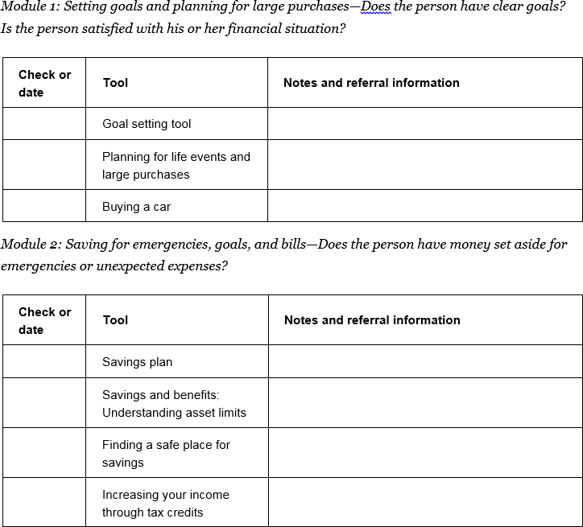
Intro Part 1, Tool 1: Financial empowerment checklist
Print off and keep with an individual’s file if appropriate
Use to connect meetings you’ve had
Notes:
ACTIVITY #4: Your Money, Your Goals: An Orientation to the Toolkit CONTINUED
Presentation (Introduction Part 1)
Explain the Financial Empowerment Checklist. Point out:
Question related to financial empowerment issue addressed in module
Space to write notes regarding information or tools provided
Space to check or write date tool used
Explain the rationale for this tool :
It is designed to help identify the financial empowerment information and tools to share
Keep track of the information you have shared including any referrals
Be sure to follow your organization’s policies on storing and safeguarding people’s personal information

Slide 36
What would you do if someone. . .
Wants to file for bankruptcy?
Wants to know how to respond to a creditor’s threat to sue?
Is facing eviction?
Is facing foreclosure?
Is not able to provide enough food for herself and other members of her household?
Is in danger of losing her car due to nonpayment?
Wants to take out a debt consolidation loan?
Wants to know how to finance her child’s college?
Notes:
ACTIVITY #4: Your Money, Your Goals: An orientation to the toolkit CONTINUED
Large Group or Small Group Discussion
Have participants determine what they would do in each situation using one of two approaches:
Discuss as a large group. Write their ideas for each question on a flip chart (this will begin the process of them seeing their resource and referral network as well as when they should refer on).
Discuss as a small group and report out to the large group. Instruct groups to write their ideas on a flip chart using markers. Have each team report out on one of the questions. Have other groups add to their reports based on their own small group discussions.
Summarize by sharing:
You can make a big difference in people’s lives by introducing them to financial empowerment and providing them with some new information and tools to help them solve specific financial challenges. But some of them may need more help—help you may not feel comfortable providing—because it is technical, beyond what you feel comfortable addressing, or not available within your organization. Because the people you serve may have built trust in you, they may look to you for quality information and referrals on specialized topics. This is where a high quality resource and referral network will be essential to your work in the community.
NOTE: The financial educator providing this training to community volunteers is the primary person responsible for creating a relevant resource and referral list for community volunteers. For more help on this, see the supplemental module Creating a Referral Guide. The need for a current local resource and referral list is important because general resource lists may leave people frustrated – some organizations that are listed as providing financial education, counseling, and coaching may not have experience or enough staff to handle referrals.

Slide 37
Your Money, Your Goals
The role of referral
Notes:
Note: If there is a complete resource and referral guide for the community volunteers, use this segment of the training to review that resource and referral guide rather than the slides that follow on the subject of referrals.

Slide 38
The role of referral
Financial empowerment = VERY BIG TOPIC
No one person knows everything.
Know your limits, know your partners, and refer!
Notes:
ACTIVITY #5: The Role of Referral
Estimated Time: 30 Minutes
Methodology: Facilitated Discussion / Large Group Brainstorm / Build a Chart
Corresponding Section in Toolkit: Introduction Part 1 (Page 5) and Special Module Creating a Referral Guide
Instructions for Facilitator:
Review the key points related to the role of referral.
Explore the concept of knowing your limits by asking: “How will you know when you have reached your limits in providing financial empowerment services to the people you serve?”
Write their responses on flip chart paper.

Slide 39
The right referral partner
High quality = factual, accurate, and current
Unbiased = not influenced by factors that benefit the information provider
Notes:
ACTIVITY #5: The Role of Referral CONTINUED
Facilitated Discussion (Introduction Part 1)
Discuss the characteristics that make a referral partner likely able to provide high quality and unbiased information.
Write these on two flip charts labeled as follows:
High Quality Characteristics
Unbiased Characteristics
Discuss the reasons using a general community list (one created by 211 administrator, for example) may not be sufficient as a resource and referral list for financial empowerment.
Existing community lists (211 lists) can be a starting point, but may not be sufficient.
The information may not be up-to-date.
Organizations may be listed as providing financial empowerment services (financial education, financial capability, financial coaching, credit counseling, asset building, etc.) that provide:
Services through other partners, or
Minimal services that do not reflect a high level of experience or expertise.

Slide 40
Identifying resource and referral partners
Area of Assistance | Possible Referral Partner
Cash Flow Budgeting
Benefits Screening
Income Tax Preparation and Filing
Managing Debt
Dealing with Debt Collectors
Understanding Credit Reports and Scores
Fixing Errors on Credit Reports and Scores
Using Financial Services
Protecting Consumer Rights
Asset Building
Other
Notes:
ACTIVITY #5: The Role of Referral CONTINUED
Optional Activity - Build a Chart (Introduction Part 1)
Give each group a stack of large self-adhesive notes (unique color per group and 4” X 6” or 5” X 8” size).
Have them write potential referral partners--one per large self-adhesive note.
Have them complete the chart by hanging the referral partner in the right spot on the table (which you must create using flip charts in advance of the training).
Distribute resource and referral guide you created in advance of the training.
As a group, determine whether some of the suggestions from the participants should be added to the list (they are high quality, unbiased providers and they actually do provide the services or products relevant to the people you serves); instruct participants to write these into their resources and referral guides.
NOTE: If you have already created a resource and referral guide for your community volunteers, be sure to add any high quality and unbiased providers identified by the group following the training.
NOTE: You can use this time instead to review the resource and referral guide you have created for your community.
Brainstorming
Ask participants to brainstorm a list of questions they would ask a potential referral partner to make sure they were an unbiased and high quality provider of information and support.
Write their ideas on a flip chart.
Use the following ideas from the toolkit to add to theirs.
Does the individual, organization, or business earn revenue by selling financial products or services?
Does the individual, organization, or business require cash up front?
Has the individual, organization, or business had an action taken against it because of complaints submitted to the Better Business Bureau, the state Attorney General’s Office, state nonprofit association, or other entities?
Can the individual, organization, or business provide references?
Will the individual, organization, or business agree to provide general information only and refrain from marketing its financial products or services?
Do former or current the people you serves report having been helped?
Have you had positive experiences working with this partner?
Other questions?

Slide 41
Your Money, Your Goals
Understanding the situation and starting
the money conversation

Slide 42
Financial empowerment self-assessment
Complete Tool 2: Financial empowerment self-assessment
Reflection Questions
How did you feel about completing this assessment?
Were there topics you knew more about than you thought you would?
What topics would you like to learn more about?
How can you learn more about them?
Notes:
ACTIVITY #6: Understanding the Situation and Starting the Money Conversation
Estimated Time: 60 Minutes
Methodology: Presentation / Individual Activity and Discussion in Pairs /Role Play / Skit or Large Group Brainstorm
Corresponding Section in Toolkit: Introduction Part 1, Introduction to the Toolkit (Page 1) Introduction Part 2, Understanding the Situation (Page 27) and Introduction Part 3, Starting the Money Conversation (Page 37)
Instructions for Facilitator:
Individual Activity and Discussion in Pairs (Introduction Part 1)
Provide rationale for assessment Tool 2:
Tool 2: Financial Empowerment Self-Assessment (Page 17) is a four-part tool designed to help you understand how much financial knowledge you already have.
Learning more will not only benefit the people you serve, but it may also benefit you as you apply what you learn to your own life. This tool will help you see how much you know and where you may need to learn more.
Invite participants to complete this assessment tool. Provide 7 minutes.
Review the answers in a participatory way.
NOTE: In the toolkit, the answer key immediately follows the tool. Be sure to ask participants to not look ahead when completing the self-assessment.
Ask participants to get into pairs and discuss the reflection questions—be sure to review one question at a time.

Slide 43
Situation assessment
A picture of conditions today used
to inform and plan for actions to
change conditions in the future
Notes:
ACTIVITY #6: Understanding the Situation and Starting the Money Conversation CONTINUED
Presentation (Introduction Part 2) (Page 27)
Define situation assessment using slide.
Review the purpose of My Money Picture, an assessment tool.
Tool 1: My Money Picture (Page 29) is designed to help community volunteers understand the goals and financial situations of the people they are serving. This information can help community volunteers target the right module of the toolkit for each the people they serve.
For example, if an individual has a goal to buy a car or a home, learning about how to improve his/her credit history and scores may help the individual qualify for a lower cost loan. You can target Module 7: Understanding Credit Reports and Scores (Pages 241).
If someone is unable to make ends meet every month, you can target Module 5: Getting through the Month (Page 169).
This tool will help you match each person’s goals and financial situation with specific modules and tools within the toolkit.
Briefly review the contents of and analysis procedure for My Money Picture.
Be sure to state that using this assessment is NOT MANDATORY. It is a tool they can use to more effectively and efficiently match people with information and tools in the toolkit.
Share options for using the assessment:
When people fill out intake paperwork for your organization or program
When meeting with people for an initial assessment
When people are waiting for other services (such as waiting to have their tax returns prepared at a Volunteer Income Tax Assistance site)
Send this home with people to fill out privately
Use it as a guide to ask questions in a conversational style to better understand the financial concerns and goals of individuals
Ask the questions over several sessions

Slide 44
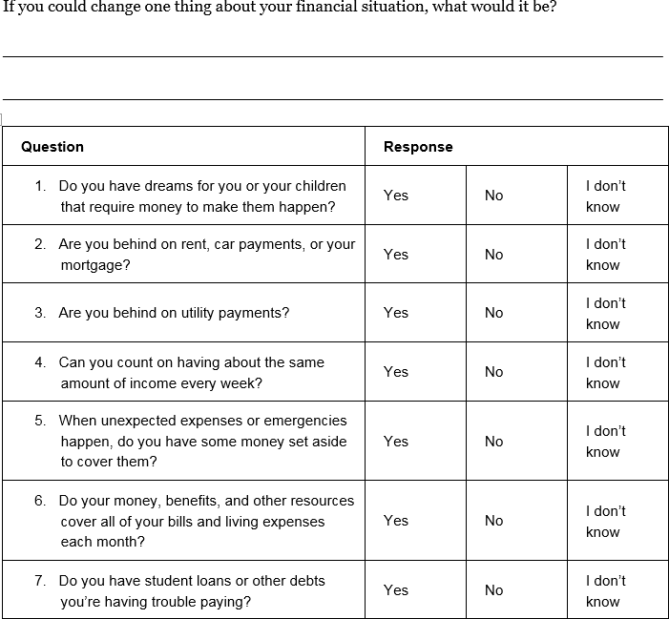
Tool 1: My money picture
Notes:
ACTIVITY #6: Understanding the Situation CONTINUED
Excerpt from My Money Picture, which is Tool 1 (page 29) in Introduction Part 2: Understanding the Situation.

Slide 45
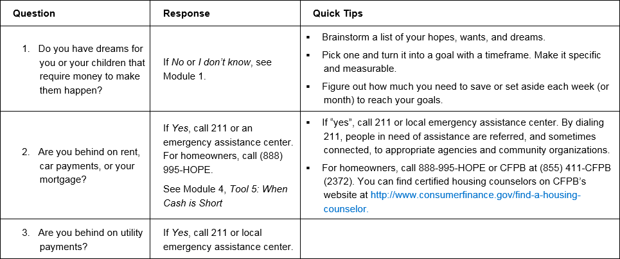
Tool 1: My money picture
Notes:
ACTIVITY #6: Understanding the Situation CONTINUED
Excerpt from the Financial goal and situation assessment answer key—My Money Picture, which is Tool 1 in Introduction Part 2: Understanding the Situation.
Point out the “Quick Tips.”

Slide 46
Goals and financial situation assessment role play
Role 1 = Person meeting with the volunteer
  Role play the person meeting with the volunteer and complete assessment as instructed by the volunteer once you “feel comfortable” during the meeting.
Role 2 = Community volunteer
  Start discussion, introduce assessment when appropriate, analyze assessment (if time allows), make a plan for financial empowerment work.
Role 3 = Observer
  Watch discussion, take notes using form, provide feedback.
Notes:
ACTIVITY #6: Understanding the Situation CONTINUED
Role Play
Count off participants into groups of three.
Have each triad draw a role from an envelope.
Explain each role in the role play.
Provide observer with observation worksheet (see note below).
NOTE: Prior to the training, set up envelopes with three slips of paper in each. Each slip of paper should have one of the roles listed above written on it. Make sure you have enough envelopes for the group—if you have 21 participants, you will need 7 envelopes.
NOTE: Prior to the training, use the following questions to create a form for the observers:
What were the most effective techniques the community volunteers used in listening to and talking with people?
What approaches or techniques did not seem to work as well?
What could have made the situation even better for the person being served?
How well did the assessment work in the context of a “meeting?”
How useful do you think this tool will be in the work you do?
Feel free to add your own questions to this form.

Slide 47
Goals and financial situation assessment role play
Person meeting with the volunteer
How did it feel taking the assessment?
What did the community volunteer do to make you feel more comfortable answering these questions?
Was there anything that could have made the situation less stressful or threatening?
Did you feel the steps the community volunteer outlined following the assessment made sense for you (if there was time during the role play)?
Notes:
ACTIVITY #6: Understanding the Situation CONTINUED
Role Play
Ask participants to share from their experiences during the role play.
Use the questions on the slide to facilitate their sharing.

Slide 48
Goals and financial situation assessment role play
Community volunteer
How did it feel introducing the assessment?
How comfortable was it “analyzing it” on the spot? Why is relatively quick analysis important?
What do you think you did to make the situation comfortable for the person you were meeting with?
How useful do you think this tool will be in your volunteer work?
Notes:
ACTIVITY #6: Understanding the Situation CONTINUED
Role Play
Ask participants who were community volunteers to share from their experiences during the role play.
Use the questions on the slide to facilitate their sharing.

Slide 49
Goals and financial situation assessment role play
Observer
What were the most effective listening and communication techniques the volunteer used?
What could have made the situation even better for the person they were meeting with?
How well did the assessment work in the context of a “meeting?”
How useful do you think this tool will be in the volunteer work you do?
Notes:
ACTIVITY #6: Understanding the Situation CONTINUED
Role Play
Ask participants who were observers to share from their observations and notes.
Use the questions on the slide to facilitate their sharing.
If not covered during the introduction to this section of the training, be sure to share the following now:
Share options for using the assessment:
When people fill out intake paperwork for your organization or program
In an initial assessment (if your volunteer work includes this type of activity)
When people are waiting for other services (such as waiting to have their tax returns prepared at a Volunteer Income Tax Assistance site)
Send this home with people to fill out privately
Use it as a guide to ask questions in a conversational style to better understand people’s financial concerns and goals
Ask the questions over several sessions with an individual

Slide 50
Other strategies for starting the conversation
Brainstorm with your group specific opportunities for beginning the financial empowerment conversation with the people you serve.
Notes:
ACTIVITY #6: Understanding the Situation and Starting the Money Conversation CONTINUED
NOTE: Select Option A: Brainstorm or Option B: Skit in advance of the training
Option A: Brainstorm (Introduction Part 3) (Pages 37)
Instruct participants to brainstorm a list of ways they can initiate the financial empowerment discussion with the people you serve.
NOTE: This can be done as a large group or in small groups with a large group report out.
Option B: Skit (Introduction Part 3) (Pages 37)
Invite pairs of participants to “read” and act out scripts provided in the toolkit on pages 40 - 43.
Solicit feedback from participants about what worked well and how they would change the discussion.
Introduce participants to Tool 1 in the Introduction Part 3, Top Money Conversations on page 45 – 46. Explain that this is just another way to help them see how to use questions as the starting point for use of the Toolkit.

Slide 51
Your Money, Your Goals
Module 1: Setting goals and planning for large purchases

Slide 52
Setting goals
Work toward making your future better.
Prioritize how you spend your money so that it goes toward things that really matter to you.
Measure and track your progress toward getting the things you want out of life.
Take pride in bettering your life and the lives of your children.
Notes:
ACTIVITY #7: Setting Goals and Planning for Large Purchases
Estimated Time: 45 Minutes
Methodology: Presentation / Facilitated Discussion / Scenarios in Small Groups / Presentation
Corresponding Section in Toolkit: Module 1 (Pages 55)
Instructions for Facilitator:
Presentation (Module 1)
Encourage participants to follow along in Module 1 in the toolkit.
Describe the role of goal setting in financial management and financial planning.
Explain the rationale for setting goals using the above slide.

Slide 53
SMART Goals
Specific
Measurable
Able to be reached
Relevant
Time-framed
Notes:
ACTIVITY #7: Setting Goals and Planning for Large Purchases CONTINUED
Presentation (Module 1)
Explain the qualities of strong goals using the following:
Specific
When setting a goal, ask yourself the questions: Who? What? Why?
A specific goal has a much greater chance of being met than a general goal.
Measurable
You should be able to track your progress toward meeting the goal.
Ask yourself questions like: How much? How many? How will I know when it is done?
Able to be reached
Is this goal something that you can actually reach?
You might want to get rid of credit card debt tomorrow or become a millionaire in a year, but for most of us, that's a totally impossible goal!
That doesn't mean that your goals should be easy. Your goal may be a stretch for you, but it should not be extreme or impossible.
Relevant
Set goals that matter to you and are a priority in your life.
Ask yourself the questions: Is this something that I really want? Is now the right time to do this?
Time-framed
Goals should have a clearly defined time frame, including a target or deadline date.

Slide 54
Hopes, wants, and dreams vs. strong goal
Hopes, wants, and dreams
Strong goal
I’d like to buy a new television.
I want to get out of
credit card debt.
I will save $400 and purchase a new television in six months.
I will pay down $1,000 of my debt in the next year.
Notes:
ACTIVITY #7: Setting Goals and Planning for Large Purchases CONTINUED
Facilitated Discussion (Module 1)
Review examples by asking: “Why is a hope, want or dream NOT a goal?” “What makes this strong goal strong?”
Ask participants to list the things the people they serve need to reach goals. Write their responses on flip chart paper. Be sure to add the following:
Every goal requires commitment and time. To reach goals, you may also need:
Information
Tools
Assistance from a professional
Transportation
Other resources
Money
An action plan—small steps needed to reach a goal
For goals that require money to reach, you will want to know: How much do I need to set aside every week (or month) to meet my goal?
This applies to both debt reduction and savings goals.

Slide 55
Tool 1: Goal-setting tool
Brainstorm list of hopes, wants and dreams
Figure out weekly savings target
Action plan
SMART goals
Notes:
ACTIVITY #7: Setting Goals and Planning for Large Purchases CONTINUED
Facilitated Discussion (Module 1)
Review the steps to completing Tool 1: Goal-setting Tool (page 65).
Step 1: Brainstorm a list of the hopes, wants, and dreams for yourself or your family. You may also want to brainstorm a list of the life events you anticipate experiencing as well as the costs associated with some of these life events. Determine whether they are short-term or long-term. Write these in the chart below.
Step 2: Turn your hopes, needs, wants, and dreams into SMART goals using the second worksheet.
Step 3: Create an action plan to reach your goals. For long-term goals, your action plan may be long and involve many steps. For other goals, you may only need to take a few steps to reach your goal.
Step 4: Finally, for goals that require money, figure out how much you need to set aside each week (or month) to reach your goal using the final section of the worksheet.

Slide 56
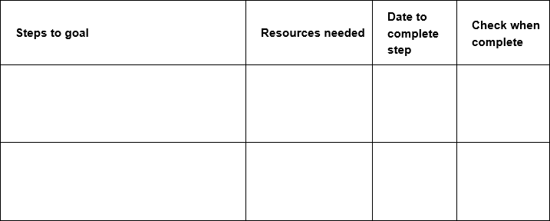
Action plan
Goal: _______________________________
Notes:
ACTIVITY #7: Setting Goals and Planning for Large Purchases CONTINUED
Presentation (Module 1)
Explain how to use this tool using the following example or another example.
Remind participants that while some goals require setting money aside to reach, they may also require more information, help from a professional, use of a new tool, or an action plan. For example, a goal may be:
I want to pay my bills on time every month starting August 1.
Assuming lack of money is not the primary reason bills are not being paid on time, here are some steps you could take to reach that goal:
Collect credit card statements, loan payment statements, utility bills, phone bills, and documentation of other payments made each month.
Highlight payment amounts and due dates.
Fill in the bill paying calendar tool.
Consider using automatic payment methods for some recurring bills or online bill payment.
NOTE: You could write these steps in the action plan format on a flip chart or fill in the chart on the PPT with this example or another.
Explain that goals generally need to be reset or revised when:
The goal has been achieved.
Emergency savings are used and need to be replenished.
Circumstances change.
Values change and a goal no longer feels relevant.

Slide 57
Calculating amount to set aside each week
Number of weeks to reach goal
Amount to set aside each week
Total amount needed
Divided By
Equals
Notes:
ACTIVITY #7: Setting Goals and Planning for Large Purchases CONTINUED
Presentation (Module 1)
When figuring out how much to set aside every week to meet the goal, two pieces of information are needed: the total amount needed to reach the goal and the number of weeks to reach the goal.
Explain how to get a monthly amount—multiply the weekly amount by 4 or divide the total amount needed by 12 months.
Go through an example on a flip chart using a participant’s goal, the one in the toolkit, or one you create.
Discuss how this weekly set-aside can be used in developing a budget or cash flow.

Slide 58
Life cycle events and large purchases
What is a life cycle event likely to cost?
Everyone is different, but here are some estimates we have seen:
Out of pocket childbirth expenses for women with insurance coverage—$3,400
Out of pocket expenses associated with breast cancer—$712/month
Quinceañera—coming of age celebration for 15-year old girls in Latino families—$15,000 to $20,000
Typical cost for final expenses—$10,000
Notes:
ACTIVITY #7: Setting Goals and Planning for Large Purchases CONTINUED
Facilitated Discussion (Module 1)
ASK: What is a life event?
Something that happens—may be planned or unplanned—that many people experience generally at specific life stages although this is not always the case.
ASK: What is a large purchase?
Something that is generally only purchased one or a few times in life that requires more money than most people have in disposable income from one paycheck. Examples include: large appliances, cars, and home repairs. These may be planned or unplanned.
Review costs of some life cycle events or large purchases. Solicit other examples from participants – like weddings, divorce, faith-based celebrations, education for you or your children, saving for a down payment for a home, training or tools for a new job, etc.

Slide 59
Planning for life events and large purchases
Group 1: 18-year old graduating from high school. Plans to attend trade school to become a skilled welder.
Group 2: 28-year old food services manager at a state university diagnosed with cancer. He is married and has an infant.
Group 3: 36-year old mother who is getting divorced. She has two children ages 4 and 8. Must find a job for the first time in 9 years; before having children she was a math teacher in the public school system.
Group 4: 45-year old man being downsized out of manufacturing job. Married with one child who is 15 years old. The child has plans to go to college out of state.
Group 5: 56-year old long-haul truck driver who would like to retire in 6 years. Has saved minimally for retirement. Children are grown and out of the house; however, one has lost his job and has plans to return home with his two preschool children.
Notes:
ACTIVITY #7: Setting Goals and Planning for Large Purchases CONTINUED
Scenarios in small groups (Module 1)
Show the slide above.
Divide the participants into small groups.
Give each group one of the scenarios.
Instruct participants to identify what life events the individual is likely to have already experienced, likely to experience one day as well as any large purchases you can see them incurring in their futures.
On a flip chart, draw a path with a stick figure or star person in the middle of it. Label the bottom of the path “The Past” and label the top of the path “The Future.”
Instruct participants to list these life events and large purchases as well as a guesstimate of the costs associated with each on the path and when they will occur (in the past or in the future).
Each group should be prepared to present.

Slide 60
Planning for life events and large purchases
What are the reasons for thinking about and anticipating life events and large purchases?
Do most people do this? Why or why not?
How does an exercise like this empower individuals?
How can an exercise like this backfire?
What did you learn from this exercise?
Notes:
ACTIVITY #7: Setting Goals and Planning for Large Purchases CONTINUED
Scenarios in small groups (Module 1)
Following the group presentations, process the exercise using the following questions (also on the PPT slide).
What are the reasons for thinking about and anticipating life events and large purchases?
Do most people do this? Why or why not?
How does an exercise like this empower individuals?
How can an exercise like this backfire?
What did you learn from this exercise?

Slide 61
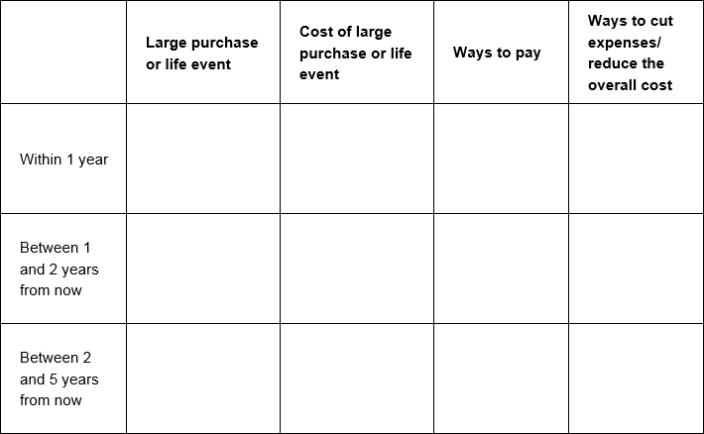
Tool 2: Planning for life events and large purchases
Notes:
ACTIVITY #7: Setting Goals and Planning for Large Purchases CONTINUED
Presentation (Module 1)
Introduce Tool 2 (page 69) and explain how to complete it using the following instructions from the Tool:
Think about the life events you are likely to experience and large purchases you might need to make. If you rely on a car to get to and from work, you will probably need to replace this vehicle in your future, maybe even more than once. If you use tools for your trade, these may need to be periodically updated or replaced due to normal wear and tear. Brainstorm a list of those expenses using the timeline chart below. Consider where you are now, and when you are likely to experience some life events (your daughter’s quinceañera or bat mitzvah) or need to make large purchases. If your daughter is eight years old now, her quinceañera will be in seven years. If your car is five years old or has a lot of mileage on it, you may need to replace it within five years or less.
Estimate the costs of these expenses. Research the costs of large purchases or life events. If the life event or need to make a large purchase is likely to happen more than five years from now, remember that the cost of almost everything gradually increases over time. This increase is called inflation.
Identify potential ways to pay for the large purchases or costs associated with life events. For example, you can borrow money to buy a reliable used or new car. If you plan to borrow money, consider saving some money for a down payment to keep your monthly payments as low as possible. Many large purchases may require a combination of financing and savings to cover the cost.
Identify ways to keep the costs as low as possible. For example, for your daughter’s quinceañera or bat mitzvah, can you save on the rental of a location by holding it in a rent-free or reduced-rent facility like a community hall in your community of faith? Can you save on the meal by involving family and friends in helping you prepare food rather than hiring a catering company?

Slide 62
Tool 3: Buying a car
When you buy a car, you can:
  Pay for it in cash
  Borrow money to pay for it and pay it back over time
Auto loans are available from:
  Credit unions
  Banks
  Finance companies
  Car dealers
Notes:
ACTIVITY #7: Setting Goals and Planning for Large Purchases CONTINUED
Presentation (Module 1)
Review Tool 3: Buying a car (page 73) to share highlights of this tool.
Explain the rationale for this tool: next to buying a home, the cars people buy are the largest purchases many of them will make throughout their lives and that for many who never buy a home, it will be their biggest purchase.
Explain that this tool is informational in nature, i.e., there is nothing for them to fill in.

Slide 63
Tool 3: Buying a car
The amount of interest and fees (the annual percentage rate or APR) you pay on a loan may depend on:
  Your credit history and score
  The term of the loan
  The price of the car you are buying
APRs are lower for people with positive credit histories and high credit scores.
The APR is also generally lower when you buy a new car.
Notes:
ACTIVITY #7: Setting Goals and Planning for Large Purchases CONTINUED
Presentation (Module 1)
Review Tool 3: Buying a car to share highlights of this tool.
Discuss the reasons for shopping for a car loan before shopping for a car.
Discuss deciding on a down payment.

Slide 64
Module 1: Wrap up
SMART goals can provide direction to financial plans.
SMART goals can help you plan for the money you need to reach your goals.
Action plans can help ensure you have the information and resources you need to reach your goals.
Anticipating life events and large purchases including cars can empower you to plan and save for them.
Use Tool 1: Goal-setting tool to set SMART goals, make plans, and figure out weekly savings target.
Use Tool 2: Planning for life events and large purchases to anticipate and plan for the expenses associated with these.
Use Tool 3: Buying a car to discuss key considerations before buying a car.
Notes:
ACTIVITY #7: Setting Goals and Planning for Large Purchases CONTINUED
Presentation (Module 1)
Review highlights of the module using the module 1 wrap up.
Summarize by sharing:
Goals are specific, measurable, able-to-be reached, relevant, and time-framed statements of where someone wants to be with their life or what they want to achieve. Goals provide direction for how to use money.
Goals often require money, but may require other resources in order to achieve them.
Goals may require action plans, too.
Many goals are related to life events and large purchases. Thinking about these before they happen can help people prepare for them—this will lessen the financial shock these events and purchases may create.
Finally, next to buying a home and paying for post secondary education, a car is often the largest purchase people will make. The Buying a Car tool provides some basic information about terminology that can empower people in the car-buying process.

Slide 65
Your Money, Your Goals
Module 2: Saving for the emergencies, goals, and bills
Notes:
Take time to acknowledge that for very low-income people, savings may not be their main goal.
Remember, Your Money, Your Goals is a toolkit, not a curriculum. The fact that we’re covering this before other modules isn’t meant to imply that it’s what you should begin with when you work with the people you serve.
The concepts that are discussed in this module are applicable to other types of goals that require someone to “find” money in their budget that they can apply to a goal such as debt repayment.

Slide 66
Saving
What is savings?
Savings is money you set aside today from your income for use in the future
What are examples of unexpected expenses or emergencies?
Notes:
ACTIVITY #8: Saving for the Emergencies, Goals, and Bills
Estimated Time: 60 Minutes
Methodology: Facilitated Discussion and Small Group Brainstorm / Presentation / Exercise in Pairs / Facilitated Discussion and Large Group Activity / Carousel / Presentation or Facilitated Discussion
Corresponding Section in Toolkit: Module 2 (Page 77)
Instructions for Facilitator:
Facilitated Discussion and Small Group Brainstorm (Module 2)
Ask participants to share their definition of savings.
Share definition of savings using slide.
Have participants list examples of unexpected expenses or emergencies in small groups on flip chart paper using marker.
After 3 minutes, ask participants to circle those they think could be handled with $1,000 or less.
Instruct groups to post their flip charts and share cumulatively.
Make summary comments about the number of unexpected expenses that can be managed with $1,000. Contrast to the “conventional wisdom” advocating 3 - 6 months’ worth of living expenses.
Explain that $500 to $1,000 is a possible goal for most—they can imagine it and it can make a very, very big difference.
Explain that having $500 to $1,000 to cover emergencies and unexpected expenses can help avoid debt.
Also explain the following:
Once people see they can save this much, then they can work toward 1 month’s living expenses, 3 months’, etc. over the longer term.

Slide 67
Emergency fund
Emergency fund or a rainy day fund = an important part of your savings plan.
Having your own money set aside to cover unexpected expenses can save you money, because you won’t pay interest, fees, or other costs that come from borrowing the money you need.
Notes:
ACTIVITY #8: Saving for Emergencies, Goals, and Bills CONTINUED
Presentation (Module 2)
Review definition of emergency fund.
Explain that emergency savings can help prevent taking on debt to cover unexpected or emergency expenses; explain this protects future income (income is not obligated going forward to cover debt incurred today).

Slide 68
Cost to replace spark plugs on your car = $350
 | Emergency savings | Credit card | Payday loan
Amount to cover expense | $350 | $350 | $350
APR |  | 21.99% annual percentage rate (APR) | $15 for every $100 borrowed for 14 days. This means a 391% annual percentage rate (APR).
Payment |  | Must pay at least a certain amount each month. (For the purposes of the example, the individual is choosing a fixed monthly payment of $50.) | Must pay back loan amount ($350) plus fee ($52.50) within 14 days. If entire loan cannot be paid within 14 days, it can be rolled over (or extended) for another 14 days for an additional fee of ($52.50).
Total cost and time to repay | $0 | You would pay $28.11 in interest in addition to the principal borrowed. It will take just over eight months to pay back the full amount. | The total cost depends on how long it takes you to save up to pay back the entire loan. If you renew or roll over this loan seven times, you would be in debt for 14 additional weeks and could pay up to $367.50 in fees.
Notes:
ACTIVITY #8: Saving for Emergencies, Goals, and Bills CONTINUED
Exercise in Pairs (Module 2)
Before showing above slide, ask people some of the benefits of having emergency savings. Write on flip chart.
Share that one benefit is that it can save you money—sometimes a lot of money.
Ask participants to review the table (on Page 83 in their Toolkit or on this slide) in pairs. Explain that the terms of the two loan products are for example purposes only – that terms vary.
Have them list the costs of each approach to covering the spark plugs—an unexpected or emergency expense. Be sure to explain that there are direct costs—the additional money that each approach may require. But, there may be other costs, too such as stress of repaying a new debt.
Give pairs 5 minutes to complete.
Ask groups to share their thoughts.
Keep track of direct costs and other costs on flip charts.
ASK: How do you think the people you serve would respond to this information?
NOTE: Use the following answers as a guide for the discussion.
Emergency Savings
Direct costs: use of savings, decreased spending because income dedicated to savings, future savings to replenish the amount used for spark plugs
Other costs: discipline of regular savings to build and replenish emergency fund
Credit Card
Direct costs: interest paid on money borrowed—$28.11; obligation of future income until credit card balance is paid in full
Other costs: stress of credit card bill; could impact credit score positively or negatively depending on payment pattern
Payday Loan
Direct costs: origination and renewal fees—for 8 months, this is 16 payments x $52.50 = $840; obligation of future income until payday loan paid in full
Other costs: stress of payment and amount of total payment; lost opportunity to use the money paid to origination and renewal fees elsewhere (could have purchased 3 sets of spark plugs in the end).

Slide 69
Tool 1: Savings plan
The reasons you are saving
The amounts you need to save
How you are going to find that money to save
Where you are going to put that savings—a place that is safe and secure
Notes:
ACTIVITY #8: Saving for Emergencies, Goals, and Bills CONTINUED
Presentation (Module 2)
Review the components of a savings plan.

Slide 70
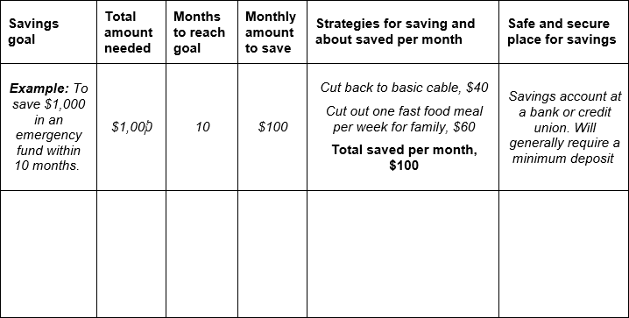
Tool 1: Savings plan
Notes:
ACTIVITY #8: Saving for Emergencies, Goals, and Bills CONTINUED
Share an excerpt from the savings plan tool (page 91).

Slide 71
Finding money to save
Decrease spending on one item or many things
  Major costs versus little cuts in spending
Increase your income
Turning money saved—from additional income or decreased spending— into actual money in savings
Notes:
ACTIVITY #8: Saving for Emergencies, Goals, and Bills CONTINUED
Facilitated Discussion (Module 2)
Facilitate a discussion about ways participants and their the people you serves can find money to save. Write ideas on flip chart.
Review list generated by indicating whether it is an example of decreasing spending or increasing income after showing above slide and sharing that all ways to find money to save can be put into one of these two categories.
Discuss the challenge of turning “money saved” into actual “money in savings.” Be sure to explain that increasing income and decreasing spending saves money, but it’s not savings until it is set aside for use in the future.

Slide 72
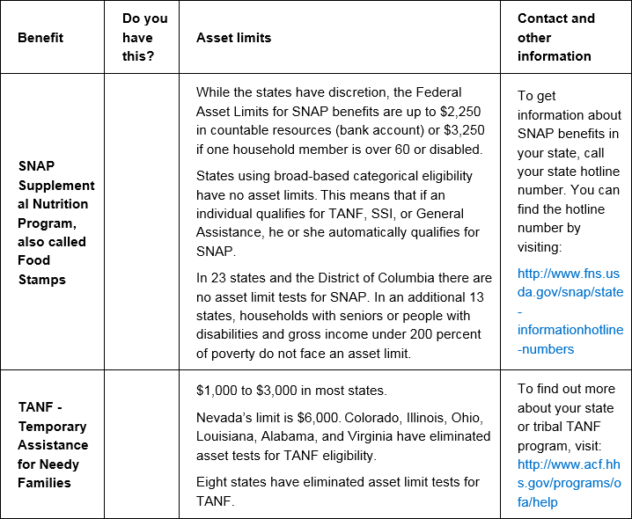
Tool 2: Savings and Benefits: Understanding asset limits
What are the reasons this tool is included?
Notes:
ACTIVITY #8: Saving for Emergencies, Goals, and Bills CONTINUED
Facilitated Discussion and Large Group Activity (Module 2)
Review tool by asking: “What are the reasons this tool (page 97) is included?”
If there is time, complete the tool as much as possible with the group based on their own knowledge and experience.
You may also complete the tool with your state’s information, make copies, and share it with the group.
NOTE: Prior to training, make a copy of the tool using flip charts that can be filled in with the group during the training. Following the training, check the information. When the tool is completed, be sure to recognize the contributions of the group in a footnote.
Following the training, fill in their contributions and get copies of the completed chart to all of the community volunteers.
Depending on time in the training, if you are not including Module 3, consider reviewing the information on public benefits and wage garnishment (on page 115) using the following:
Garnishment is a legal procedure. A garnishment order from a court orders a third party—an employer or a bank, for example—to withhold or freeze your wages or other property. This happens when a debt has been unpaid.
There are two kinds of garnishment:
Wage garnishment—your earnings are garnished or attached to pay for a debt.
Nonwage garnishment—money in a bank account is attached or garnished to pay for a debt.
Common reasons for wage garnishment are:
Taxes owed to the IRS or the state
Money owed for child support
Money owed for delinquent student loans
Other unpaid or delinquent debts such as credit card or medical debt
All income and money in an account is available for garnishment unless you receive a protected income source:
Social Security Payments
Supplemental Security Income
Veteran’s Benefits
Railroad Retirement Board Benefits
Federal Employee and Civil Service Retirement Benefits
If you owe money for federal taxes, child support, or federal student loans, even protected income sources can be garnished. If you owe state or federal debt, no court order is needed to attach your bank account.

Slide 73
Tool 3: Finding a safe place for savings
Where can you keep money you save?
What are the benefits?
  A benefit is something that provides you with an advantage. A benefit is something that is good for you.
What are the risks?
  A risk is any chance for loss. Where there is risk, there is uncertainty in the outcome or result.
Notes:
ACTIVITY #8: Saving for Emergencies, Goals, and Bills CONTINUED
Carousel (Module 2)
NOTE: This is an optional activity. If you are short for time, consider cutting this activity.
ASK: Where can you keep money you save?
Write each idea on its own flip chart. (Prior to session, hang flip charts throughout the room that have a “T” with benefits written on one side and risks on the other.)
NOTE: For all of those places that include keeping the money in the home, put these on one flip chart.
Have the group count off so small groups each have one flip chart to start with.
Have them visit each flip chart and brainstorm the benefits and risks of each place to save.
Give them 30 seconds at each flip chart—less as the exercise progresses; the idea is to make this a kinesthetic brainstorming session (carousel).
Once every group has visited each flip chart, review each flip chart briefly with the group.

Slide 74
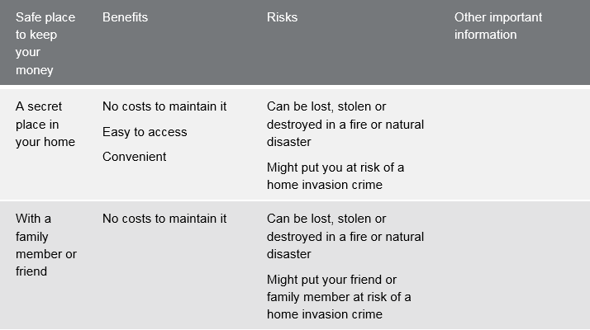
Tool 3: Finding a safe place for savings
Notes:
ACTIVITY #8: Saving for Emergencies, Goals, and Bills CONTINUED
Share an excerpt of Tool 3 (page 105) following the activity and have people find the toolkit in their toolkits.

Slide 75
Banking history reports
Information about the accounts such as routing transit number and/or account number.
The date information was reported about an account.
The reason for the report.
Information on returned checks from retailers and other businesses that is reported to a reporting agency such as SCAN (Shared Check Authorization Network).
Notes:
ACTIVITY #8: Saving for Emergencies, Goals, and Bills CONTINUED
Presentation (Module 2)
Review how negative banking history reports can prevent people from opening a savings or checking account at banks and credit unions and what reports commonly include: information about how people manage their saving and checking accounts—overdrafts, unpaid fines, and fraud.
Highlight some of the common reporting systems: ChexSystems, TeleCheck, Early Warning, and others.
Explain that people can order their reports using information in the toolkit and that they are entitled to at least one free report per year:
You can order your own free ChexSystems report online at http://www.consumerdebit.com, call for more information at (800) 428-9623, or send a written request to: Chex Systems, Inc., 7805 Hudson Road, Suite 100, Woodbury, MN 55125.
You can request your annual file disclosure from TeleCheck Services by calling (800) 366-2425. You can order your TeleCheck Services Report by sending a written request and include a daytime phone number, a copy of your driver’s license, your Social Security number, and a copy of a voided check to: TeleCheck Services, Inc., Attention: Consumer Resolution – FA, P.O. Box 4514, Houston, TX 77210-4515.
To request your Early Warning report, call (800) 325-7775.

Slide 76
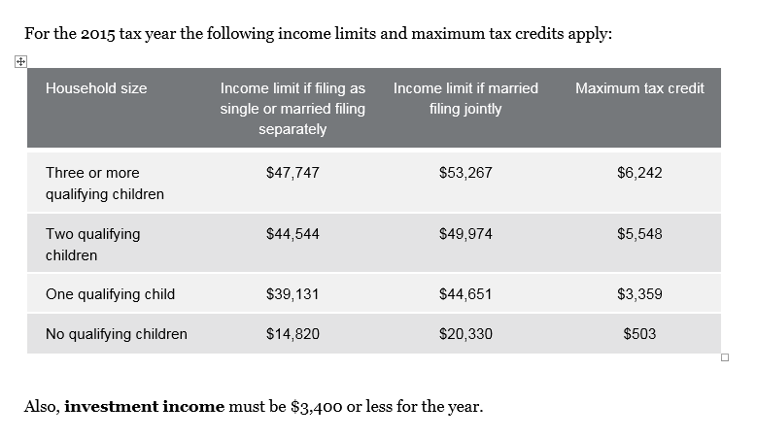
Tool 4: Increasing your income through tax credits
All information regarding tax credits from the Internal Revenue Service at www.irs.gov.
Notes:
ACTIVITY #8: Saving for Emergencies, Goals, and Bills CONTINUED
Facilitated Discussion (Module 2)
Review key points of the earned income tax credit as one way to increase income using information from Module 3, Tool 4 (page 109) including:
Benefit for working people who have low to moderate income.
Reduces the amount of federal income tax owed and may result in a refund. (May be state or city EITC depending on where they live.)
Tax refund is based on income and filing status.
Explain that there are other tax credits, too, such as the Child Tax Credit.
Refer back to your resource and referral guide and highlight where people can get their taxes done free of charge (VITA and other free tax preparation sites).
Explain the advantages of using VITA preparers.
Explain that this information must be updated annually as it changes due to increases in the cost of living.

Slide 77
Module 2: Wrap up
You may want to set aside income for your goals, emergencies, and bills.
Many emergencies or unexpected expenses can be managed with $500 to $1,000 in an emergency fund.
Use Tool 1: Savings plan to help you plan for and build your savings.
Use Tool 2: Savings and benefits: Understanding asset limits to better understand how benefits may impact ability to save.
Use Tool 3: Finding a safe place for savings to better understand the benefits and risks of different places to put your savings so you can make the best choice for you.
Use Tool 4: Increasing your income through tax credits to learn more about tax credits that may increase your income.
Notes:
ACTIVITY #8: Saving for the Unexpected, Emergencies, and Goals CONTINUED
Review highlights of the module using the module 2 wrap up.
Summarize by sharing:
Savings is money you set aside today to use in the future. People save for many reasons. Reasons to save include emergencies and goals such as: their own goals - like a new TV, appliances, a home, their children’s education, and retirement
Why save for emergencies? Because they will happen.
When you save for emergencies in advance, you can handle them when they happen without having to skip your other bills or borrow money.
When you borrow money, you have to pay fees and sometimes interest. And on top of that, you will probably have to use some of your income going forward to pay back the money you borrow. So saving money now for unexpected expenses and emergencies can save you money later.

Slide 78
Your Money, Your Goals
Module 3: Tracking and managing income and benefits

Slide 79
Income, benefits and wage garnishments
Income
Regular income
Irregular income
Seasonal
One-time occurrence
Benefits
Wage garnishments
Notes:
ACTIVITY #9: Tracking and Managing Income and Benefits
Estimated Time: 30 Minutes
Methodology: Facilitated Discussion / Tool Analysis / Presentation
Corresponding Section in Toolkit: Module 3 (Pages 113)
Instructions for Facilitator:
Facilitated Discussion (Module 3)
Define income.
Ask participants to differentiate regular, irregular, seasonal, and one-time income.
ASK: How do these different kinds of income impact budgeting and cash flow?
ASK: How are benefits (public) different from income?
Explain wage garnishment using the following from the materials in Module 3 (Page 115):
Wage garnishments give the government or creditors the right to collect money directly out of someone’s paycheck. This can generally only happen with a court order.
Common reasons for wage garnishment are:
Taxes owed to the IRS or the state
Money owed for child support
Money owed for delinquent student loans
Other unpaid or delinquent debts
With a wage garnishment order, only a certain percentage of the employee’s disposable earning can be withheld.
Federal law limits the amount that may be garnished.
Generally the amount must be the lesser of two figures: 25% of disposable income or the amount that the person earns each week over the federal minimum wage multiplied by 30. You may wish to direct participants to the example in the toolkit.
Some states provide additional protections that allow consumers to take home more pay than would be allowed using only only the federal limits.
All mandatory deductions are protected outright from garnishment:
Federal, state and local taxes and
FICA contributions
Voluntary deductions are not protected.
Generally, Social Security, disability, retirement, child support, and alimony are protected from garnishment from regular creditors.
If you owe the federal government for student loans or back taxes, however, these sources may not be protected.
Finally, some states have additional protections. Find a legal aid organization in your community to learn more about protections from wage garnishment.

Slide 80
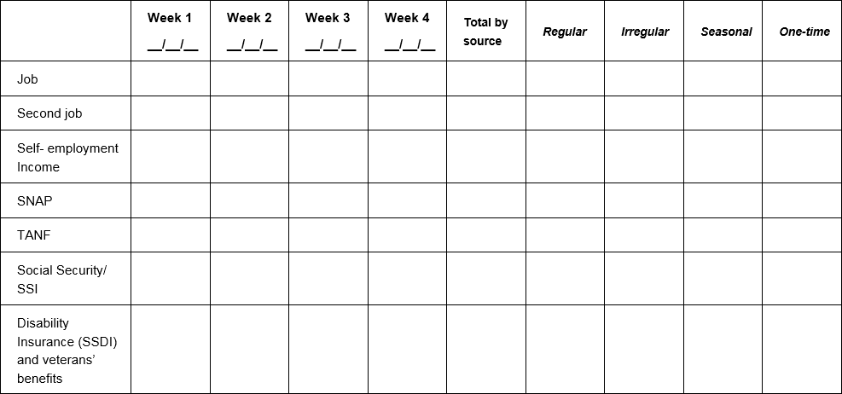
Tool 1: Income and resource tracker
Notes:
ACTIVITY #9: Tracking and Managing Income and Benefits CONTINUED
Presentation (Module 3)
Explain how to use the income and resource tracker (page 121).
Review the categories included.
Ask participants if they feel there are major categories missing. (Explain the tradeoff between many categories and utility of the form.)

Slide 81
Tool 2: Ways to receive income and benefits
Cash
Paychecks
Direct deposit
Payroll cards
EBT
Notes:
ACTIVITY #9: Tracking and Managing Income and Benefits CONTINUED
Presentation (Module 3)
Review each method for receiving income as well as the benefits and risks of each (page 125).
Ask participants to share their feelings about the utility of this tool with the people that they serve.

Slide 82
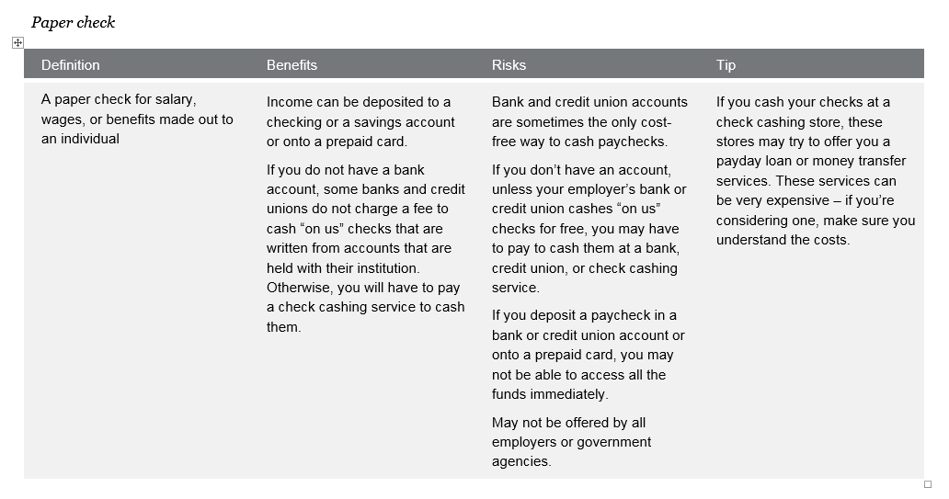
Tool 2: Ways to receive income and benefits
Notes:
ACTIVITY #9: Managing Income and Benefits (CONTINUED)
Presentation (Module 3)
Show excerpt from the tool.

Slide 83
Tool 3: Ways to increase income and resources
Review this tool on page 131.
Think about the people that you serve.
Which strategies listed do you think are potentially feasible for them?
  Circle these.
What strategies are missing?
  Add these.
Notes:
ACTIVITY #9: Tracking and Managing Income and Benefits CONTINUED
Tool Analysis (Module 3)
NOTE: This activity can be done individually, in pairs, or in small groups.
NOTE: You can also assign half of the group Tool 3 and half of the group Tool 4 (next slide) and then have them report out. This will be faster and potentially more interesting.
Ask participants to think about the people they serve in their volunteer work.
Ask them to analyze this form from the perspective of the people they serve as volunteers (page 131).
Have them circle the strategies for increasing cash and other financial resources they think will be feasible the people they serve.
Have them add strategies they feel are missing.
Solicit ideas from the group.
Write them on flip charts.
Consider adjusting the tool post-training and redistributing it based on participants’ insights.

Slide 84
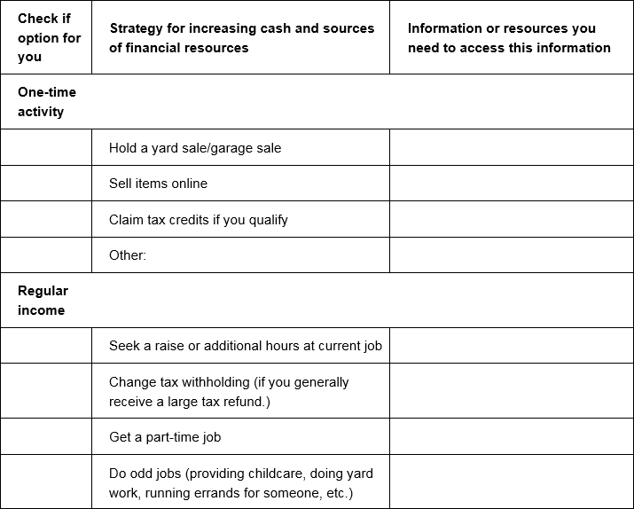
Tool 3: Ways to increase income and resources
Notes:
ACTIVITY #9: Tracking and Managing Income and Benefits CONTINUED
Tool Analysis (Module 3)
Show excerpt from the tool.

Slide 85
Module 3: Wrap up
Income is all of the money or financial resources that come into your household.
Managing irregular or seasonal income is challenging and hard to plan with.
Wage garnishments for debts or other unpaid obligations will reduce your take home income.
Use Tool 1: Income and resource tracker to help you understand when and how much income and benefits you receive.
Use Tool 2: Ways receive income and benefits to better understand the benefits and risks of different ways of receiving income and benefits.
Use Tool 3: Ways to increase income and resources to identify ways to possibly increase your income or financial resources.
Notes:
ACTIVITY #9: Tracking and Managing Income and Benefits CONTINUED
Presentation (Module 3)
Review highlights of the module using the Module 3 wrap up.
Summarize by sharing:
Managing income and benefits is essential to financial empowerment. Many people do not think about their income beyond the amount they receive.
Understanding issues of timing and predictability can help you take control of your finances. And if you find you don’t have enough money, it’s important to identify strategies that can help you bring in more income or resources.
Finally, some ways of receiving income may be more beneficial to you than others. Understanding the benefits and risks of a paper paycheck versus direct deposit versus a payroll card can empower you to make a different choice that may benefit you and your family.

Slide 86
Your Money, Your Goals
Module 4: Paying bills and other expenses

Slide 87
Paying bills and other expenses
Spending
Money you use to pay for a wide range of basic needs, your financial obligations, and other things you may want.
Needs, wants, and obligations
Needs are things you must have to live.
Wants are things you can survive without.
Obligations are things you must pay because you owe someone money (a car loan) or have been ordered to pay someone (child support).
Notes:
ACTIVITY #10: Paying Bills and Other Expenses
Estimated Time: 30 Minutes
Methodology: Vote with Your Body/ Presentation / Tool Analysis / Small Group Exercise / Presentation
Corresponding Section in Toolkit: Module 4 (Pages 137)
Instructions for Facilitator:
Vote with Your Body
Prior to the session, hang up three signs on the walls: “Need,” “Want,” and “Obligation.”
Review the definition of spending.
Review the definitions of needs, wants, and obligations.
Tell people you are going to read off a list of items that you could spend money on. Use the list of example expenses below or use others that may be more contextually or culturally relevant to the people you are training. Limit the number of examples to 4 – 6.
Ask participants to stand under the sign that best represents the category they would put that item in: need, want, or obligation.
After you read each item, facilitate a discussion to uncover the reasons people have voted the way they have.
Be sure to ask questions like:
What could be some of the reasons people see the same item so differently?
How does this inform your work with the people you serve?
Link back to opening exercise related to attitudes and values about money and the influence of culture.
Example expenses:
Rent
Savings for vacation
Cell phone including data plan
Paper towels
Personal grooming related expenses
Bottled water
Coffee (the kind you make at home)
Pet food
Credit card payment
Home-based Internet connection
Baby formula
Cigarettes

Slide 88
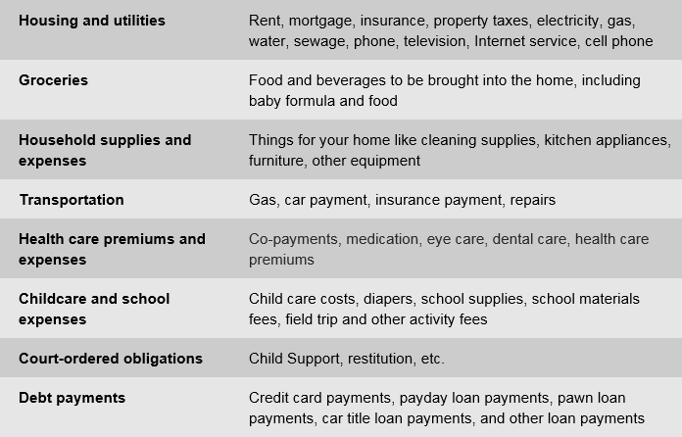
Tool 1: Spending tracker
Notes:
ACTIVITY #10: Paying Bills and Other Expenses CONTINUED
Presentation (Module 4)
Explain how to use the spending tracker (page 145).
Review the categories included.
Ask participants if they feel there are major categories missing. (Explain the tradeoff between many categories and utility of the form.)
List continues on the next slide.

Slide 89
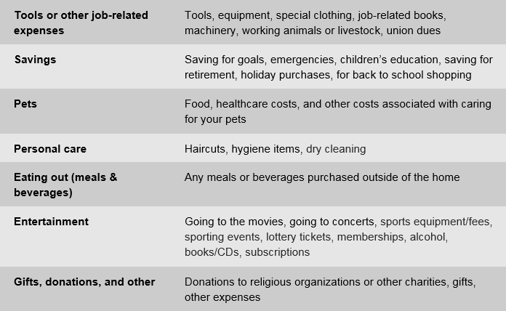
Tool 1: Spending tracker
Notes:
ACTIVITY #10: Paying Bills and Other Expenses CONTINUED
Presentation (Module 4)
Continue to review the categories included.

Slide 90
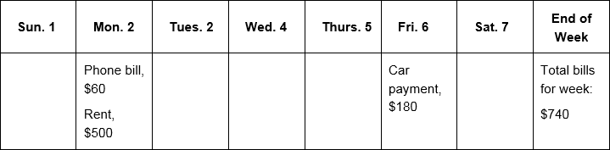
Tool 2: Bill Calendar
Notes:
ACTIVITY #10: Paying Bills and Other Expenses CONTINUED
Presentation (Module 4)
Review Tool 2: Bill Calendar (page 151) —with participants using the following instructions excerpted from the tool.
Print the bill calendar and fill in the name of the month and year.
Add numbers to represent the days of the month.
Gather all of the bills you pay in one month OR use the information from your spending tracker.
Write the due dates for these bills. Since due dates are when bills must arrive, write the date bills must be sent:
If paying by mail, mark the due date at least 7 days before it is due.
For in-person or automatic bill payment, mark one or two days before the due date to ensure you are not late.
Fill in the calendar with the business or person you owe the money to, the date the money must be sent to arrive on time, and the amount that is due.
Put this calendar somewhere you will see it every day to ensure you are not forgetting about important bills.

Slide 91
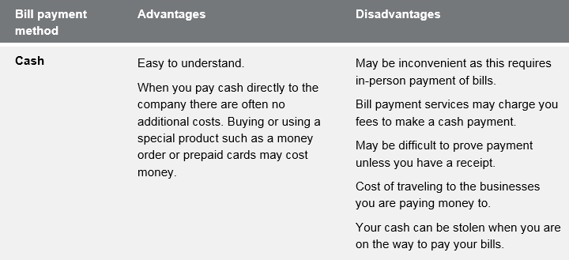
Tool 3: Ways to pay bills: Know your options
Notes:
ACTIVITY #10: Paying Bills and Other Expenses CONTINUED
Presentation (Module 4)
Explain the advantages and disadvantages of different ways to pay bills using the information in Tool 3: Ways to pay bills: Know your options (page 155):
Cash
Money order
Check
Credit cards
Automatic debit from checking/savings accounts, prepaid card, or credit card
Online bill payment
Explain that with information about the advantages and disadvantages of each method of bill payment, individuals can make choices that may help them:
Save time
Save money
Avoid additional or unnecessary fees
Create a reliable record of bill payment

Slide 92
Tool 4: Strategies for cutting expenses
Review this tool on page 159.
Think about the people you serve.
Which strategies listed do you think are potentially feasible for them?
  Circle these.
What strategies are missing?
  Add these.
Notes:
ACTIVITY #10: Paying Bills and Other Expenses CONTINUED
Tool Analysis (Module 4)
NOTE: This activity can be done individually, in pairs or in small groups.
Ask participants to think about the people they serve.
Ask them to analyze this tool from the perspective of their the people they serve.
Have them circle the strategies for cutting spending and other uses of financial resources they think will be feasible for the people they serve.
Have them add strategies they feel are missing.
Solicit ideas from the group.
Write them on flip charts.
Consider adjusting the tool post-training and redistributing it based on participants’ insights from working with community members and the strategies they would add or remove from the tool.

Slide 93
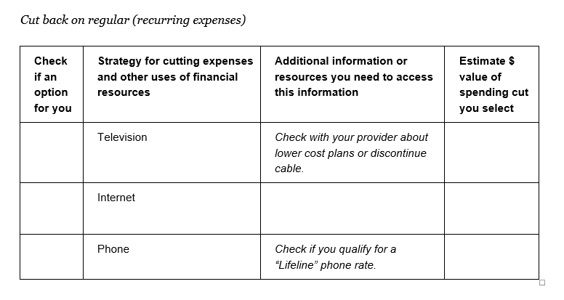
Tool 4: Strategies for cutting expenses
Notes:
ACTIVITY #10: Paying Bills and Other Expenses CONTINUED
Tool Analysis (Module 4)
Show excerpt of the tool for reference (page 159).

Slide 94
Consequences of skipping bills
Group 1:
  a. Consequences of paying rent late.
  b. Consequences of missing multiple rent payments.
Group 2:
  a. Consequences of making car payment late.
  b. Consequences of missing multiple car payments.
Group 3:
  a. Consequences of being late with electricity bill.
  b. Consequences of multiple late electricity bill payments.
Group 4:
  a. Consequences of missing payday loan payment.
  b. Consequences of missing credit card payment.
Notes:
ACTIVITY #10: Paying Bills and Other Expenses CONTINUED
Small Group Exercise (Module 4)
Have participants count off into 4 groups.
NOTE: If there are more than 20 participants, consider have two group 1s, two group 2s, etc. as necessary.
Have each group list the consequences of both its “a” and “b” scenario on a flip chart.
Have groups share their lists after 7 minutes.
Add to list of consequences as appropriate.

Slide 95
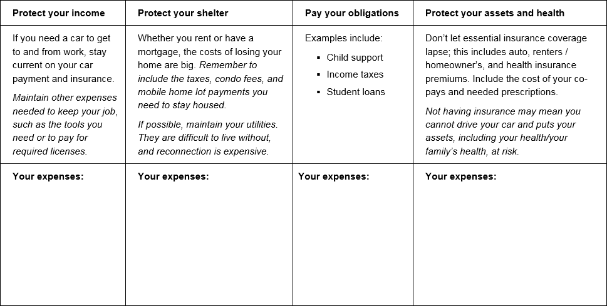
Tool 5: Prioritizing bills
Notes:
ACTIVITY #10: Paying Bills and Other Expenses CONTINUED
Presentation (Module 4)
Review common approach to prioritization and the rationale for this using Tool 5 (page 165).
Be sure to emphasize that this is a short-term plan ONLY.
Explain that people often pay the creditors that complain the loudest. IF and only IF they truly cannot make their bills, they must come up with a short-term plan to avoid long-term consequences of not paying some bills or expenses that could lead to their losing their job, their shelter, key assets, or having legal consequence by not paying obligations, especially those that have been court-ordered.

Slide 96
Module 4: Wrap up
Making changes to how you spend means knowing the difference among your needs, wants, and obligations—changes can generally only be made to spending for wants.
Paying bills on time may help you avoid late fees, fines, increased costs of services, and decreases in your credit scores.
Use Tool 1: Spending tracker to understand how you use your money now.
Use Tool 2: Bill calendar to create a visual reminder of when your bills are due and how much is due.
Use Tool 3: Ways to pay bills: Know your options to better understand the advantages and disadvantages of different methods for paying bills.
Use Tool 4: Strategies for cutting expenses to identify ways to cut spending.
Use Tool 5: When cash is short—prioritizing bills and planning spending to help you develop a short-term plan to get through times when you do not have enough income to cover your needs, wants, and obligations.
Notes:
ACTIVITY #10: Paying Bills and Other Expenses CONTINUED
Presentation
Review highlights of the module using the module 4 wrap up.
Summarize the module by sharing:
Understanding how you use your income and other financial resources is an essential step to financial empowerment.
Use the tools in this section to track and analyze how you use your financial resources. Use Tool 2: Bill Calendar, to organize your regular payments. Once completed, this can serve as a visual reminder to pay your bills on time. There are online tools as well as apps that can help you do the same thing.
If you find you are spending too much, you can apply some of the strategies for cutting spending. But be sure you are clear about the items that are your needs, your obligations and your wants before you start cutting spending. Finally, sometimes you can’t cover all of your needs, wants and obligations in a month.
Use a conscious strategy if you are going to have to skip or delay payments. Consider protecting your income, shelter, and assets before sending a payment to the “squeakiest wheel”.
Often debt collectors and creditors that fall outside of this strategy will call demanding payment. It is always your responsibility to pay what you owe. But, for example, if you need your car to get to and from your job, in a month that your income is short, you may want to consider delaying a credit card payment and risking late fees instead of missing a car payment and risking repossession.
The tools from this module and Module 3 will help you create a cash flow budget, which is covered in Module 5.

Slide 97
Your Money, Your Goals
Module 5: Getting through the month

Slide 98
Getting through the month
What is a cash flow budget?
How is it different from a regular budget?
What do you think may be the benefit of this approach for your the people you serves?
Notes:
ACTIVITY #11: Getting Through the Month
Estimated Time: 45 Minutes
Methodology: Facilitated Discussion / Presentation / Scenario Analysis / Small Group Exercise / Presentation
Corresponding Section in Toolkit: Module 5 (Pages 169)
Instructions for Facilitator:
Facilitated Discussion
Explore what participants know about cash flow by asking: “What is a cash flow budget?”
After participants offer some ideas, share definition: A projection of how you will get and use your cash and other financial resources.
Contrast cash flow to regular budget by asking: “How is a cash flow budget different from a regular budget?”
After participants offer some ideas, share definition: A cash flow budget tracks the timing of income and spending. This is key.
ASK: What do you think may be the benefit of this approach for the people you serve?

Slide 99
Developing a cash flow budget
Keep track of everything you earn and spend money on for a week, two weeks, or one month. Tool 1: Income and Resource Tracker from Module 3: Managing Income and Benefits and Tool 1: Spending Tracker from Module 4: Paying Bills and Other Expenses.
Analyze your spending. Tool 1: Spending Tracker from Module 4: Paying Bills and Other Expenses.
Use this information to create a cash flow budget. Tool 1: Cash Flow Budget or Tool 2: Cash Flow Calendar.
Your cash flow budget is about setting targets for how you will use your income going forward.
Notes:
ACTIVITY #11: Getting through the Month CONTINUED
Presentation (Module 5)
Review the steps to making a cash flow budget and explain how these steps relate to the tools in this module.
ASK: If you find you cannot cover your expenses, what can you do?
After participants offer some ideas, show the next slide.

Slide 100
Tool 1: Cash flow budget
 | Week 1 | Week 2
Beginning balance for the week | $37.00 | $142.37
Sources of cash and other financial resources
Income from job | $305.34 | $290.80
SNAP | $280.00
Public housing voucher | $650.00
Total sources of cash and other financial resources | $1,272.34 | $433.17
Uses of cash and other financial resources
Housing | $650.00
Utilities | $59.97 | $95.50
Groceries | $180.00 | $80.00
Eating out (meals and beverages)
Transportation | $240.00 | $60.00
Total uses of cash and other financial resources | $1,129.97 | $235.50
Ending balance for the week | $142.37 | $197.67
Ending balance from previous week.
To get a starting balance, total your cash, debit card , and account balances
Notes:
ACTIVITY #11: Getting through the Month CONTINUED
Presentation (Module 5 – The tool begins on Page 171.)
Explain how a cash flow budget works.
Discuss the beginning and ending balance—that the ending balance from one week is the beginning balance to the next. (This is what makes a cash flow, flow.)
Explain how to get a starting balance: total your cash and debit card and account balances. Total anything that can be used to pay bills.

Slide 101
Tool 1: Cash flow budget
 | Week 1 | Week 2
Beginning balance for the week | $37.00 | $142.37
Sources of cash and other financial resources
Income from job | $305.34 | $290.80
SNAP | $280.00
Public housing voucher | $650.00
Total sources of cash and other financial resources | $1,272.34 | $433.17
Uses of cash and other financial resources
Housing | $650.00
Utilities | $59.97 | $95.50
Groceries | $180.00 | $80.00
Eating out (meals and beverages)
Transportation | $240.00 | $60.00
Total uses of cash and other financial resources | $1,129.97 | $235.50
Ending balance for the week | $142.37 | $197.67
Total sources minus total uses.
This becomes your beginning balance for next week.
Notes:
ACTIVITY #11: Getting through the Month CONTINUED
Presentation (Module 5 – The tool begins on Page 171.)
Highlight how public benefits figure into the cash flow.
Discuss how some public benefits like SNAP can be used to free up cash—cash formerly spent on food can be used cover other needs, wants, obligations.
Explain that some public benefits like SNAP are not the SAME as cash because you can’t use SNAP to pay for rent. This must be understood when budgeting with benefits.

Slide 102
Reading a cash flow budget: Scenario overview
Rafael is a single parent with two children.
He is often late with his rent and other bills, because he does not have the money when he needs it.
After tracking his spending, he developed a cash flow budget with an educator at a parenting class he takes through Cooperative Extension in his community.
Using the cash flow, make some recommendations to Rafael so he can make ends meet.
Notes:
ACTIVITY #11: Getting through the Month CONTINUED
Scenario Analysis (Module 5)
Instruct participants to get into groups of three.
Review the introduction facts of the scenario they will analyze.
Give each group a copy of the next slide.

Slide 103
Managing cash flow scenario
Notes:
ACTIVITY #11: Getting through the Month CONTINUED
Scenario Analysis (Module 5)
Make copies of this slide and distribute.
Additional information on the scenario
Rafael earns $14.65/hour and works 40 hours per week; he is paid every other week. (His net pay was calculated using an online calculator from ADP based on Oklahoma state tax laws. He is head of household, claims 3 federal exemptions, and has no voluntary deductions. The number was rounded up to $990.)
Credit card payment reflects minimum payment; personal loan is to grandmother (owes $2,000).
Rent includes utilities--electricity, gas, water, sewer, garbage pickup.
Part-time childcare is provided by family member at a big discount ($10/day to cover expenses for 7 days a week). This expense increases during the summer months when the kids are not in school (from $10/day to $25/day). However, during May, June, July, and August, the income from landscaping (his part-time job) doubles.

Slide 104
Cash flow analysis questions
When does Rafael run out of money?
What can he do (or try to do) to better match the timing of his income and his expenses?
  Develop a prioritized list.
How does the SNAP benefit factor into the cash flow?
The next month is not included in the example. What will Rafael’s situation be at the beginning of next month? How much cash will he have? What bills will he have? What should he do now to prepare for the following month?
Notes:
ACTIVITY #11: Getting through the Month CONTINUED
Scenario Analysis (Module 5)
Instruct participants to analyze the cash flow and answer the first three questions above.
After 5 minutes, reveal the fourth question and instruct them to answer this within their groups.
Process as a large group.
When does Rafael run out of money? Answer: At the end of the first week.
What can he do (or try to do) to better match the timing of his income and his expenses?
Develop a prioritized list.
Possible Answers:
See if landlord will accept rent payment the second week instead of the first.
See if the landlord will take half of the payment the first week of the month and half the third week of the month.
See if student loan payment can be moved to final week of the month. Explore other payment plans depending on type of loan such as IBR.
See if auto loan payment can be moved.
How does the SNAP benefit factor into the cash flow? Answer: SNAP is important because it covers food; However, it makes it look like he has more cash during the first week than he actually does because SNAP can only be used for food.
The next month is not included in the example. What will Rafael’s situation be at the beginning of next month? How much cash will he have? What bills will he have? What should he do now to prepare for the following month? Possible answers: His situation will be the same next month. He needs to get more income. First, he should make sure he is getting all of the benefits he and his family qualify for. Once this is done, he needs to consider getting more income from another part-time job.
ASK: Would a regular monthly budget highlight the shortfalls in cash?
Answer: No
Reason: Total income and benefits not including the starting cash balance is $3,272 for the month.. Total expenses for the month $3167.22. While the budget is tight, a typical static monthly budget would show that everything is covered with a surplus of $104.78. This is the problem with a regular, static monthly budget.
Be sure to ask participants:
What do you think about this approach to budgeting versus the traditional approach? Be sure to discuss the week-by-week nature of this tool rather than the overall monthly approach presented by most financial educators.
What do you think are the potential benefits of using this approach with people? For yourself?
How did your opinion of this approach change after the case study?
What additional information do you need to feel comfortable with this approach to budgeting?

Slide 105
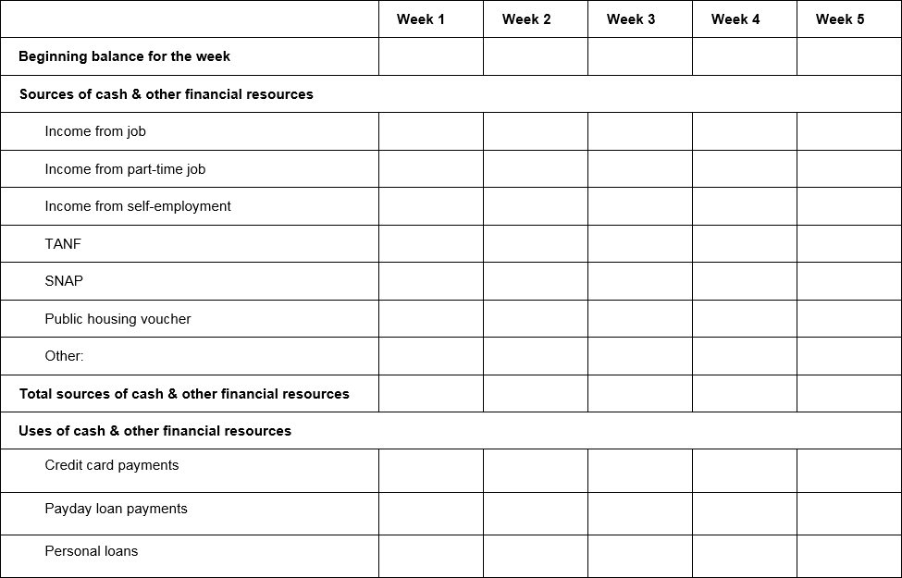
Tool 1: Cash flow budget
Notes:
ACTIVITY #11: Getting through the Month CONTINUED
Presentation (Module 5)
Share excerpt of Tool 1 (page 171).
Summarize steps for making a cash flow budget.

Slide 106
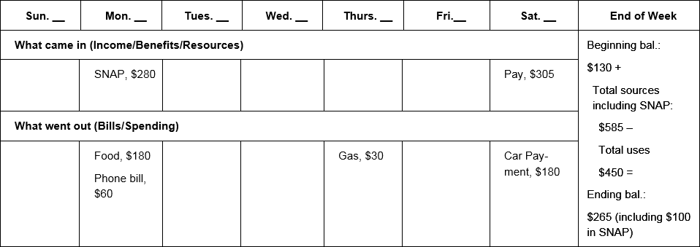
Tool 2: Cash flow calendar
Notes:
ACTIVITY #11: Getting through the Month CONTINUED
Presentation (Module 5)
Orient participants to the other format included for cash flow—Tool 2: Cash Flow Calendar (page 181).
Discuss the pros and cons of this format with participants.
Explain that they should feel free to introduce the one they think will work best for each person they work with.
Encourage participants to use these tools in their own households for a month or two to increase their familiarity with their use.

Slide 107
Tool 3: Improving cash flow checklist
    Increase sources of cash, income, or other financial resources, including accessing public benefits and applying for tax credits for which you qualify.
    Decrease your spending or uses of cash and other financial resources.
    Match timing of sources and uses of income where possible.
Notes:
ACTIVITY #11: Getting through the Month CONTINUED
Presentation and Small Group Exercise (Module 5)
Explain that there are basically three overall strategies to improving cash flow:
Increase sources of cash, income, or other financial resources, including accessing public benefits and applying for tax credits.
Decrease spending or uses of cash and other financial resources.
Match timing of sources and uses of income where possible.
Instruct small groups to brainstorm specific ways to smooth out cash flow. Encourage them to think about ways to increase income, decrease spending, and match timing.
Encourage the group to select one person to write the ideas on a piece of paper.
Give teams 3 minutes to brainstorm.
Have them report out cumulatively soliciting ideas using round robin format (one idea per team until all teams have contributed, then repeat until ideas are exhausted).
Write their ideas on flip charts organizing them by category.
Following exercise, instruct participants to review Tool 3 (page 185). Encourage them to add ideas from the activity not included in the tool.

Slide 108
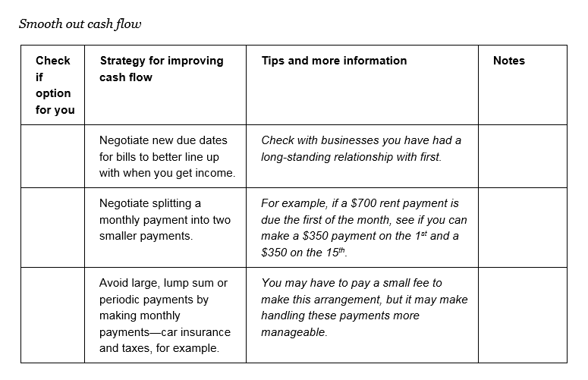
Tool 3: Improving cash flow checklist
Notes:
ACTIVITY #11: Getting through the Month CONTINUED
Presentation (Module 5)
Share excerpt of Tool 3 (page 185).

Slide 109
Module 5: Wrap up
The following steps can help you make a cash flow budget;
  Keep track of everything you earn and spend money on for a week, two weeks, or one month. Tool 1: Income and Resources Tracker from Module 3 and Tool 1: Spending Tracker from Module 4.
  Analyze your spending. Tool 1: Spending Tracker from Module 4.
  Use this information to create a cash flow budget. Use Tool 1: Cash Flow Budget to complete this step or Tool 2: Cash Flow Calendar.
Your cash flow budget is about setting targets for how you will use your income going forward.
Use Tool 3: Improving cash flow checklist to identify specific strategies for improving cash flow.
Notes:
ACTIVITY #11: Getting through the Month CONTINUED
Presentation (Module 5)
Summarize process for creating a cash flow as the wrap up for the module.
Remind participants that a cash flow budget helps someone see and understand how the timing of income and expenses may be causing shortfalls within a month; these shortfalls can be masked in a static monthly budget.
Summarize by sharing:
A cash flow budget is a projection of how you will get and use your cash and other financial resources.
A cash flow budget is different from a regular budget, because it includes not only the amount for each budget item, but the timing of your income and expenses.
This is important because people often find themselves flush with cash one week—and splurge on something fun—but come up short the next week for a necessity.
Timing matters. A cash flow budget will help an individual identify where she is falling short within the month. It can help her ensure she has the financial resources on hand to cover the most important expenses—so she doesn’t fall short covering the rent, for example. A cash flow budget can better help an individual target areas where they could consider cutting back.
Remember, sometimes there is not enough money to cover the month. In this case it is important to develop a short-term plan to prioritize bills and pay those that protect income, shelter, assets, and continue obligations. This can help responding in the moment to a high pressure debt collector collecting on a lower priority debt. But when making these decisions, people should be fully aware of the consequences and know money not paid today will become a debt in the future.

Slide 110
Your Money, Your Goals
Module 6: Dealing with debt

Slide 111
Dealing with debt
What is debt?
  Money you owe to another person or business. Debt is a liability. Debt may obligate future income.
How is debt different from credit?
How is secured debt different from unsecured debt?
Notes:
ACTIVITY #12: Dealing with Debt
Estimated Time: 45 Minutes
Methodology: Facilitated Discussion / Stand Up-Sit Down / Activity in Pairs / Presentation / Exercise in Small Groups / Personal Stories
Corresponding Section in Toolkit: Module 6 (Pages 193)
Instructions for Facilitator:
Facilitated Discussion (Module 6)
ASK: What is a debt?
After participants offer some ideas, share definition: Money you owe to another person or business. Debt is a liability. Debt may obligate future income.
ASK: How is debt different from credit?
After participants offer some ideas, share definition: Credit means you can borrow money. Debt is the result of using credit. Credit is not a liability. When you use it, though, you create a liability.
ASK: How is secured debt different from unsecured debt?
After participants offer some ideas, share definitions: Secured debt is debt that has an asset attached to it. When debt is secured, a lender can collect that asset if you do not pay.
Ask participants for examples of secured debt.
After participants offer some ideas, share examples:
A home loan—the debt is secured with the home you are buying. If you do not pay your loan, the lender will foreclose on your home, sell it, and use the money from the sale to cover your loan.
An auto loan—the debt is secured with your car. If you do not pay your loan, the lender will repossess (repo) your car and sell it to cover the loan.
A payday loan—the debt is secured with your post-dated check. If you do not renew the loan, the check will be cashed.
A pawn loan—the debt is secured with the item you have pawned. If you do not make payment when it is due, the pawned item is sold to the general public.
A rent-to-own loan—the debt is secured with the items (furniture, fixtures, electronics, appliances) you are making payments on. If you do not make your payments, the item is repossessed and made available to someone else to rent. You do not get back any rental payments you have made.
Unsecured debt does not have an asset attached to it.
Ask participants for examples of unsecured debt.
After participants offer some ideas, share examples:
Credit card debt
Department store charge card debt
Signature loans
Medical debt
Student loan debt
If these loans are not paid as agreed, they often go to collections.

Slide 112
Good debt, bad debt
Loan from friend or family member
Car loan
Student loan
Payday loan
Mortgage (loan for a home)
Car title loan
Pawn shop loan
Notes:
ACTIVITY #12: Dealing with Debt CONTINUED
Stand Up, Sit Down (Module 6)
Explain that some people think of some debt as good debt and some debt as bad debt.
Explain that as each type of debt appears on the screen, they should stand up if they think the debt is bad debt and stay seated if they think it is good debt.
Reveal the debts listed above one at a time.
Facilitate a discussion about the reasons people think the debt is good or bad.
NOTE: Be sure to challenge them a bit around “conventional wisdom.” For example, people have long believed student loan debt is “good debt.” Is this always the case? The same was true with mortgages in the past. Are pawn shop loans always bad? If someone is short of money, given a payday loan versus a pawn shop loan, do they think one is a better option than the other?
Use the following points to augment the discussion:
Loan from friend or family member
GOOD—Likely to have flexible terms; may be low or no interest; missed payments not reported to credit reporting agencies
BAD—Can create family conflict; cannot be used to build credit history
Car loan:
GOOD—Can help you get needed transportation for job, school, life; secured with the car so will likely not need additional collateral; regular payment can help build credit history
BAD—Depending on loan, terms can be unfavorable; borrowing full value of car can lead to being upside down in loan (owing more than the car is worth); missed payment can result in repossession—no transportation for job and negative entry on credit reports
Student loan:
GOOD—Can help you access postsecondary education or training, which can lead to a higher paying job; federal student loans have repayment options; regular payment can help build credit history
BAD—Borrowing more to pay for education than likely wages within career can support in terms of repayment; borrowing for education but not completing degree (created a liability without the benefit of a potentially higher paying job); terms and conditions misunderstood (allowing interest to accrue); likely to not be forgiven even in bankruptcy except under extreme circumstances
Payday loan:
GOOD—Can help you get needed cash quickly and with little hassle
BAD—High-cost; may not to be able to pay in full within initial term (generally 14 days) and may need to renew; often leads to repeat loans; if renewal not paid, post-dated check will be cashed and can deplete your accounts and/or overdraft them and lead to overdraft charges
Mortgage (loan for a home):
GOOD—Can help you get a home of your own; currently, interest rates are low, so the loans is less expensive than in decades past; secured with the house so will likely not need additional collateral; regular payment can help build credit history
BAD—Depending on loan, terms can be unfavorable; if you borrow the full value of the home and home values decrease, you could be upside down in the loan (owing more than the home is worth); missed payments can result in foreclosure—no home and negative entry on credit reports; selling the home can be difficult depending on the market and the condition of the home
Car title loan:
GOOD—Can help you get needed cash quickly and with little hassle
BAD—Can lead to loss of your car title if the loan not paid as agreed
Pawn shop loan:
GOOD—Can help you get needed cash quickly and with little hassle
BAD—Can lead to loss of asset pawned if loan not paid as agreed

Slide 113
Medical debt
What are the factors that can lead to medical debt?
Medical debt is almost always the result of an unplanned event—someone becoming ill or injured.
The costs of the care are almost never fully known upfront.
Invoices and bills may be confusing.
Uninsured individuals are generally charged more for services.
Notes:
ACTIVITY #12: Dealing with Debt CONTINUED
Facilitated Discussion (Module 6)
Ask participants to share some of the reasons people have medical debt (page 208).
If not shared, provide the following factors that lead to medical debt:
Medical debt is almost always the result of an unplanned event—someone becoming ill or injured. Even with health insurance, co-pays and deductibles can add up. This is one reason that emergency savings is important for building financial stability.
Secondly, the costs of the care are almost never fully known upfront. Unlike the cost of a house or car, where you should know what you will pay when you sign the loan agreement, when you accept responsibility for payment of your treatment at a hospital or other medical provider, you generally have no idea how much the treatment will cost. You may also not know your share of the cost.
Invoices and bills may be confusing. Rather than one itemized bill, you may receive several bills over a period of weeks or months with hospital stays or situations that involved multiple health care services providers. Because of this confusion, people may be more likely to not recognize the information contained on the invoice or hesitate or delay paying a medical bill. They may have questions about whether the amount was already paid by insurance, whether the correct amount was billed, or whether they actually received the billed treatment.
And without knowing how much the total cost should be, how much the insurer will cover, and how much of the cost will be passed on to you, it becomes difficult to determine whether you are being charged the right amount. That leaves consumers in a position where they need to review each medical bill carefully and contact providers or insurers when they have questions.
Uninsured individuals are generally charged more for services. Insurance companies negotiate discounts for services. This means that if you are uninsured, your bill will likely be higher than the bill that someone who has insurance receives for the same procedures and care.

Slide 114
Avoiding medical debt
Get cost estimates up front
Find out whether there is a prompt payment discount
Ask for a discount on the treatment
Ask about “charity care”
If you are asked to put a hospital bill on a credit card, be careful
Work with the health care provider to set up a reasonable repayment plan
Notes:
ACTIVITY #12: Dealing with Debt CONTINUED
Facilitated Discussion (Module 6)
Review some ways to avoid medical debt. Be sure to ask participants for their ideas and suggestions.
Use the following information from the toolkit to add to the discussion (Page 208):
Get cost estimates up front—then you can decide whether to proceed or delay elective procedures.
Find out whether there is a prompt payment discount, which can be substantial. This may mean cutting back in other areas for a few months in order to pay the bill and secure the discount.
Ask for a discount on the treatment.
Ask about “charity care” from the hospital and government before or immediately following treatment.
If you are asked to put a hospital bill on a credit card, watch out. Many hospitals have some obligation to provide for charity care for those who can’t afford treatment. Once you put your hospital bill on a credit card, you won’t be considered for a later write-down of your bill under the charity care program. Some medical providers even offer a credit card for you to use at the provider’s office. Healthcare credit cards can have tricky terms, so make sure you know what you’re getting into. For tips on healthcare credit cards see: http://www.consumerfinance.gov/blog/whats-the-deal-with-health-care-credit-cards-four-things-you-should-know/
If you can’t afford to pay for the care even after charity care and discounts have been applied, take steps to work with the provider to set up a reasonable repayment plan. As you negotiate, ensure that as long as you pay as agreed, reports made to credit reporting agencies will reflect that you are making payments as required by the plan. Be sure to get your repayment plan agreement in writing. Also, consider asking for the following terms:
No interest on the debt
Monthly statements showing the amount paid and the outstanding balance
Request that the debt not be turned over to a third party collection agency – that the debt servicing stays in-house
Be sure you do not sign an agreement that states you will make full payment of the debt if you are late or miss a payment on your plan.
Check your credit report to make sure resolved bills are reported accurately or any errors are removed from your credit history. If the credit reporting agency doesn’t respond, contact your state’s consumer protection agency, attorney general, or the Consumer Financial Protection Bureau.
If you do get sued by a medical service provider or hospital, respond. Get legal assistance from the legal aid organization in your community or a lawyer.
Be sure you do not jeopardize your ability to earn income or pay for your shelter or food because you have paid more income than you can afford to cover a medical debt.

Slide 115
Payday loans and deposit advance products
Notes:
ACTIVITY #12: Dealing with Debt CONTINUED
Facilitated Discussion (Module 6)
ASK: What is a payday loan?
Augment participants’ responses with the following facts from the toolkit (page197):
A payday loan is a short-term loan, generally for $500 or less.
They generally come due your next payday.
You must give lenders access to your checking account or write a check for the full balance in advance that the lender has an option of depositing when the loan comes due.
Other loan features can vary. For example, payday loans are often structured to be paid off in one lump-sum payment, but interest-only payments – "renewals" or “rollovers” – are not unusual.
In some cases, payday loans may be structured so that they are repayable in installments over a longer period of time.
Some ways that lenders might give you the loan funds are providing cash or a check, loading the funds onto a prepaid debit card, or electronically depositing the money into your checking account.
The cost of the loan (finance charge) may range from $10 to $30 for every $100 borrowed.
A typical two-week payday loan with a $15 per $100 fee equates to an annual percentage rate (APR) of almost 400%.
By comparison, APRs on credit cards can range from about 12 percent to 30 percent.
State laws and other factors can influence how much you can borrow and the fees you are charged.
Some state laws do not permit payday lending and in other states lenders may choose not to do business rather than abide by the state’s regulations.
There are special protections through the Military Lending Act for active duty service members and their dependents who use certain payday loans and other small dollar credit products. These rights include:
A 36% interest cap. You cannot be charged more than a 36% Military Annual Percentage Rate (MAPR), which includes the following costs:
interest
fees
credit service charges
credit renewal charges
credit insurance premiums
other fees for credit-related products sold in connection with the loan
Written and oral disclosure. Creditors must tell you the interest rates and other fees you owe, both orally and in writing, before a loan is issued.
No roll-over loans. A creditor cannot “roll-over” or refinance the same loan, unless the new loan results in more favorable terms for you. This rule helps to make sure you will not get stuck with a loan that becomes more expensive to pay back every few months.
No mandatory waivers of consumer protection laws. Creditors cannot require you to waive any state or federal law, including the Service members Civil Relief Act, which protects service members from being sued while on active duty.
No mandatory arbitration. Creditors cannot require you to submit to arbitration, which is when an outside party decides how a dispute should be resolved instead of a court.
No mandatory allotments. A creditor cannot require you to create a voluntary allotment in order to get the loan. An allotment is an automatic amount of money taken from your paycheck to pay back your loan.

Slide 116
Avoiding Debt Traps
What is a “debt trap?”
  A situation where a person takes a loan and has to repeatedly take new loans to make payments on the first loan.
When can a “debt trap” happen?
  When people use short-term loans that have to be paid back in just a couple of payments, and they do not have the money to repay the loan and the finance charges when they are due.
Notes:
ACTIVITY #12: Dealing with Debt CONTINUED
Facilitated Discussion (Module 6)
Explain what a debt trap is using the information on the slide above (page 201).

Slide 117
Avoiding Debt Traps
What do short-term loans that can lead to “debt traps” have in common?
  They are small dollar loans— generally under $500.
  They must be repaid quickly—14 days is the median term of payday loans, for example.
  They require the borrower to give creditors access to repayment through an authorization to present a check or to debit a borrower’s deposit account.
Notes:
ACTIVITY #12: Dealing with Debt CONTINUED
Facilitated Discussion (Module 6)
Explain what a debt trap is using the information on the slide above (page 201).

Slide 118
Alternatives to high-cost credit
Using your own emergency savings
Using lower-cost, short-term loan alternatives from a credit union or bank
Borrowing from a friend or family member
Using a credit card – while it will increase your monthly card payment, it may prove cheaper in the long run
Negotiating for more time to pay if the loan is for a bill that is due
Bartering for part or all of what you are borrowing the money to cover
Determining whether the item or circumstance you are borrowing the money for is a need, an obligation, or a want. If it’s a want, consider whether it’s possible to spend less money for it, not purchase it, or wait until you have the money for it.
Notes:
ACTIVITY #12: Dealing with Debt CONTINUED
Facilitated Discussion (Module 6)
Review alternatives to avoiding high-cost credit (page 204).

Slide 119
Know your rights
The Fair Debt Collection Practices Act protects consumers from harassment:
Repeated phone calls intended to annoy, abuse, or harass
Obscene or profane language
Threats of violence or harm
Publishing lists of people who refuse to pay their debts
Calling you without telling you who they are
Using false, deceptive, or misleading practices
Notes:
ACTIVITY #12: Dealing with Debt CONTINUED
Presentation (Module 6)
Explain highlights of the Fair Debt Collection Practices Act (page 207).
The Fair Debt Collection Practices Act (FDCPA) says what debt collectors can and cannot do.
This law covers businesses or individuals that collect the debt of other businesses. These are often called “third party debt collectors.”
This law does not apply to businesses trying to collect their own debts.
The law states that debt collectors may not harass, oppress, or abuse you or any other people they contact. Some examples of harassment are:
Repeated phone calls that are intended to annoy, abuse, or harass you or any person answering the phone
Obscene or profane language
Threats of violence or harm
Publishing lists of people who refuse to pay their debts (this does not include reporting information to a credit reporting company)
Calling you without telling you who they are
The law also says debt collectors cannot use false, deceptive, or misleading practices. This includes misrepresentations about:
The debt, including the amount owed
That the person on the phone is an attorney (unless they are an attorney)
Threats to have you arrested
Threats to do things that cannot legally be done
Threats to do things that the debt collector has no intention of doing
Keep a file of all letters or documents a debt collector sends you and copies of anything you send to a debt collector.
Write down dates and times of conversations along with notes about what you discussed. These records can help you if you have a dispute with a debt collector, meet with a lawyer, or go to court.
Show the example letters in Tool 5.

Slide 120
Tool 1: Debt worksheet
On the debt management worksheet, you will include:
The person, business, or organization you own money to
The amount you owe them
The amount of your monthly payment
The interest rate you are paying and other important terms
To complete this worksheet, you may need to get all of your bills together in one place and a copy of your credit report.
Notes:
ACTIVITY #12: Dealing with Debt CONTINUED
Presentation (Module 6)
Explain how to use the debt worksheet (Tool begins on Page 213.)

Slide 121
Tool 2: Debt-to-income worksheet
How much debt is too much?
Debt-to-income ratio
This simple calculation shows you how much of your income goes toward paying your debt.
The debt-to-income ratio is good measure of how much of your income is obligated to debt.
Notes:
ACTIVITY #12: Dealing with Debt CONTINUED
Presentation (Module 6)
Explain what the DTI ratio is and how it is used (page 217).

Slide 122
Tool 2: Debt-to-income worksheet
Your total month debt payment (from Tool 1)
DIVIDED BY your monthly gross income (your income before taxes are taken out) | ÷
EQUALS your debt-to-income ratio | =
Notes:
ACTIVITY #12 Dealing with Debt CONTINUED
Presentation (Module 6)
Explain how to calculate the debt-to-income (DTI) ratio.
Reference Tool 2 (page 217).

Slide 123
Activity in pairs
Shawna has just graduated, completing her associates degree in nursing. She has already landed a full-time job earning $17.50 per hour. She works full time (160 hours per month). She will be working at a hospital 21 miles from her home and public transportation is not a viable option for her.
She found a good used car, but she can’t afford to buy it without a loan. Her monthly payments on that loan would be $158.
Every month she also pays the following debts:
School loan $205.00
Credit card #1 $90.00; Credit card #2 $55
Mortgage $625.00
What is the debt to income ratio without car loan? With the car loan?
Based on her DTI, do you think she can afford the loan?
Notes:
ACTIVITY #12: Dealing with Debt CONTINUED
Activity in Pairs (Module 6)
Note: This exercise is optional as there is another opportunity to complete a DTI following the explanation of Tool 4.
Instruct participants to complete the DTI in pairs.
Have them determine whether the individual should take on more debt.
Instruct them to calculate the DTI without the proposed new debt and with the proposed new debt.
Show the following slide after about 3 minutes, so participants can analyze the answers.
Consider writing the answers on a flip chart.
Answers
Gross income = 160 hours x $17.50/hour = $2,800
Monthly debt before car loan = $975/month
DTI = .35 or 35%
Monthly Debt with car loan = $1,133
DTI with car loan = .41 or 41%

Slide 124
Tool 2: Debt-to-income worksheet
Renters
Consider maintaining a debt-to-income ratio of .15 - .20, or 15% - 20%, or less.
Homeowners
Consider maintaining a debt-to-income ratio of .28, or 28%, or less for just the mortgage (home loan), taxes, and insurance.
Consider maintaining a debt-to-income ratio for all debts of .36, or 36%, or less.
Notes:
ACTIVITY #12: Dealing with Debt CONTINUED
Presentation (Module 6)
Explain how to interpret the DTI ratio.
Renters: Consider maintaining a debt-to-income ratio of .15 - .20, or 15% - 20%, or less.
This means that monthly credit card payments, student loan payments, auto loan payments, and other debts should take up 20% or less of your gross income.
Homeowners: Consider maintaining a debt-to-income ratio of .28, or 28%, or less for just the mortgage (home loan), taxes, and insurance.
This means that if you have a mortgage, the mortgage alone should take up no more than 28% of your income.
This includes the monthly principal, interest, taxes, and insurance (called PITI).
Homeowners: Consider maintaining a debt-to-income ratio for all debts of .36, or 36%, or less.
This means that if you have a mortgage and other debts—credit card payments, student loan payments, auto loan payment, and payday loan payments–your debt-to-income ratio should be below 36%.
If you have court-ordered, fixed payments, such as child support, count these as debt for this purpose.
Some lenders will go up to 43% or higher for all debt.
Instruct participants to share their answers and whether they felt the individual should get the new loan.
Explain that if Shawna gets the loan, that $.41 out of every $1 she earns will be committed each month to cover her debts.
Explain that this leaves $.59 out of every dollar to cover everything else. Ask participants what everything else includes. Write their ideas on a flip chart.
Be sure to add the following if not shared by the participants:
Savings
Taxes
Insurance – Car and Health
Utilities
Food
Clothing
Childcare
Health care (that has not turned into debt)
Child support
Charitable contributions and gifts and
Other family expenses
ASK: What can Shawna do to lower her DTI?

Slide 125
Tool 3: Reducing debt worksheet
The two primary methods for reducing debt are:
  Highest interest rate method
  Snowball method
Consider the pros and cons of each.
Notes:
ACTIVITY #12: Dealing with Debt CONTINUED
Presentation (Module 6)
Review two primary methods for reducing debt outlined on Tool 3 (page 221):
Highest Interest Rate Method
List your debts from highest rate to lowest rate.
In the column labeled additional payment, list the extra payment you will dedicate to the debt with the highest interest rate until you have it paid off.
When this debt is eliminated, allocate the entire payment (monthly payment + extra payment) to the next debt on the list.
Focus on the unsecured debt with the highest rate of interest, and eliminate it as quickly as possible, because it is costing you the most. Once it is paid off, focus on the next most expensive debt.
PRO
You eliminate the most costly debt first.
CON
You may not feel like you are making progress very quickly especially if this debt is costly.
Snowball Method
List your debts from smallest to largest in terms of the amount outstanding.
In the column labeled additional payment, list the extra payment you will dedicate to the smallest debt until you have it paid off.
When this debt is eliminated, allocate the entire payment (monthly payment + extra payment) to the next debt on the list.
Focus on the smallest debt. Get rid of it as soon as possible. Once you have paid it off in full, continue with the payment, but now dedicate it to the next smallest debt. This is called the “snow ball method.” You create “a snow ball of debt payments” that keeps getting bigger as you eliminate each debt. How? You keep making the payments, but you are redirecting them to the next debt as each debt is paid off.
PRO
You may see progress quickly, especially if you have many small debts; in theory, this creates momentum and motivation.
CON
You may pay more in total because you are not necessarily eliminating your most costly debt.

Slide 126
Tool 3: Reducing debt worksheet
Call your creditors.
Get another job in the short-term.
Sell something.
If you qualify, file for tax credits.
Notes:
ACTIVITY #12: Dealing with Debt CONTINUED
Presentation (Module 6)
Review other ways to reduce debt:
Call your creditors to see if they will lower your interest rates. If you have paid all of your bills on time, they may lower it to maintain your loyalty. If you are in a difficult position, you could explain your hardship and ask them to lower the rate.
Get another job in the short-term. Use all of your additional earnings to eliminate debts.
Sell something, and use the income to pay off a debt or debts.
If you are eligible, file for tax credits, and use your refund to pay down or eliminate debts.

Slide 127
Tool 4: Repaying student loans
Federal student loans versus private student loans
Options for federal student loan repayment
  Standard payment
  Graduated payment
  Extended payment
  IBR
  Pay as you earn
  Consolidated loan
Notes:
ACTIVITY #12: Dealing with Debt CONTINUED
Personal Stories and Presentation (Module 6)
Discuss student loan debt with the participants using information from Tool 4 (Page 225).
Ask participants to share stories from their work with the people they serve (without naming them) or their own student loan stories.
Keep track of themes from stories.
Share how many seem to stem from not understanding terms completely or not matching borrowing level with earning potential.
Explain the difference between Federal Student Loans and Private Student Loans.
Federal student loans are loans that are funded by the federal government. Private student loans are nonfederal loans made by a lender such as a bank, credit union, state agency, or a school. In both federal and private student loans, delinquent payment will impact your credit history and scores and may result in collections.
Private student loans do not offer the flexible repayment terms or borrower protections featured by federal student loans.
Explain the options for paying back federal student loans.
Standard repayment—this is the payment plan most borrowers start with. This repayment plan has fixed payment of at least $50/month for up to 10 years.
Graduated repayment—the payment is lower the first year and then gradually increased every 2 years for up to 10 years.
Extended repayment—the payment is fixed or graduated for up to 25 years. The monthly payments are lower than the standard or graduated repayment plans, but you will pay more interest over the life the loan(s).
Income-based repayment (IBR)—payment is limited to 15% of discretionary income, which is the difference between your adjusted gross income and 150% of the Federal Poverty Guidelines.
Payments change as income changes and the terms can last up to 25 years.
To qualify for IBR, you must be able to show partial hardship.
After 25 years of consistent payment (you have missed no payments or caught up with payments), the loan will be forgiven.
You will have to pay income tax on the portion of the loan that is forgiven.
Pay as you earn—payment is limited to 10% of discretionary income as defined above, payment changes as income changes, and the loan term is 20 years.
To qualify. you must be able to show partial hardship.
After 20 years of payments, the loan is forgiven as described above, and taxes will be owed on the amount forgiven.
Consolidation loan—you pay off all of your existing federal student loans with a new loan.
This simplifies paperwork and payment for you—you go from monthly payments on multiple loans to one payment per month on the one new loan.
Your loans must be in good standing to qualify.
This results in lower monthly payments as the term is 30 years; however, you will pay more interest over the life of the loan.
Be sure to state the following:
Do not ignore student loan paperwork—nonpayment and delinquency reduces options for payment plans as many require loans in good standing to qualify.
Explain deferment and forbearance.
In deferment, payment of both principal and interest is delayed.
If you have a subsidized federal loan, the government pays your interest during the deferment.
Otherwise you must pay interest or it accrues, which means builds up. When interest accrues on student loans, it becomes part of what you owe. This means you ultimately end up paying interest on the interest.
Deferments are only granted for specific circumstances including: enrollment in college, a trade school, a graduate fellowship, or a rehabilitation program for individuals with disabilities; during unemployment; during military services; and during times of economic hardship, including Peace Corps service.
Forbearance means that you stop paying or pay a lesser amount on your loan for a 12-month period. Interest accrues during forbearance.
When applying for a repayment option, be sure to continue making your loan payments until you receive written notification that you have been approved for IBR or forbearance, for example. This ensures your loan continues to be in good standing.
Explain the situations where loan forgiveness, cancellation, or discharge may be an option:
Total and permanent disability
Death (someone would apply on your behalf)
Closed school
Teacher loan forgiveness—you are eligible for this if you are a teacher working in certain educational settings.
Public services loan forgiveness—you are eligible for this if you work in a public service sector and have made 120 loan payments
Except for the above circumstances, it is nearly impossible to eliminate federal student loan debt even in bankruptcy. And your wages and bank accounts can be garnished for nonpayment.

Slide 128
Student loan debt
CFPB’s “Paying for College” online tool:
Researching schools
Filling out the Free Application for Federal Student Aid (FAFSA), a first step in figuring out how to pay for college
Choosing a loan
Comparing financial aid packages and college costs across more than one school
Managing your money while in college
Repaying your student loans
Notes:
ACTIVITY #12: Dealing with Debt CONTINUED
Presentation (Module 6)
Review paying for college tool on the CFPB website.
NOTE: If you have a live Internet link, go to the site and show it to people you are training.

Slide 129
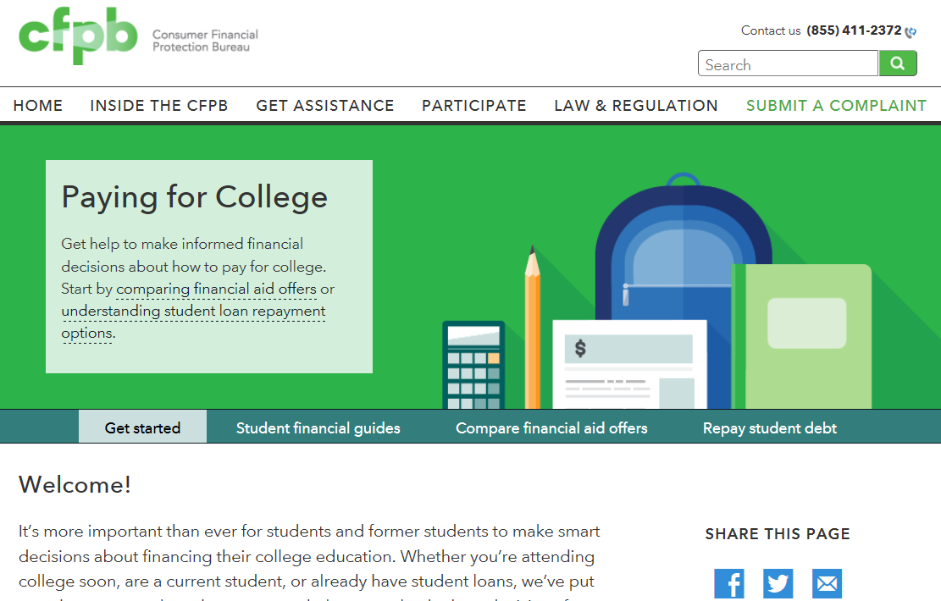
Student loan debt
Visit http://www.consumerfinance.gov/paying-for-college
Notes:
ACTIVITY #12: Dealing with Debt CONTINUED
Presentation (Module 6)
Review paying for college tool on the CFPB website.
NOTE: If you have a live Internet link, go to the site and show it to people you are training.

Slide 130
Dealing with debt exercise
Maya wants to buy a home. Use the following information to find out whether she is in the position of considering a new home at this point in time by calculating a debt-to-income ratio.
If she determines that she needs to reduce her debt before considering a home purchase (based on the DTI calculation she has completed with you), what strategy would you recommend that she follow? Why?
Earnings:
$11.85/hour
She works almost 160 hours per month and consistently works an additional 20 hours per month at time and a half.
Her gross monthly income = $2,252.
Continued…
Notes:
ACTIVITY #12: Dealing with Debt CONTINUED
Optional Exercise (Module 6)
Make copies of the two Dealing with Debt Exercise slides for participants (this slide and the next slide)
Instruct participants to work in small groups to calculate the DTI to determine if Maya is in the position to consider a home purchase at this time.
NOTE: You may need to show the slide with the DTI interpretation or have them refer to this in their Toolkits.
Instruct them to refer to Tool 3 in their toolkits to determine which approach she should use and how they would apply it to Maya’s situation.
Facilitate a discussion about their solutions after allowing them to work for 7 – 10 minutes.
NOTE: DTI Calculation
$170 + $178.21 + $100 + $92.06 + $120.65 = $660.92
$660.92/$2,252 = .29 or 29%
Explain that this means that out of each dollar she earns, she spends $.29 on debt. This means there is $.71 out of every dollar she earns to pay for everything else. What is everything else that she must pay for? Write ideas on flip chart.
NOTE: If you covered this concept when talking about DTI, do not repeat it here.
Provide summary statements about debt and dealing with debt exercise.
NOTE: Loan balances based on Excel amortization tables where appropriate.

Slide 131
Dealing with debt exercise (continued)
Debts:
Credit card debt—$3,408 balance with a 21.99% interest rate; Monthly payment = $170.
Car loan—Borrowed $9,000 at 7% for 5 years; After 17 months, she owes $6,760; Monthly payment = $178.21.
Personal loan—Borrowed $1,000 from cousin 12 months ago after a short-term layoff; Monthly payment = $100.
Federal student loan—$8,000 at 6.8% in 2009; completed 2 years of college; Monthly payment = $92.06.
Medical debt—Owes $2,750 from emergency surgery two years ago. On a payment plan with hospital collections department. Agreement to pay within two years. The hospital is charging 5% interest for this service. Monthly payment = $120.65
Notes:
ACTIVITY #12: Dealing with Debt CONTINUED
Optional Exercise (Module 6)
Make copies of the two Dealing with Debt Exercise slides for participants (this slide and the next slide)
Instruct participants to work in small groups to calculate the DTI to determine if Maya is in the position to consider a home purchase at this time.
NOTE: You may need to show the slide with the DTI interpretation or have them refer to this in their Toolkits.
Instruct them to refer to Tool 3 in their toolkits to determine which approach she should use and how they would apply it to Maya’s situation.
Facilitate a discussion about their solutions after allowing them to work for 7 – 10 minutes.
NOTE: DTI Calculation
$170 + $178.21 + $100 + $92.06 + $120.65 = $660.92
$660.92/$2,252 = .29 or 29%
Explain that this means that out of each dollar she earns, she spends $.29 on debt. This means there is $.71 out of every dollar she earns to pay for everything else. What is everything else that she must pay for? Write ideas on flip chart.
NOTE: If you covered this concept when talking about DTI, do not repeat it here.
Provide summary statements about debt and dealing with debt exercise.
NOTE: Loan balances based on Excel amortization tables where appropriate.

Slide 132
Tool 5: When debt collectors call
Do not send money or even acknowledge the debt the first time you are contacted. Why?
  You want to make sure you actually owe the debt, and
  You want to make sure the individual contacting you really has the authority to collect the debt.
Notes:
ACTIVITY #12: Dealing with Debt CONTINUED
Presentation (Module 6)
Review Tool 5 (page 229) with participants.
In addition to information, it contains sample letters people can send to debt collectors to verify the debt or to request that they stop contacting them.
Remember, however, that stopping contact does not erase the debt.

Slide 133
Module 6: Wrap up
Debt is money you owe. You generally have to use future income to make payments on your debt.
Debt is different from credit—credit is the ability to borrow money.
Secured debt is debt that has an asset attached to it in case you don’t pay the loan—a home loan or auto loans are examples.
Unsecured debt is debt that does not have an asset attached to it—credit card debt and student loan debt are examples of unsecured debt.
Notes:
ACTIVITY #12: Dealing with Debt CONTINUED
Presentation
Review highlights of the module using the module 6 wrap up.
Summarize by sharing:
After lack of income, debt is likely to be the most common concern the people your serve share.
Understanding what debt is, how to manage debt, and how to reduce it not only improves individual and family financial stability (less income is being eaten up by debt every month), but also reduces stress.
Understanding rights around debt collection and dealing with special debts like medical debt and student loans is also important to many the people you serves.
As with reaching a goal, however, getting out of debt takes time and commitment.
The people you serve often have many things going on in their lives, so if this is their biggest concern, focusing on this area can make a big difference in their lives.
Dealing with debt today gives people more options tomorrow.

Slide 134
Module 6: Wrap up
Use Tool 1: Debt worksheet to make a list of your debts and the details associated with each debt—this is the foundation of a debt reduction plan.
Use Tool 2: Debt-to-income worksheet to figure out how much of your income is going to cover your debts on a monthly basis.
Use Tool 3: Reducing debt worksheet to identify a strategy for reducing or eliminating your debts.
Use Tool 4: Repaying student loans to understand some of the key terms related to student loans as well as repayment options.
Use Tool 5: When debt collectors call: Steps you can take to help you understand your rights in debt collection.
Notes:
ACTIVITY #12: Dealing with Debt CONTINUED
Presentation
Review highlights of the module using the module 6 wrap up.
Summarize by sharing:
After lack of income, debt is likely to be the most common concern the people your serve share.
Understanding what debt is, how to manage debt, and how to reduce it not only improves individual and family financial stability (less income is being eaten up by debt every month), but also reduces stress.
Understanding rights around debt collection and dealing with special debts like medical debt and student loans is also important to many the people you serves.
As with reaching a goal, however, getting out of debt takes time and commitment.
The people you serve often have many things going on in their lives, so if this is their biggest concern, focusing on this area can make a big difference in their lives.
Dealing with debt today gives people more options tomorrow.

Slide 135
Your Money, Your Goals
Module 7: Understanding credit reports and scores

Slide 136
Understanding credit reports & scores
Header/identifying information
Public record information
Collection agency account information
Credit account information
Inquiries made to your account
Notes:
ACTIVITY #13: Understanding Credit Reports and Scores
Estimated Time: 45 Minutes
Methodology: Facilitated Discussion / Exercise in Groups of Three / Presentation / Large Group Brainstorming
Corresponding Section in Toolkit: Module 7 (Page 241)
Instructions for Facilitator:
Facilitated Discussion (Module 7)
ASK: What is a credit report?
After people share their ideas, explain that it is a consumer report that is a written history of some of your bill paying history, including loans, credit cards, and other credit accounts you have or have had in the past.
A credit report also includes accounts that have gone to collection, public record information, and a record of how much credit has been applied for.
Explain that credit reports are divided into sections:
Header/identifying information—This includes your name and current address, as well as other information that can be used to distinguish or trace your identity, either by itself, like your Social Security number, or when combined with other personal information, including date and place of birth.
This information may not be complete—all of the jobs you have held, for example, may not be listed. But what is listed should be accurate. A credit report does not include some personal information such as race or ethnicity.
Public record information—This section includes public record data of a financial nature, including consumer bankruptcies, judgments, and state and federal tax liens.
Records of arrests and convictions generally do not appear on your credit file, but other types of consumer reporting agencies, such as employment background screening agencies, often include them.
Other public records that usually do not appear in credit reports are marriage records, adoptions, and records of civil suits that have not resulted in judgments.
Collection agency account information—This section will show if you have any accounts with a collection agency and the status of those accounts.
Credit account information—This section may include accounts you have now or that you had before with creditors.
This includes:
The company name
Account number
Date opened
Last activity
Type of account and status
Date closed if the account is no longer open
Credit limit
Items as of date (any amount currently owed and whether you are current or late with payments)
The balance
Whether you have a past due amount
The date information was reported to the credit bureau.
Some accounts may not be listed, especially older accounts or those you have closed. So there may be inconsistencies across credit files and credit reporting agencies in the contents of this section. It is important to make sure what is listed, however, does or did belong to you.
Inquiries made to your account—Companies look at your credit report when you apply for credit, when they review your account, or when they offer you a special promotional rate.
When you apply for credit and a lender reviews your credit report, it is listed as an “inquiry” on your report.
Promotional inquiries, periodic reviews of your credit history by one of your creditors, and your requests for a copy of your report aren’t listed as an “inquiry.”

Slide 137
Reading a credit report
Who does this credit report belong to?
Where does this person live?
Where does he work? How long has he worked there?
Does he have public records? If yes, describe it (them).
Is he late on any of his accounts? If yes, describe.
Are any of his accounts in good standing? If yes, describe.
What are the balances of his accounts in the account information section?
Does he have accounts in collection? What is the balance owed in collections?
What do his inquiries tell you?
What is your opinion of this person’s credit history. Is it positive or negative?
Notes:
ACTIVITY #13: Understanding Credit Reports and Scores CONTINUED
Exercise in Groups of Three (Module 7)
Instruct participants to get into groups of 3.
Instruct them to answer the questions on the slide using the example credit report starts on Page 245 in the toolkit.
Explain that the credit report is an example and is not based solely on any one of the formats used by the three major credit reporting agencies.
After 7 – 10 minutes, solicit answers from participants.
Who does this credit report belong to? Miguel Simon Smith
Where does this person live? 457 First Street, Littleton, MI 90876
Where does he work? How long has he worked there? Riveria Restaurant Group; 2 years and 4 months
Does he have public records? If yes, describe it (them). Yes. Chapter 7 Bankruptcy and Civil Judgment
Is he late on any of his accounts? If yes, describe. Yes. He is 30 days late on his auto loan with Littletown Community Bank
Are any of his accounts in good standing? If yes, describe. Yes. His credit card payment.
What are the balances of his accounts in the account information section? Auto loan balance is $14,680; Credit card balance is $3,626
Does he have accounts in collection? What kind of debt was sent to collections? Yes. $1,000.
What do his inquiries tell you? He explored an auto loan and likely a store credit/debit card.
What is your opinion of this person’s credit history. Is it positive or negative?
NOTE: If time allows, cover some of the key terms used in credit reporting found in the toolkit immediately following the credit report example.
Ask participants if they know the definition before providing the explanation. Focus specifically on:
Authorized User
Delinquent
Default
Charge Off
Discharge

Slide 138
Understanding credit reports & scores
Banks and credit unions
Credit card companies
Service providers (cell phone companies and utility companies)
Insurance company
Landlords
Potential or current employers
Notes:
ACTIVITY #13: Understanding Credit Reports and Scores CONTINUED
Presentation (Module 7)
Review the reasons credit reports and scores are important.
A bank or credit card company will use them to decide whether to give you a loan.
A lender may use them to decide what interest rate you will pay for the loan if you are approved.
Other service providers, like cell phone companies and utility companies, may use them to screen you for deposit levels and cost of service.
An insurance company may use your reports or scores to determine whether to give you insurance coverage and the rates you will pay for coverage. This depends on the state you live in.
A landlord may use your reports or scores to determine whether to rent an apartment to you.
A potential employer may use your reports to determine whether you will get a job. (Note: According to the credit reporting agencies, scores are not used by employers; a special version of the credit reports is used by employers.)

Slide 139
Module 7: Understanding credit reports & scores
Equifax
Experian
TransUnion
www.annualcreditreport.com
Notes:
ACTIVITY #13: Improving Credit Reports and Scores CONTINUED
Presentation (Module 7)
Review the three largest companies that create credit reports.
Explain FACT Act and www.annualcreditreport.com. Be sure to inform people to be aware of imposter websites.
Explain how they get their information—from information furnishers and to whom they sell the information once compiled.

Slide 140
Tool 1: Getting your credit reports and scores
To order through the website, visit: https://www.annualcreditreport.com
  Complete a form with basic information (name, Social Security number, address, etc.).
  Select the report(s) you want—Equifax, Experian, and/or TransUnion.
  Answer security questions: former addresses, amount of a loan you have, phone numbers that have belonged to you, counties you may have lived in, etc.
If you are unable to answer these questions, you will have to use another method.
  You will save a PDF version of your report, print the report, or both.
Be sure you do this in a safe and secure location. Avoid doing this on public computers (library).
Notes:
ACTIVITY #13: Understanding Credit Reports and Scores CONTINUED
Presentation (Module 7)
Explain how to order credit reports using Tool 1 (page 261).
Explain alternative methods for getting a report from AnnualCreditReport.com in case the online report cannot be accessed (security questions are answered wrong or cannot be answered if generated by fraudulent information on the report).
Explain the other times you may be able to get free reports. IF:
Unemployed and planning to look for employment in the next 60 days
Receiving public assistance
Victimized by fraud including identity theft
Had action taken (you have been denied credit, employment, insurance, etc.) because of information in the credit report. You must be given notice of your rejection (adverse action) and in this notice should be information about the company that provided the information that led to your denial. In this case, you have 60 days to request report BUT, you must request these reports. They don’t just show up for you.
If someone is under 18, she should not have a credit report unless:
She is an authorized user or joint owner on an account
She is an emancipated minor
State law allows 17-year olds to enter contracts and she has entered into a contract that generates information that would be reported on a credit report
She has student loans
She has been the victim of identity theft and credit or financial fraud
Use the following notes from the toolkit to explain getting credit scores:
Free credit scores are offered online.
These are approximations of your scores. They are not the actual scores businesses will use to make decisions about you.
Some people find they can be useful for education because you can see if your credit scores are generally moving up or down.
The actual number may not reflect your actual FICO Scores - so this may be confusing for some people.
There are a variety of credit scores you can purchase in the marketplace. The type of credit score most used by lenders is a FICO score.
Explain that while credit scores are important and used, the most important thing for the people you serve to focus on is their credit report.
Ask participants why focusing on the credit report is more important than the credit score?
Following some discussion, if not shared, explain that the score is calculated using information from credit reports.
If the information in the report is strong (and error-free), the scores will reflect this.

Slide 141
Credit scores: Example based on FICO score
These percentages reflect how much each category determines a typical FICO score.
Notes:
ACTIVITY #13: Understanding Credit Reports and Scores CONTINUED
Presentation (Module 7)
Note: Only present this information if you have time. (see page 253 – 258 for more information).
Use the following information from the toolkit to explain the composition of the FICO Score.
“Payment history” tracks whether you are paying your bills on time and as agreed. This is the biggest factor in your FICO Scores.
Paying bills late, not paying bills at all, and having bills that go to collections will cause your scores to drop.
The older this information is, the less impact it has on your scores.
This is the reason is it more important to stay current with active accounts than it is to pay off old debts. Debts that have gone to collections have already damaged your scores.
“Amounts owed” includes whether you are paying down your loan balances as agreed.
It also includes your credit utilization rate (page 258). Your credit utilization rate is how much of your available credit you are using.
If you use more than 20 - 30% of your credit limits, your scores may drop. The lower your credit utilization rate, the better from the perspective of scoring models.
“Length of credit history” is the next factor that impacts your scores. Your score increases the longer you have a credit history.
“New credit” tracks your inquiries. If you have too many inquiries, the model interprets this to mean you have a high demand for credit, which may be an indicator of risk, and your scores may drop.
When you are shopping for a loan, however, most models give you a window of time when multiple inquiries can be made for some types of credit without causing your score to drop.
Finally, “types of credit used” is considered.
Your FICO scores increase if you have both credit cards (revolving credit) and loans (installment credit such as a mortgage or car loan).
Generally, it is considered a positive to have a mortgage, an auto loan, and not too many credit cards.
Source: FICO. www.myfico.com.

Slide 142
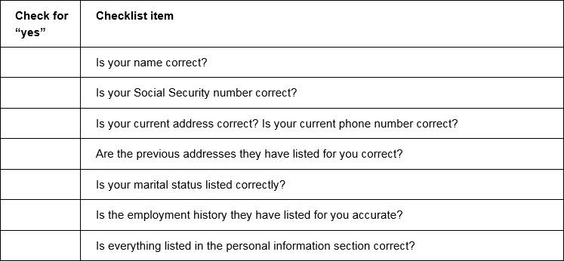
Tool 2: Credit report review checklist
Notes:
ACTIVITY #13: Understanding Credit Reports and Scores CONTINUED
Presentation (Module 7)
Review the credit report review checklist, Tool 2 (page 267).

Slide 143
Filing a dispute
To correct mistakes, it can help to contact both the credit reporting company and the source of the mistake.
You may file your dispute online at each credit reporting agency’s website.
If you file a dispute by mail, your dispute letter should include:
  Your complete name, address, and telephone number;
  your report confirmation number (if you have one); and
  the account number for any account you may be disputing.
In your letter, clearly identify each mistake, state the facts, explain why you are disputing the information, and request that it be removed or corrected.
You may want to enclose a copy of the portion of your report that contains the disputed items and circle or highlight the disputed items.
Send your letter of dispute to credit reporting companies by certified mail, return receipt requested.
Notes:
ACTIVITY #13: Understanding Credit Reports and Scores CONTINUED
Presentation (Module 7)
Review how to file a dispute.

Slide 144
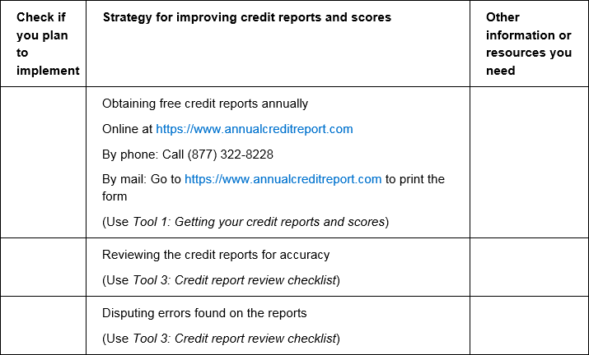
Tool 3: Improving credit reports and scores
Notes:
ACTIVITY #13: Understanding Credit Reports and Scores CONTINUED
Presentation (Module 7)
Go through each point on Tool 3 – Improving your credit reports and scores (Page 275) . Ask participants if they have any tips to add.
Provide brief overview of the new rule around young people in foster care—community volunteers must review credit reports each year starting at age 16 and until they turn 18.
Explain that young people in most cases cannot enter into a credit contract under the age of 18; therefore, if a young person under 18 has a credit file, there is a chance identify theft and financial fraud have been committed. Note the exceptions to this.
Discuss challenges related to credit reporting and young people in general.

Slide 145
Tool 4: Keeping records to show you have paid bills
When repairing or building credit – or managing finances more generally – it is important to create a paper trail.
What does this mean?
It means you must keep records so you can prove that you have:
  Paid a bill on time that a creditor has reported late.
  Paid a debt that a creditor has reported unpaid.
  Sent a letter to a debt collector who has claimed he did not receive it.
  Insurance coverage.
  A warranty for a cell phone.
  Paid your rent in cash (you have a receipt).
Notes:
ACTIVITY #13: Understanding Credit Reports and Scores CONTINUED
Large Group Brainstorming (Module 7)
Before showing this slide, ask participants to brainstorm a list of financial records that they think someone should keep.
Review Tool 4 (page 279).

Slide 146
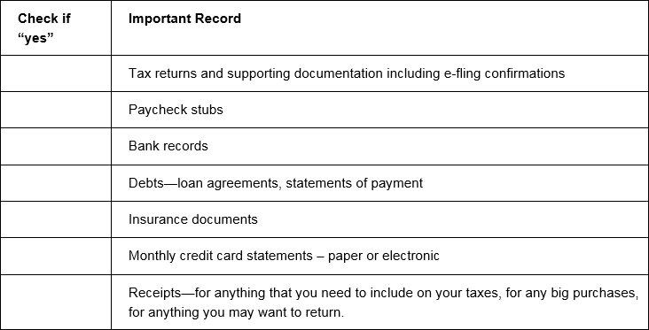
Tool 4: Keeping records to show you have paid bills
Notes:
ACTIVITY #13: Understanding Credit Reports and Scores CONTINUED
Large Group Brainstorming (Module 7)
Review Tool 4 (page 279).
Go back to the brainstormed list and identify the category that each item belongs in based on this checklist.

Slide 147
Ordering, reviewing, and improving
Ordering = Use Tool 1
Reviewing = Use Tool 2
  Credit report review checklist
    Ensure ALL information is correct—personal information, public record information, account/trade information, collection account information.
    Make sure negative information is not being reported longer than it should be.
Improving = Use Tool 3
  Improving credit reports and scores
Proving = Use Tool 4
  Keeping records to show you have paid bills
Notes:
ACTIVITY #13: Improving Credit Reports and Scores CONTINUED
Presentation (Module 7)
Explain the tools listed on the slide above.
Explain the importance of filing a dispute if there are any errors on their credit reports and the reason for checking all three reports.
Review the dispute letter and process in the toolkit.
Discuss reasons to hold on to copies of all items sent in for dispute, records of when disputes sent in, and the reasons for sending disputes certified mail with return receipt.
Be sure to discuss the reasons to send to both credit reporting agencies and the information furnisher.
Summarize by sharing:
Taking care of your credit history is important. Why?
Because credit reports and scores are not only used to determine whether you will get a loan or credit card.
This information can be used to determine access to and costs of other services like utilities, insurance and cell phones, ability to rent apartments, and employment.
While there are laws ensuring the information that is reported about you is fair and accurate, it is your responsibility to ensure the information is accurate.
The best way to do this is to regularly review your credit reports—at least one time per year. Use these tools to get, review, and then improve your credit reports and scores.

Slide 148
Your Money, Your Goals
Module 8: Money services, cards, accounts, and loans: Finding what works for you

Slide 149
Financial service providers
Department stores—credit cards or charge cards
Automobile dealers—car loans
Retail superstores, convenience stores, grocery stores, and other stores—check cashing, bill payment, money orders, prepaid cards, and money transfers
Check cashers and payday lenders – check cashing, money transfers, bill payment, money orders, prepaid cards, and short-term loans
Online companies—money transfers, bill payment services, loans, financial management tools, online “wallets” or “accounts”
Mortgage companies—loans for homes
Commercial tax preparers—refund anticipation loans
Consumer finance companies—loans
U.S. Postal Service—money orders and money transfers
Notes:
ACTIVITY #14: Money services, cards, accounts, and loans: Finding what works for you
Estimated Time: 45 Minutes
Methodology: Individual Activity / Exercise in Pairs, Presentation to Large Group, and Facilitated Discussion / Presentation and Facilitated Discussion
Corresponding Section in Toolkit: Module 8 (Page 283)
Instructions for Facilitator:
Facilitated Discussion (Module 8)
Ask participants who provides financial services. Write their suggestions on a flip chart.
Then reveal the ideas listed on slide above.
Explain that financial services are provided by more than just banks.

Slide 150
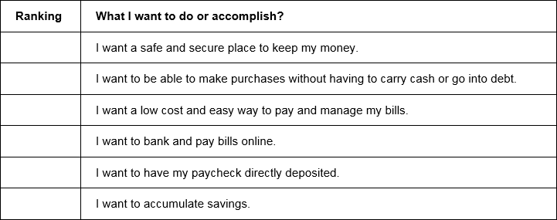
Tool 1: Know your options: Money services, cards, accounts, and loans
Complete Tool 1 on page 293.
Do not look ahead in your materials.
Notes:
ACTIVITY #14: Money services, cards, accounts, and loans: Finding what works for you CONTINUED
Individual Activity and Facilitated Discussion (Module 8)
Invite participants to complete Tool 1 (page 293).
Instruct them not to look ahead in their materials.

Slide 151
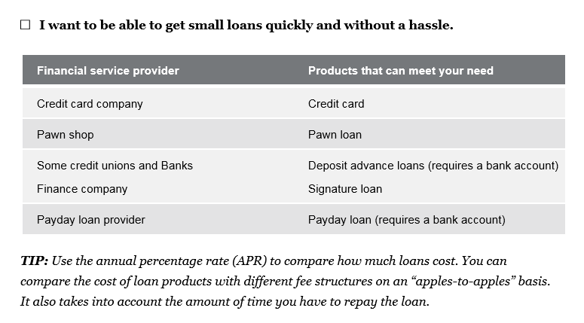
Tool 1: Know your options: Money services, cards, accounts, and loans
Notes:
ACTIVITY #14: Money services, cards, accounts, and loan: Finding what works for you CONTINUED
Individual Activity and Facilitated Discussion (Module 8)
After 3 minutes, instruct them to use the analysis section of Tool 1 (starting on page 294) to find the provider and tools that have products or services that meet their priorities.

Slide 152
Tool 1: Selecting a financial service provider
What surprised you when using this tool?
Was the tool helpful? Do you think it will be helpful for your the people you serves?
What additional information do you need to select a financial service provider?
Notes:
ACTIVITY #14: Money services, cards, accounts, and loans: Finding what works for you CONTINUED
Individual Activity and Facilitated Discussion (Module 8)
Use the following questions, also listed on the slide above to facilitate a discussion about the tool:
What surprised you when using this tool?
Was the tool helpful? Do you think it will be helpful for the people you serve?
What additional information do you need to select a financial service provider?
Explain that this approach is a needs-first approach.
Explain that generally, people think of financial services as meaning a bank account.
Explain that this approach starts with what people want or need in terms of financial services, then provides guidance in terms of what products or services may address that want or need and where the product or service may be available.

Slide 153
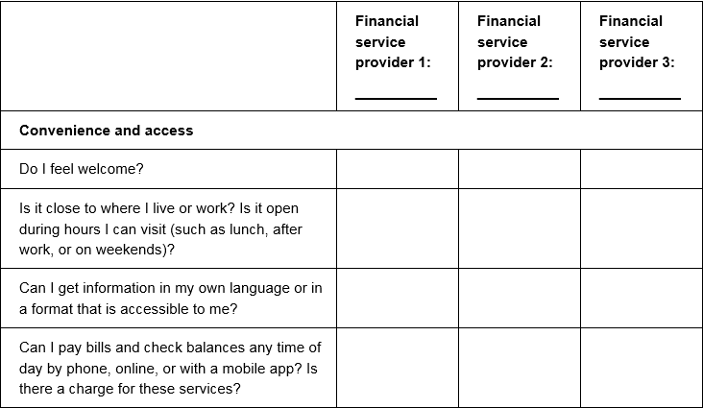
Tool 2: Ask questions: Choosing where to get what you need
Notes:
ACTIVITY #14: Money services, cards, accounts, and loan: Finding what works for you CONTINUED
Presentation (Module 8)
Review Tool 2 (page 299)—the purpose is to compare financial product and service providers.
Explain that individuals may want to circle the top 5 criteria that are most important to them in making a decision about the right financial service provider. This can help them focus while using this tool and make it’s use a little easier.

Slide 154
Tool 3: Money services and banking basics
With your partner:
  Define the product or service.
  Brainstorm all of the places you can get this product or service.
  Brainstorm when you would use this product or service to manage your finances.
  List the benefits of this product or service.
  List the risks of this product or service.
Be prepared to present your product or service and your work to the rest of the group.
Notes:
ACTIVITY #14: Money services, cards, accounts, and loans: Finding what works for you CONTINUED
Exercise in Pairs; Presentation to Large Group; Facilitated Discussion (Module 8)
Get participants into groups of 2.
Distribute financial product/service cards to each pair.
NOTE: The next 10 slides are the cards. Print these prior to the training. Consider using card stock.
NOTE: If you have a small group, you may want to give two cards to each pair.
Instruct participants in groups of 2 to:
Define the product or service.
Brainstorm all of the places you can get this product or service.
Brainstorm when you would use this product or service to manage your finances.
List the benefits of this product or service.
List the risks of this product or service.
Instruct participants to use the material from Tool 3 (page 303) and their own experiences to complete the group activity.
After 6 – 8 minutes, ask participants to report to large group.
Ask each group to present their product/service to the rest of the group.
Using Tool 3 (page 303), organize them by the type of product or service they are as groups present.
Transaction
Depository
Credit
Credit building
Other
Add to group presentations as appropriate.
Relate this information to Tool 2: Ask questions: Choosing where to get what you need.
Ask participants to share any questions or experiences they may have about these products or services or others from Tool 3 not covered.

Slide 155
Checking account
Definition
Where can you get this product/service
When would you use this product/service
Benefits
Risks
Notes:
PRINT PRIOR TO TRAINING.
PRINT ONE COPY FOR EVERY TWO PARTICIPANTS.
IF YOU HAVE 20 PARTICIPANTS, YOU WILL NEED ONLY ONE COPY EACH OF THE NEXT 10 SLIDES.
DO NOT DISPLAY THESE SLIDES IN YOUR PRESENTATION.

Slide 156
Prepaid debit card
Definition
Where can you get this product/service
When would you use this product/service
Benefits
Risks
Notes:
PRINT PRIOR TO TRAINING.
DO NOT DISPLAY IN PRESENTATION.

Slide 157
Money transfer
Definition
Where can you get this product/service
When would you use this product/service
Benefits
Risks
Notes:
PRINT PRIOR TO TRAINING.
DO NOT DISPLAY IN PRESENTATION.

Slide 158
Bill payment service
Definition
Where can you get this product/service
When would you use this product/service
Benefits
Risks
Notes:
PRINT PRIOR TO TRAINING.
DO NOT DISPLAY IN PRESENTATION.

Slide 159
Savings account
Definition
Where can you get this product/service
When would you use this product/service
Benefits
Risks
Notes:
PRINT PRIOR TO TRAINING.
DO NOT DISPLAY IN PRESENTATION.

Slide 160
Line of credit
Definition
Where can you get this product/service
When would you use this product/service
Benefits
Risks
Notes:
PRINT PRIOR TO TRAINING.
DO NOT DISPLAY IN PRESENTATION.

Slide 161
Car title loan
Definition
Where can you get this product/service
When would you use this product/service
Benefits
Risks
Notes:
PRINT PRIOR TO TRAINING.
DO NOT DISPLAY IN PRESENTATION.

Slide 162
Online banking
Definition
Where can you get this product/service
When would you use this product/service
Benefits
Risks
Notes:
PRINT PRIOR TO TRAINING.
DO NOT DISPLAY IN PRESENTATION.

Slide 163
Credit building loan
Definition
Where can you get this product/service
When would you use this product/service
Benefits
Risks
Notes:
PRINT PRIOR TO TRAINING.
DO NOT DISPLAY IN PRESENTATION.

Slide 164
Money order
Definition
Where can you get this product/service
When would you use this product/service
Benefits
Risks
Notes:
PRINT PRIOR TO TRAINING.
DO NOT DISPLAY IN PRESENTATION.

Slide 165
Tool 4: Opening an account checklist
Can anyone open an account at a bank or credit union?
Should everyone open an account at a bank or credit union?
What is needed
Money to open account
Identification
A Social Security Number or ITIN for interest-bearing account
Bank System Report—ChexSystems, TeleCheck, Early Warning, and others
Notes:
ACTIVITY #14: Money services, cards, accounts, and loans: Finding what works for you CONTINUED
Facilitated Discussion and Presentation (Module 8)
ASK: Can anyone open an account at a bank or credit union?
After getting some responses from participants, explain that the answer is “not necessarily.” They may not have the money, have negative information in consumer reports, and/or lack proper identification.
ASK: Should everyone open an account at a bank or credit union?
After getting some responses from participants, explain that this is an opinion question. While money in a bank or credit union may offer people protection of their money, if they do not understand how their accounts work, they could end up with more financial challenges.
Explain what is needed to open an account:
Money to open account (and maintain minimum balance to avoid fees)
Identification
A U.S. government- or state-issued form of identification with your photo on it, such as a driver’s license, U.S. Passport, or military identification.
And one of the following:
Social security card
A bill with name and address on it
Birth certificate
If someone does not have a U.S. government-issued form of identification, some banks and credit unions accept foreign passports and Consular IDs, such as the Matricula Consular card, which is an official Mexican identification document.
Other countries, such as Guatemala and Argentina have similar IDs.
Consulates in the United States offer them.
The people you serves can visit their country’s consulate for more information about how to get an ID card, and talk with the banks and credit unions about whether they accept it.
A Social Security Number or ITIN for interest-bearing account
Interest is considered income. If you earn interest, you must pay taxes on it.
To open an interest bearing account, such as a savings account, you must have a Social Security number or an Individual Taxpayer Identification Number (ITIN).
Or, you must be able to show evidence that you have applied for an ITIN.
If you do not have a Social Security number, you do not have an ITIN, or you have not applied for an ITIN, you can open a non-interest bearing account.
A negative bank system report
When you complete the application to open an account at a bank or credit union, the bank or credit union often contacts specialty consumer reporting agencies that have information on checking account history.
Banks and credit unions contact companies like ChexSystems, TeleCheck, Early Warning, and others like them to find out if you have had prior difficulties using a checking account, such as writing bad checks or suspected fraud.
These agencies collect information about how consumers manage savings and checking accounts.
Financial institutions use the information to assess the risk of opening an account for a specific person based on his or her past history of managing similar accounts.
The report includes information about:
The accounts that have been reported (routing transit number and/or account number)
Date information was reported about an account
The reason for the report
The report also includes retail information, which refers to returned checks. Retailers and other businesses report this type of information to SCAN (Shared Check Authorization Network).
If you are denied a checking account based on a report from any of these specialty consumer reporting agencies, you have the right to a free disclosure of certain information in your file from the agency.
The notice you receive from the bank or credit union will give you the name, address, and phone number of the consumer reporting company and how you can contact it to obtain your free disclosure.
If you find mistakes, you can dispute these by sending a letter (you may choose to use certified mail) describing the mistake and including copies of any evidence.
Explain that some banks and credit unions review credit reports, too.
Review Tool 4 (page 311) with participants.
Go over steps for opening an account at a bank or credit union.

Slide 166
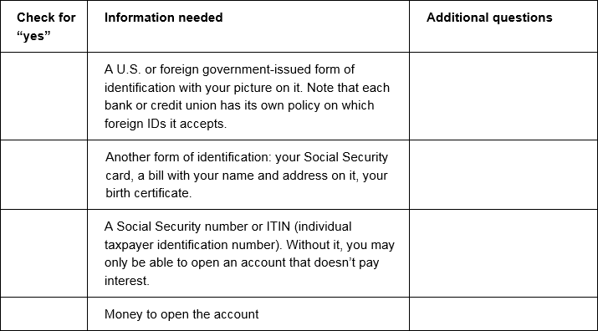
Tool 4: Opening an account checklist
Notes:
ACTIVITY #14: Money services, cards, accounts, and loan: Finding what works for you CONTINUED
Facilitated Discussion and Presentation (Module 8)
Share excerpt of the checklist that is a part of the Tool 4 (page 314).

Slide 167
Overdraft coverage
Overdraft = spending or withdrawing more money than is available in your account
Money advanced to cover overdraft = overdraft coverage (sometimes called “overdraft protection”)
Can be charged daily fees for this service
Notes:
ACTIVITY #14: Money services, cards, accounts, and loans: Finding what works for you CONTINUED
Facilitated Discussion and Presentation (Module 8)
Review overdraft coverage from the toolkit (page 287).
Review alternatives to overdraft coverage:
Keep track of your balances.
Sign up for low balance alerts at your bank or credit union.
Know when regular electronic transfers, such as rent payments or utility bills, will be paid.
Link your checking account to your savings account.
Link your checking account to a line of credit.

Slide 168
Tool 5: Money Transfers and Remittances
A “remittance transfer” is an electronic transfer of money from a consumer in the United States to a person or business in a foreign country.
The rules generally require companies to give disclosures to consumers before they pay for the remittance transfers. The disclosures must contain:
  The exchange rate
  Fees and taxes collected by the companies
  Fees charged by the companies’ agents abroad and intermediary institutions
  The amount of money expected to be delivered abroad, not including certain fees charged to the recipient or foreign taxes
  If appropriate, a disclaimer that additional fees and foreign taxes may apply
Notes:
ACTIVITY #14: Money services, cards, accounts, and loan: Finding what works for you CONTINUED
Presentation (Module 8)
Review remittance rules using Tool 5 (page 317).
Summarize by sharing:
Financial products and services can help you more efficiently and effectively get, manage, and use your money.
Knowing the reasons you may need financial services and matching your needs with the right products and services can ensure you are getting what you need from this complex marketplace.
Learn the basic terms for financial products and services.
If information’s not clear, don’t be afraid to ask questions.
Finally, shop around for financial services.
Look at convenience, cost, and service provided before selecting a product, service or provider.
Be aware of debt traps—products that may not only get you into debt, but keep you there.
With all financial products there are lots of rules.
Do you best to understand the rules so you avoid fees and fines.
Finally, use the CFPB website’s Ask CFPB as a resource to learn more about the financial services industry and the product and services they sell.

Slide 169
Module 8: Wrap up
Financial products and services are provided by a broad range of providers from banks and credit unions to retail stores to the federal government.
Use Tool 1: Know your options: Money services, cards, accounts, and loans (Which financial product or services do you need?) to help you figure out which financial products or services will meet your needs
Use Tool 2: Ask questions: Choosing where to get what you need (Comparing financial service providers) to help you compare financial service providers based on their characteristics as well as the features and benefits of the products and service they offer.
Notes:
ACTIVITY #14: Money services, cards, accounts, and loan: Finding what works for you CONTINUED
Presentation (Module 8)
Review highlights of the module using the module 8 wrap up.

Slide 170
Module 8: Wrap up
Use Tool 3: Money services and banking basics (The basics of financial products and service) to help you learn about the different financial products and services offered at banks, credit unions, and other financial service providers.
Use Tool 4: Opening an account checklist to understand the specific steps for opening an account including information you may want to have before opening an account.
Use Tool 5: Money transfers and remittances: What you need to know to learn more about using these products and services.
Notes:
ACTIVITY #14: Money services, cards, accounts, and loan: Finding what works for you CONTINUED
Presentation (Module 8)
Review highlights of the module using the module 8 wrap up.

Slide 171
Your Money, Your Goals
Module 9: Protecting your money

Slide 172
Tool 1: Submitting a complaint to the CFPB
www.consumerfinance.gov/complaint
855-411-CFPB (2372)
Complaint submitted
Complaint reviewed and routed
Company response
Consumer review
CFPB review and investigation
Analysis and report
Notes:
ACTIVITY #15: Protecting Your Money
Methodology: Presentation and Facilitated Discussion / Skits / Teach back
Corresponding Section in Toolkit: Module 9 (Pages 321)
Estimated Time: 45 Minutes
Instructions for Facilitator:
Presentation and Facilitated Discussion (Module 9)
NOTE: If you covered this earlier in the training, consider doing a quick review or asking participants questions about submitting a complaint to help them recall what you covered earlier in the training. Example questions include:
What kinds of complaints does the CFPB take?
What are the different ways someone can submit a complaint?
How many languages can the CFPB accept complaints in?
What happens to a complaint once it’s submitted?
How long do companies have to respond to complaints?
How can consumers find out more about complaints in their communities?
Why is it important for community volunteers and frontline staff to know about the CPFB complaint portal and process?
Refer participants to the CFPB complaint contact information on slide and in their toolkit, Tool 1 (page 327).
Explain the following:
Part of being a smart consumer is understanding your rights. When you know you have rights, you can protect yourself. There are many laws that protect your rights when it comes to financial products and services. It is the CFPB’s job to enforce these laws and handle consumers’ complaints about financial products and services.
The CFPB has already handled over 700,000 of consumer complaints about:
Credit cards
Mortgages
Bank accounts and services
Private student loans
Vehicle or consumer loans
Money transfers
Credit reporting
Debt collection
Payday loans
Prepaid cards, credit repair, debt settlement, and pawn and title loans
Virtual currency
Based on these complaints and research, the CFPB takes action to stop practices that are unfair, deceptive, or abusive or otherwise violate the law. In many cases, CFPB partners with other federal agencies and state officials to address these problems.
Through their enforcement actions, the CFPB can require companies to refund money to customers when their consumer rights have been violated.
Explain that you can submit a complaint on behalf of someone else following the directions on the site.
Explain that, if you don’t use a computer or need help in a language other than English, you can also submit a complaint over the phone by calling the CFPB at 855- 411-CFPB (2372), toll free. U.S.-based call centers can help you in over 180 languages and can also take calls from consumers who are hearing impaired or speech-disabled. Live operators in Spanish are available and the CFPB has received over 700,000 complaints as of October 2015.
Explain what happens to a complaint submitted to the CFPB using the following:
Complaint Submitted: The CFPB will screen your complaint based on several criteria. These criteria include whether your complaint falls within the CFPB’s primary enforcement authority, whether the complaint is complete, and whether it is a duplicate of another complaint you have submitted.
Review and Route: If a particular complaint does not involve a product or market that is within the Bureau’s jurisdiction or that is currently being handled by the Bureau, the CFPB refers it to the appropriate regulator. Screened complaints are sent via a secure web portal to the appropriate company—the business you have the complaint with.
Company Response: The company reviews the information, communicates with you as needed. It then determines what action to take in response. The company reports back to you and the CFPB via the secure “company portal.” After your complaint is sent to the company, the company has 15 days to provide a substantive response to you and the CFPB. Companies are expected to close all but the most complicated complaints within 60 days.
Consumer Review: CFPB then invites you to review the response and provide feedback. Consumer Tracking: You can log onto the secure “consumer portal” available on the CFPB’s website or call a toll‐free number to receive status updates, provide additional information, and review responses provided to the you by the company.
Review and Investigate: The CFPB reviews your feedback about company responses, using this information along with other information such as the timeliness of the company’s response, for example, to help prioritize complaints for investigation.
Analyze and report. Complaints help with the CFPB’s work to supervise companies, enforce federal consumer financial laws, and write better rules and regulations. The CFPB also reports to Congress about the complaints we receive and posts consumer complaint data on the website in an easy-to-use format: www.consumerfinance.gov/complaint database/.

Slide 173
Tool 2: Protecting your identity
Identifying information is anything that is specifically unique to you, such as your:
Credit card and bank account numbers
Driver’s license number
Date, city, and state of birth
Social security number
Passwords or PIN numbers
Notes:
ACTIVITY #15: Protecting Your Money CONTINUED
Presentation and Facilitated Discussion (Module 9)
Review key information about protecting identity using Tool 2 (page 331).
Review the list of signs of identity theft (from the FTC):
There are mistakes on your bank, credit card, or other account statements
There are mistakes on the explanation of medical benefits from your health plan
Your regular bills and account statements don’t arrive on time
You get bills or collection notices for products or services you never received
You receive calls from debt collectors about debts that don’t belong to you
You get a notice from the IRS that someone used your Social Security number
You receive mail, email, or calls about accounts or jobs in your minor child’s name
You receive unwarranted collection notices on your credit report
Businesses turn down your checks and
You are turned down unexpectedly for a loan or job

Slide 174
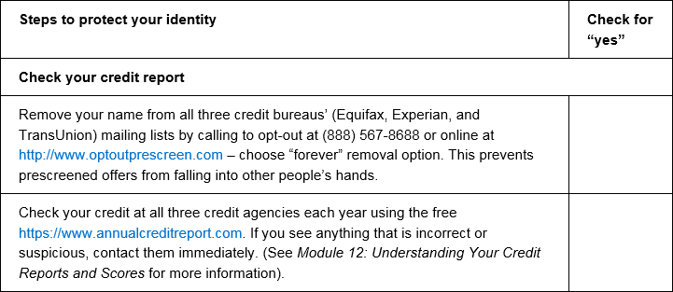
Tool 2: Protecting your identity
Notes:
ACTIVITY #15: Protecting Your Money CONTINUED
Presentation (Module 9)
Review identity theft checklist (page 332).
Review primary strategies for dealing with identity theft using the list below and information from the module.
Place a fraud alert on your credit file
Consider a security freeze
Order your credit reports
Create an identity theft report

Slide 175
Tool 3: Red flags
Watch the skit.
See if you can identify the red flags (up to 3) using the tool.
Notes:
ACTIVITY #15: Protecting Your Money CONTINUED
Skits (Module 9)
ASK: What is a red flag?
Explain that a red flag is something to watch out for.
Explain that sometimes when shopping for or using consumer financial products, you may encounter a red flag.
Explain that this does not mean something illegal is going on, but that you should ask more questions and get help to ensure you are not being subjected something that is not fair or right.
Give teams of 3 or 4 participants red flags to turn into a skit (there are 3 skits on the following four slides, so not everyone will be able to act in a skit).
Explain that they should develop skit coming up with example or hypothetical products/services and use any props they feel may be necessary. Explain that they are to improvise the skit.
Instruct them to try to be specific to their red flag.
Instruct them to develop a short 1 to 3 minute skit that showcases the red flag(s).
Participants will have to guess the red flags using Tool 3: Red Flags (page 337).
Thank skit performers and congratulate those who guess the red flags following each skit.
NOTE: Consider organizing skits during breaks to give teams time to think about scenario for acting out red flags.

Slide 176
Skit 1: Identifying red flags
Steering and coercing
  Aggressive sales tactics are used to steer and coerce you toward a high-cost loan, even though you could have qualified for a regular prime loan.
Prepayment penalties
  Prepayment penalties are fees lenders require a borrower to pay if the borrower pays off a loan early.
Unexplained fees
  No one can explain what certain fees are for or why they are so high.
Incomplete paperwork
  You are asked to sign a contract with blank spaces to be filled in later
Notes:
PRINT 1 COPY FOR 1 TEAM.
HIDE FOR PRESENTATION.

Slide 177
Skit 2: Identifying red flags
Paperwork doesn’t match the sales pitch
  The promises made to you by a salesperson are not in the papers that you are asked to sign.
Confusing fine-print
  A good rule of thumb is to refuse to sign anything that you don’t understand.
Pressure sales tactics
  You are pressured to purchase things or to take out loans you don’t want or can’t afford.
Notes:
PRINT 1 COPY FOR 1 TEAM.
HIDE FOR PRESENTATION.

Slide 178
Skit 3: Identifying red flags
Additional insurance and other add-on products
  Some lenders may insist on, intimidate, or imply that borrowers must buy unnecessary items—additional insurance, unneeded warranties, monitoring services, etc. They get incorporated into the loan amount, and the borrower pays interest on them over the life of the loan.
Lack of uniformity
  Different staff or salespeople are telling you different things regarding pricing or other information.
Won’t put it in writing
  No one will give you clear information in writing—even when you ask for it.
Notes:
PRINT 1 COPY FOR 1 TEAM.
HIDE FOR PRESENTATION.

Slide 179
Tool 4: Learning more about consumer protection
Read your law.
Summarize it in your own words for presentation to the group.
Provide one specific example of the ways this law or regulation matters to the people you serve.
Share where to go if someone feels their rights protected under your law or regulation have been violated.
Notes:
ACTIVITY #15: Protecting Your Money CONTINUED
Teach back (Module 9)
Give teams of two participants one or two of the laws outlined in Tool 4 (page 339) to read, discuss, and teach back to the group in their own words.
Instruct them to use examples where possible.
Instruct them to develop their presentation to last two to three minutes.
Have each group present; add important elements of the law not covered.
NOTE: You may need to cut this out if you are out of time.
Summarize by sharing:
We hope this gave you an idea of how many laws and rules are in place to protect you.
While the laws summarize your rights, it is still your responsibility to learn about these laws and take steps to ensure your rights are not violated. For example, you have the right to a free credit report every year from the major consumer reporting agencies; however, it is your responsibility to order the reports, review them for accuracy, and get errors fixed.
Fortunately, there are many resources to help you understand your rights and take action should your rights be violated.
Visit the CFPB website often for information and updates regarding laws designed to protect you and your family in learning about, accessing, and using financial products and services.

Slide 180
Module 9: Wrap up
Remember, you have many rights when it comes to consumer financial products and services.
If you do feel like you have a complaint with a financial product, service or provider submit a complaint with the CFPB using Tool 1. Submitting a complaint to the CFPB and visit: http://www.consumerfinance.gov/complaint/
Your identity is one of the most important assets you must protect. Use Tool 2: Protecting your identity to ensure you are taking all steps possible to keep your identity safe.
When applying for financial products or services, be aware of red flags. Use Tool 3: Red flags to become familiar with common red flags.
If you are interested in learning more about consumer protection laws, use Tool 4: Learning more about consumer protection.
For additional resources, visit the Consumer Financial Protection Bureau website: http://www.consumerfinance.gov/
Notes:
ACTIVITY #15: Protecting Your Money CONTINUED
Presentation (Module 9)
Highlight key information from module 9.

Slide 181
Additional resources
For additional resources, visit the Consumer Financial Protection Bureau website: http://www.consumerfinance.gov/
If you have a consumer complaint, visit: http://www.consumerfinance.gov/complaint/
If you have questions about consumer financial products and services, visit: http://www.consumerfinance.gov/askcfpb
The CFPB wants to hear about your experiences with money and financial services, good and bad. Visit: http://www.consumerfinance.gov/your-story
Notes:
ACTIVITY #15: Protecting Your Money CONTINUED
Presentation and Facilitated Discussion (Module 9)
Review resources available at the CFPB.

Slide 182
Your Money, Your Goals
Closing

Slide 183
Closing
What is the most important thing you are taking away from this training?
What is something you would like to learn more about?
Notes:
ACTIVITY #16: Closing
Estimated Time: 20 Minutes
Methodology: Closing / Individual Activity
Corresponding Section in Toolkit: None
Instructions for Facilitator:
Ask each participant to share “the most important take away” from the training and “something they would like to learn more about.”
Write responses on flip chart.
Administer post-training assessment and evaluation.
Conclude with thanks to host and participants.

